Slide 1

Phased Array Ghost Elimination (PAGE) for Segmented SSFP Imaging with Interrupted Steady-State
Peter Kellman, Michael A. Guttman, Daniel A. Herzka, Elliot R. McVeigh
Laboratory for Cardiac Energetics
National Heart, Lung, and Blood Institute
National Institutes for Health
Notes:
I will present an application of phase array ghost elimination to cancel hosts that arise in cardiac imaging using true-triggered FISP during the approach to interrupted steady state.

Slide 2
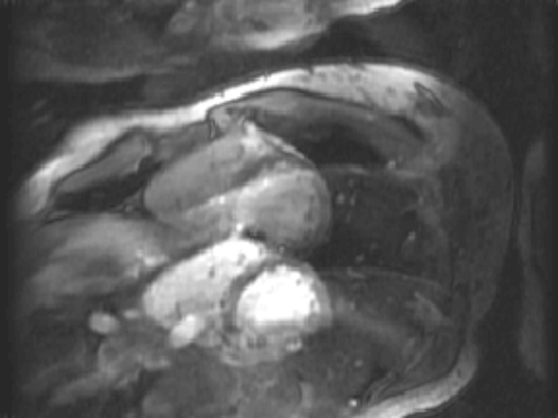
Motivation
True Triggering
Tagging
Fat Saturation
Notes:
ECG gated, segmented cardiac imaging using FISP commonly uses a continuous train of RF pulses, and imaging is performed essentially at steady state after 1 or more RF pulses during steady state approach are discarded.
Applications requiring precise triggering or additional magnetization preparations such as tagging or fat saturation interrupt the steady state and create ghost artifacts during the first few cardiac phases during early systole.
I will describe a method for eliminating these ghosts which occur during the approach to interrupted steady state.

Slide 3

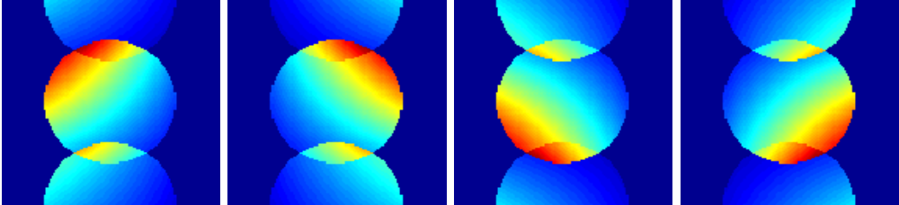

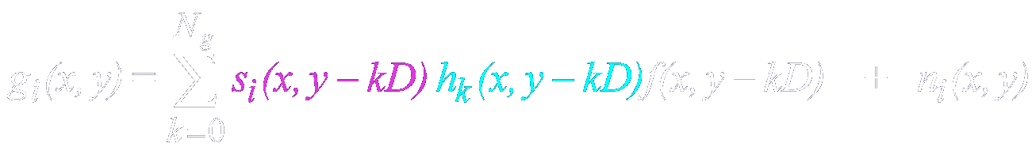
How Phased Array
Ghost Elimination (PAGE) Works?
Given knowledge (estimates) of coil sensitivity profiles
Ghost images can be separated by solving linear equations (“inverse” problem)
Coil 1
Coil 2
Coil 3
Coil 4
Notes:
Let me begin by describing how the basic ghost elimination method (referred to as PAGE) works.
In phased array or multi-coil reception, the desired image as well as ghosts are weighted by the coil sensitivity for individual coils as depicted for this example with 4 coils and FOV/2 ghosts.
The individual coils sensitivity weights both the desired image as well as ghosts, denoted here by s_{i}(x,y).
This weighted superposition is a set of linear equations which can be solved (in a least square sense) by a matrix inversion if the sensitivity profiles are known.
The desired image and ghost are also weighted by their respective values of complex point spread function, h₀ and h₁ in this case. Therefore, the equations actually solve for the PSF weighted desired and ghost images, h₀ f and h₁ f.
Unlike the SENSE accelerated imaging application for which the ghosts are caused by intentional undersampling with a space invariant PSF, this method is quite general and may be used with a spatially varying PSF. That is to say h₀ and h₁ are functions of (x,y).

Slide 4
Sequence Timing
ECG
optional magnetization preparation
(fat sat, tagging,….)
crusher
-α
α
-α
α
-α
α
α
-α
α
α/2
…
-α/2
…
sequence
timing
1 2 3 4 1 2
1st cardiac
phase
segment #1
2nd cardiac
phase
segment #1
last cardiac
phase
segment #1
Notes:
The sequence timing is shown in this slide
The ECG R-wave is used as a trigger followed by an optional magnetization preparation for either tagging or fat saturation.
A single alpha/2 pulse is used to accelerate the approach to steady state, followed by the segmented acquisition.
A single alpha/2 pulse is used to store the magnetization prior to a small trigger window, followed by a crusher to destroy any residual transverse magnetization.
After the 1st heartbeat which is discarded, the interrupted steady state transient response is essentially the same from beat to beat.
In this example there are 4 phase encode lines acquired per cardiac phase corresponding to approximately 16 ms temporal resolution.

Slide 5
Simulated Transient Response for off-resonance (fat)
Point Spread Function
h₂
h₃
h₀
h₁
h₂
cardiac phase
8 7 6 5 4 3 2 1
-FOV/2 -FOV/4 0 FOV/4 FOV/2
phase encode direction
Segmented, ECG triggered: 46 cardiac phases, 4 views per segment
Notes:
The k-space distortion is periodic leading to image ghosts during the approach to steady state.
In this example, with 4 phase encodes lines acquired per cardiac phase, the k-space distortion has a period of 4, which results in 4 ghosts spaced FOV/4.
The simulated transient approach to interrupted steady state with alpha/2 preparation is shown for fat tissue at off-resonance.
Both magnitude and phase are plotted.
The phase distortion contributes most significantly to the ghost amplitudes and leads to the asymmetry.
The point spread function is shown for the first 8 cardiac phases.
Ghosts along the phase encode direction which last for several cardiac phases are spaced FOV/4 and have amplitudes denoted h₀, h₁, h₂, & h₃.

Slide 6
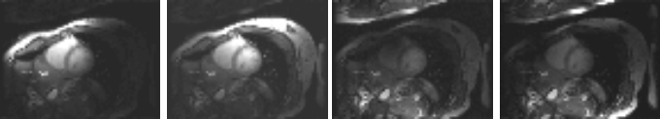
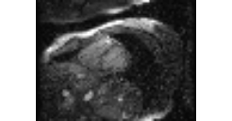
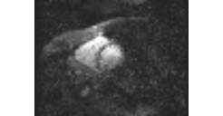
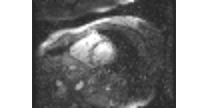
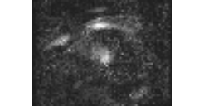
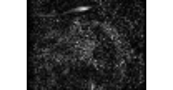
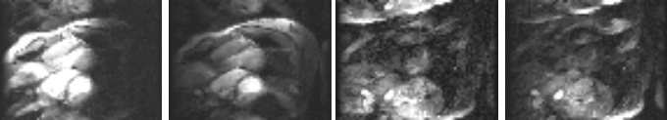
Simplified Block Diagram
coil 1 coil 2 coil 3 coil 4
average
ghost free
images
calculate
phased array
coefficients
sequence of
multi-coil
k-space data
FFT
recon
phased array
combiner
ghost
artifact
cancelled
image
shift
¼ FOV
phased array
combiner
combine
shift
½ FOV
phased array
combiner
shift
¾ FOV
phased array
combiner
images
with
ghosts
coil 1 coil 2 coil 3 coil 4
Notes:
A block diagram of the phase array ghost elimination method illustrates the processing steps.
A sequence of complex multi-coil images are reconstructed including the images with ghosts during the initial cardiac phases.
Ghost free images after steady state is reached are averaged and used for the estimating the B1-maps which are used in calculating the phased array combiner coefficients.
Phased array combining is applied to the full-FOV images at each shift to separate the superimposed (ghost) images.
The individual images are each weighted by their (space variant) point spread function value, h₀(x,y), h₁, h₂, & h₃, respectively.
These separated images may be combined to produce a final ghost artifact cancelled image.

Slide 7
Imaging Parameters*
imaging sequence: ECG Gated, Segmented SSFP (FISP)
acquisition matrix: 192x96
FOV: 320 x 240 mm²
spatial resolution: 1.7x 2.5 mm²
slice thickness: 8 mm
bandwidth: +/- 125 kHz
RF readout flip angle: 45 degrees
TR: 3.9 ms
# lines per segment: 4
# cardiac phases: 46 (75% trigger window)
breath-hold duration: 24 heartbeats
*using GE LX CV/i custom modified with 8 digital receivers
Morris, HD., Derbyshire, JA, Kellman, P., Chesnick, AS, Guttman, MA, McVeigh, ER. A Wide-Bandwidth Multi-channel Digital Receiver and Real-Time Reconstruction Engine for use with a Clinical MR Scanner. ISMRM‘02. p.61.
Notes:
The imaging parameters are listed in this chart.
With 4 phase encodes acquired per segment, the temporal resolution was approximately 16 ms.

Slide 8
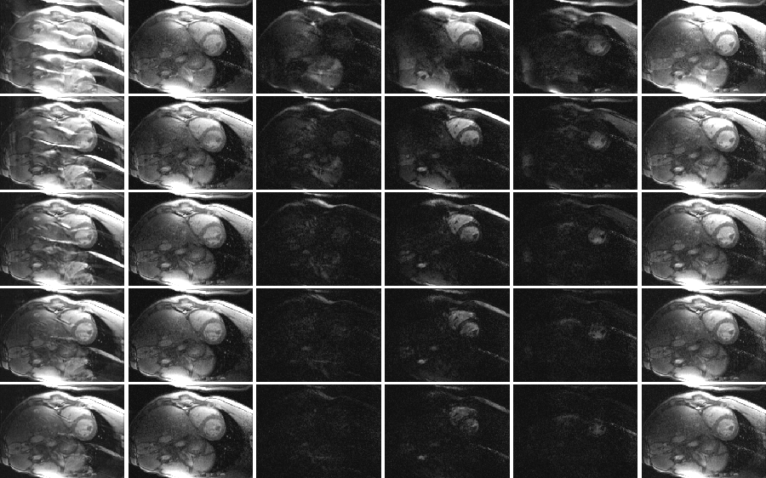
ECG triggered SSFP Example
images
with
ghosts
separated ghost images
magnitude
combined
(rss)
h₀
h₁
h₂
h₃
1
2
3
4
5
cardiac phase
Notes:
This slide shows the first 5 cardiac phases before and after ghost cancellation.
The individual separated ghost images, weighted by point spread values h₀, h₁, h₂, & h₃, are shown in the center 4 columns.
In this example:
Ghosting of the blood is predominately at ½ FOV and lasts several phases.
Chest wall ghosts due to off-resonant fat are seen at ¼ , ½, and ¾ FOV in the first cardiac phase and decay rapidly.
The distribution of ghost varies considerably for different subjects and for different shimming

Slide 9
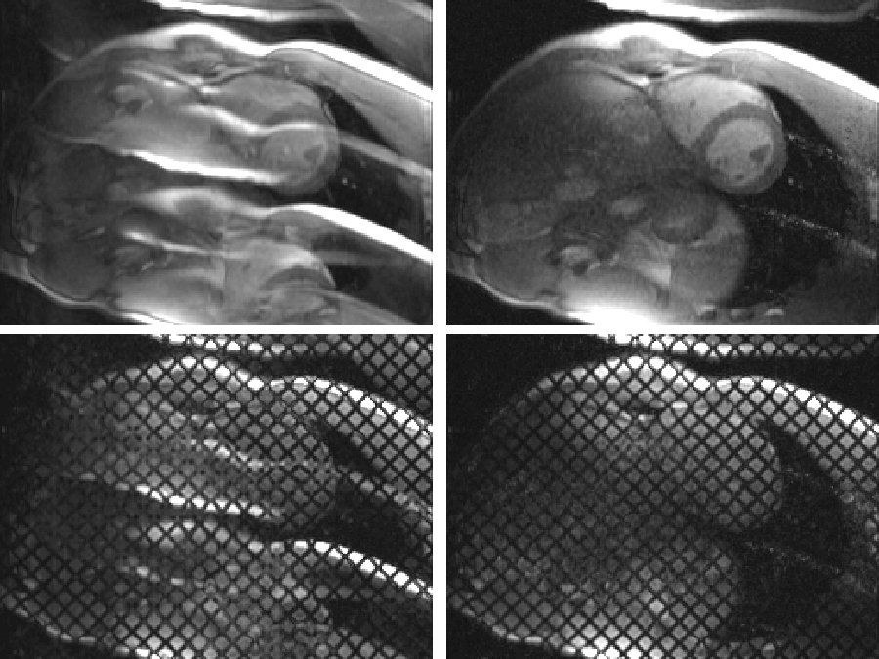
ECG triggered SSFP Examples
Ghost Cancelled
(RSS combined)
Conventional
no preparation
tagged
Notes:
These example illustrate ghost cancellation with and without tagging for the first cardiac phase.
The analysis of tags in early systole is greatly improved by this method.

Slide 10
Conclusions
PAGE Ghost cancellation method works well for
  several widely spaced ghosts
Cardiac Imaging:
  Ghost free imaging during early systole
  ECG triggering, tagging, fat saturation
SNR losses
  variance inflation due to ill-conditioned inverse solution
    G-factor ~ 4-5 for 4 ghosts with 4 coils (shown in abstract)
    ~ 1.5-2 for 4 ghosts with 8 coils
  SNR loss partially offset by magnetization re-growth
  PAGE used only for early cardiac phases

