Slide 1

Comparison of Several 8-element Surface Coil Configurations for Cardiac Imaging using SENSE
Peter Kellman¹, J. Andrew Derbyshire¹, H. Douglas Morris¹, Patrick J. Ledden², Elliot R. McVeigh¹
¹Laboratory for Cardiac Energetics
National Heart, Lung, and Blood Institute
National Institutes for Health
²Nova Medical, Wakefield, MA
Notes:
This work was a collaborative effort between Nova Medical, Inc. and our laboratory at NIH.

Slide 2
Purpose
Cardiac Imaging Application
Comparison of Surface Coil Arrays
  - 4 & 8-element arrays
  - 1-d linear & 2-d area arrays
Evaluation of image quality
  - full k-space
  - accelerated SENSE imaging (R=2,3,4)
Notes:
The performance of parallel imaging using SENSE is highly dependent on the size, position, and number of surface coils, as well as the imaging geometry.
We evaluated performance of surface coils arrays with several geometries for performing the SENSE method specifically for cardiac imaging.

Slide 3
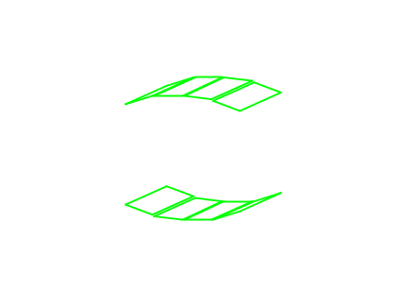
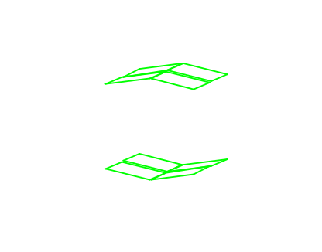
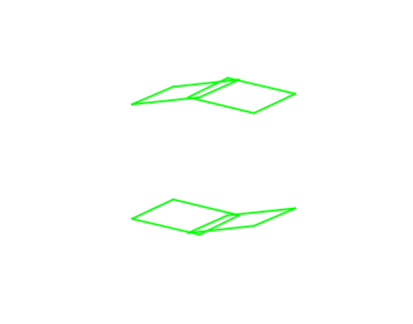
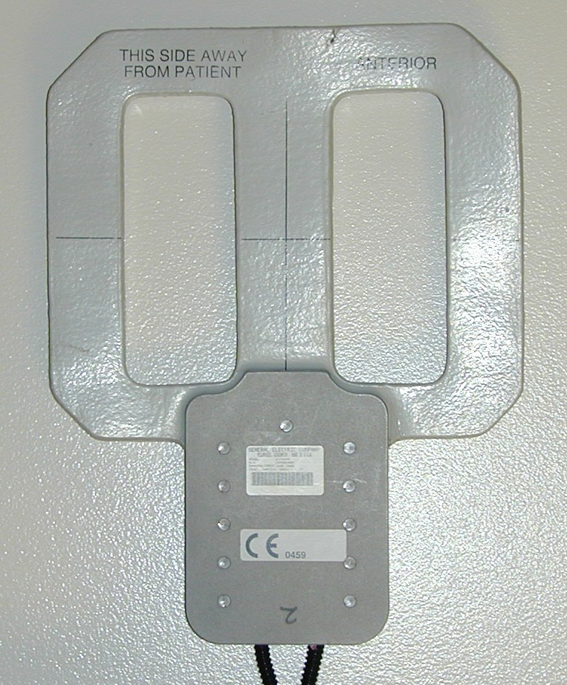
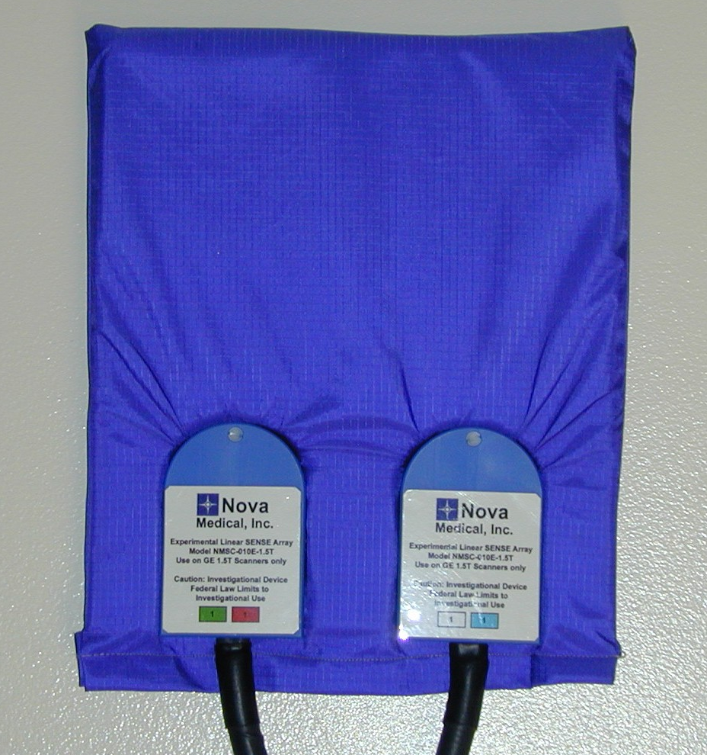
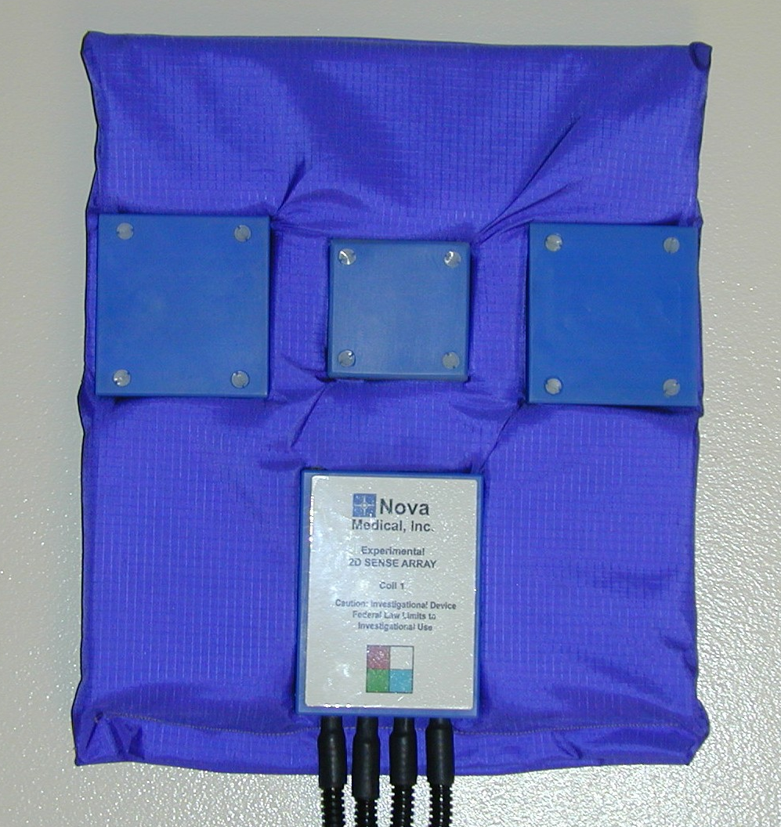
Surface Coil Array Geometry
8-element configurations
4-element configuration
4-element linear array 4-element 2d array
2-element overlapped
linear array
21 cm (8.3”)
21 cm (8.3”)
2 cm (0.75”)
21 cm
(8.3”)
21 cm
(8.3”)
19 cm
(7.5”)
preamplifier decoupled with
adjacent elements capacitatively decoupled
21 cm (8.3”)
Notes:
The coils configurations tested are shown this slide.
The 8-element surface coil arrays developed by Nova Medical were preamp decoupled with ultra-low impedance pre-amps to minimize inductive coil-to-coil coupling while maintaining sample noise loading.
Additional isolation was achieved by capacitative nulling of the inductive coupling between adjacent elements.
The 4-element array was the standard GE cardiac surface coil array product.
The overall array area was approximately the same for each array , therefore the combined SNR was very similar at the center if the body.

Slide 4
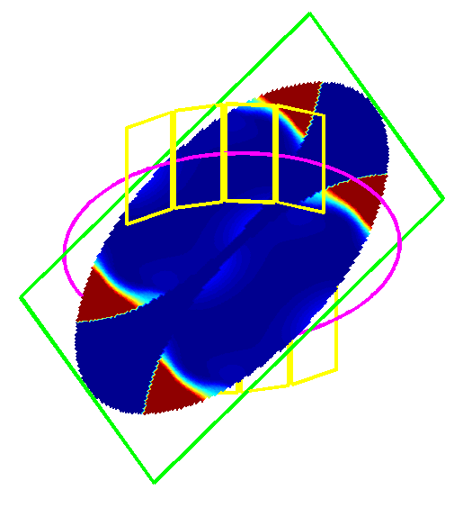
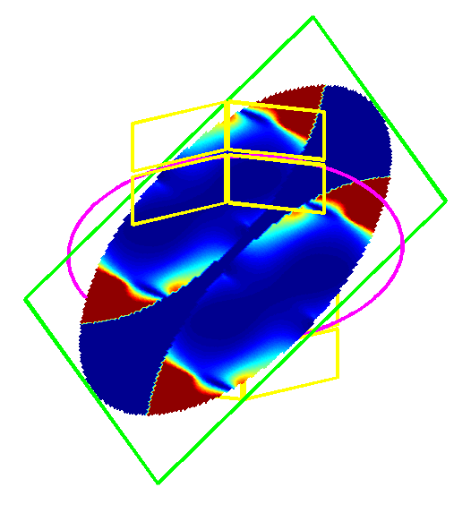
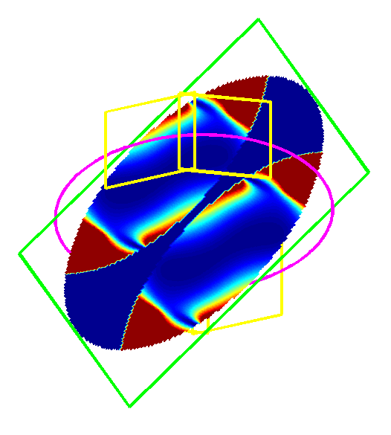
SENSE g-factor (R=2) doubly oblique geometry for SAX slice
1
1.05
1.1
1.15
1.2
1.25
Notes:
The g-factor represents the loss in SNR above the √R loss due to acceleration which results from ill-conditioning of the inverse solution.
The g-factor depends depend on the positions and sizes of coil elements as well geometry of the imaging plane.
The value of the g-factor varies across the FOV and may have significant hot spots.
A simulation was performed to calculate the g-factor while varying a number of parameters.
The examples shown here (for R=2 SENSE) illustrate the g-factor for the 3 different array configurations previously described for a doubly oblique imaging plane typical of cardiac imaging of a short axis slice.
The g-factor for the 8-element linear array shown in the left is below 1.05 over the central region of interest, while the 4-element array has hot spots on the order of 1.25 for the same imaging plane.

Slide 5
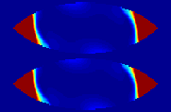
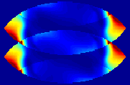
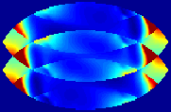
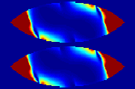
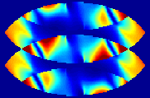
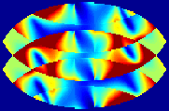
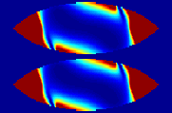
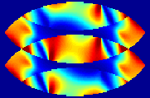
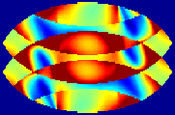

G-factor comparisons
(simulated doubly oblique slice)
R=2
R=3
R=4
G_{mean}= 1.15
G_{max} = 1.5
G_{mean} = 1.6
G_{max} = 2.1
1
1.1
1.2
1
1.5
2
2.5
3
1
2
3
4
5
Notes:
The simulated SENSE g-factors are shown for acceleration rates 2,3 & 4 for the same arrays and doubly oblique imaging geometry.
The performance advantage of 8-elements is substantial at higher values of acceleration.
In the central region of interest, the hot spots in g-factor were less than 2.1 for the 8-element linear array with mean value of 1.6, while the 4-element array reached a value of 5.

Slide 6
Cine Imaging Parameters*
imaging sequence: ECG Gated, Segmented SSFP (FISP)
acquisition matrix: 256x144
FOV: 340 x 255 mm²
spatial resolution: 1.3 x 1.8 mm²
# cardiac phases: 34
TR: 4.1 ms
# lines per segment: 6
breath-hold duration: 24 heartbeats
12 (R=2 SENSE)
9 (R=3 SENSE)
6 (R=4 SENSE)
*using GE LX CV/i custom modified with 8 digital receivers
Morris, HD., Derbyshire, JA, Kellman, P., Chesnick, AS, Guttman, MA, McVeigh, ER. A Wide-Bandwidth Multi-channel Digital Receiver and Real-Time Reconstruction Engine for use with a Clinical MR Scanner. ISMRM‘02. p.61.
Notes:
Cardiac cine imaging was performed using an ECG gated, segmented FISP sequence.
With the spatial resolution and other parameters used, the breath-hold duration was 24 heart beats without acceleration, and was reduced by factors of 2, 3, & 4 using SENSE.
SENSE coefficients were estimated adaptively by the TSENSE method wherein the phase encode lines are shifted 1 line each cardiac phase to produce a ghost free reference with lower temporal resolution.
Imaging was performed on a GE LX scanner which was custom modified for 8 channel operation using a multi-channel digital receiver.

Slide 7
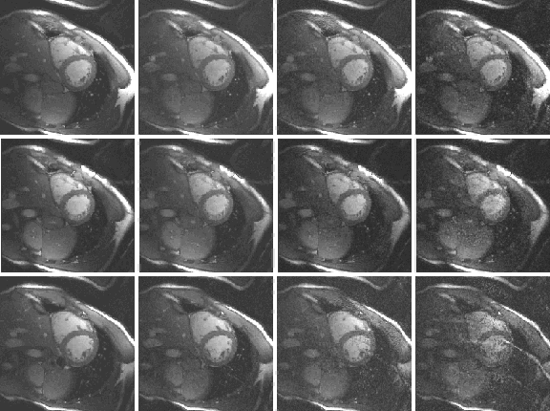
SAX slice Cardiac Cine using SENSE acceleration
R=1
R=2
R=3
R=4
Notes:
These images show the same short axis slice for each surface coil array (rows) at various SENSE acceleration rates (columns).
The breath-hold duration was 24, 12, 9 and 6 seconds from left to right, with corresponding √R acceleration loss of approximately 1.4, 1.7, & 2
Care was taken to maintain the same slice localization for each coil configuration.
The artifact rejection was significantly poorer with 4 coils at higher accelerations rates of 3 & 4 due to the high sensitivity to B1-map errors in regions of ill-conditioning.
For this slice and imaging geometry, the 8 channel arrays performed comparably, with the linear array performing slightly better at rate 4.

Slide 8
Conclusions
- Overall array performance
  all arrays tested had same SNR in central region (within 15%)
  reasonable agreement with simulation
  good pre-amp decoupling achieved
Cardiac SENSE performance
  8 coils provided reasonable quality up to R=3 acceleration
  increased robustness to differences in coil positioning or slice orientation
  4 coils degraded rapidly for R>2 due to ill-conditioning
  high sensitivity to B1-map errors reduced artifact suppression
Notes:
The SNR of the myocardium in the posterior wall of the LV which represents the worst case region was approximately the same for arrays tested, which was in reasonable agreement with simulations.
A high level of isolation between coils was achieved and did not limit degrade performance.
Using the 8-element surface coil arrays, cardiac imaging using SENSE was robust and had reasonable quality up to rate 3 with the imaging parameters used.
Using 4 coils, the SENSE performance degraded for rates higher than 2, as expected.

