Slide 1
Verifying Object Construction
How to use the builder pattern with the type safety of constructors
Martin Kelloggª, Manli Ran^{b}, Manu Sridharan^{b},
Martin Schäf^{c}, Michael D. Ernst^{a,c}
ªUniversity of Washington ^{b}University of California, Riverside ^{c}Amazon Web Services
Notes:
Slot is 8+4, remote

Slide 2
Object construction APIs
public class UserIdentity {
private final String name; // required
private final int id; // required
private final String nickname; // optional
}

Slide 3
Object construction APIs
public class UserIdentity {
private final String name; // required
private final int id; // required
private final String nickname; // optional
}
public UserIdentity(String name, int id);
public UserIdentity(String name, int id,
String nickname);

Slide 4
Object construction APIs
public UserIdentity(String name, int id);
public UserIdentity(String name, int id,
String nickname);
new UserIdentity(“myName”);

Slide 5
Object construction APIs
public UserIdentity(String name, int id);
public UserIdentity(String name, int id,
String nickname);
new UserIdentity(“myName”);
error: constructor UserIdentity in class UserIdentity cannot be applied to given types;
new UserIdentity("myName");
^
required: String,int
found: String
reason: actual and formal argument lists differ in length

Slide 6
Pros and cons of constructors
compile-time verification that arguments are sensible

Slide 7
Pros and cons of constructors
compile-time verification that arguments are sensible
user must define each by hand
exponentially many in number of optional parameters
arguments are positional (hard to read code)

Slide 8
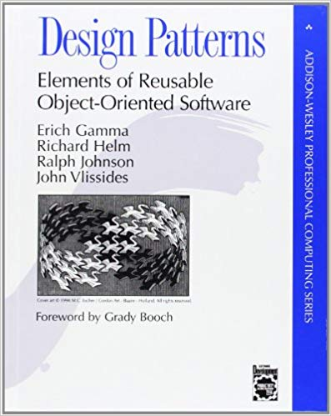
The builder pattern
public class UserIdentity {
public static UserIdentityBuilder builder();
public class UserIdentityBuilder {
public UserIdentityBuilder name();
public UserIdentityBuilder id();
public UserIdentityBuilder nickname();
public UserIdentity build();
}
...
}
Notes:
Notice the builder has “setter” methods - emphasize that

Slide 9
The builder pattern
UserIdentity identity = UserIdentity.builder()
.name(username)
.id(userId)
.build();

Slide 10
Pros and cons of the builder pattern
Flexible and easy to read
Frameworks implement automatically

Slide 11
The builder pattern
UserIdentity identity = UserIdentity.builder()
.name(username)
.id(userId)
.build();
.build();

Slide 12
The builder pattern
UserIdentity identity = UserIdentity.builder()
.name(username)
.build();
Possible outcomes:
Run-time error (bad!)
Malformed object is used (worst!)

Slide 13
The builder pattern
UserIdentity identity = UserIdentity.builder()
.name(username)
.build();
Possible outcomes:
Run-time error (bad!)
Malformed object is used (worst!)

Slide 14
Pros and cons of the builder pattern
Flexible and easy to read
Frameworks implement automatically
No guarantee that required arguments provided

Slide 15
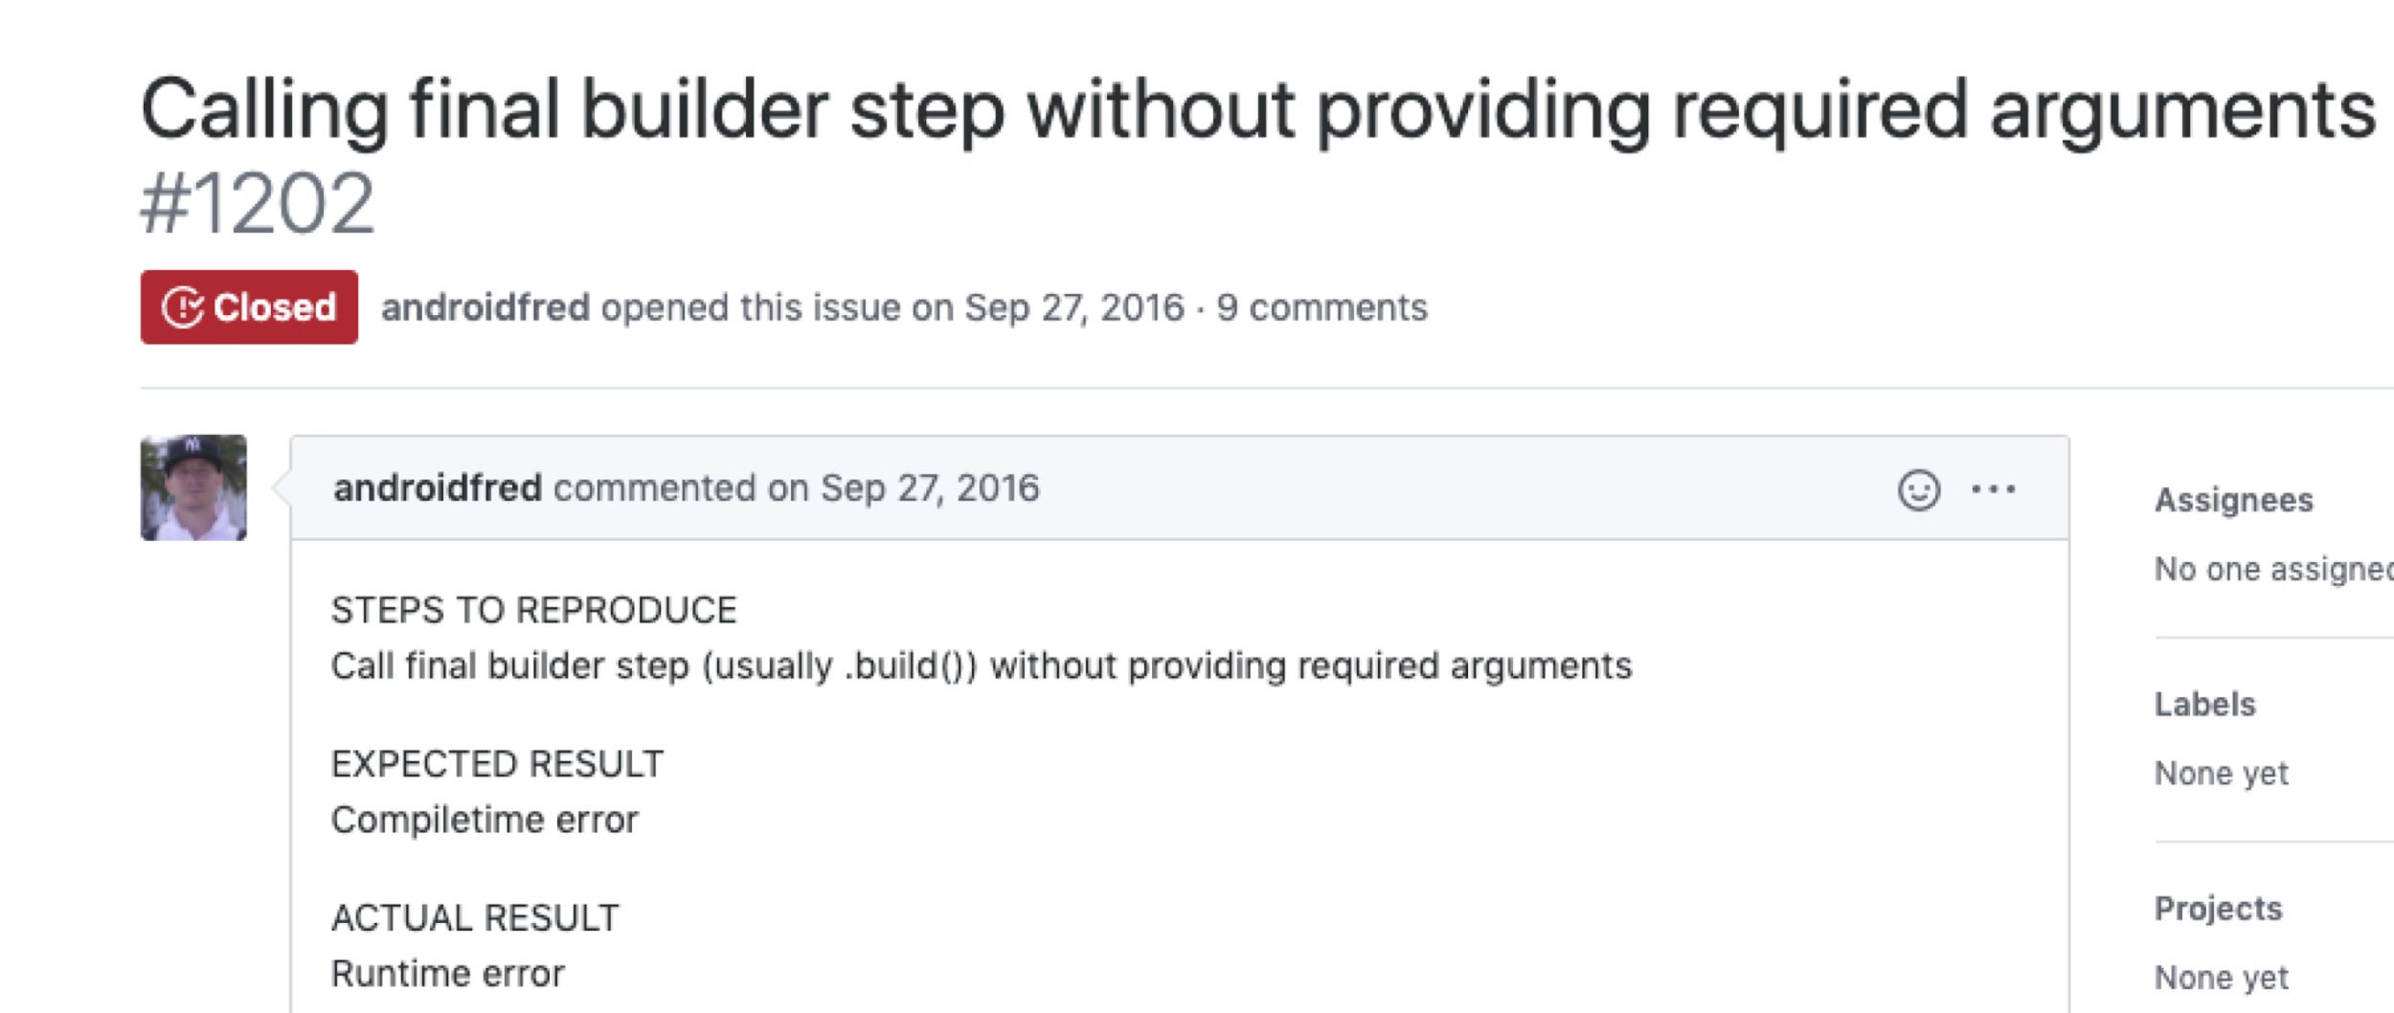
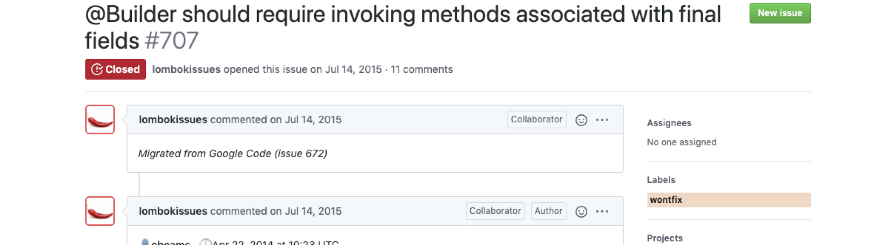
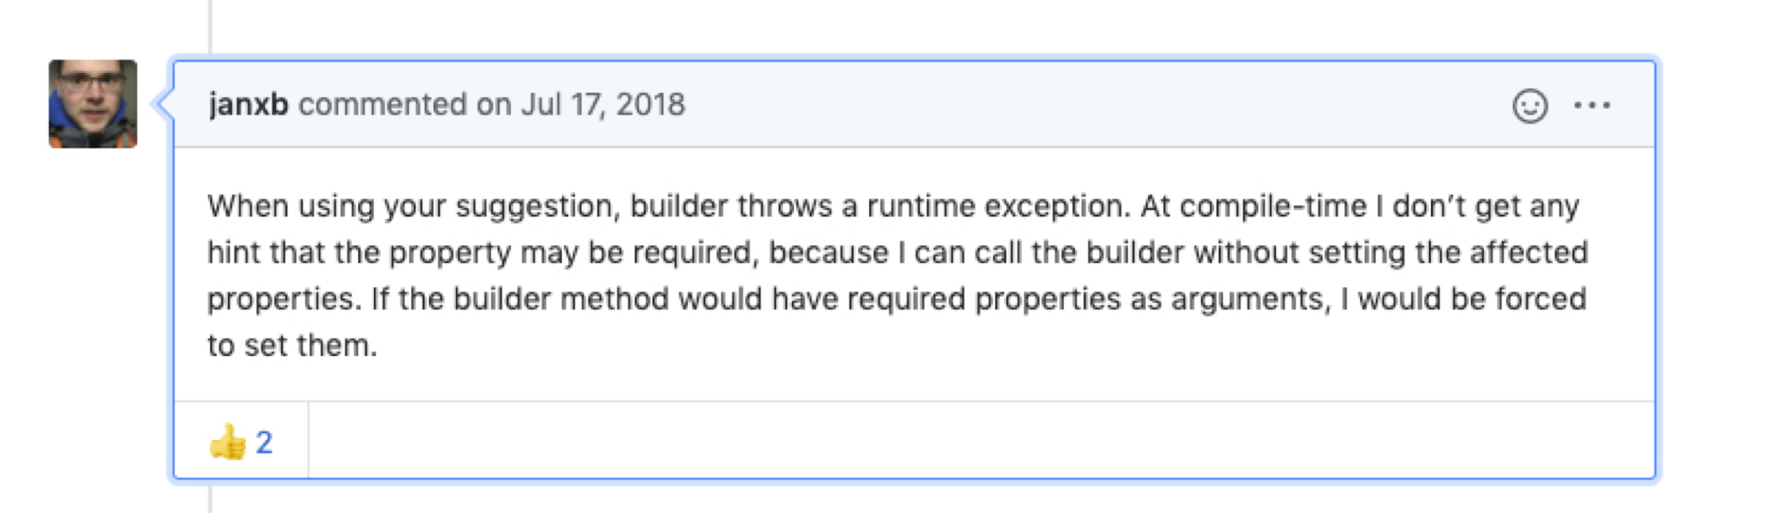
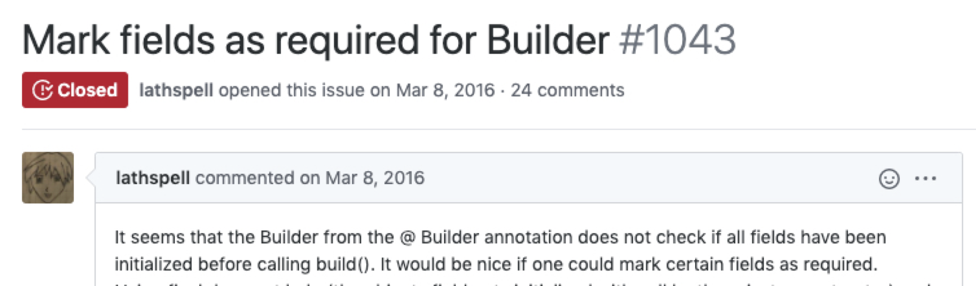
Pros and cons of the builder pattern
Flexible and easy to read
Frameworks implement automatically
No guarantee that required arguments provided

Slide 16
Pros and cons of the builder pattern
Flexible and easy to read
Frameworks implement automatically
No guarantee that required arguments provided
“We get this feature request every other week”
- Reinier Zwitserloot, Lombok project lead

Slide 17
Pros and cons of the builder pattern
Flexible and easy to read
Frameworks implement automatically
No guarantee that required arguments provided
Our approach:
Provides type safety for uses of the builder pattern
Keeps advantages of builder pattern vs. constructors
“We get this feature request every other week”
- Reinier Zwitserloot, Lombok project lead

Slide 18
Builder correctness as a typestate analysis
UserIdentity identity =
UserIdentity.builder()
.name(username)
.id(userId)
.build();

Slide 19
Builder correctness as a typestate analysis
UserIdentity identity =
UserIdentity.builder()
.name(username)
.id(userId)
.build();
…
name()
id()
build()
…
name()
…
id()
…
Notes:
Add explicit arc for build on the accepting state
Replace the star with a ...

Slide 20
Builder correctness as a typestate analysis
UserIdentity identity =
UserIdentity.builder()
.name(username)
.id(userId)
.build();
…
name()
id()
build()
…
name()
…
id()
build()
…
X

Slide 21
Builder correctness as a typestate analysis
UserIdentity identity =
UserIdentity.builder()
.name(username)
.id(userId)
.build();
…
name()
id()
build()
…
name()
…
Problem:
Arbitrary typestate analysis is expensive: a whole-program alias analysis is required for soundness
id()
build()
…
X

Slide 22
Builder correctness as a typestate analysis
UserIdentity identity =
UserIdentity.builder()
.name(username)
.id(userId)
.build();
…
name()
id()
build()
…
name()
…
id()
Key insight:
Transitions flow in one direction!
build()
…
X

Slide 23
Builder correctness as a typestate analysis
UserIdentity identity =
UserIdentity.builder()
.name(username)
.id(userId)
.build();
…
name()
id()
build()
…
name()
…
id()
Key insight:
Transitions flow in one direction!
build()
…
X

Slide 24
Builder correctness as a typestate analysis
UserIdentity identity =
UserIdentity.builder()
.name(username)
.id(userId)
.build();
…
name()
id()
build()
…
name()
…
id()
Key insight:
Transitions flow in one direction!
build()
…
X

Slide 25
Builder correctness as a typestate analysis
accumulation
UserIdentity identity =
UserIdentity.builder()
.name(username)
.id(userId)
.build();
…
name()
id()
build()
…
“accumulation analysis”
name()
…
id()
Key insight:
Transitions flow in one direction!
build()
…
X
Notes:
Add an animation of an arrow with an illegal transition that would make this not an AA

Slide 26
Advantages of accumulation analysis
always safe to under-approximate
Notes:
Have more here on this connection
Spiel should be fixed in advance

Slide 27
Advantages of accumulation analysis
always safe to under-approximate
does not require alias analysis for soundness
Notes:
Have more here on this connection
Spiel should be fixed in advance

Slide 28
Advantages of accumulation analysis
always safe to under-approximate
can be implemented modularly (e.g., as a type system)
does not require alias analysis for soundness
Notes:
Have more here on this connection
Spiel should be fixed in advance

Slide 29
Advantages of a type system
provides guarantees
no alias analysis + modular ⇒ scalable
type inference reduces need for annotations
Notes:
Don’t say anything about precision. Let the audience ask because they will.

Slide 30
build()’s specification
build(@CalledMethods({“name”, “id”})
UserIdentityBuilder this);
Notes:
Colors look bad

Slide 31
Results (1 of 3): security vulnerabilities
Lines of code | 9.1M
Vulnerabilities found | 16
False warnings | 3
Annotations | 34
Notes:
Drop number of
Changes slide title: results (1 of 4): security vulns
Be better about saying “partners”

Slide 32
Contributions
Static safety of constructors with flexibility of builders
Accumulation analysis: special case of typestate
Does not require whole-program alias analysis
https://github.com/kelloggm/object-construction-checker

Slide 34
Accumulation doesn’t need alias analysis
UserIdentityBuilder b = UserIdentity.builder();
b.name(username);
UserIdentityBuilder b2 = b;
b2.id(userId)
UserIdentity identity = b.build();

Slide 35
Accumulation doesn’t need alias analysis
UserIdentityBuilder b = UserIdentity.builder();
b.name(username);
UserIdentityBuilder b2 = b;
b2.id(userId)
UserIdentity identity = b.build();
False positive here is worst-case scenario

Slide 36
Why typestate needs alias analysis
read()
File f = …;
f.open();
File f2 = f;
f.close();
f2.read();
open()
close()
open()
read(), close()
X

Slide 37
Why typestate needs alias analysis
read()
File f = …;
f.open();
File f2 = f;
f.close();
f2.read();
open()
close()
open()
read(), close()
X
No alias analysis leads to false negative

Slide 38
Example: Netflix/SimianArmy
public List<Image> describeImages(String... imageIds) {
DescribeImagesRequest request =
new DescribeImagesRequest();
if (imageIds != null) {
request.setImageIds(Arrays.asList(imageIds));
}
DescribeImagesResult result =
ec2client.describeImages(request);
return result.getImages();
}
Notes:
Be explicit about why you know it’s nullable (callers in the codebase)

Slide 39
The builder pattern
@Builder
public class UserIdentity {
private final String name; // required
private final int id; // required
private final String nickname; // optional
}

Slide 40
The builder pattern
@Builder
public class UserIdentity {
private final @NonNull String name;
private final @NonNull int id;
private final String nickname; // optional
}
Notes:
Drop this slide entirely as an impl detail of the framework?

Slide 41
The builder pattern
@Builder
public class UserIdentity {
private final @NonNull String name;
private final @NonNull int id;
private final String nickname; // optional
}
UserIdentity identity = UserIdentity.builder()
.name(username)
.id(userId)
.build();
Notes:
Make this a bad example

Slide 42
Type hierarchy
@CalledMethods({}) Object
@CalledMethods({“name”}) Object
@CalledMethods({“name”, “id”}) Object
Notes:
Say accumulate here when describing how these work

Slide 43
What’s the type of b?
UserIdentityBuilder b = UserIdentity.builder();
b.name(username);
b.id(userId)
UserIdentity identity = b.build();
Notes:
Possible idea: add FSM here, show it transition

Slide 44
What’s the type of b?
@CalledMethods({})
UserIdentityBuilder b = UserIdentity.builder();
b.name(username);
b.id(userId)
UserIdentity identity = b.build();
Notes:
Explain fluent api
Slide support for showing types as we go

Slide 45
What’s the type of b?
@CalledMethods({})
UserIdentityBuilder b = UserIdentity.builder();
b.name(username);
b.id(userId)
UserIdentity identity = b.build();
@CalledMethods({“name”})
Notes:
Explain fluent api
Slide support for showing types as we go

Slide 46
What’s the type of b?
@CalledMethods({})
UserIdentityBuilder b = UserIdentity.builder();
b.name(username);
b.id(userId)
UserIdentity identity = b.build();
@CalledMethods({“name”})
@CalledMethods({“name”, “id”})
Notes:
Make sure that we say that the call on this slide is legal

Slide 47
Fluent APIs and receiver aliasing
UserIdentity identity = UserIdentity.builder()
.name(username)
.id(userId)
.build();
Notes:
Cut this discussion, don’t go into detail here

Slide 48
Fluent APIs and receiver aliasing
UserIdentity identity = UserIdentity.builder()
.name(username)
.id(userId)
.build();
@CalledMethods({“id”})
Notes:
What’s the type after name? CM name
What’s the type after id? ...

Slide 49
Fluent APIs and receiver aliasing
UserIdentity identity = UserIdentity.builder()
.name(username)
.id(userId)
.build();
@CalledMethods({“id”})
How do we know that the return type of id() is the same object that name() was called on?
Notes:
Add slide on what the receiver type of build should be. Show the spec

Slide 50
Returns receiver checking
A special case of aliasing, needed for precision!
@MaybeThis Object
@This Object

Slide 51
Returns receiver checking
A special case of aliasing, needed for precision!
@MaybeThis Object
class UserIdentityBuilder {
@This UserIdentityBuilder name();
@This UserIdentityBuilder id();
}
@This Object

Slide 52
Showing correct code is safe
UserIdentity identity = UserIdentity.builder()
.name(username)
.id(userId)
.build();
Notes:
Cut this discussion, don’t go into detail here

Slide 53
Showing correct code is safe
UserIdentity identity = UserIdentity.builder()
.name(username)
.id(userId)
.build();
Accumulate more “called methods”
Notes:
Cut this discussion, don’t go into detail here

Slide 54
Results (2 of 3): Lombok user study
6 industrial developers with Java + Lombok experience
Task: add a new @NonNull field to a builder, and update all call sites
Results:
6/6 succeeded with our tool, only 3/6 without
Those who succeeded at both 1.5x faster with our tool
“It was easier to have the tool report issues at compile time”

Slide 55
Results (3 of 3): case studies
5 projects: 2 Lombok, 3 AutoValue (~200k sloc)
653 calls verified, 1 true positive (google/gapic-generator)
131 annotations, 14 false positives
"your static analysis tool sounds truly amazing!"
- gapic-generator engineer

