Slide 1
Space DashBoard DataViz Assessment 2
The Aim of the project was to follow through on assessment 1 and complete and infographic that was to inspire the reader about space but as the title might hint the project had to take a drastic shift. After revaluating where my skills lie and if I could complete and infographic in time for the deadline that choice to switch to a dashboard was made. The tools that are going to be used throughout the projects are:
Excel for data cleaning
Anaconda for data cleaning and data exploration
Flourish for data cleaning and plotting visuals
Streamlit to publish the Dashboard

Slide 2
Reffrences
Aché, M. (2020). Kaggle. Retrieved from Space Agency Budget: https://www.kaggle.com/datasets/mathurinache/spaceagencybudget?resource=download
Kurkowski, S. (2022, Dec 7). Space Explored . Retrieved from How many people are in space right now? : How many people are in space right now?
LaCla3D. (2020). Kaggle. Retrieved from All Space Missions from 1957: https://www.kaggle.com/datasets/agirlcoding/all-space-missions-from-1957
Roberts, T. G. (2022, Jul 5). AreoSpace Security. Retrieved from International Astronaut Database: https://aerospace.csis.org/data/international-astronaut-database/
Salas, E. B. (2022, Mar 27). Statista. Retrieved from Government space program spending of the leading countries in the world 2020-2021 : https://www.statista.com/statistics/745717/global-governmental-spending-on-space-programs-leading-countries/
Union of Concerned Scientists . (2022, May 1). UCS Satellite Database. Retrieved from In-depth details on the 5,465 satellites currently orbiting Earth, including their country of origin, purpose, and other operational details.: https://www.ucsusa.org/resources/satellite-database

Slide 3
The First plots are single number stories arranged in a row along the bottom of the page title one is shown below.
Visual 1
The Visual was created by connecting multiple sources into a single Excel sheet.
The Data frame and Data cleaning took place in Jupyter Notebook. We got rid of all the Null values and rows that held data that would interfere with the final result.
This line of code will allow us to choose a column and remove rows such as NaN or multi-ventured flights with no country included.
This will show us the remaining data able to create the first column of the .csv file the amount of people where hand entered from information found on the web [2]. It's loaded on Streamlit by doing a sum on the number of people.

Slide 4
Visual 2 and 3
By taking the Kaggle.csv [3] and using as simple count of unique values in the column and this is USA value is hard coded into the site.
The 3rd visual is created by using the IAD.csv [4] dropping redundant columns then joining them onto the selfmade.csv in the previous slide after a quick max value query the data can be rendered.

Slide 5
Single Digit Stories
Singular Data Source International Astronaut Database.csv
Create by summing up the how many unique column values reside in the Names of astronauts
This this then rendered on the page with the following code.

Slide 6
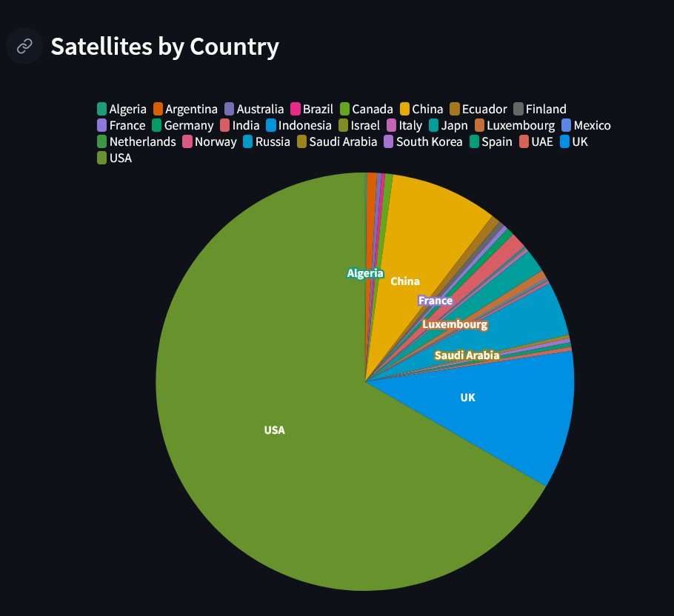
Pie Charts
Both the pie chats were created using Flourish and Jupyter Notebook and are from the UCS satellite Database.
They both start the same loading into Jupyter to dropping unwanted columns.
Then continued the same path by deleting rows that held unwanted data such as NaN and multinational ventures these took up way too much in the country bar and made it unreadable.
Count the number of values in the column for each unique row using command.
Enter data into Flourish and set correct columns to create the final charts

Slide 7
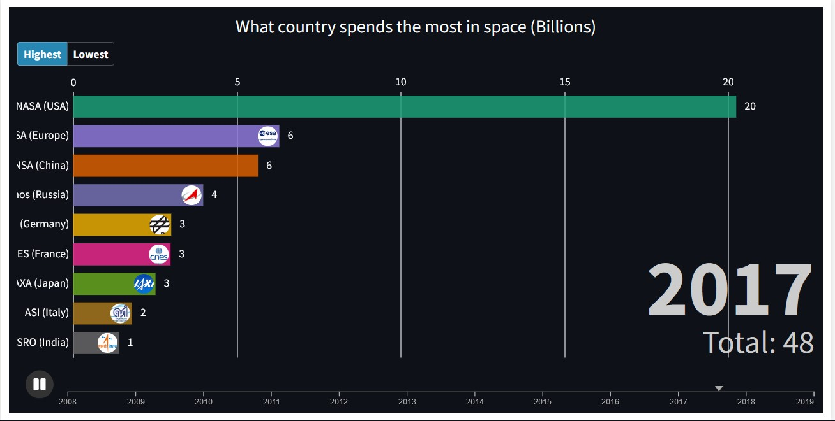
Bar Race
The Bar Race was created by using the Space Agency Budget.csv
The data was already in a usable state when found
Once put into Flourish and choose the correct columns the visual is complete then embedded in the Dashboard.

Slide 8
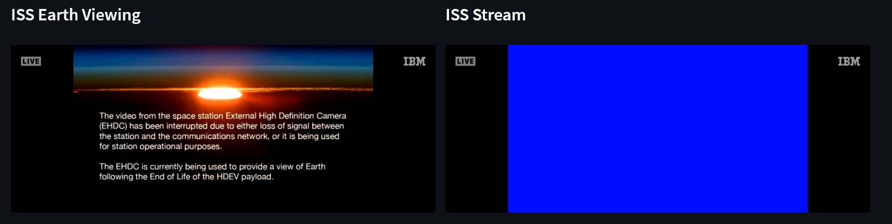
ISS
These are included into the site to give it more that just data.
They are both live videos from the ISS and are embedded into the site with the toggle for Autoplay on so on load the videos will start.

Slide 9
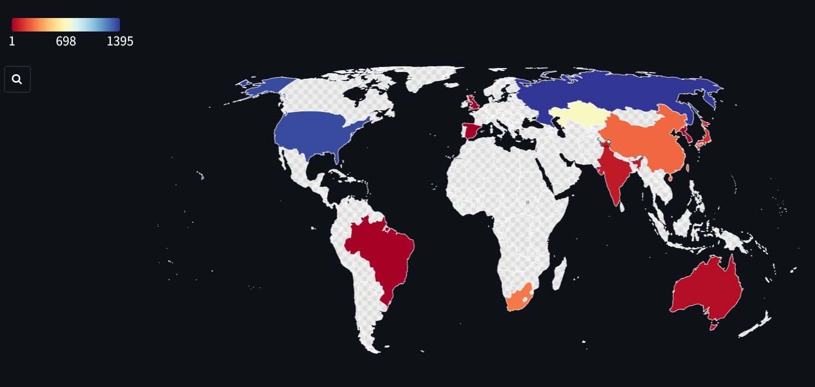
Map Plot
Plot was created from the Kaggle.csv all space missions
This one got a little tricky as I couldn't get the column with the location of launch to spilt into the launch site and unwanted data.(will show attempted code.
The way I done it was using the find all function
And fill in the data by hand into Flourish where the sample data already had the correctly formatted region data.
One completion of data and choosing correct columns the visual is complete.

Slide 10
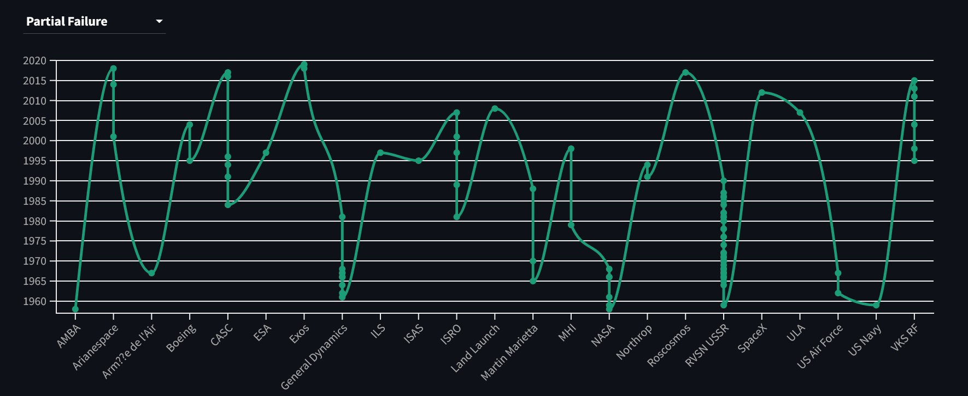
Map Plot
Map Plot was created using Flourish, Jupyter Notebook and Excel.
The Kaggle.csv Space flights was used
Company name for the x-axis was already formatted along with the mission status.
The Datum column had to be spilt to get the date and then limiting the new columns limit to remove more data.
Excel was then used with the find function to delete all the days left in the column.
We can then put the remaining data into Flourish and complete the visual.

Slide 11
Conclusion
My conclusion to the project is that nothing turned out the way I had planned I was overzealous with the amount of work and new skill it would take to create the infographic I had imagined and should have just stuck to the skill and technologies I know polishing existing skill instead of trying to outright learn new ones.
Template for slide from:
https://slidesgo.com/theme/outer-space

Slide 12
ALTERNATIVE RESOURCES

Slide 13
RESOURCES
VECTOR
Universe infographic with solar system
Infography about the different planets in the milky way
Hand drawn planet collection
ICON
Space Icon Pack
PHOTO
Abstract background with planets in space
Beautiful trees in the middle of the road at night
Multiracial group of smiling coworkers

