Slide 1

DATA DETECTIVE

Slide 2

Robbery at the Jewelry Store!

Slide 3
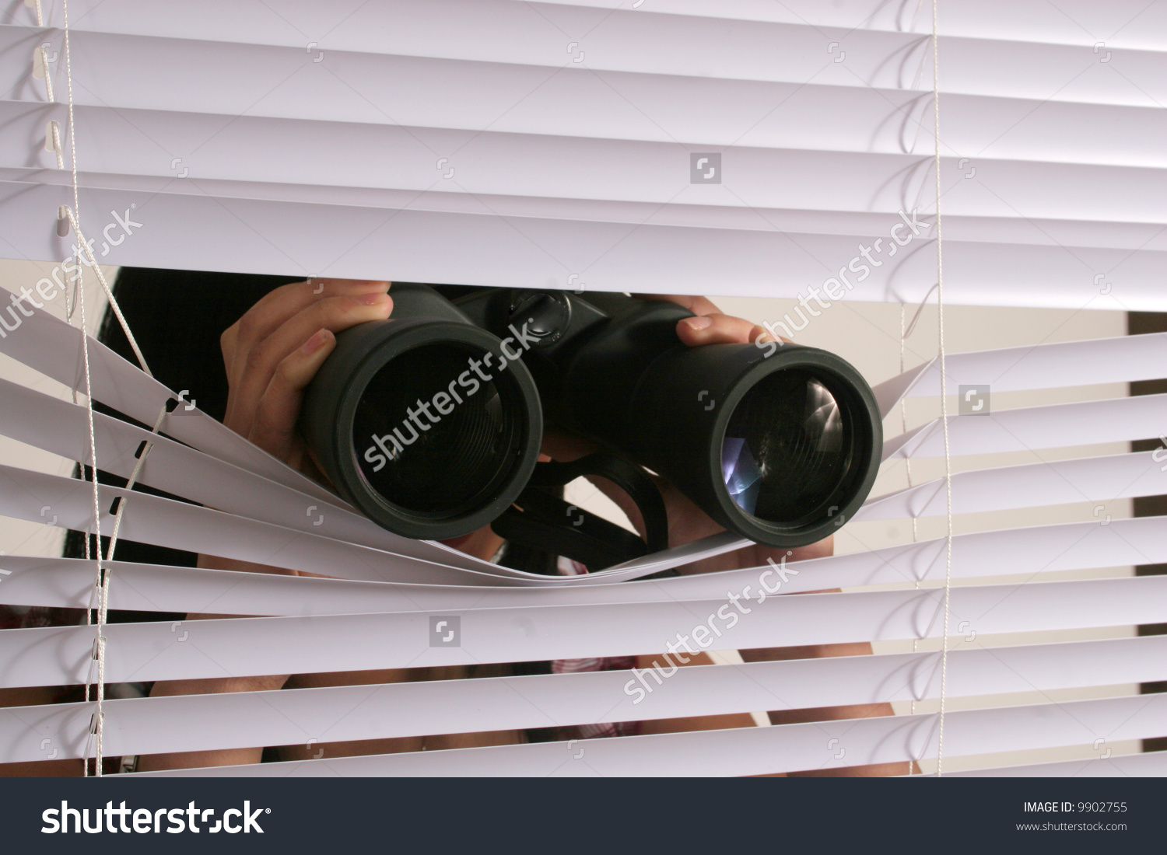
Two witnesses have reported information about the robbery

Slide 4
Witness testimonies
Witness 1
Witness 2
Claims that the thief took off their shoes during their getaway and threw them over his fence into his yard. The shoes are size 10.
Also claims his thermometer showed 25 degrees Celsius.
Claims that the thief left a shoeprint in the mud on the sidewalk in front of his house that was size 8.
Also claims the thief ran past his house about 70 seconds after the alarm went off, and his house is approximately 160 meters away from the jewelry store.

Slide 5
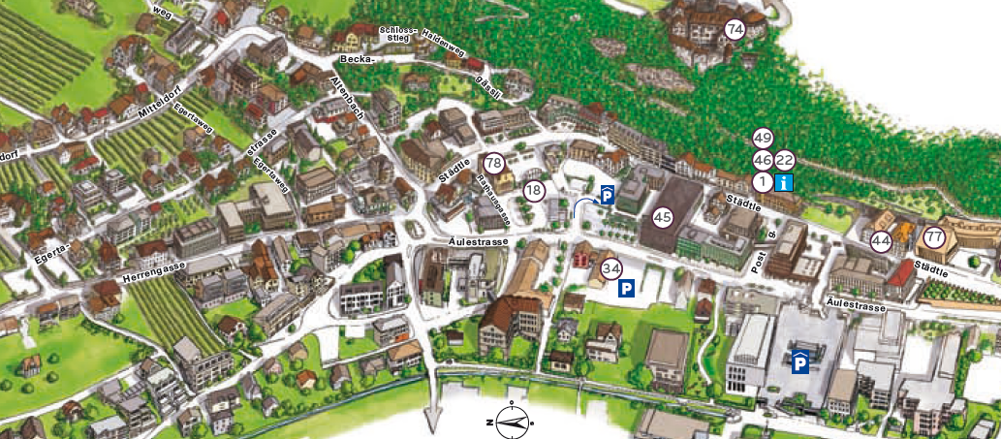

The Initial Facts
Using video camera footage from several locations, we know the thief escaped through the front door (which set off the alarm) and ran away at a constant speed, covering 300 meters in the first 80 seconds.
It was 77 degrees Fahrenheit outside at the time of the robbery

Slide 6

Are the witnesses Trustworthy???
THINK-PAIR-SHARE

