Slide 1
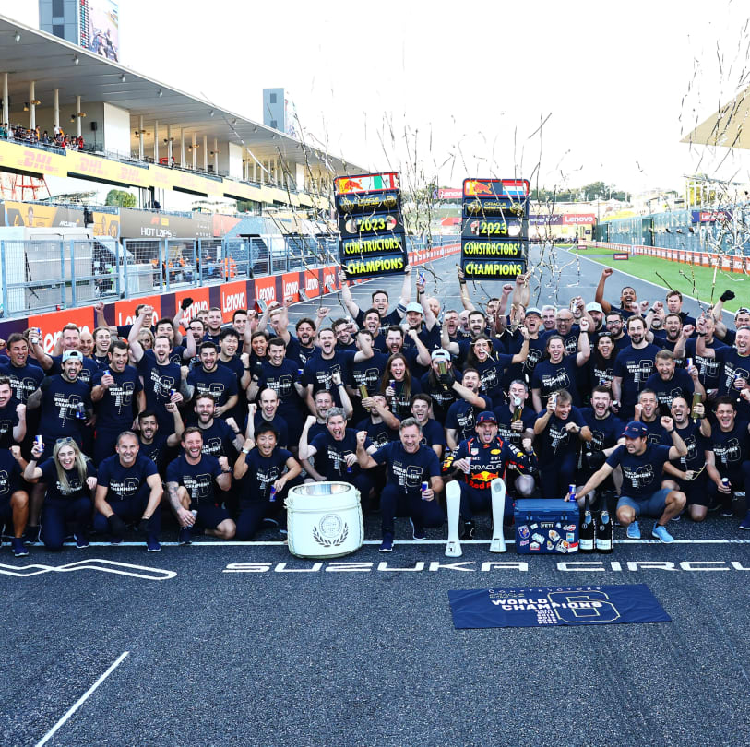

Formula 1 Beginner’s Guide Video
IST-707 Applied Machine Learning
Kelly Arseneau

Slide 2
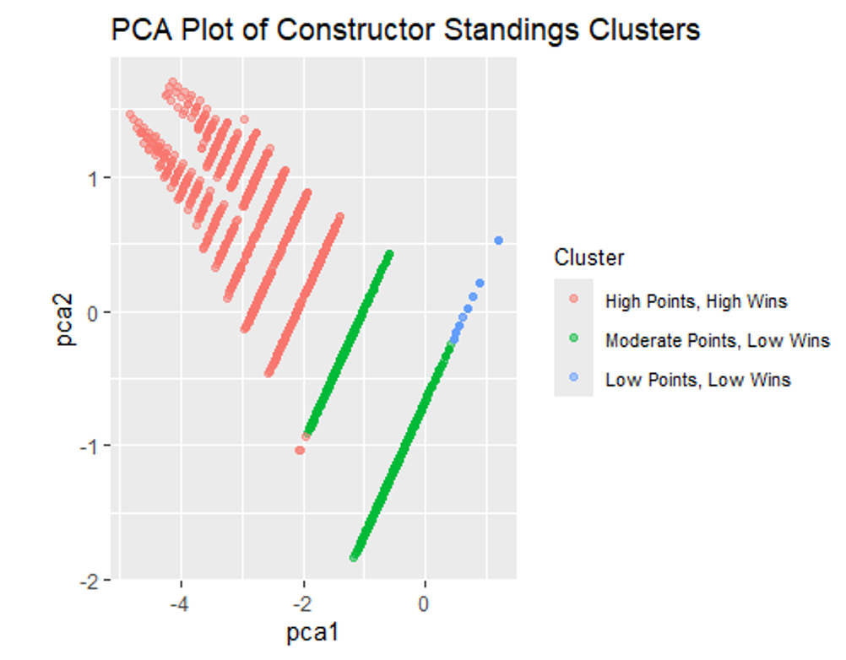
Executive Summary Formula 1 Constructor Success Analysis (Data from the 2014–2022 F1 seasons)
🎯 Goal
Identify key factors that drive constructor success using machine learning and performance data.
🛠️ Data & Methods
14 linked datasets (Kaggle)
EDA, PCA, K-means clustering
Supervised learning & predictive modeling: Decision Tree & Random Forest (regression)
Rule mining for strategic patterns
🧠 Key Findings
Grid position & qualifying rank = top predictors
Pit stop duration = minimal impact
Feature importance revealed clear trends
Random Forest explained 82.4% of variance
→ strong model accuracy
🚀 Why It Matters
Shows how ML reveals strategic insights in high-speed, real-world team performance.
PCA clustering reveals 3 clear tiers of constructor performance.

Slide 3
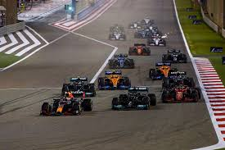
What Drives Constructor Success in Formula 1? Investigating team performance using data from 2014–2022
🎯 Objective
Analyze key performance indicators to understand what separates top-performing F1 constructor teams from the rest — and how those factors have changed over time.
Using data from 14 connected sources across 9 seasons, I explore patterns in race results, team metrics, and strategy to uncover what actually matters for constructor success.
Focus: Constructor teams (not drivers)
Period: 2014–2022 F1 seasons
Output: Insights + Predictive Model + Strategy recommendations
Performance on race day reflects dozens of underlying variables — but which ones matter most?

Slide 4
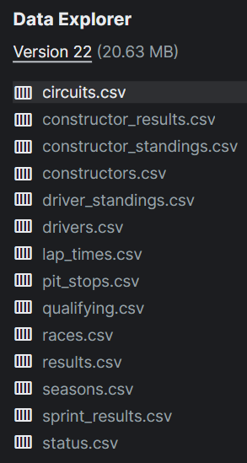
The Data 2014–2022 F1 Seasons
Sourced from Kaggle’s Formula 1 dataset (14 relational CSVs)
Focused on 2014–2022: consistent rules + complete data
Covered race results, lap times, qualifying, pit stops, constructors & more
Structured format enabled team-level analysis across seasons
14 interlinked CSVs enabled multi-season,
constructor-level modeling.

Slide 5
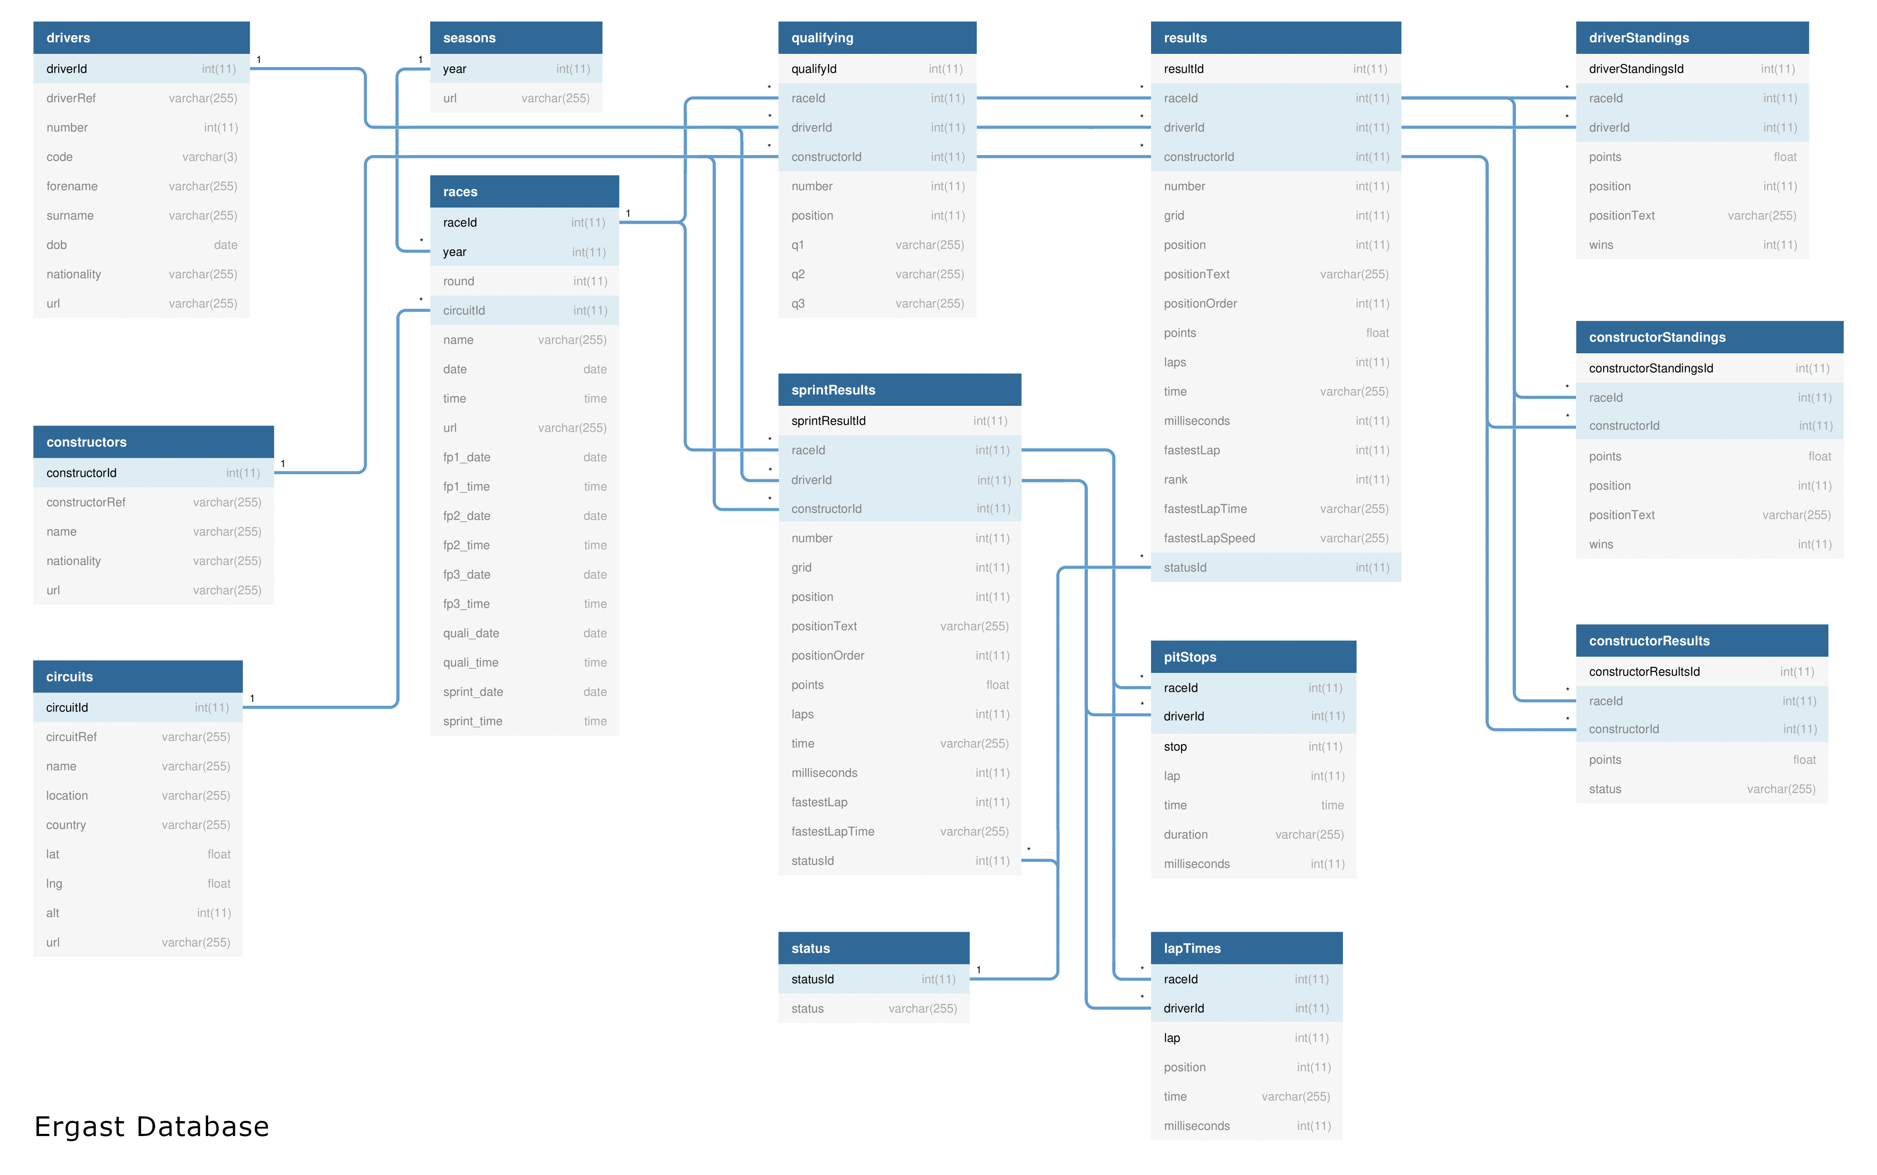
Relational Structure of the Dataset 14 entity-linked tables from Kaggle
This Formula 1 dataset from Kaggle consists of 14 linked .csv files, structured through entity relationships.

Slide 6
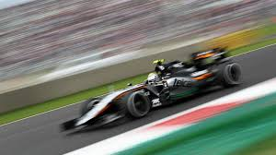
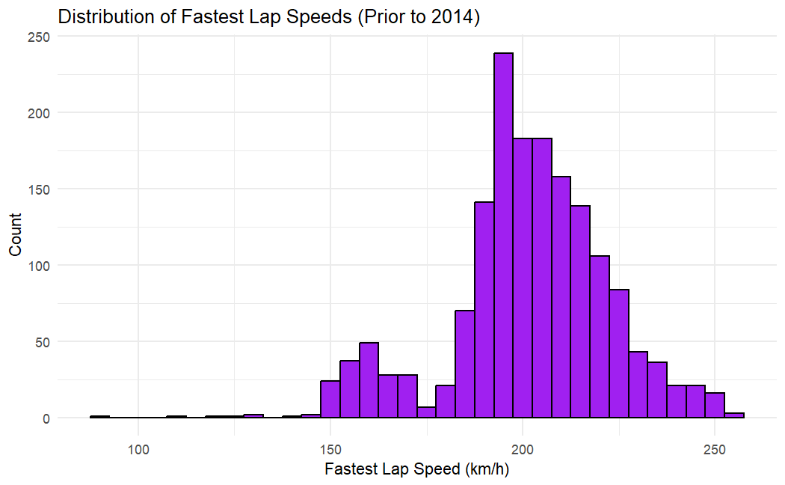
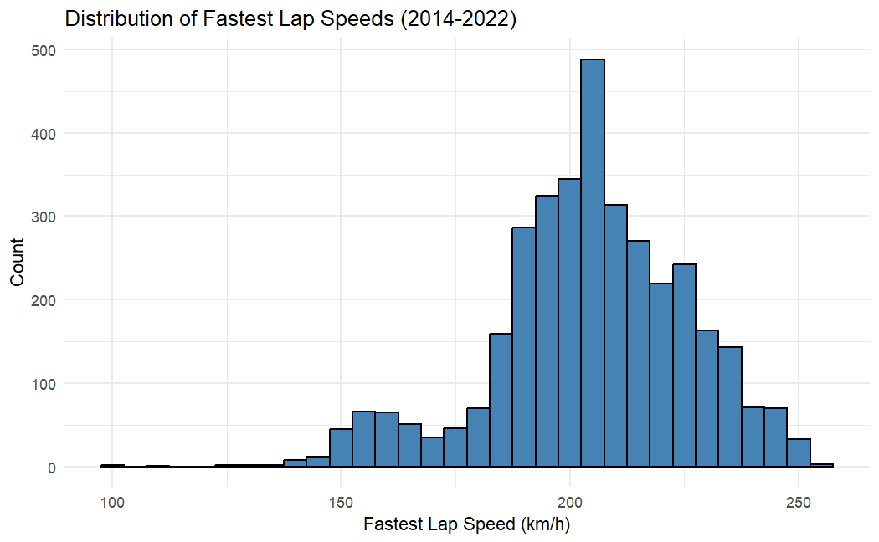
Fastest Lap Speed Distributions – Before vs. After 2014
Typical fastest laps stayed around 200–210 km/h. Post-2014, speeds are more consistent — reflecting tighter engineering and performance variability among constructors.
Drivers in the top 10 of a Grand Prix can earn a bonus point for setting the fastest lap time. If a driver outside the top 10 sets the fastest lap, they won't receive the point but will prevent a top 10 driver from earning it.

Slide 7
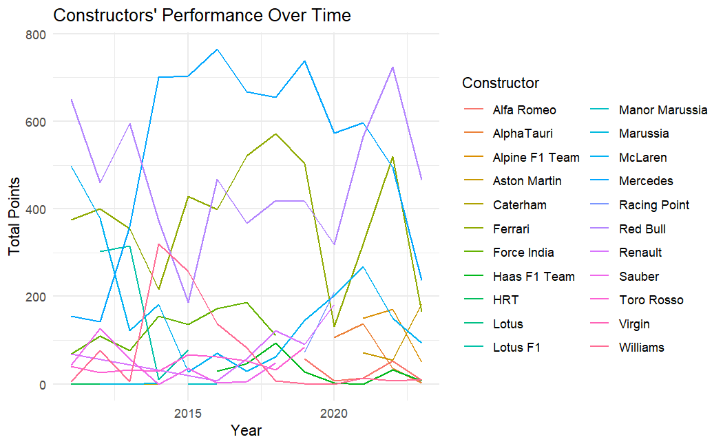
Team Performance Trends (2014–2022)
The plot highlights the dominance of Mercedes, Red Bull, and Ferrari, from 2014 to 2022, while also revealing performance trends among mid- and lower-tier teams. It offers a clear view of the competitive dynamics across constructors during this period.

Slide 8
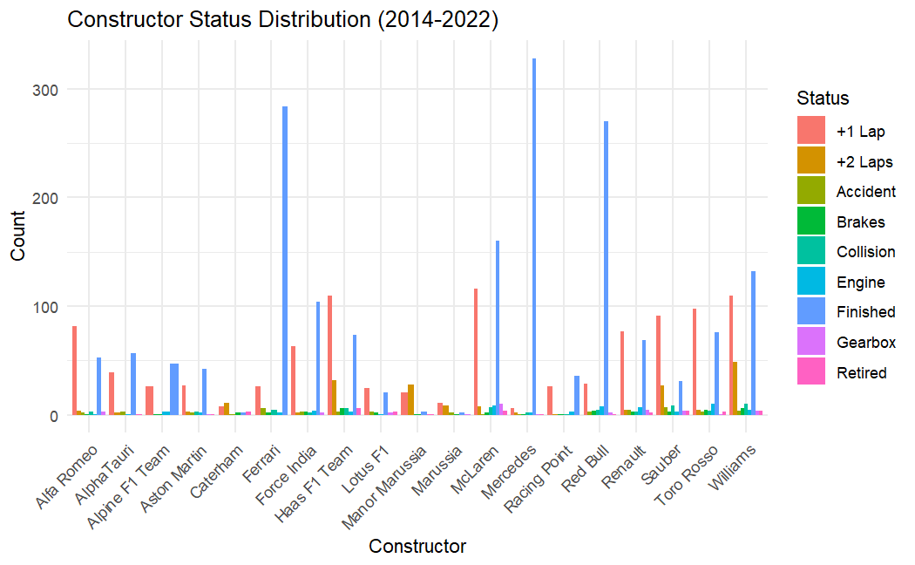
Constructor Status Distribution (2014-2022)
1. Finished Races
Mercedes, Ferrari, and Red Bull finish most races — showing high reliability.
Haas and McLaren show more inconsistent finish counts.
2. +1 and +2 Laps
Mercedes, Ferrari, and Force India often finish just behind the leader.
These gaps indicate competitive but slightly trailing performance.
3. Failures
Gearbox and engine failures hit teams like McLaren and Renault more often — reliability issues.
Collision- and accident-related DNFs are spread across teams.
4. Outliers
Ferrari and Red Bull have occasional brake/collision DNFs.
Haas and Williams show retirement spikes — potential concern.

Slide 9
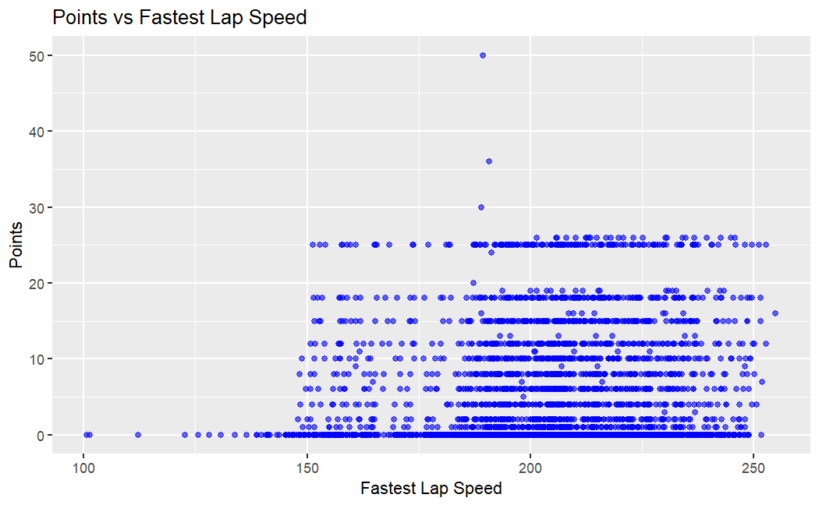
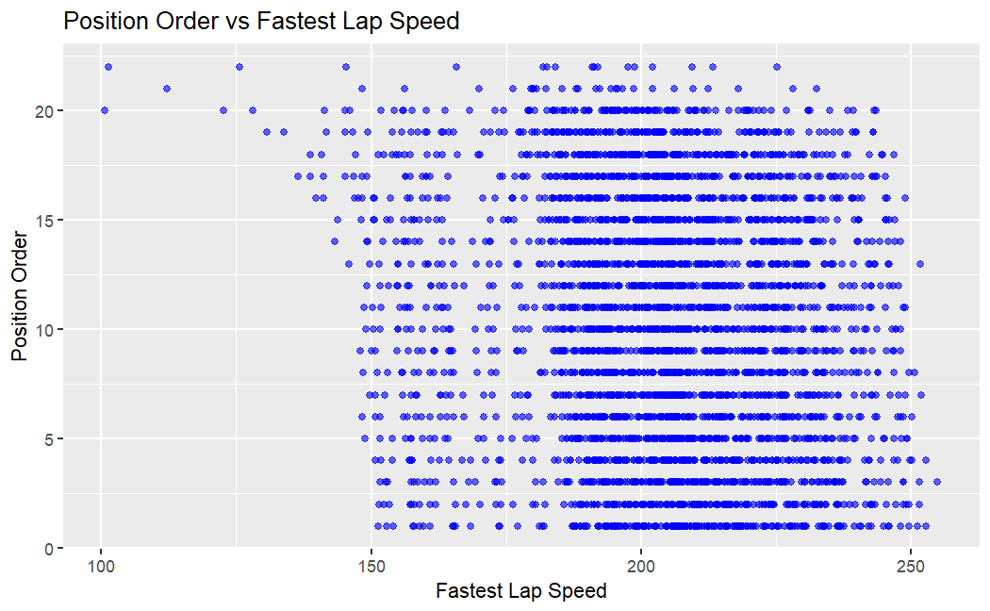
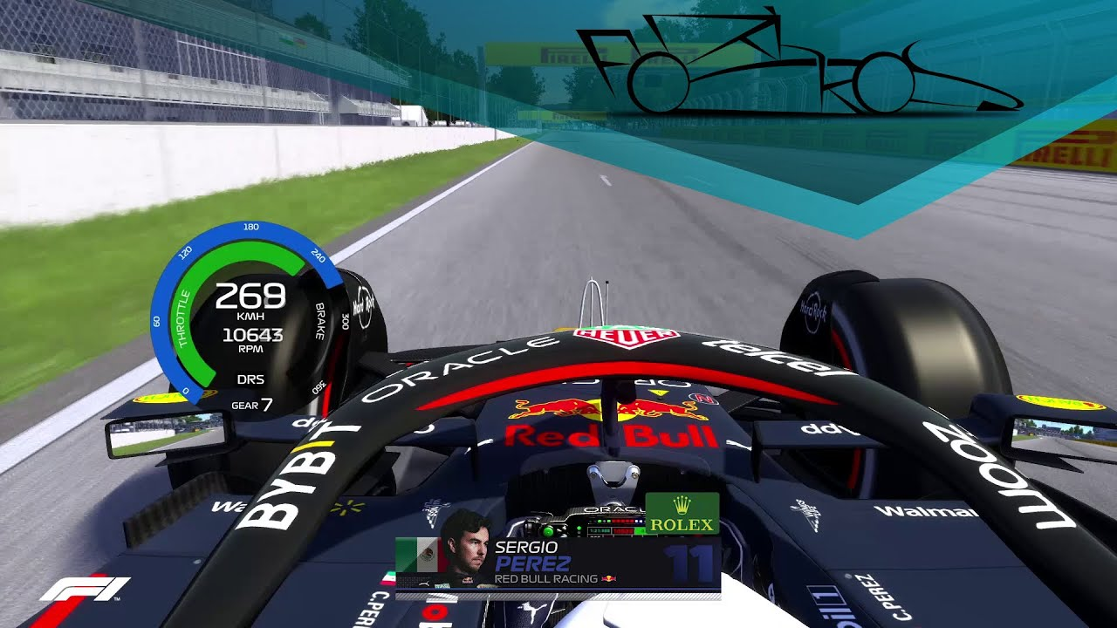
Scatter Plot: Position Order vs Fastest Lap Speed
The scatter plot of position order versus fastest lap speed indicates that higher speeds are generally associated with better (lower) position orders. However, there is a considerable spread, especially at higher speeds. Some drivers achieve high speeds but still finish with poorer positions, possibly due to race incidents or strategic errors.

Slide 10
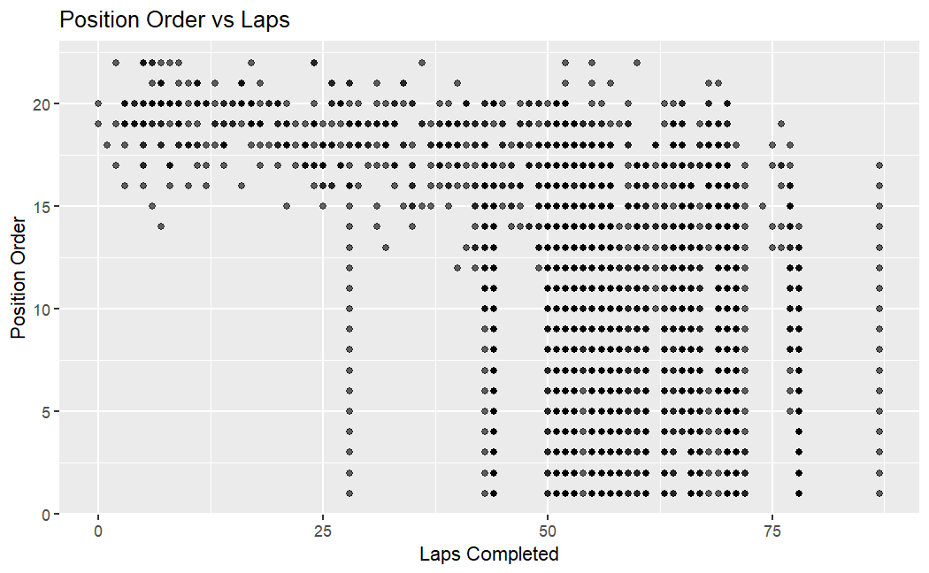
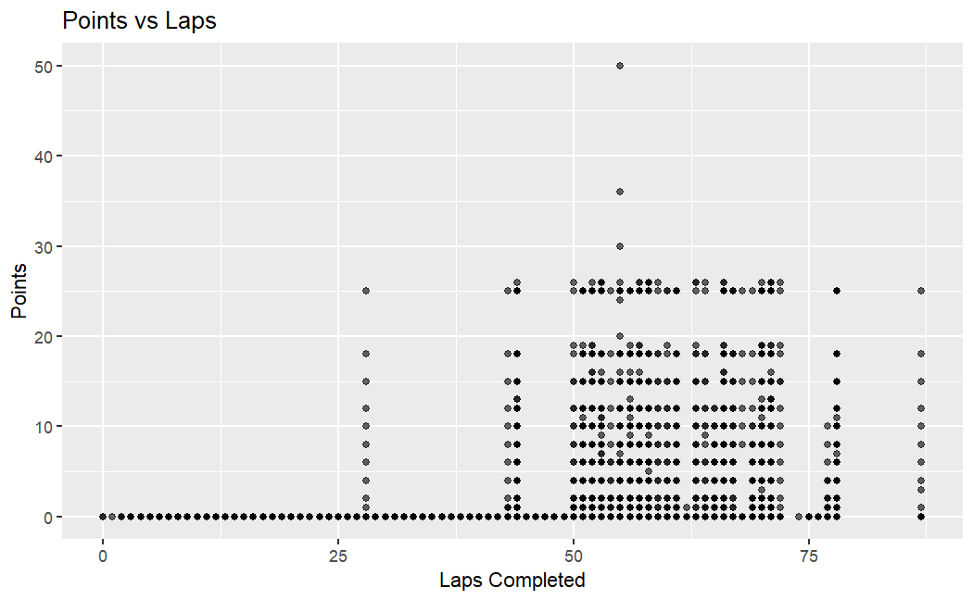
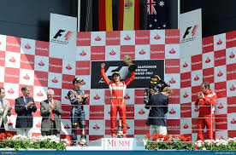
Position Order vs Laps Completed
Fewer laps completed= higher (worse) position result
Higher laps completed = lower (better) position result
The scatter plot of position order versus laps completed shows a distinct pattern. The majority of drivers who complete fewer laps tend to have higher (worse) position orders, indicating they did not finish the race. As the number of laps completed increases, the position orders tend to cluster around lower (better) positions. This trend reflects the importance of race completion for achieving better positions.

Slide 11
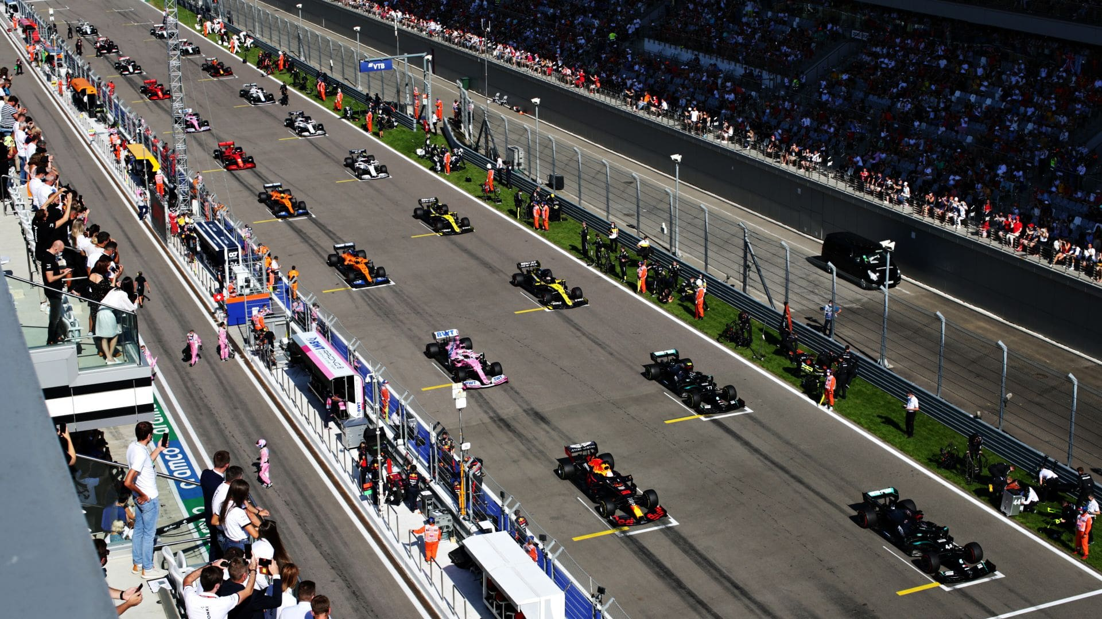
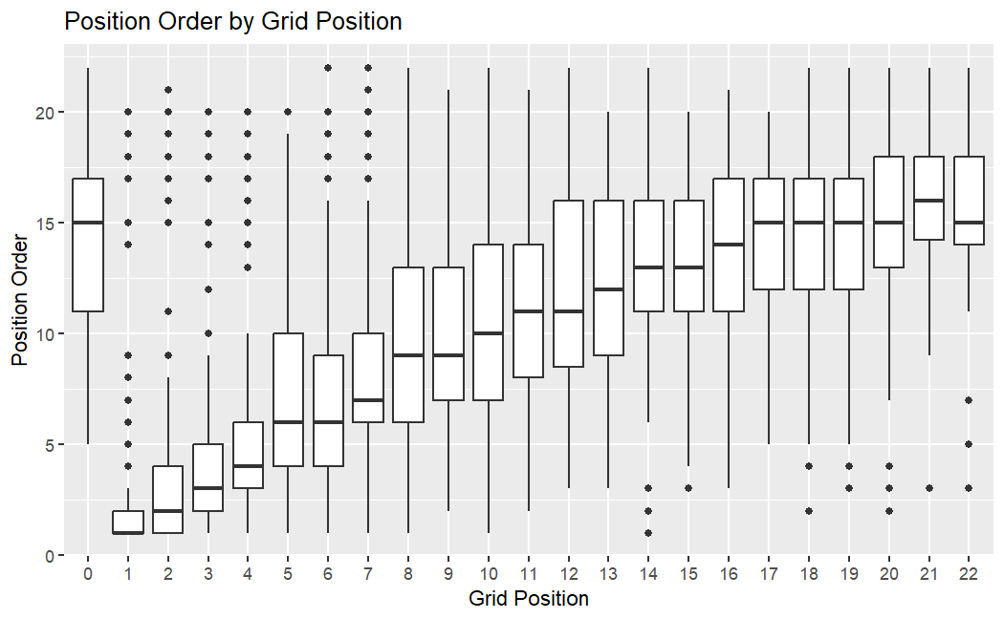
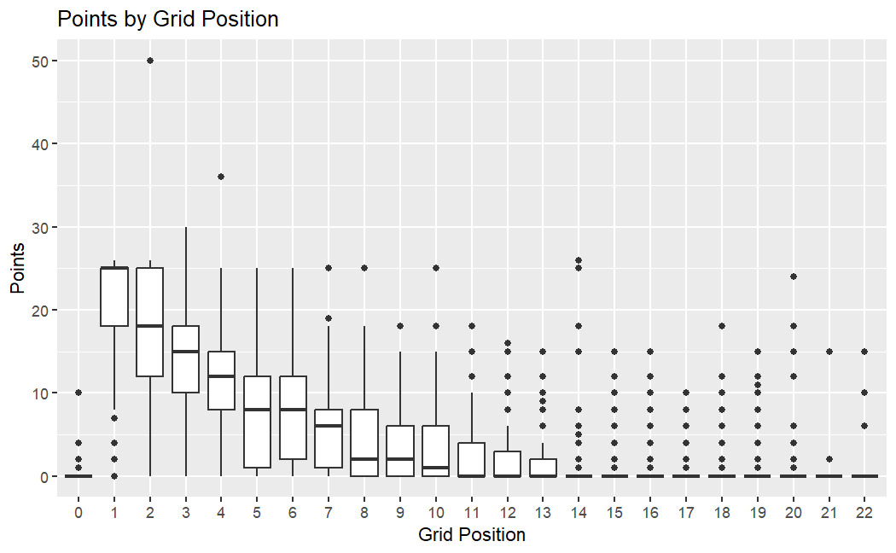
Position Order by Starting Grid Position- Box Plot
The box plot of position order by grid position shows a clear trend wherein starting from a better grid position (closer to 1) results in better (lower) finishing positions. Drivers starting at the front of the grid have a higher likelihood of securing top positions, as indicated by the lower median and smaller interquartile ranges. *
The box plot depicts the distribution of points scored based on starting grid positions. The data indicates a clear trend where drivers starting in the front grid positions (1 to 10) tend to score higher points. Notably, drivers in the first few grid positions show a higher median point score and less variability, suggesting a competitive advantage starting near the front. Conversely, starting positions beyond the 10th grid show a sharp decline in median points, with greater variability and lower points, emphasizing the challenge of scoring high points from back positions.

Slide 12
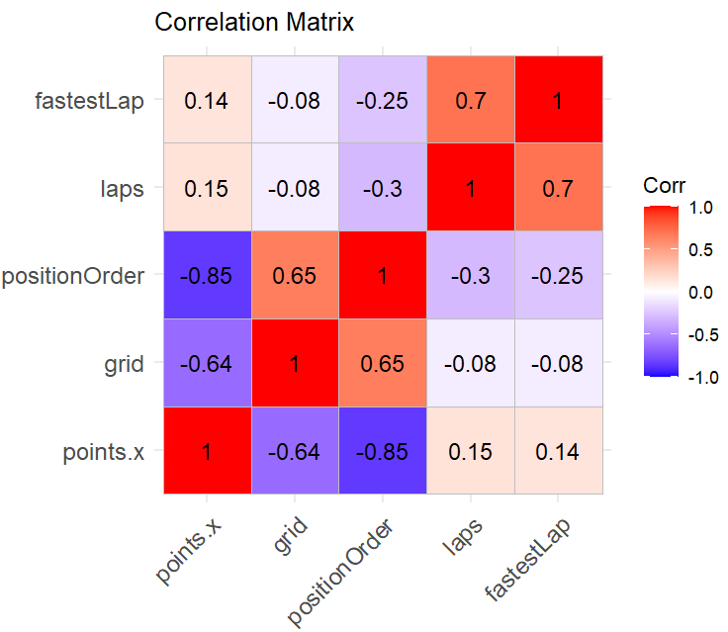
Correlation Matrix – What Drives Points?
The correlation matrix highlights the importance of grid position and finishing position in predicting constructors' points. Achieving low numbered grid positions and finishing well are crucial for scoring more points. Fastest laps and the number of laps completed also contribute to a lesser extent.

Slide 13
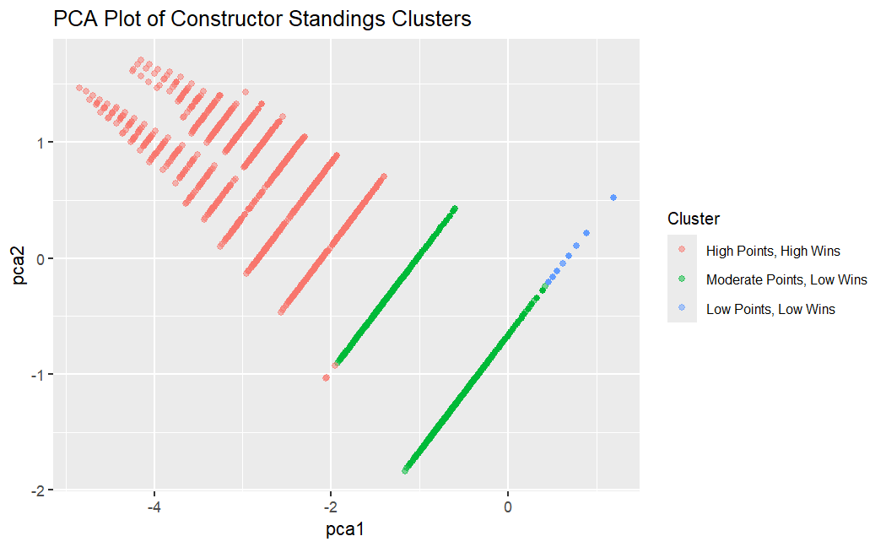
Team Performance Clusters (PCA + K-means)
PCA revealed three clear clusters among constructors based on points and wins: 🔴 High-performing teams (Red) 🟢 Mid-tier teams (Green) 🔵 Low-performing teams (Blue)
This unsupervised learning approach helps segment teams by performance level, revealing strategic differences across tiers.

Slide 14
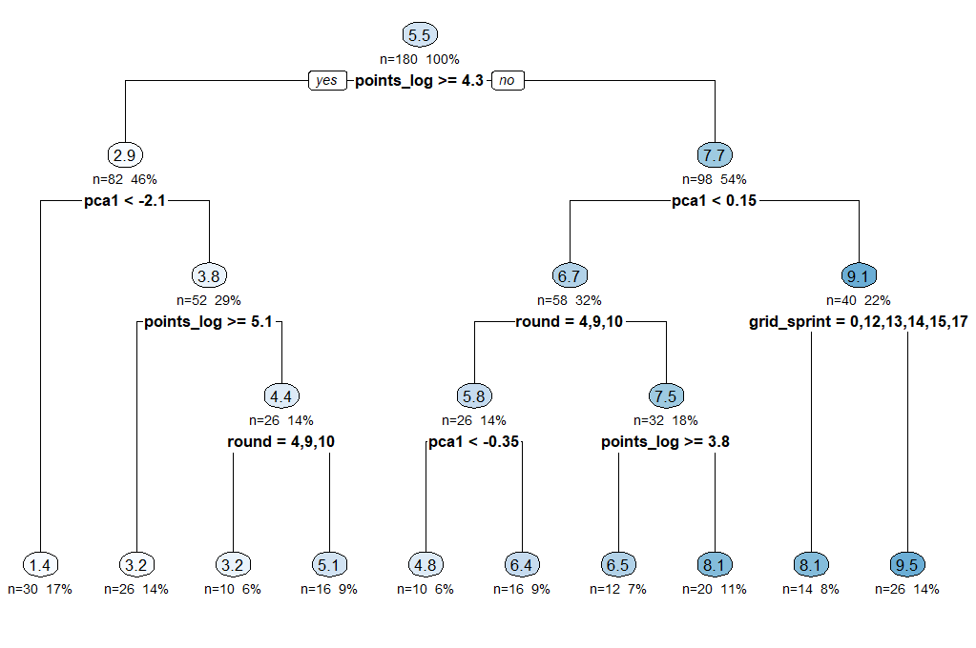
Decision Tree – Feature Hierarchy
The decision tree was built to predict constructor points using race features.
Top predictors: • Grid position • Wins • PCA component (PC1)
The tree structure shows how these features combine to separate high- and low-performing constructors.

Slide 15
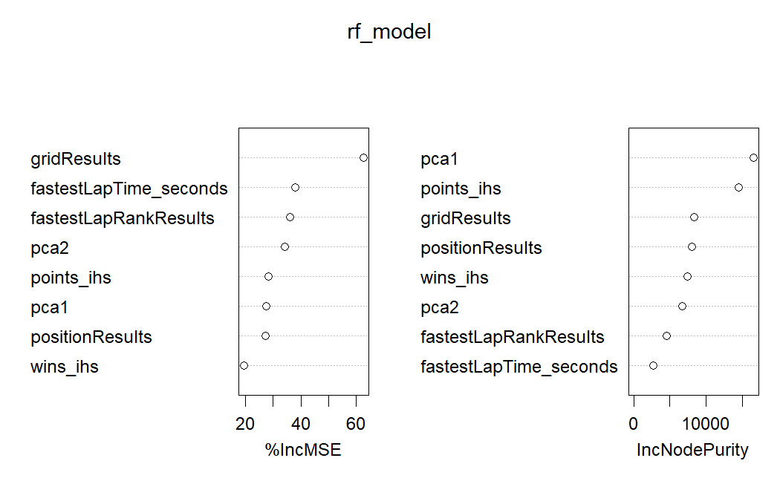
Random Forest – Feature Importance
The Random Forest model explained 82.4% of the variance in constructor performance.
Most important features: • Grid position • Fastest lap rank • PCA components • Wins and points (transformed)
The variable importance plot highlights the factors with the greatest predictive power for constructor success.

Slide 16
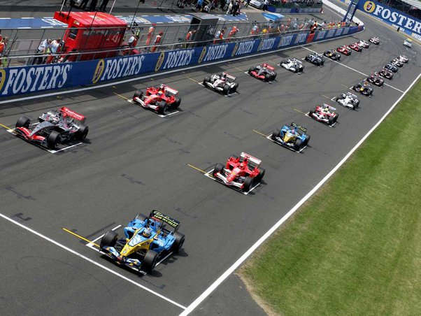
Summary & Strategic Implications
The analysis identified key predictors of constructor success: points, wins, qualifying position, grid position, and fastest lap rank.
The decision tree and random forest models consistently highlighted these as the most impactful features. Grid position, in particular, showed strong influence on final standings.
By focusing on these factors, teams can improve qualifying strategy, race consistency, and technical execution — all of which contribute to better performance across a season.
These findings offer clear, data-driven insights into what drives success in Formula 1 at the constructor level.

