Slide 1
2018 CDI Internship Daily Report -1
Group 4
Choi Ayoung / Electronic Engineering
Kim Donghee / Computer Science
Kim Minju / Electronic Engineering
Lee Junghoo / Electronic Engineering

Slide 2
Index
What is IoT?
IoT Architecture
Team project Outline

Slide 3
IOT( Internet of Things)
What is IoT?
IoT = Internet of Things.
Technology that connects objects to the internet, by incorporating sensors and communication functions into object
cloud
Smart
device
sensor

Slide 4
Essential Elements of IoT
A complete IoT system integrates four distinct components:
1) Sensors/Devices
Get data from Arduino ,or devices.
2) Connectivity
All items are connected with internet.

Slide 5
Essential Elements of IOT
Essential Elements of IoT
3) Data Processing
Once the data gets to the cloud,
software performs some kind of processing on it
4) User Interface
information is made useful to the end-user in some way
Ex) a user check in their house via a phone app or a web browser.
not always a one-way street
be able to perform an action and affect the system.
EX)the user might remotely adjust something via an app on their phone.
some actions are performed automatically

Slide 6
IOT( Internet of Things)
IoT
Artificial intelligence technology
-That allows objects connected to the Internet
-To send and receive data,
and provide information that has been analyzed and learned to user.
-Allows remotely control it.

Slide 7
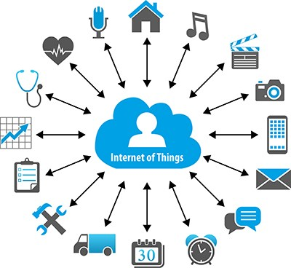
Where to use
Where to use
Smart home
Light
temperature
security
Smart Car
Health care
Heart beat
temperature

Slide 8
IoT Architecture
Devices(Embedded device) linked to the internet with cloud(MQTT)
Some devices such as smart phone, and Aws, link to server and server link to cloud with internet.
You can use the Internet to exchange data through MQTT clouds and server.

Slide 9
e
IoT Architecture
Server (Openhab,freeboard)
Data
MQTT broker
Device
(Sensor)
Data
Devices
(SmartPhone,computer,etc.)

Slide 10
IOT( Internet of Things)
What is MQTT? - Word index
MQTT - Message Queuing Telemetry Transport.
Protocol - Rules and commitments on how to communicate between computers.
Message Protocol - Protocol used to send and receive messages
Topic - Data’s feature (ex temperature,humidity).
Message in MQTT - Measured value of Topic.
Pub/Sub - Publisher : Users who make Topic and send topic and data.
Subscriber : Users who select Topic and if Topic is correct, receive the data.
MQTT-Broker - Match topic and hand over data received from publisher

Slide 11
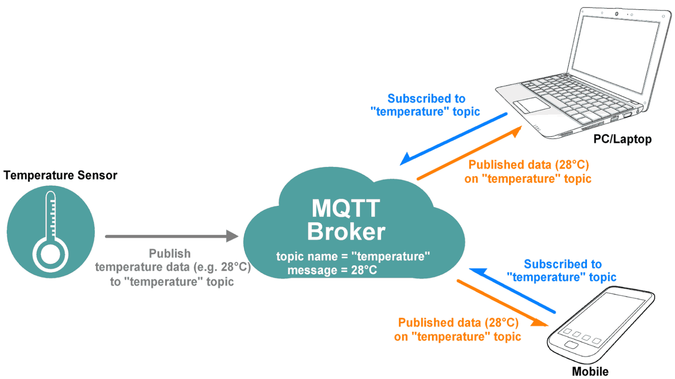
IOT( Internet of Things)
What is MQTT? - Basic Structure

Slide 12
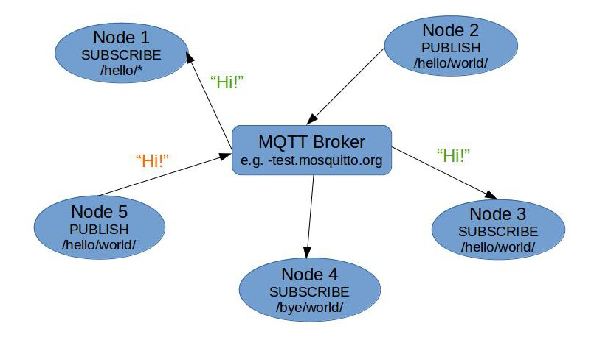
IOT( Internet of Things)
What is MQTT? - Operating Examples.

Slide 13
How to use MQTT (QoS)
Quality of Service
Pre-agreed communication service level
Guarantee the delay time or the rate of data loss
Technology for sending data to destination fast, reliable, stable
In MQTT, QoS is used for how to publish and subscribe data.

Slide 14
QoS Level 0
Client
(Publisher)
Broker
Client
(Subscriber)
Send message
Send message
Delete message
Fire and Forget

Slide 15
QoS Level 1
Client
(Publisher)
Broker
Client
(Subscriber)
Store message
Send message
Store message
Send message
Delete message
Puback
Delete message

Slide 16
QoS Level 2
Client
(Publisher)
Broker
Client
(Subscriber)
Store message
Send message
Store message
PUREC / PUREL
Send message
Delete message
PUCOMP
Delete message

Slide 17
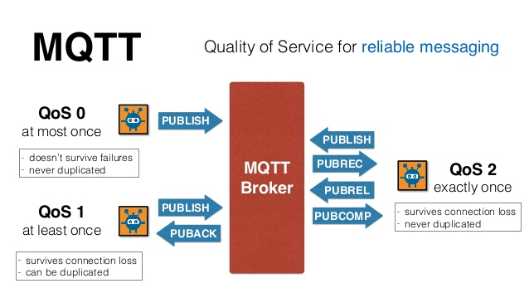
QoS Level

Slide 18
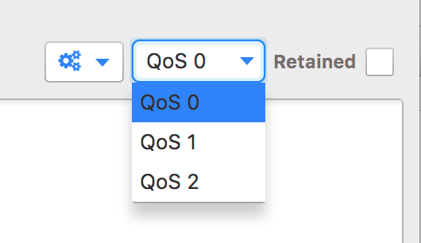
R
Retained Message
What does it mean “Retained” ??

Slide 19
How to use MQTT (SSL/TLS/LWT)?
SSL (Secure Sockets Layer)/TLS(Transport Layer Security) :
standard security protocol for establishing encrypted links between a web server and a browser in an online communication.
The usage of SSL technology ensures that all data transmitted between the web server and browser remains encrypted.

Slide 20
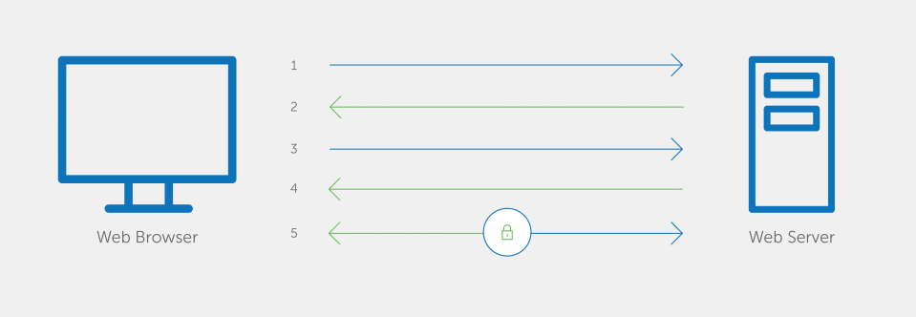
e
SSL/TLS
S
: Secure
S
: Sockets
L
: Layer

Slide 21
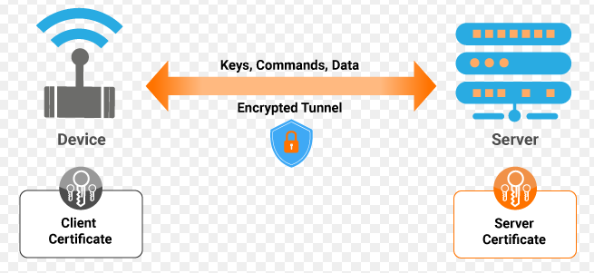
e
SSL/TLS
T
: Transport
L
: Layer
S
: Sercurity

Slide 22

e
LWT
L
: Last
W
: Will
T
: Testament

Slide 23
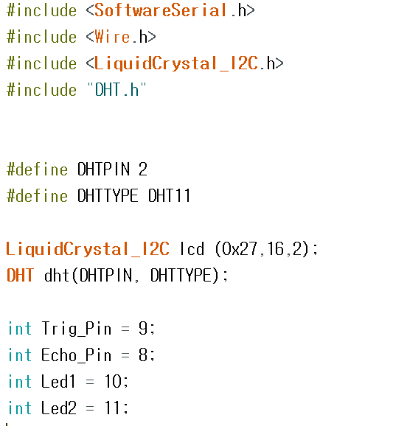
e
Team project-code
DHT&LCD header file
DHT type - DHT 11
Define LCD.
Define dht. Declare Pins of UltraSonic & LED.

Slide 24
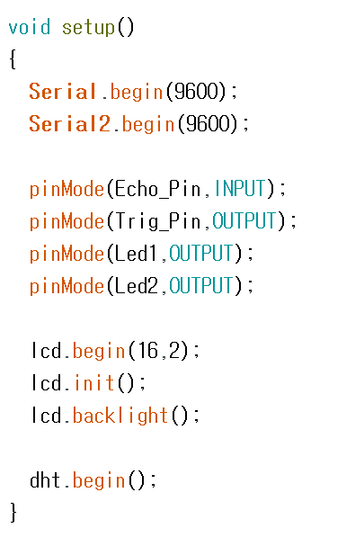
e
Team project-code
Serial meas A command that communication to other devices
Serial -> Communicate with computer.
Serial2 -> Communicate with wizet board
Begin the sensors
(Arduino, Ultra Sonic, LED, LCD and DHT).

Slide 25
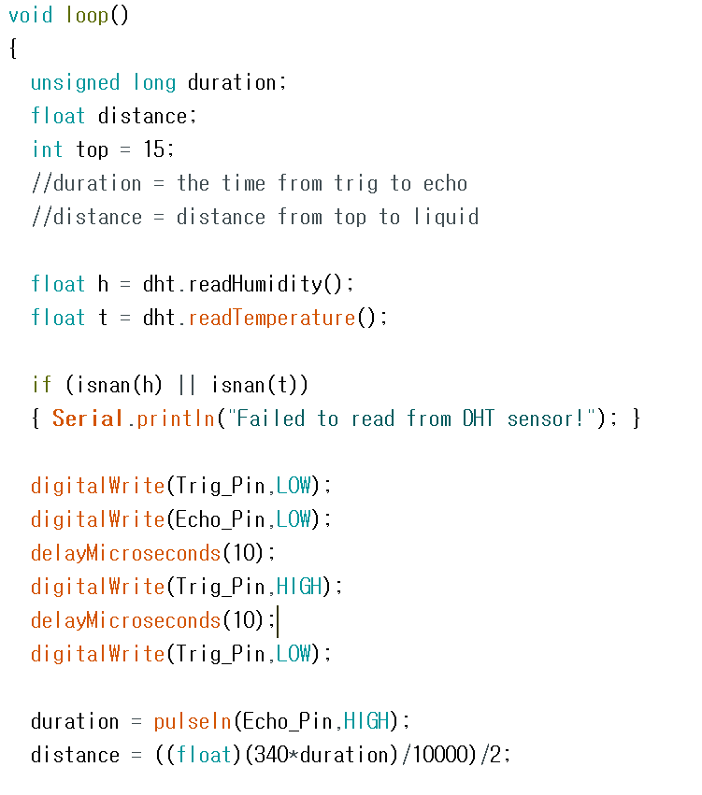
e
Team project-code
Read. -> measure the Humidity and temperature.
Read two things and then put value to variable h, t => DHT sensor.
HIGH -> send ultra sonic and receive
LOW -> stand by mode.
pulsein -> funtion that measurevalue of time between sending and revceiving ultra sonic.
Put value to distance that is calculated in hours by a formula for obtaining length.

Slide 26
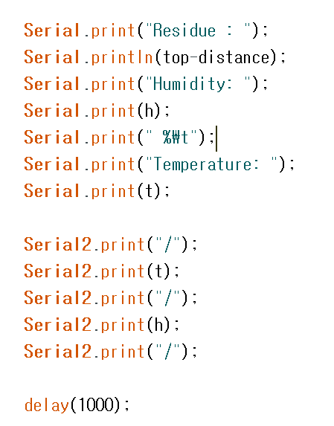
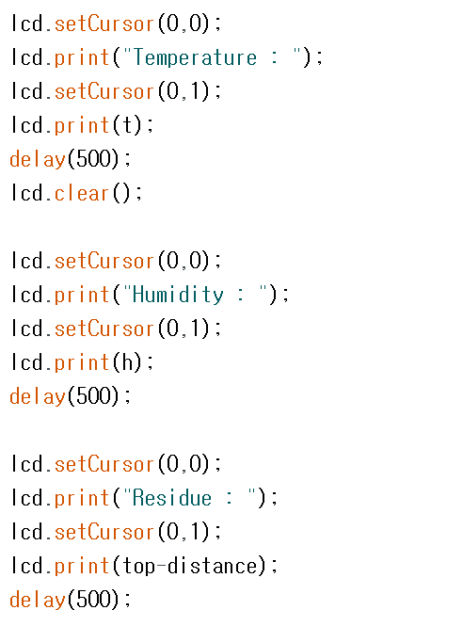
e
Team project-code
Left parts are the communication with wizet and computer(Serial monitor).
And Right parts are showing our value using LCD moniter.

Slide 27
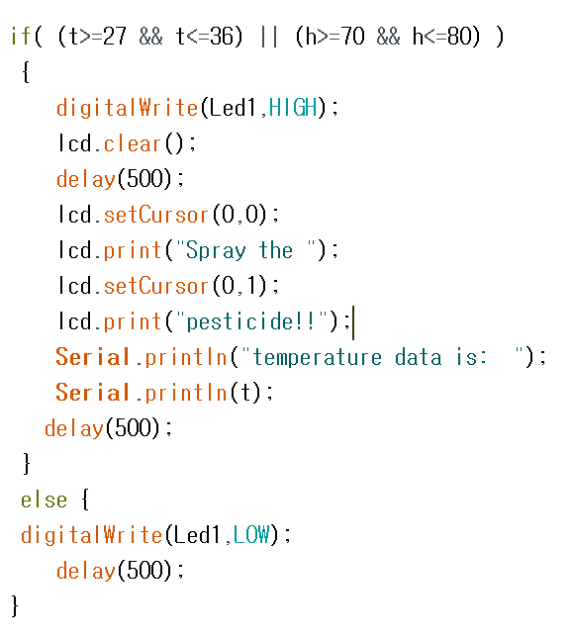
e
Team project-code
If the temperature and humidity measured are favorable for mosquitoes, the LED1 should be lit.
And it had the sentence "Spray the pesticide!" written on the LCD.

Slide 28
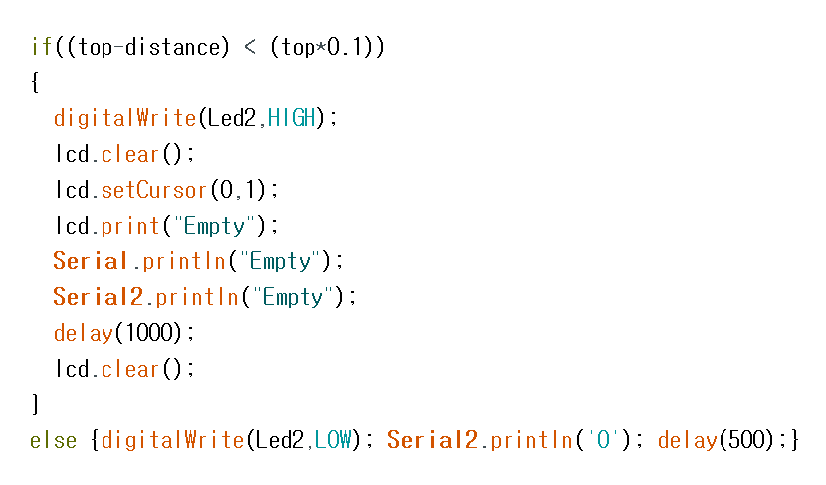
e
Team project-code
This code indicates the amount of pesticide residue and, if the barrel is empty, sends a " Empty " message to our server.
We show “Empty” on LCD too.

Slide 29
Thank you

