Slide 1
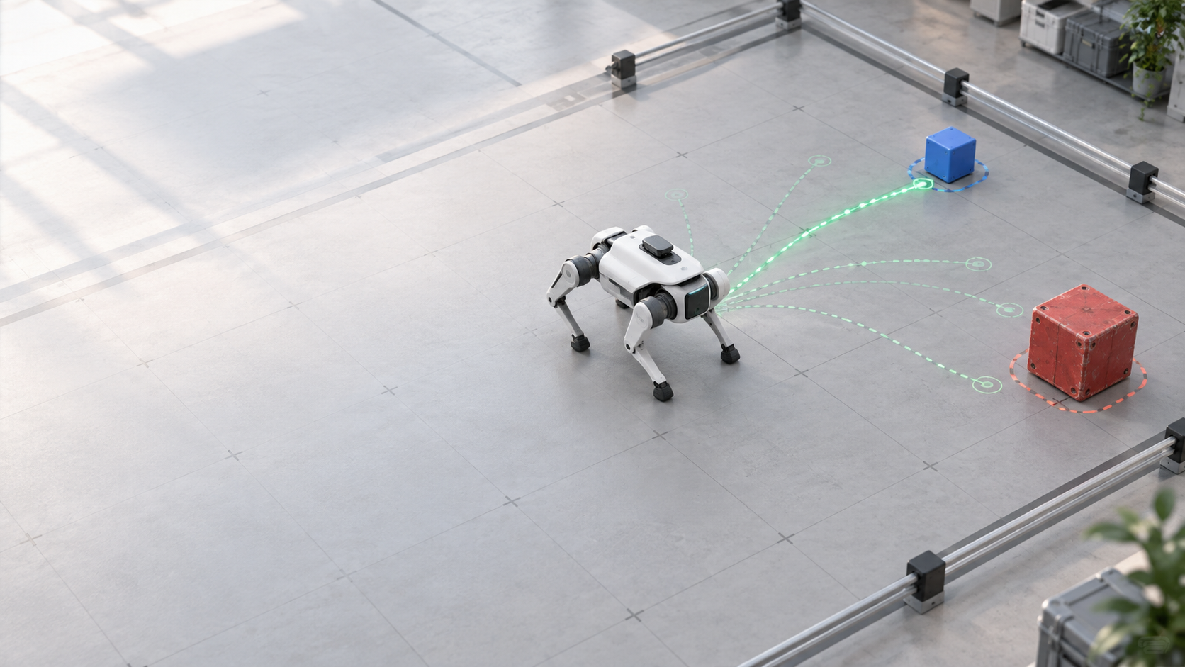
forepaw
Forecast six blocks.
Execute one.
Reusable dimOS skills for a simulated Unitree Go2
KELLY YANG · HACKMIT 2026
Notes:
10 seconds. Forepaw gives a simulated Unitree Go2 a short forecast before every movement. It compares possible futures, records its choice, moves for half a second, then observes and replans.

Slide 2
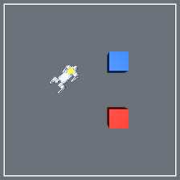
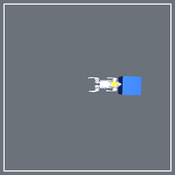
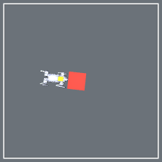
Push it — or plan around it.
02
One goal, two outcomes: push the movable blue box or detour around the resistant red box.
BLUE · 1 KG
RED · FIXED
PUSH
DETOUR
TASK
The box clears the route
The box resists the push
Goal + scene
Notes:
20 seconds. The task has one goal and two useful behaviors. The blue one-kilogram box can move, so pushing can clear the route. The red box is fixed, so the robot should plan around it. The colors identify behavior in this environment. I am not claiming hidden mass inference.

Slide 3
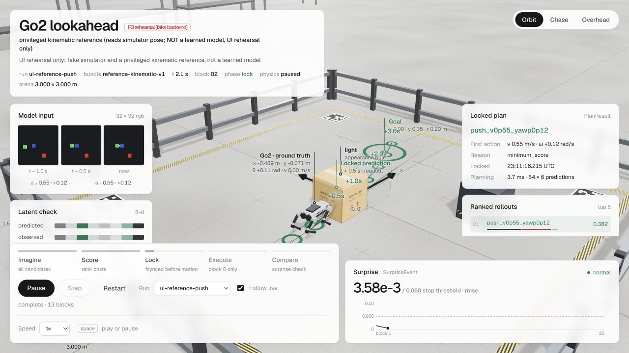
dimOS-native control
dimOS-native control
Reusable skill boundary
Reusable skill boundary
dimOS
Forepaw skills
Controller
True-Go2
External blueprint
MCP discovery + invocation
imagine
plan_to
stop_motion
Sole motion owner
lock before motion
MjLab simulation
0.5 s first block
45 VERIFIED PLANNING CYCLES
64 CANDIDATES × 6 BLOCKS
REFERENCE PREDICTOR
The current predictor reads simulator pose. The learned LeWM experiment is not used for control.
Notes:
25 seconds, then optional 45-second demo. dimOS discovers Forepaw as an external blueprint with three skills. imagine returns predicted outcomes without motion. plan_to runs the closed loop. stop_motion exposes the safety surface. A separate controller service is the only process allowed to publish motion to the true-Go2 MjLab simulation. In the live viewer, show the three input frames, the ranked candidates, the saved plan, and the first half-second action.

Slide 4
Forecast six blocks. Execute one. Observe again.
04
At 2 Hz, every fresh observation invalidates the unexecuted tail and starts a new locked plan.
OBSERVE
FORECAST
SCORE
EXECUTE
CHECK
3
384
64
0.5 s
1
RGB frames
2 prior commands
candidate blocks
scored each cycle
candidate
sequences
first block
only
new observation
starts next cycle
CURRENT DEMO
Planner cadence: 3 RGB frames, 2 prior commands, and a goal.
Current reference predictor additionally reads simulator pose; learned LeWM is disabled.
Notes:
25 seconds. Each cycle uses three RGB frames spanning one second plus the two applied commands between them. Forepaw scores 64 candidate sequences with six half-second blocks, which is 384 candidate blocks. It locks the selected forecast, executes only block zero, and starts a new plan from the next observation. The current integration demo uses the labeled reference predictor, not LeWM.

Slide 5
Retained evidence, not demo theater.
05
Every number below is tied to a saved run packet or executable gate.
G0 · PHYSICS
DIMOS · CONTROL
SOFTWARE
1.2292 m
45 cycles
201 passed
minimum blue displacement
red ≤ 0.0448 m
0 falls
64 candidates each
6-block forecast
lock before motion
6 skipped
Ruff + protocol gates
restart + failure path
LEARNED LeWM FAILED G3 — NOT USED FOR CONTROL
G0 remains pending co-owner sign-off · github.com/kellyang135/forepaw
Notes:
25 seconds. The retained evidence shows 45 dimOS planning cycles with 64 candidates each and lock-before-motion ordering. In the formal Go2 scene, every blue-box trial moved at least 1.2292 meters, every fixed red-box trial stayed below 0.0448 meters, and no robot fell. The repository currently passes 201 tests with 6 environment-gated skips. G0 still awaits the second owner's sign-off.

Slide 6
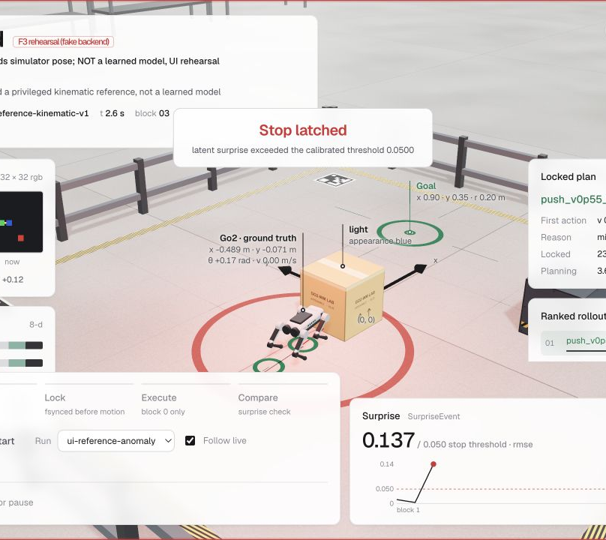
Why this architecture matters
Why inspectable
control matters
Physical agents need inspectable decisions before motion.
Physical agents need decisions that can be reviewed before motion.
ONE
ONE
motion owner
motion owner
SIX
SIX
forecast blocks
forecast blocks
Audit every action
Audit every action
VALUE HYPOTHESIS · WORKFLOW VERIFIED
VALUE HYPOTHESIS · WORKFLOW VERIFIED
Notes:
20 seconds. The product idea is inspectable control for physical agents. One service owns motion. Every selected future is saved before execution. Operators can review what the agent expected and compare it with what happened. The workflow is verified in simulation. Broader business impact remains a hypothesis until deployment with users.

Slide 7
Verified now. Next gates.
07
DIMOS + CONTROL
SOFTWARE
45 verified cycles
201 passed · 6 skipped
MCP skill discovery
True-Go2 MjLab execution
Restart + failure handling
Planner + telemetry contracts
Ruff and protocol gates
Retained evidence verifier
NEXT GATES
Learned multi-step predictor · held-out evaluation · Linux active stop preemption
Today’s demo uses a privileged reference predictor — deliberately labeled.
Notes:
15 seconds. Today I verified the dimOS skill boundary, true-Go2 MjLab execution, restart behavior, and the evidence pipeline. The learned predictor did not pass its gate, so I kept it out of control. The next gates are learned multi-step prediction, held-out task evaluation, and active stop preemption on Linux. The MVP is the working, auditable dimOS control loop you just saw.

