Slide 1

forepaw
Forecast six blocks.
Execute one.
Reusable dimOS skills for a simulated Unitree Go2
KELLY YANG · HACKMIT 2026
Notes:
Twenty seconds. Forepaw predicts the visual result of possible actions before moving. It selects one action, executes it for half a second, then observes again. The cover image is an illustration, not experimental evidence.

Slide 2
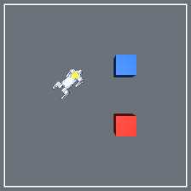
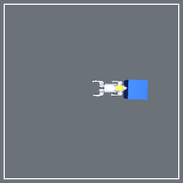
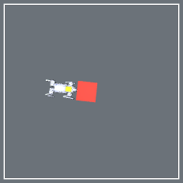
Push it — or plan around it.
02
One goal, two outcomes: push the movable blue box or detour around the resistant red box.
BLUE · 1 KG
RED · FIXED
PUSH
DETOUR
TASK
The box clears the route
The box resists the push
Goal + scene
Notes:
Thirty seconds. The boxes share geometry but have distinct colors and physical behavior. The blue one-kilogram box moves under the robot. The red twenty-kilogram box resists the same command. Forepaw uses the visual cue to predict which action preserves progress. This is an appearance-to-behavior association, not hidden mass inference.

Slide 3
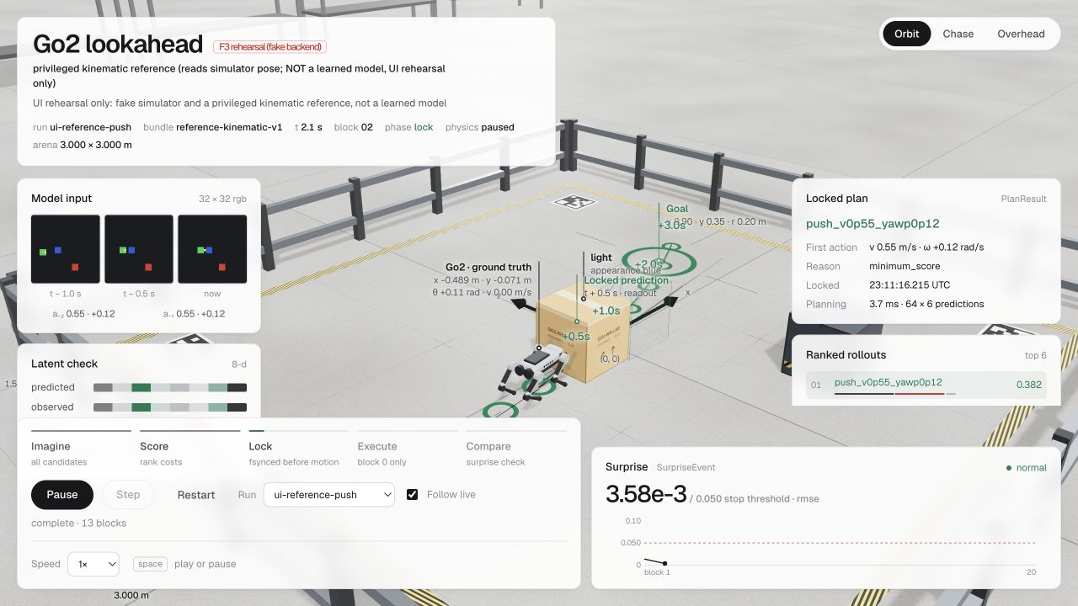
dimOS-native control
dimOS-native control
Reusable skill boundary
Reusable skill boundary
dimOS
Forepaw skills
Controller
True-Go2
External blueprint
MCP discovery + invocation
imagine
plan_to
stop_motion
Sole motion owner
lock before motion
MjLab simulation
0.5 s first block
45 VERIFIED PLANNING CYCLES
64 CANDIDATES × 6 BLOCKS
REFERENCE PREDICTOR
The current predictor reads simulator pose. The learned LeWM experiment is not used for control.
Notes:
Three minutes. Switch to the live viewer. Ask the judge to choose a supported goal. Identify the three input frames, the 64 ranked candidates, and the selected first action. Pause on the saved plan before motion. Execute one half-second block, compare the next observation with the saved prediction, and show the next planning cycle. State which backend is running.

Slide 4
Forecast six blocks. Execute one. Observe again.
04
At 2 Hz, every fresh observation invalidates the unexecuted tail and starts a new locked plan.
OBSERVE
FORECAST
SCORE
EXECUTE
CHECK
3
384
64
0.5 s
1
RGB frames
2 prior commands
candidate blocks
scored each cycle
candidate
sequences
first block
only
new observation
starts next cycle
CURRENT DEMO
Planner cadence: 3 RGB frames, 2 prior commands, and a goal.
Current reference predictor additionally reads simulator pose; learned LeWM is disabled.
Notes:
Sixty seconds. Three frames span one second. LeWM predicts 64 candidate sequences with six half-second blocks each, for 384 forecast blocks. The planner scores them, saves the selected forecast before motion, and executes only the first block. The next camera frame replaces the remaining plan. Runtime planning never receives simulator pose, contacts, mass, or an oracle future.

Slide 5
Retained evidence, not demo theater.
05
Every number below is tied to a saved run packet or executable gate.
G0 · PHYSICS
DIMOS · CONTROL
SOFTWARE
1.2292 m
45 cycles
201 passed
minimum blue displacement
red ≤ 0.0448 m
0 falls
64 candidates each
6-block forecast
lock before motion
6 skipped
Ruff + protocol gates
restart + failure path
LEARNED LeWM FAILED G3 — NOT USED FOR CONTROL
G0 remains pending co-owner sign-off · github.com/kellyang135/forepaw

Slide 6
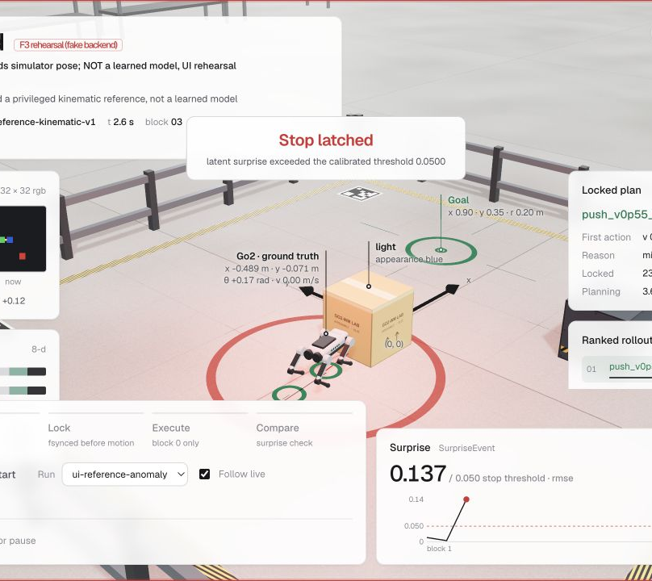
Why this architecture matters
Why inspectable
control matters
Physical agents need inspectable decisions before motion.
Physical agents need decisions that can be reviewed before motion.
ONE
ONE
motion owner
motion owner
SIX
SIX
forecast blocks
forecast blocks
Audit every action
Audit every action
VALUE HYPOTHESIS · WORKFLOW VERIFIED
VALUE HYPOTHESIS · WORKFLOW VERIFIED
Notes:
Backup. In the software rehearsal, the latent mismatch exceeded the threshold and latched a stop. The runtime issues zero motion and blocks new plans until reset. This is detection and stop, not online adaptation.

Slide 7
Verified now. Next gates.
07
DIMOS + CONTROL
SOFTWARE
45 verified cycles
201 passed · 6 skipped
MCP skill discovery
True-Go2 MjLab execution
Restart + failure handling
Planner + telemetry contracts
Ruff and protocol gates
Retained evidence verifier
NEXT GATES
Learned multi-step predictor · held-out evaluation · Linux active stop preemption
Today’s demo uses a privileged reference predictor — deliberately labeled.
Notes:
Backup. Separate software-contract evidence from task evidence. The dimOS wrapper and validation tests exist, but real dimOS deployment remains unverified. Passing fake-backend tests does not establish robot or task performance.

