Slide 1

P.O. Box 3185
Mankato, MN 56002-3185
(507) 934-7700
www.ruralmn.org
COVID-19 impacts on rural the rural workforce
Before the pandemic, job vacancy rates (number of job vacancies as a percentage of total jobs) was highest outside of the Seven County metro. Finding workers was the number one priority for workforce development organizations in rural Minnesota. Not surprisingly, the pandemic has impacted job vacancies. The job vacancy rate between September and October of 2020 is about 2 percentage points less compared to the average in 2019. However, there are still employment opportunities, particularly in our rural parts of the state.
To read the full report, visit our website at ruralmn.org.

Slide 2
P.O. Box 3185
Mankato, MN 56002-3185
(507) 934-7700
www.ruralmn.org
COVID-19 impacts on rural the rural workforce
The chart above provides the number of weekly unique job postings as a percent of weekly continuous unemployment claims. The weekly job postings are making an increasingly larger share of unemployment claims since September. Most regions outside of the Seven County Metro have a higher percentage. In fact, in Southwest Minnesota there were more weekly job postings than continuous unemployment claims by the end of October.
However, not every person unemployed can simply take any job available. Training and experience is needed for many employment opportunities in our regions. Therefore, it’s important to assess in which occupations there are job opportunities and the labor pool that exists in that occupation. And interviews with our Workforce Development Boards in Greater Minnesota have indicated an interesting situation where they are dealing with exactly this issue. The occupation of our unemployed individuals don’t exactly match with the job opportunities available.
To read the full report, visit our website at ruralmn.org.

Slide 3
P.O. Box 3185
Mankato, MN 56002-3185
(507) 934-7700
www.ruralmn.org
COVID-19 impacts on rural the rural workforce
There are job postings for nearly all occupations across all of Minnesota. However, that doesn’t mean there isn’t a pool of workers available. For example, in Northern Minnesota one of the highest number of job postings is for food preparation and serving related occupations. Yet, this is also one of the highest occupations of people filing continuous unemployment claims. Therefore, there is a labor pool within those occupations so it’s up to the businesses to entice them back into the workforce. This isn’t the case for many occupations though, particularly in rural areas of the state.
The chart below provides the number of occupations (there are 23 total) that have more job postings than people filing continuous unemployment claims. The largest increases in the number of job vacancies with workforce shortages appear in southern Minnesota (Southwest & Southeast). The regions with the lowest number of occupations experiencing workforce shortages are the Seven County metro and Central Minnesota.
To read the full report, visit our website at ruralmn.org.

Slide 4


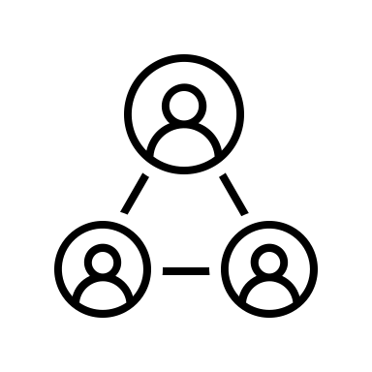

P.O. Box 3185
Mankato, MN 56002-3185
(507) 934-7700
www.ruralmn.org
COVID-19 impacts on rural the rural workforce
Across all of Minnesota, there is currently a significant shortage of individuals in the healthcare practitioners and technical occupations. This occupation was listed in the top-5 labor force shortage occupations in every Economic Development Region in the state. Beyond that, however, there was significant nuance in occupations experiencing workforce shortages. Here is a list of occupations that are experiencing labor force shortages throughout Greater Minnesota.
Transportation and material moving: Shortages in this occupation were particularly prevalent in the western side of Minnesota such as Northwest and Southwest planning regions.
Production: Some of the largest workforce shortages have been in production occupations. This was particularly true in Northwest and Southwest Minnesota.
Community and social services: Shortages in this occupation were particularly large in Central Minnesota .
Farming, fishing and forestry: Shortages in this occupation were particularly large in Southern Minnesota.
Shortages weren’t just relegated to these occupations either. When breaking it own by EDR, there was a significant amount of variation in which occupations were facing workforce shortages. Other occupations include computer and mathematical, architecture, legal, and other more professional occupations.
What this analysis tells us is that this isn’t a typical “recession” in that there are lots of unemployed with very few job opportunities. The pandemic has been unique in that it has hit a few occupations particularly hard while bolstering other industries and occupations. The state’s approach to dealing with the impacts of the pandemic on the workforce is not only about taking care of our unemployed workers but also finding creative and strategic ways to engage unemployed workers and matching the with other employment opportunities.
To read the full report, visit our website at ruralmn.org.

