Slide 1

Austin Crime Analysis
Kelly Blumhagen, Mounica Pokala,
Amro Elhag, Petros Paterakis

Slide 2
Questions:
What are Austin’s safest and most dangerous neighborhoods according to zip code?
How has crime evolved over the years?
What time of the year does crime occur most frequently?
Hypotheses:
Crime rates will increase as Austin’s population continues to grow
Low income areas are prone to higher rates of crime

Slide 3
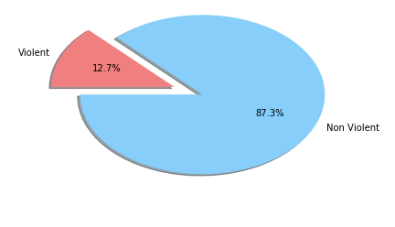
Classification of Crimes
Violent vs. Non-Violent Crimes
Non-violent crimes represent nearly 90% of all crimes reported

Slide 4
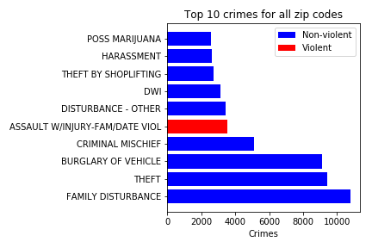
Classification of Crimes
Family disturbance, theft, and burglary are the most frequently reported

Slide 5
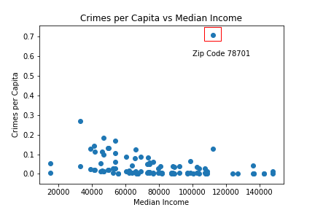
Crime vs. Income (by Zip Code)
Zip code 78701 (downtown) is a major outlier with significantly higher crime (most likely not committed by its residents)

Slide 6
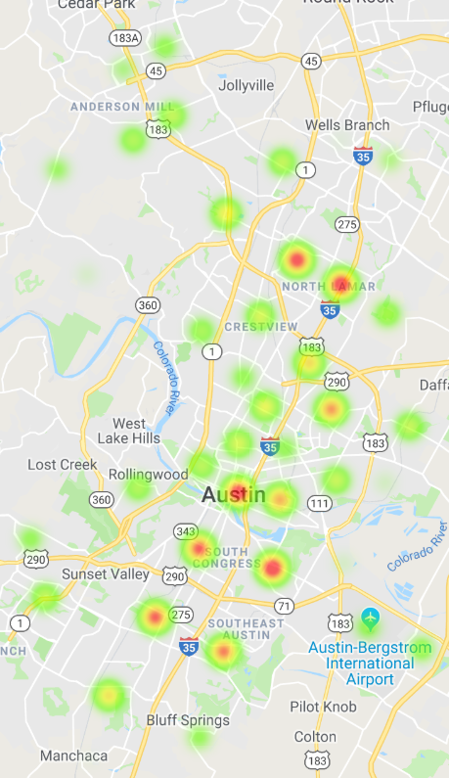
Geomapping Crime
Higher crime zones along Interstate 35
Popular tourist areas (S. Congress, The Domain, and Downtown) have higher crime rates

Slide 7
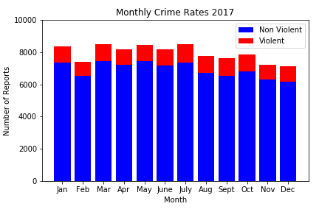
Crimes vs. Month
Violent vs. non-violent crime ratios remains stable throughout the year
February has the lowest number of reports (possibly due to being the shortest month)

Slide 8
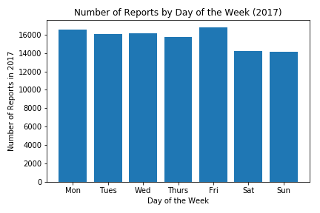
Crimes vs. Days of the Week
Surprisingly, there is a slight decrease (15%) in crime reported on the weekends

Slide 9
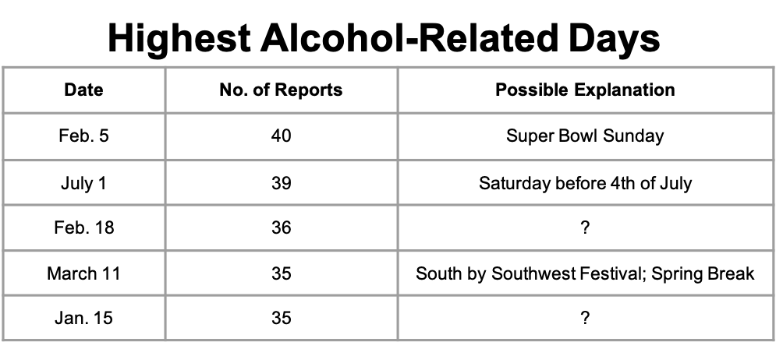
Major Holidays and Events
Average daily number of reports for alcohol-related crimes: 19

Slide 10
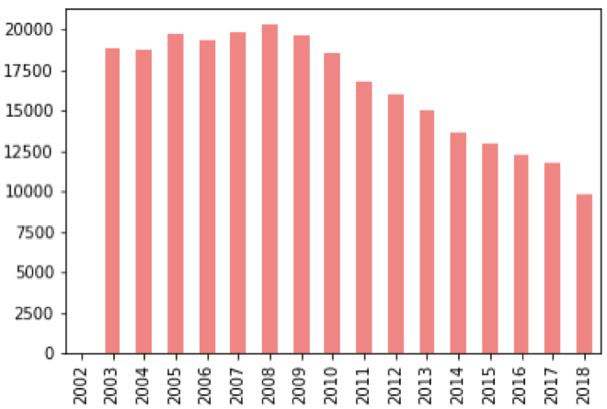
Crime Over the Years
Crime Rate
Crime rate = (crimes reported ÷ population) × 100,000
Crime reached it’s highest point in 2008 (possibly due to recession)
After 2008, crime steadily declined, despite Austin becoming the fastest growing city in U.S. (Forbes)
Year

Slide 11
Conclusion
Higher crime rates are associated with lower income areas (with the except of downtown)
Annual crime rates steadily declined after 2008
Major holidays and local events attract more criminal activity
Violent crime rates appear consistent throughout the year

Slide 12
Sources:
APD Crime Data
Census
Gmaps
Cleanup Process:
Converted csv files to Pandas dataframes
Merged Census income data, Austin population data, and violence crime rate data with Austin crime reports
Insights:
Austin PD’s public API prohibits access to data > 50,000. We were, however, able to download a csv with all police reports recorded for the year

