Slide 1
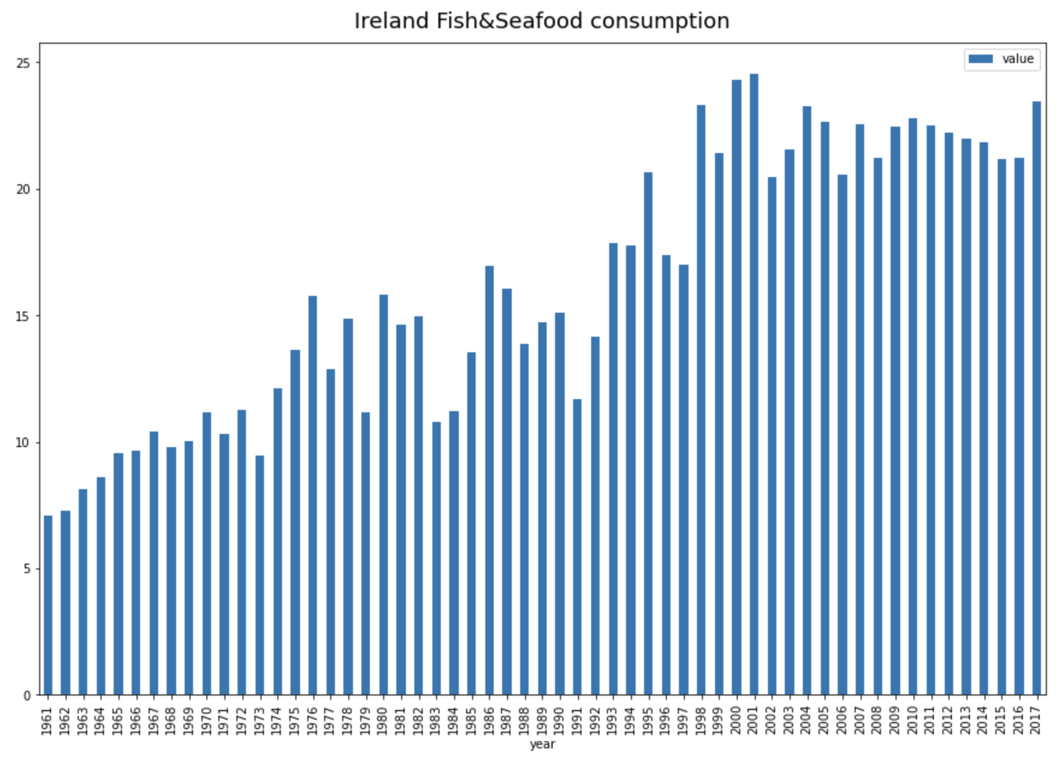
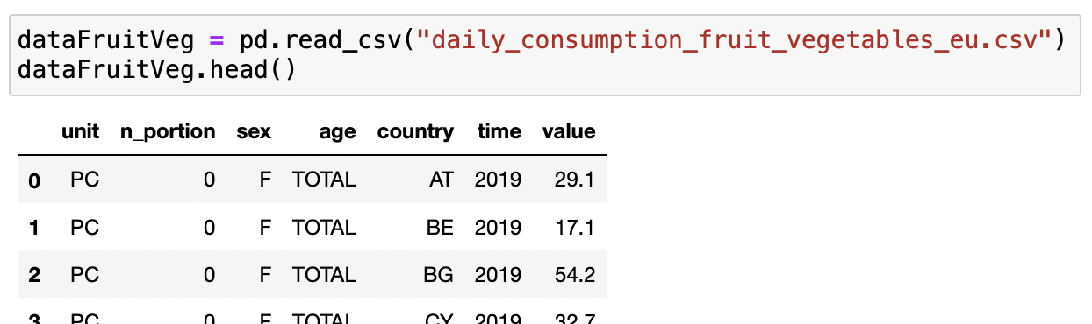
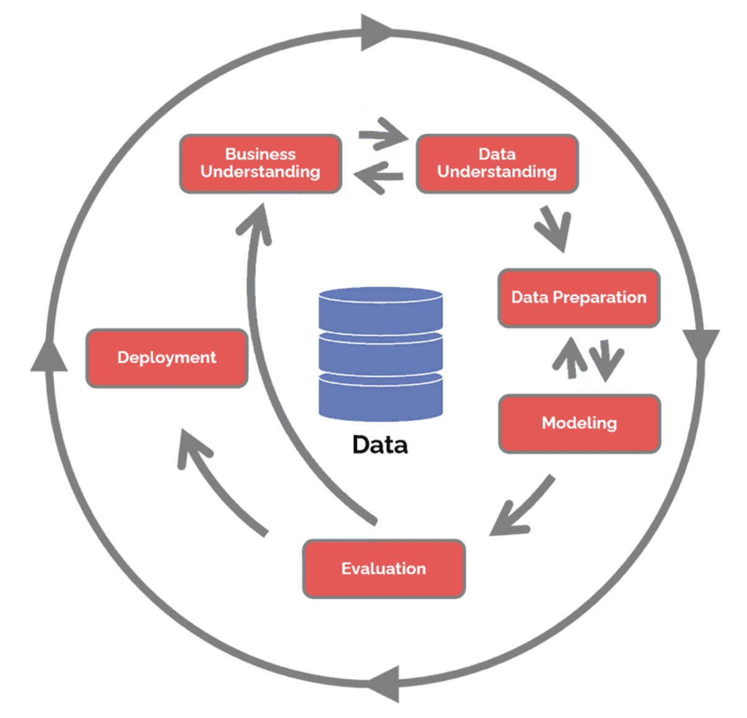
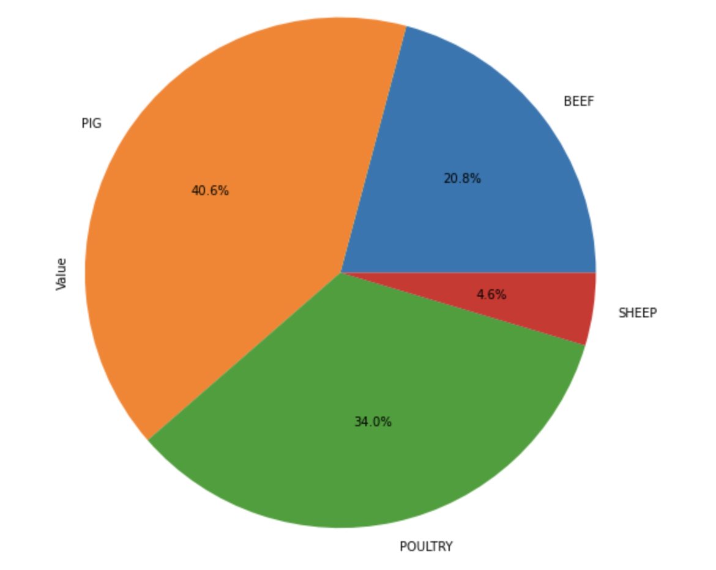
Menu Assistance
Kelly Crystine Ferreira Jesus - 2019375 | Leo Jaime Kayser Macieski - 2019221
Problem Solving in Industry - Supervisor: Dr. Muhammad Iqbal
ABSTRACT
Developing a ingredients recommendation menu system to restaurants based on the restaurant data and/or city food purchase data to help and change the way restaurants build their menu.
BUSINESS UNDERSTANDING
In this phase of the CRISP-DM process will be to determine the business objectives of our project, we will evaluate the aspects of the situation to produce the project plan, and from this which tools, datasets and machine learning will be used.
Our business proposal is to help chefs to create dishes for their restaurants with more accuracy and higher probability to be ordered by their customers.
The main business goal of our project is to predict what ingredients customers would like to eat and from that, give restaurants ingredient suggestions to create their next menu.
DATA PREPARATION
…
EVALUATION
Models accuracy:
…
INTRODUCTION
Our project aims to solve the problem of restaurants and chefs when it comes to preparing menus, the latter with ingredients and dishes that encourage their customers to order more, come back and recommend the restaurant.
Visualisation :
RESEARCH QUESTIONS
The four questions below represent the core focus of the entire project:
Q.1. How Menu Assistance will work as a business?
Q.2. Why Menu Assistance will be helpful to restaurants?
Q.3 Where to collect the data?
Q.4 What is (are) the model(s) to be used?
DATA UNDERSTANDING
In the second phase of the CRISP-DM process we are going to access the data using the resources listed in the first stage in Project resources. This stage is important for understanding the data and it will help us to make decisions during data preparation.
We will cover collecting and describing the data, exploring the data using EDA to perform the investigations on our dataset and verifying the data quality.
Project Datasets - Resources from Kaggle.com:
Fruit and Vegetables consumption - Preda, G. (2022)
Fish and Seafood consumption - Geukjian, S. (2022)
Meat consumption of meat - Vagif, A. (2020)
Loading the dataset example
DEPLOYMENT
…:
…
PROJECT METHODOLOGY
We will use the CRISP-DM model to build our project. CRISP DM is the abbreviation for Cross Industry Standard Process for Data Mining. CRISP-DM will break down the data mining project into six phases, they are:
Business understanding - 1st Phase
Data understanding - 2nd Phase
Data preparation - 3rd Phase
Modelling - 4th Phase
Evaluation - 5th Phase
Deployment - 6th Phase
CONCLUSIONS
…
MODELLING
Models accuracy:
…
ROLES & RESPONSIBILITIES
Kelly:
The report writing, CRISP-DM methodology, dataset decision-making, business and data understanding EDA, data preparation, discuss models, Python code, and Poster.
Leo:
…
Pie Chart Visualisation - EDA:
REFERENCES
Bandura, A. (1986). Social Foundations of Thought and Action: Social Cognitive Theory. U.S.A: Pearson Education.
Gogh, Van (1880 to 1890). Project Poster and Slides Palette inspired in Van Gogh paintings.

