Slide 1
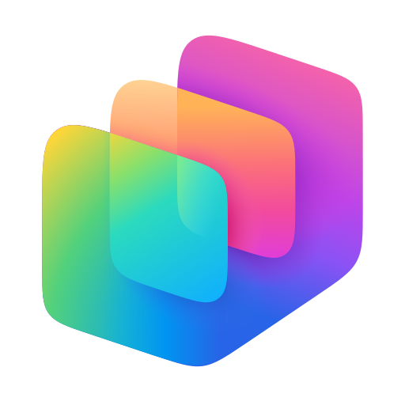


MICROSOFT COPILOT STUDIO
Copilot Studio
Building custom agents that know, reason, act, and reach users — across every channel of your organization
Copilot Studio
1
Notes:
Opening. Frame the session as a progression from AI-powered productivity to AI-powered processes. Copilot Studio is the focus: agents that know, reason, act, and reach users across channels. Keep this brief and move to the agenda.

Slide 2
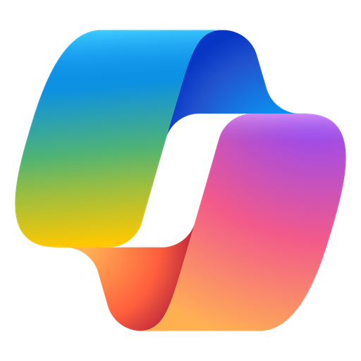
THE EVOLUTION
M365 Copilot changes how people work; Copilot Studio changes how work gets done.
The shift from AI in the flow of work to agents in the flow of business
M365 COPILOT
COPILOT STUDIO
AI in the flow of work
Agents in the flow of business
Ask · Create · Summarize
Know · Reason · Act · Reach
Transforms how people work
Transforms how work gets done
The next layer of the Microsoft agent stack
Copilot Studio
2
Notes:
M365 Copilot brings AI into the flow of work. Copilot Studio extends that experience into the flow of business. This is an expansion, not a replacement or migration. The transition happens when the organization moves from using AI in the flow of work to designing agents for specific business outcomes.

Slide 3

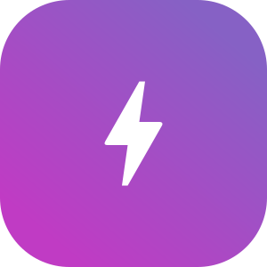
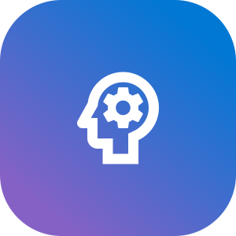
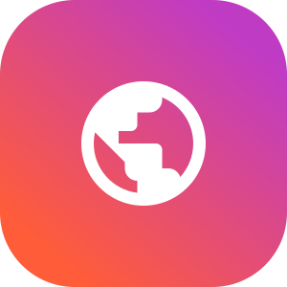
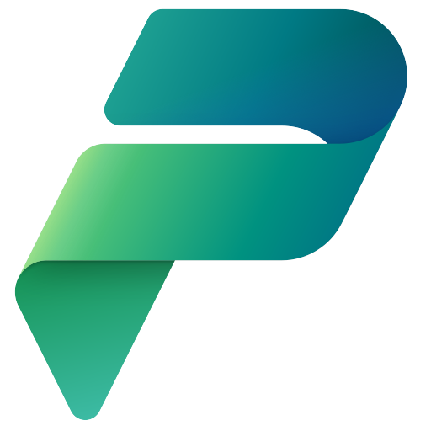
WHAT IS COPILOT STUDIO
What is Copilot Studio?
One low-code platform to build agents that build, connect, act, and reach.
BUILD
CONNECT
ACT
REACH
Create agents using natural language and low-code tools
Ground agents in your business data and systems with prebuilt and custom connectors
Turn conversations into actions using AI, workflows, and business processes
Engage any audience through the channels they already use
Built on Microsoft Power Platform
Security · Governance · Lifecycle · Analytics
Copilot Studio
3
Notes:
Copilot Studio is Microsoft’s low-code platform for building enterprise agents. Inherits your power platform strategy which includes security, access, authentication, and more.
Build: Build custom agents using natural language and low code tools for any audience.
Connect: Where M365 Copilot knows your work; which is primarily grounded in your M365 data, Copilot Studio can connect to virtually any business data source, allowing agents to reason over the systems, records, and knowledge that runs your organization
Act: We want to go beyond just answering questions, how can we empower agents to act on a user's behalf using tools, automation, and business processes.
Reach: lastly, copilot studio allows you to reach any audience. Internal, external, employees, citizens, through virtually any channel. Your website, Facebook, text, voice. Full service IVR

Slide 4
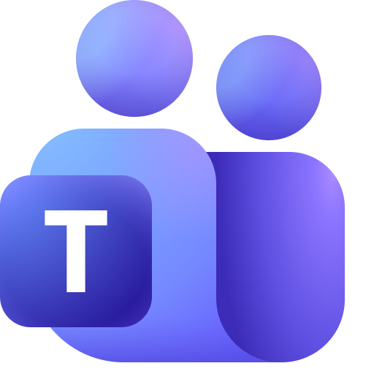
DEMO 1 · EMPLOYEE ONBOARDING
Accelerating Employee Onboarding with M365 Copilot
A hiring manager moves from onboarding questions to a completed onboarding request without leaving Microsoft 365 Copilot.
1
2
3
Ask
Act
Track
Need to onboard a new employee
• Role-specific onboarding guidance
• Equipment and access requirements
• Policy questions answered from approved DoIT knowledge
Create and route the onboarding request
• Build recommended equipment package
• Calculate costs automatically
• Trigger approval workflows
Monitor progress through completion
• Approval status
• Fulfillment updates
• Estimated completion dates
grounded knowledge • business action • approval workflow • status tracking
Copilot Studio
4
Notes:
Recorded demo, approximately three minutes. Show an employee invoking a specialized agent inside M365 Copilot, receiving a grounded and cited answer, then asking the agent to complete the next step through a connector or agent flow. The business action and visible confirmation are the differentiation; avoid a pure FAQ demonstration.

Slide 5


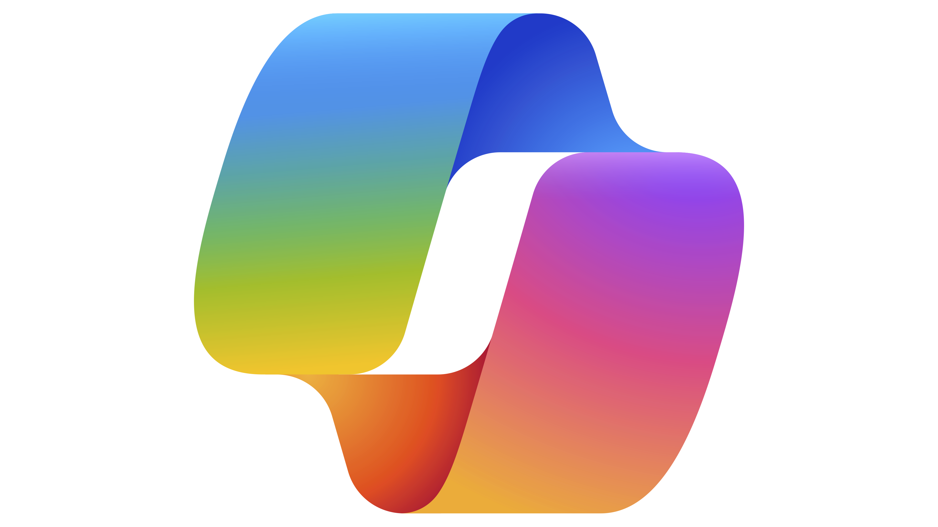
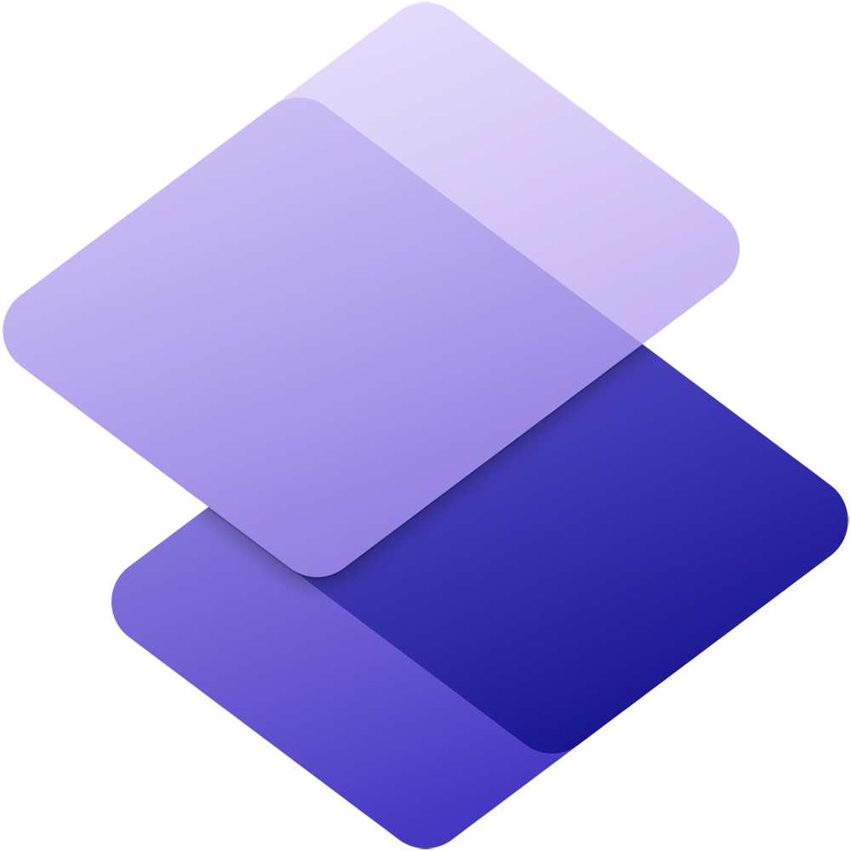




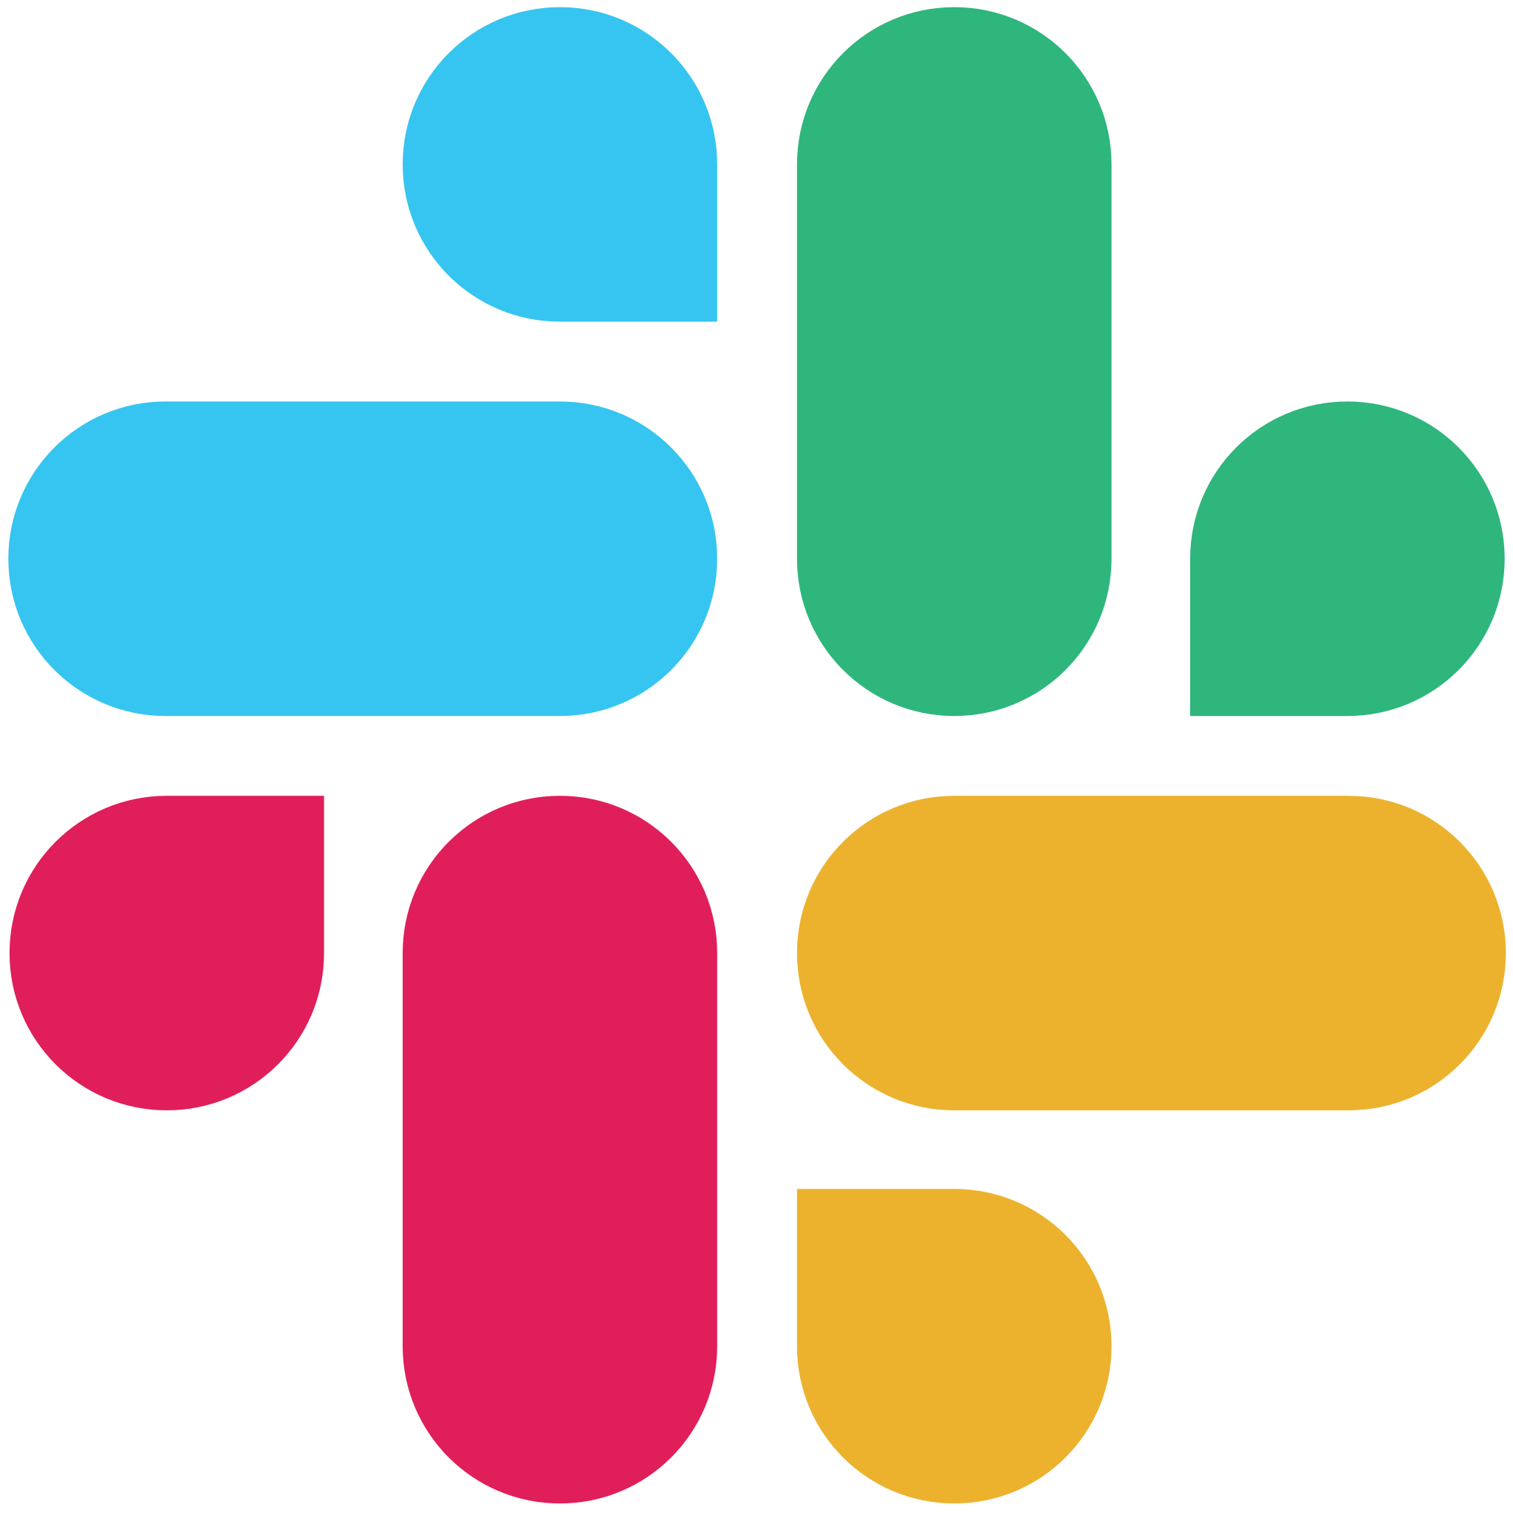




BEYOND ONE WORK SURFACE
The same platform serves employees, citizens, and service channels
External audiences change the channel, identity, data, and operating model — not the platform.
Microsoft Teams
SharePoint
Kik
Phone
Website
Mobile app
Microsoft 365 Copilot
Power Pages
Telegram
WhatsApp
Facebook
SMS*
GroupMe
Slack
Email
Line
Apple Messages for Business
Custom
WeChat
Twilio
Employees
Citizens
Copilot Studio
5
Notes:
Finally, once you’re finished building an agent, you can make them accessible to your customers and employees wherever they need to engage with an agent
For example, a restaurant might use a WhatsApp agent to help answer customer questions
Or a legal agent may be published to Teams, where marketing employees can check that their messaging is compliant with advertising law

Slide 6
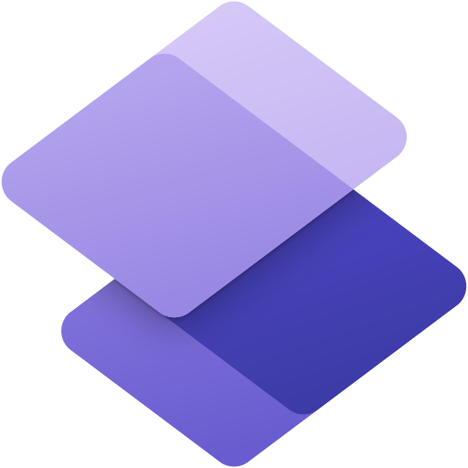
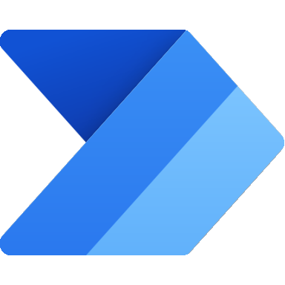
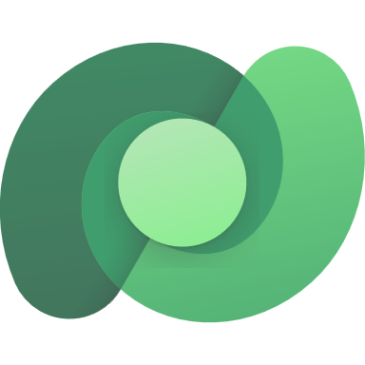
DEMO 2 · VENDOR SUBMISSION
Illinois Vendor Submission Assistant
A conversational agent reads vendor documents, validates them against business rules, and files a structured submission automatically.
1
2
3
Submit
Validate
Track
Upload the proposal packet
• Agent greets the vendor on the website
• Vendor asks to submit a new proposal
• Vendor uploads the PDFs
Extract, summarize, and check
• Reads key fields — vendor, contact, $$$ value
• Summarizes the details back to the vendor
• Flags a soon-to-expire insurance certificate
File a tracked submission
• Vendor uploads an updated certificate
• Corrected date written to the record
• Confirms Submission ID VND-2026-##### and status
document extraction • business-rule validation • automated filing • tracked submission ID
Copilot Studio
6
Notes:
Recorded demo, approximately three and a half minutes. Show a resident describing a need, receiving approved public guidance, creating a request through a governed flow, and receiving a reference number. Keep the public agent's instructions, knowledge, authentication, and tools separate from the employee agent. AI Builder document extraction is optional and should occur after submission with validation before operational use.

Slide 7
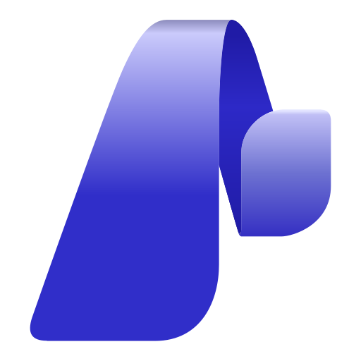
CHOOSE THE CENTER OF GRAVITY
Start where the solution belongs; connect where the value is clear.
Center of gravity picks the starting point — integration always stays open.
EMPLOYEE EXPERIENCE
BUSINESS AGENT
CUSTOM AI ENGINEERING
M365 Copilot
Copilot Studio
Microsoft Foundry
Productivity grounded in your Microsoft 365 work
Governed knowledge, actions, channels, and lifecycle
Code-first agents, model choice, evaluations, Azure-native
Copilot Studio
7
Notes:
This is a decision guide, not a scorecard. Start with M365 Copilot when employee productivity and Microsoft 365 work are central. Start with Copilot Studio for governed business agents, actions, channels, and lifecycle. Start with Microsoft Foundry when custom models, code-first orchestration, evaluations, or an Azure-native runtime are central. The bidirectional connectors reinforce that integration remains open.

Slide 8
BETTER TOGETHER
The Microsoft Agent Stack
Each technology serves a different purpose, audience, and level of engineering control.
M365 Copilot
Copilot Studio
Microsoft Foundry
BEST FOR
BEST FOR
BEST FOR
AI-powered productivity in the flow of work
Purpose-built agents for business processes
Custom, code-first AI apps and agents
KEY AUDIENCE
KEY AUDIENCE
KEY AUDIENCE
Knowledge workers across the organization
Employees, customers, citizens, and partners
Users of custom apps, services, and domain solutions
USE WHEN
USE WHEN
USE WHEN
Employees need AI in Microsoft 365 · M365 data is the primary source · Fastest path to productivity
Automate business processes with actions, tools, and Agent Flows that connect to other systems · Orchestrate connected agents across a workflow
Custom AI applications and services are required · Advanced control over models, orchestration, and data is needed · Professional engineering teams own and operate the solution
BUILT BY
BUILT BY
BUILT BY
Business users and small teams with Agent Builder
Makers + IT + pro developers (fusion teams)
Software engineers · AI engineers · data scientists
GOVERNANCE FOCUS
GOVERNANCE FOCUS
GOVERNANCE FOCUS
Permissions and information readiness
ALM, environments, DLP, authentication
Azure architecture, security, operations
Copilot Studio
8
Notes:
These aren't competing technologies. They're optimized for different ownership models and outcomes. M365 Copilot brings AI into employee productivity. Copilot Studio extends AI into business processes and agents. Foundry provides the engineering platform for custom AI applications. Many organizations use all three together as part of a unified Microsoft AI strategy.
Read the slide as decision criteria, not a scorecard: Best For and Use When identify the center of gravity; Key Audience and Built By identify the ownership model; Governance Focus reinforces that every product sits within one Microsoft governance story. Avoid framing it as a maturity ladder (“use M365 until it can't, then Studio, then Foundry”) — that diminishes the products. For this GCC customer, validate any Azure Commercial integration and data boundary separately.

Slide 9
DISCUSSION · 18:00–25:00
Discussion, product handoffs & Q&A
Where is your center of gravity today — and where should it be?
Which process deserves your first agent?
What must “governed” mean for your audience?
Handoff: when the need shifts to custom models or code-first orchestration, Microsoft Foundry becomes the starting point — or the specialized service behind your Studio agent.
Better together — from AI-powered productivity to AI-powered processes.
Copilot Studio
9
Notes:
Use the questions to open discussion. Handoff to the Foundry presenter: when the requirement shifts to custom models or code-first orchestration, Microsoft Foundry becomes the starting point or the specialized service behind the Copilot Studio agent. Close on the better-together message.

Slide 10
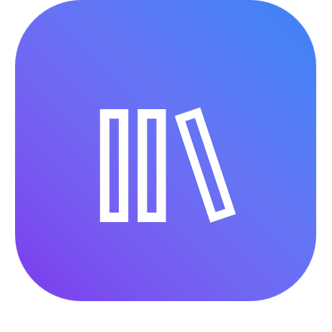
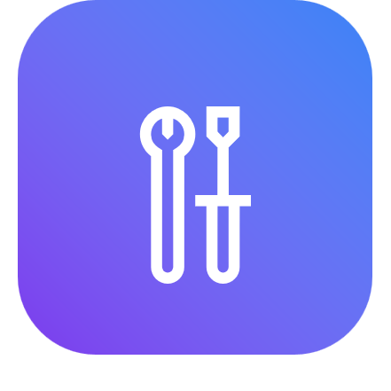
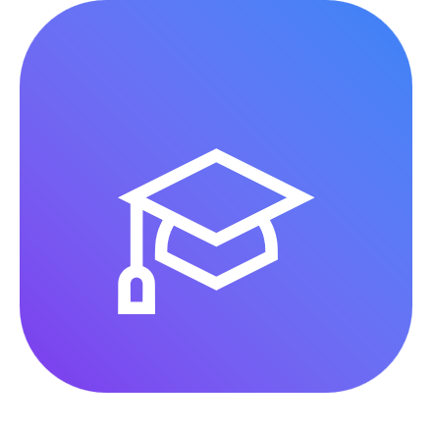
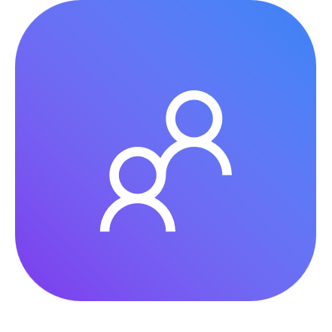
NEXT STEPS
Where to Start Learning with Copilot Studio
Curated resources to help your organization learn, build, and scale.
LEARN
BUILD
ADVANCE
ADOPT
Product documentation and guided learning paths
Hands-on workshops to create your first agent
Structured training for agent design and development
Guidance and scenarios for organizational adoption
Microsoft Learn
Guided workshop
Training path
Adoption resources
Copilot Studio
10

