Slide 1
Unit 2 Overview
Energy, Forces and Earth’s Crust
(you can find me on Schoology:)

Slide 2
Day 1 - (8/25 - 8/26)
Link to Lesson 1 slides
Intro story Afar event
Link to equake volcano map

Slide 3
8/27 - 8/28 (block day)
Revisit Lesson 1 models
Make Driving Question Board (post-its)
Progress Tracker for L1
Lesson 2 Investigations (prep the spring scales & foam blocks)
Link to Lesson 2 Lecture slides for notes
Link to L2 Investigations wkst
HW: Lesson 2 Review wkst (Net Force) Link to Lesson 2 Notes and Force review solutions

Slide 4
8/31 - 9/1 (block)
Concept Builder “Equilibrium” (Apprentice only)
Whiteboard practice
Vector Walk
Practice wkst (P.2 L2 Free Body Diagrams for partner practice)
Link to Lesson 2 Lecture notes
(solutions and video explanations are inside the lecture notes)

Slide 5
9/2 - 9/3 Block
Quiz Lesson 2 Forces & Stability
Prepare the foam for elastic demo
Link to Lesson 3 Slides modified for the Notes 3A
Link to article rock sample
Update Progress Tracker
Link to Lesson 3 Notes filled in

Slide 6
9/4 (particle model sim) - Minimum Day
Link to Lesson 4 slides modified
Notes Lesson 4 wkst
Students use the Link to Eval Model wkst
Link to Simulator particle interactions
Link to Particle Investigation wkst
Link to Krakatoa Exit Ticket
Link to Lesson 4 Notes filled in

Slide 7
9/8 - Earth’s interior
Link to Lesson 5 slides modified
Link to L5 slides
Article How do Scientists explore Earth's Interior
Article Mantle and the Moho
Part 1 - P & S waves from Earthquakes, intro to Mantle Cross Section simulator
Part 2 - Mantle Cross Section Lab activity
Link to L5 Notes filled in
Mid Unit Assessment (check for understanding)

Slide 8
9/10 - 9/11
Gizmo “Convection” Link to Gizmo Convection packet
Link to Lesson 6-7 Slides modified (including convection tank video)
Link to L6 slides
Video of the heat source under the water tank (convection)
Link to L7 slides
The Matter - Force - Energy triangle
Link to Notes 6-7 Filled in

Slide 9
9/14 Late Start
Quiz on Lessons 4 - 7

Slide 10
9/15 - 9/16
Link to L8 9 & 10 slides
Lesson 8 - Age of Rocks (what we learn)
Lesson 9 - Density of rock (basalt vs granite)
Lesson 10 - Plate boundaries (what happens at convergent, divergent and transform boundaries)
Lessons 8, 9 & 10 Notes filled in
Link to U2 Study guide
Link to solutions for Study Guide

Slide 11
Optional resources
Friction & Forces on an incline
Link to slides L11 - 12
Link to Crash Course Video "Plate Tectonics"

Slide 12
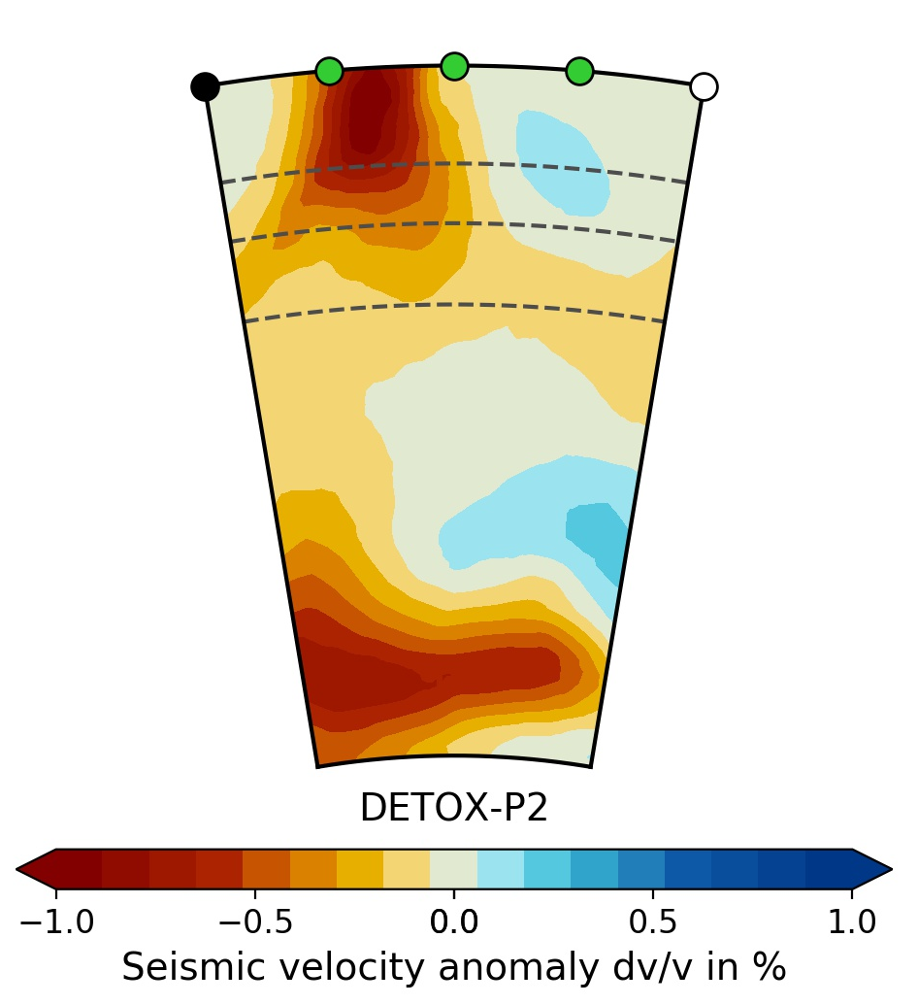
Park phones
Have 3 colored pencils at desk
Chromebook ready (go directly to nmusd.schoology.com
Questions? Q&A
Test Unit 2 Energy Forces and Earth’s Crust (27 MC & 1 Short Answer)
Work quietly when finished

Slide 13
Lesson 13

