Slide 1
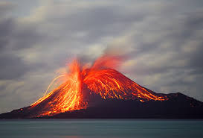
9/4
Park phones
Get out your L3 notes from last class
Krakatoa volcano (the loudest sound ever heard….)

Slide 2
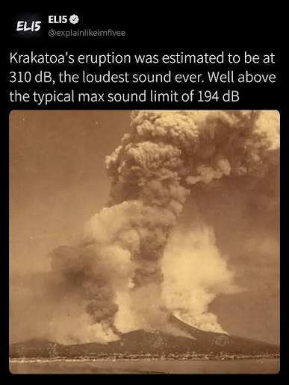
Video Krakatoa 1883
(at 6 min, the loudest sound ever heard!)
Kurzgesagt Biggest Eruptions that Changed the World
(extra info here that is more useful later)

Slide 3
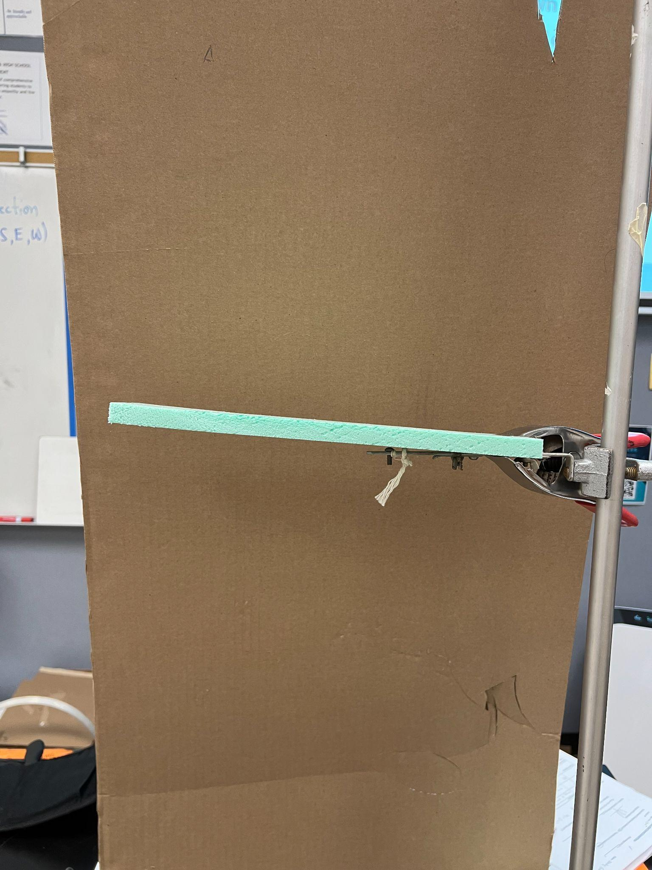
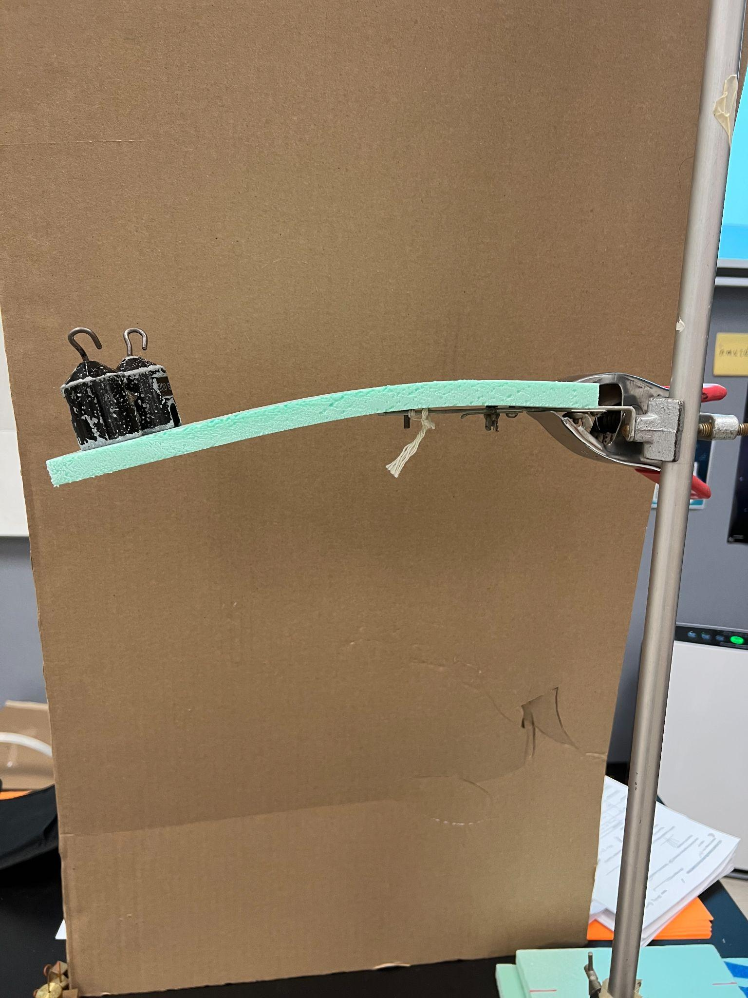
L3 Recap: What happens to matter when more force is applied? What happens to energy when force applied? When force removed?
Discuss the terms:
Elastic behavior
Deformation

Slide 4
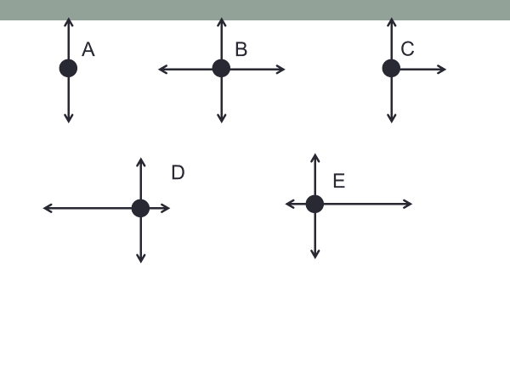

Slide 5
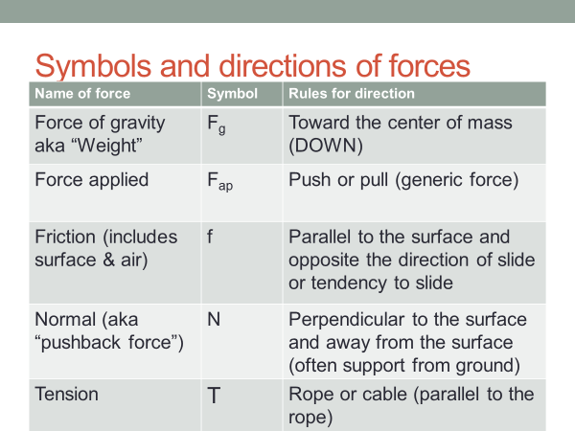
On back of L3 Notes
F_{g} = mass x (10 m/s/s)
F_{N}

Slide 6
Practice w Forces (on a whiteboard w/ partner)
Draw the arrows 2) Label the forces w/ symbol to identify
A book of mass “m” at rest on a table
A book of mass “3m” (Art History) at rest on a table (how different from above?)
Student picks up the book “m”, lifting it above the table
Student mass “M” falls through thin ice

Slide 7
Continued force diagram practice
5. Student standing at rest on a skateboard
6. Student gets a push rightward to get moving
7. Student slows down while moving rightward (wheel bearing have lots of friction)

Slide 8
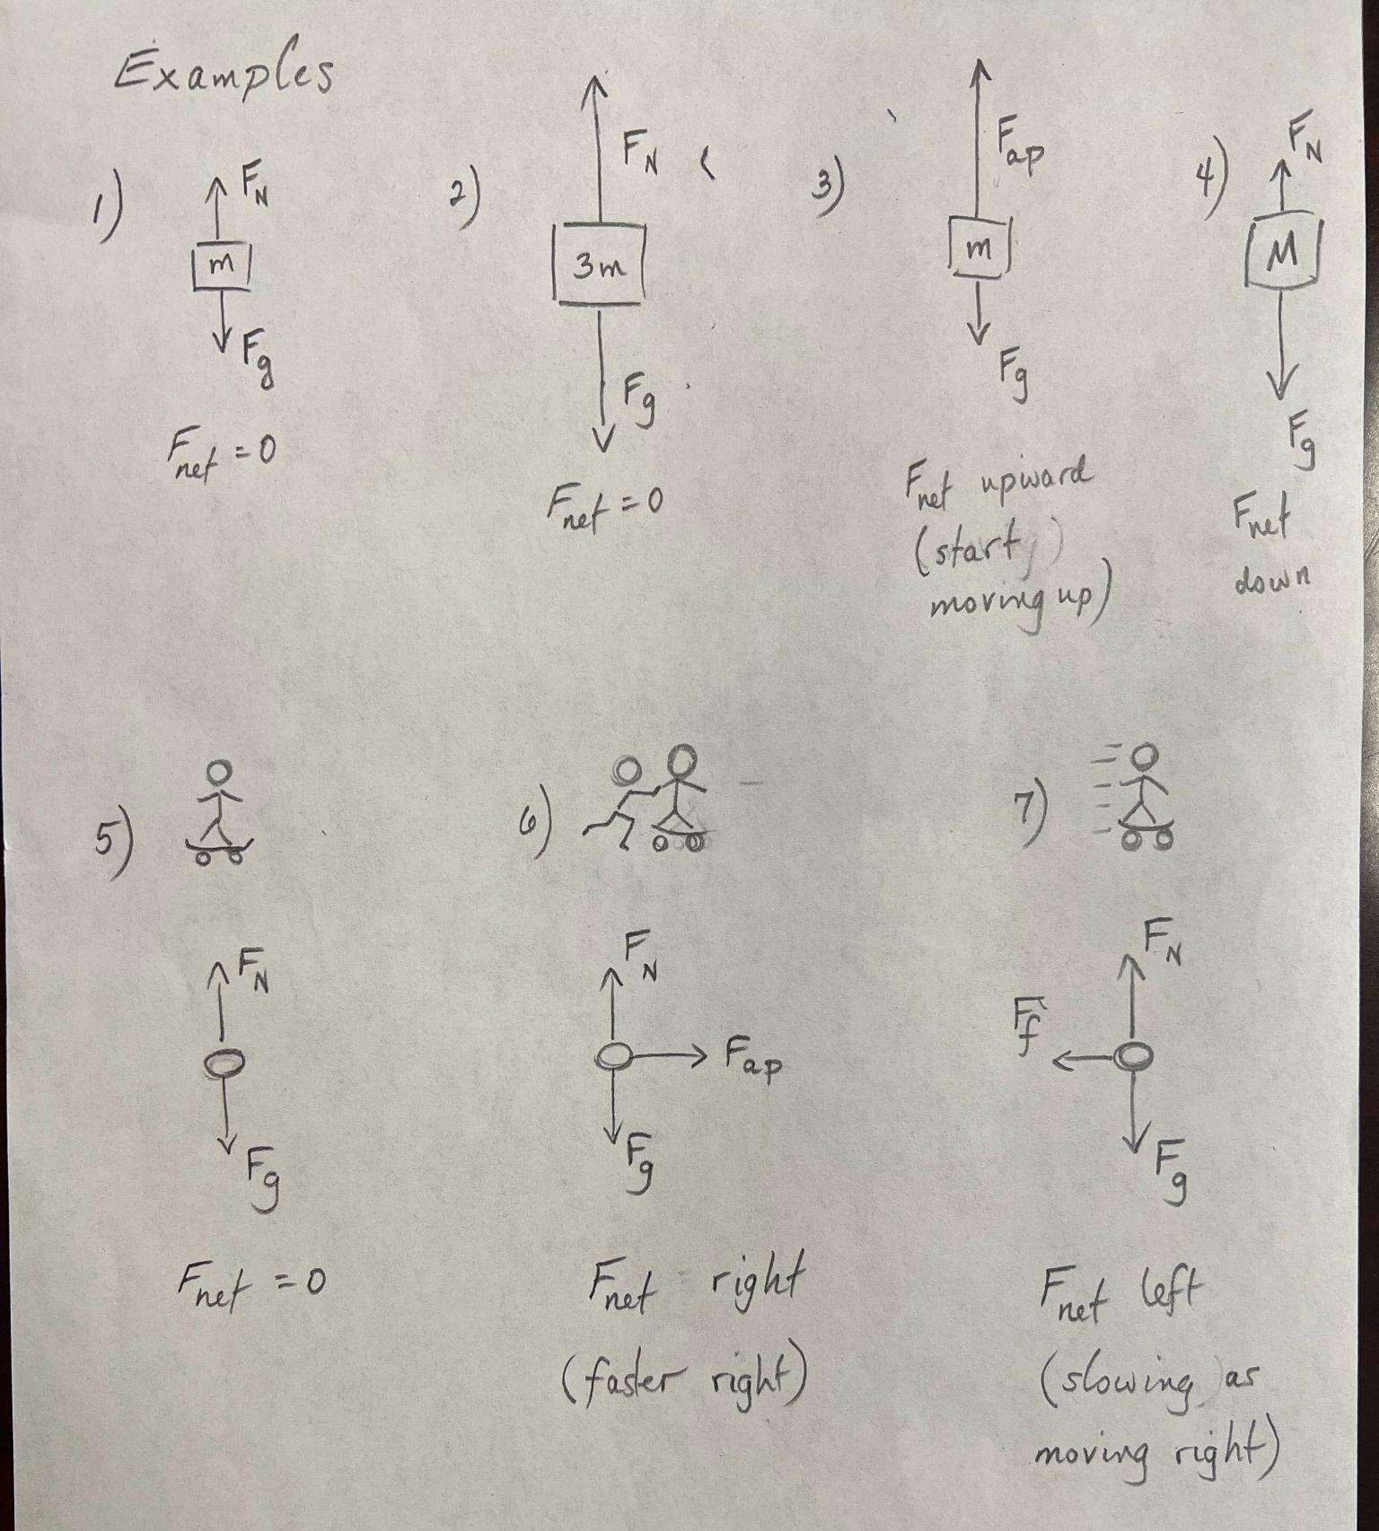
Answers

Slide 9
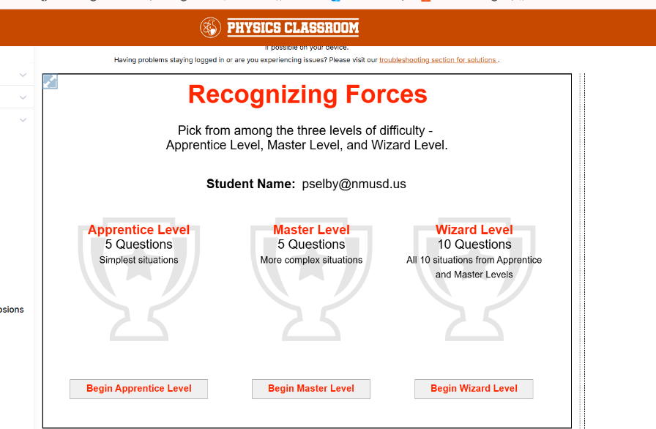
www.physicsclassroom.com
Task Tracker
Recognizing Forces
Apprentice only
(hint: use air resistance
for any scenario moving
through the air)

Slide 10
Insert link to L3 Notes here (stop here after minimum day)
Link to Lesson 3 Notes filled in

Slide 11

9/8 - 9/9 Agenda
Park phones
Have L4 Notes ready
New seats
Why do we have Labor Day?
Check in…How did you spend your holiday…

Slide 12
Industrial Conditions: During the height of the Industrial Revolution, average Americans worked 12-hour days and seven-day weeks in unsafe factories, mills, and mines just to survive. Even young children toiled in harsh conditions for minimal pay

Slide 13
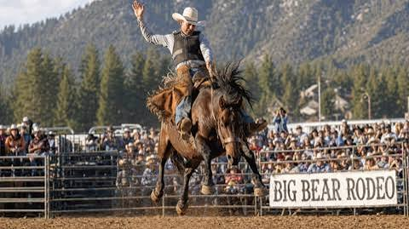
Review the forces
A horse bucks, jumping upward. Discuss a force diagram (including which forces and relative sizes)

Slide 14
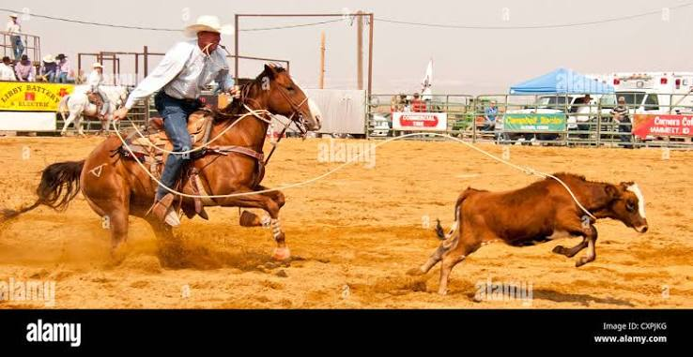
Focus on the calf. If he is slowing down, what are the forces acting on him. (side view)

Slide 15

Moving Our Thinking Forward
On your own
What do you want to try to do in your discussions over the next 2 days that could really help push both your thinking and others’ thinking forward?
Notes:
Frame the Community Agreement of “Moving Our Thinking Forward.” Present slide B. Say, We have made significant progress, thanks to the contributions of all of you. Reference the Community Agreements poster. Suggest that the work of connecting different perspectives is challenging, and we will need to lean on each other to help push our thinking forward.
Say, At the end of the period tomorrow, I’m going to ask you to name one student who helped push your thinking forward in a specific way. I’ll share those shout-outs with the class later in the unit.
Then give students a moment to quietly reflect on the prompt on the slide:
What do you want to try to do in your discussions over the next two days that could really help push both your thinking and others’ thinking forward?

Slide 16

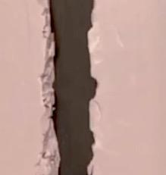
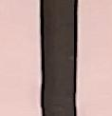
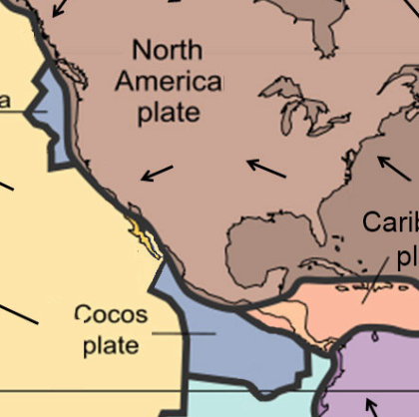
Simulate Plate Interactions along Boundaries (L4 Notes)
With your class
How do the edges of the foam in image A better represent the structure of the plates along their edges than image B?
A
B
Every model has advantages and limitations. Understanding these can help us move more flexibly between different types of models for explaining how and why phenomena occur.
Notes:
Compare structures of plate boundaries. Present slide C. Read the text at the top aloud:
Let’s prepare to use a model to simulate the interactions we think are happening between two plate boundaries.
Elicit 1-2 ideas related to the images on the slide with the prompt:
How do the edges of the foam in image A better represent the structure of the plates along their edges than image B?
Listen for students to suggest that the foam panels in image A better represent matter along plate boundaries because the plate edges along boundaries are irregularly shaped, rather than being flat or straight as in image B.
Foreground that today’s main practice is related to modeling. Refer to picking one foam model over another (for irregular edges versus straight edges) as an example of identifying an advantage in using one part of a model versus another to explore a phenomenon. Emphasize that we will focus on that type of thinking for the rest of the lesson to consider how different models may better explain some aspects of the listed phenomena.

Slide 17
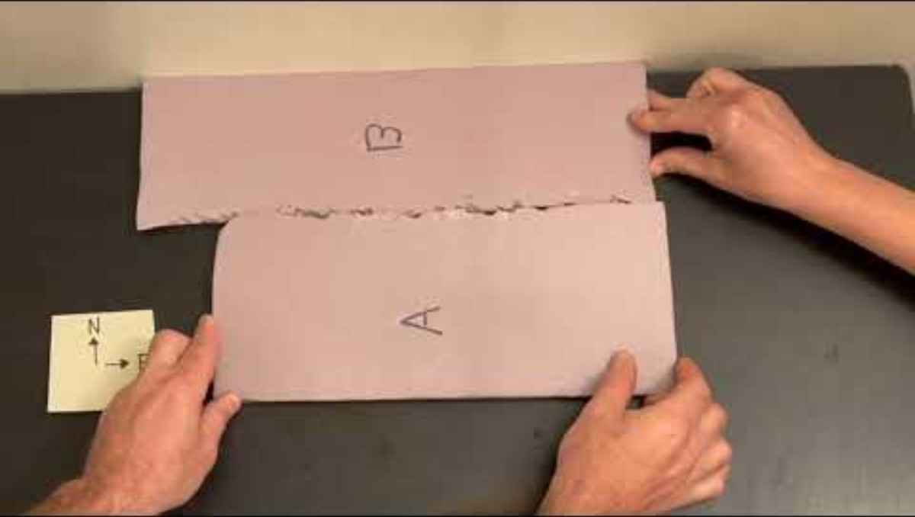
Develop and Use a Model Link to Video
With your class
Play the video with the captions on.
Pause the video when each prompt is displayed.
Turn and Talk
Discuss your answers to each prompt.
Notes:
Identify matter changes in the system. Present slide E. Open the video and display it to the whole classroom. Turn the captions on. This video shows what happens when two foam panels with irregular edges are in contact and moving perpendicularly to each other, with force of increasing magnitude applied to their movement. During the video, the following prompts will be asked:
Consider whether we would see motion at a smaller scale if we were to zoom into any part of the matter. Imagine you can observe in a zoomed in location along the plate boundary as they do this again, and the magnitude of the external force on plate B slowly increases.
What would you see happening to the matter at these locations?
Consider why these particular pieces of foam would have cracked and broken off apart from the larger piece of material they were attached to.
What if anything was different about the matter at the locations where the matter broke off versus it did not? What if anything was different about the forces acting on the matter at those locations?
Pause the video when each prompt is displayed, and have students turn and talk about it before discussing it as a class. Rewind and replay any section that you think will support this discussion.

Slide 18

Identify Model’s Advantages and Limitations
On your own
First take a moment to consider how Model 1 helps us explain how/why any of our listed phenomena occur.
Then evaluate the model’s advantages and limitations for helping to explain these phenomena through the particular lens you selected.
Notes:
Evaluate Model 1. Present slide F. Have students reflect on the first prompt:
First take a moment to consider how Model 1 helps us explain how/why any of our listed phenomena occur.
Give them 3 minutes to record their response to the slide’s second prompt on the handout:
Then evaluate the model’s advantages and limitations for helping explain these phenomena through the particular lens you selected.
Transition to the next slide by saying, We should always try to evaluate the advantages and limitations of any model in terms of what phenomena it can explain. Let’s discuss a few of those related to earthquakes.

Slide 19
Identify Model’s Advantages and Limitations
Plates can suddenly slip along where they are in contact with each other. The video claimed that this is the cause of many earthquakes along plate boundaries.
With your class
What must be happening to the matter at points of contact between the plates right before this occurs?
Why, in most cases, would breaking, fracturing, or cracking tend to occur at points along the edge of the plate instead of farther back, away from the edge?
Notes:
Focus on points in matter where slips or breaks occur. Display slide G. Read the text at the top:
Plates can suddenly slip along where they are in contact with each other. The video claimed that this is the cause of many earthquakes along plate boundaries.
Discuss the slide’s two questions as a class, as shown in the table below. Use the follow-up questions to foreground the role of scale in considering matter changes in the system. See the prompts in the teacher guide for support.
In students’ responses to the follow-up questions, listen for the following ideas:
It is hard to detect changes in solids, because the amount of elastic deformation is relatively small compared to the amount of force for most solids.
Smaller pieces are more affected by forces than larger pieces, because they have less matter.
There are fewer particles in that part of the matter.

Slide 20
Recall Particle Ideas from Prior Lessons
Particles is a general name for the smallest pieces of matter represented in a model we develop or use.
With your class
What names have we used to refer to those particles in our prior modeling work?
What particle-level changes are happening?
Notes:
Review types of particles. Present slide I. Read the text at the top, and elicit 1-2 ideas with the prompt:
Particles is a general name for the smallest pieces of matter represented in a model we develop or use.
What names have we used to refer to those particles in our prior modeling work in science class?
Listen for students to mention atoms, molecules, electrons, and protons.

Slide 21

Switch to Small-Scale Interactions
Turn and Talk
Pick one of the ideas below
All solids elastically deform up to a point.
Pieces of a solid can break off when the matter reaches its elastic limit.
What is happening at the particle level that helps explain either of these behaviors of matter?
DRAW IT!
Notes:
Consider particle-level interactions. Display slide J. Have students turn and talk for a minute about the prompt:
What is happening at the particle level within a solid that helps explain either of these behaviors of matter? (You pick.)
All solids elastically deform up to a point.
Pieces of a solid can break off when the matter reaches its elastic limit.

Slide 22
Compare Models of Bonds
Bonds between atoms or molecules are often used to help explain some of the properties of matter.
With your class
Take a poll: What does your own model suggest about what the bonds between the particles in a solid are like?
They are like strings.
They are like springs.
They are like rigid sticks.
They are like _________.
The second model we’re going to evaluate uses magnets to simulate the interactions between the nucleus of an atom and the electrons that produce bonds between atoms in a solid. As with Model 1, we’ll use a video to orient to Model 2 and discuss what is happening through any lens that you choose.
Notes:
Compare models of bonds. Say, In Chemistry, you would have probably used the term “bonds” to describe what holds atoms or molecules in a solid together. Present slide K. Read all of the slide aloud:
Bonds between atoms or molecules are often used to help explain some of the properties of matter. What does your own model suggest about what the bonds between these particles in a solid are like?
They are like strings.
They are like springs.
They are like rigid sticks.
They are like _________.
Explain that the blank option is included because these models are all analogies, which are useful in some ways but limited in others, and students may think a different model would be a more useful analogy. Give them a few moments to think on their own before polling the class about which of the listed options is closest to their own model of the bonds in a solid.
After the poll, validate that scientists represent bonds in many ways, such as those on the slide, and that these representations help explain some properties of matter but not all. Say, If you asked scientists whether bonds are actually solid physical structures, like a string, spring, or stick, they’d say that they are not, and that bonds are actually stable states that emerge from the electric forces between the charged particles that make up atoms and molecules.

Slide 23
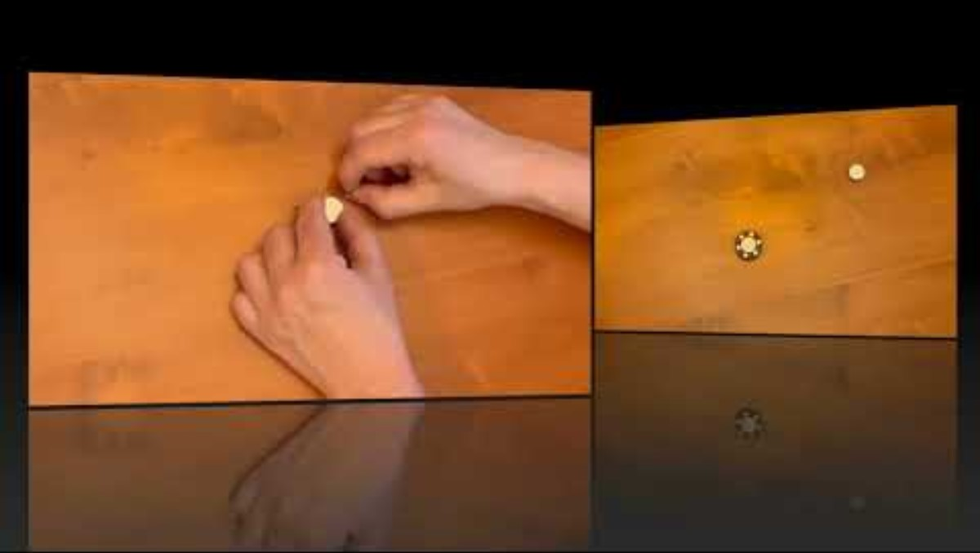
Develop and Use a Model Link to Video
With your class
Play the video with the captions on.
Pause the video when each prompt is displayed.
Turn and Talk
Discuss your answers to each prompt.
Notes:
Introduce Model 2. Say, The second model we’re going to evaluate uses magnets to simulate the interactions between the nuclei of an atom and electrons that produce bonds between two atoms in a solid. As with Model 1, we’ll use a video to orient to Model 2 and discuss what is happening through any lens that you choose.
Present slide M. Open [video:OP.PF.VID.L4.006] and display it to the whole classroom. Turn the captions on. This video shows particle-level interactions, using magnets of different sizes to represent the nuclei and electrons of an atom. During the video, the following prompts will be asked:
What relationships do you notice between the distance between the magnets and the forces acting on them?
Predict what you think the net force will be on these parts as we bring them together?
What does this tell us about the magnitude of the repulsive versus attractive forces acting on the magnets at this point in the system
Pause the video when each prompt is displayed in the video, and have students turn and talk about it before discussing it as a class. Rewind and replay any section that you think will support this discussion.

Slide 24
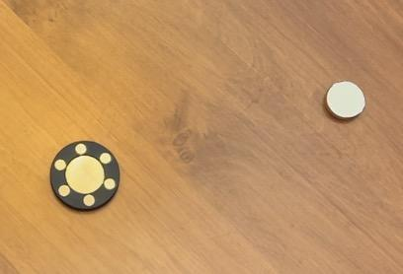
Identify Model’s Advantages and Limitations
On your own
Take a moment to consider how Model 2 helps us explain how/why any of the phenomena listed on the top of our sheet occur.
Record which lens you are using to evaluate Model 2.
Evaluate the model’s advantages and limitations for helping to explain these phenomena through the lens you selected.
Notes:
Evaluate Model 2. Present slide N. Give students a moment to consider how Model 2 helps us to explain how/why any of our listed phenomena occur. Then cue them to record the model’s advantages (merits) and limitations on their handout, as well as the lens they are using to evaluate it.

Slide 25
Navigate
With your class
What parts and interactions would we need/want in a particle-level simulation to make progress on our questions?
What characteristics of the matter could affect some of these interactions?
What would we want to be able to visualize or measure in that simulation?
Notes:
Brainstorm about a simulation. Say, To prepare to use a third model, which is a particle-level computer simulation, let’s specify what we think it should have or do, based on our model evaluation work so far. Present slide O. Discuss the three prompts as a class, as shown in the table below. See the prompts in the teacher guide for support. Say, Let’s compare the features we specified to the simulation I have for us, and consider how we could use it to design investigations to help answer some of our questions.

Slide 26
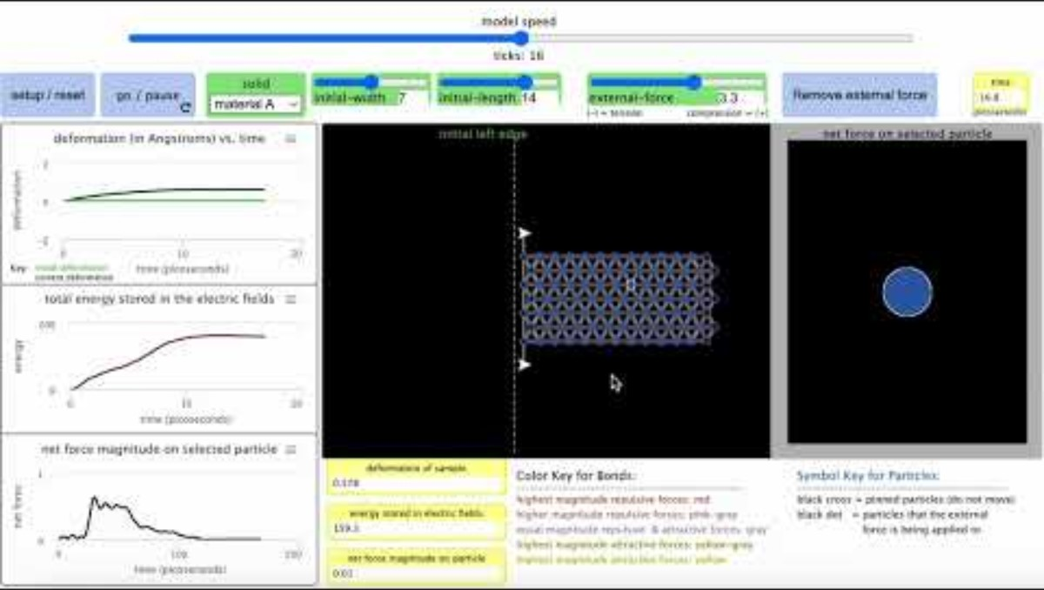
Plan to Carry Out an Investigation (find link @ Schoology Message)
With your class
Orient to the assumptions, representations, and variables built into the simulation.
Simulation link
Notes:
Orient to the simulation. Present slide P. Play the video to introduce the simulation’s assumptions, representations, and variables. Distribute the handout.

Slide 27

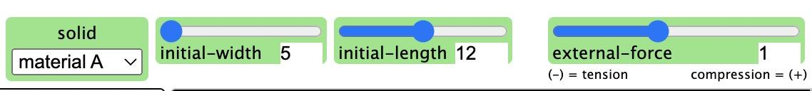
Plan to Carry Out an Investigation
With your group
Decide which independent variable each person will investigate.
Record this on Part 1 of your handout.
On your own
Carry out Investigations 1-4 and record your results.
Notes:
Prepare for the investigation. Present slide Q. Assign students to groups of 2-3. Read the task instructions aloud:
Decide which independent variable each person will investigate.
Record this on Part 1 of your handout.
Have students store the handout in their science notebooks. Collect the handout before the end of the class period.

Slide 29

Prepare for a Scientists Circle
With your group
How did changes in your independent variable affect the outcomes in the simulation?
Notes:
Share results with a partner. Present slide S. Ask students to share with a partner how the changes in their independent variable affected the outcomes in the simulation. If they only get to discuss their results from Investigation 1, that is OK. This is enough to prepare them to share all their findings in the Scientists Circle.

Slide 30

Develop a Consensus Model
Let’s work together to figure out how these new ideas apply to our phenomena.
Scientists Circle
Meet in a Scientists Circle to develop a consensus model that represents what we figured out from our investigations.
Bring your Notes 4 and Particle Investigations handout with you.
Notes:
Facilitate a Consensus Discussion in a Scientists Circle. Display slide T. Have students bring their handout to a Scientists Circle. Tell them explicitly, As in all Consensus Discussions, my role is to give everyone time to consider each proposed idea, and to weigh in on those ideas. Today we’ll consider additions to our M-E-F poster. I’ll need everyone to weigh in on those before we add anything to it.
Discuss macroscopic changes. Use the foam panel with a narrow middle section for a demonstration to establish the relationship between changes in external forces applied to a system and macroscopic changes in its matter. This supports considering differences in particle-level forces at different parts of the system. Say, Let’s use some of the M-E-F prompts and our ideas from all three models to see how particle-level thinking can help us better explain the changes in matter that we’ve observed.
Hold up a double V-notched foam piece (3” x 12” x ½”). Compress it with your hands from both ends until it is in a slightly bowed shape, before it starts cracking. Ask, What changes do we see in this matter right now? Listen for the following observations:
The foam is bending.
The foam is changing shape.

Slide 31
Develop a Consensus Model (sketch force diagrams on notes)
Scientists Circle
Consider whether forces acting on particles are balanced or unbalanced in the following conditions:
  No external forces are acting on the foam.
  Forces start bending the foam.
  Forces stop bending the foam, but keep it bent.
  Forces continue bending the foam, and cracks appear.
  The foam breaks in 2 pieces.
What is happening to the particles along this sequence?
Notes:
Discuss how forces acting on the system affect the matter. Say, We saw in the simulation that paying attention to changes in particles helped us explain changes in shape. Let’s consider what’s happening at the particle level here.
Present slide U. Use the prompts to elicit ideas about the demonstrated changes in the foam:
Consider whether forces acting on particles are balanced or unbalanced in the following conditions:
No external forces are acting on the foam.
Forces start bending the foam.
Forces stop bending the foam, but keep it bent.
Forces continue bending the foam, and cracks appear.
The foam breaks into two pieces.
What is happening to the particles along this sequence?
The class discussion might play out as shown in the table below. See the prompts in the teacher guide for support.

Slide 32
Develop a Consensus Model
Scientists Circle
Consider whether forces acting on particles are balanced or unbalanced in the following conditions:
  No external forces are acting on the foam. Bal
  Forces start bending the foam. Unbal
  Forces stop bending the foam, but keep it bent. Bal
  Forces continue bending the foam, and cracks appear.
    Unbal
  The foam breaks in 2 pieces. During unbal, after new bal reached
What is happening to the particles along this sequence?
Notes:
Discuss how forces acting on the system affect the matter. Say, We saw in the simulation that paying attention to changes in particles helped us explain changes in shape. Let’s consider what’s happening at the particle level here.
Present slide U. Use the prompts to elicit ideas about the demonstrated changes in the foam:
Consider whether forces acting on particles are balanced or unbalanced in the following conditions:
No external forces are acting on the foam.
Forces start bending the foam.
Forces stop bending the foam, but keep it bent.
Forces continue bending the foam, and cracks appear.
The foam breaks into two pieces.
What is happening to the particles along this sequence?
The class discussion might play out as shown in the table below. See the prompts in the teacher guide for support.

Slide 33
Develop a Consensus Model
Scientists Circle
What causes all changes in motion, whether the motion is at the particle level or macroscopic?
All changes in matter are a result of changes in motion at a macroscopic or particle level
Notes:
Discuss particle-level changes in the system. Present slide V. Lead students to summarize the role of unbalanced forces with the prompt:
What causes all changes in motion, whether the motion is at the particle level or macroscopic?
Students should say that unbalanced forces cause all changes in motion. Point out that we have seen unbalanced forces cause several types of changes: motion, shape change, and breaking. Suggest we use this insight to simplify the entire set of changes we listed under the “Matter” section on the M-E-F poster, as they are all changes in motion.
Emphasize that we will continue to use this idea as a way of explaining all changes we observe in matter.

Slide 34
Develop a Consensus Model
Scientists Circle
Where do we think the foam will break?
How do the number of particles across this section compare to the rest of the sample?
Why would this lead to a higher magnitude of internal force per particle in this section, compared to other parts of the matter?
Notes:
Discuss how the amount of matter affects the forces acting on it. Present slide W. Continue the discussion with the prompts, as shown in the table below. See the prompts in the teacher guide for support.
Introduce term used to describe forces on particles. Say, When scientists consider the average amount of force per particle, they sometimes refer to this as “pressure.” Ask for another example of hearing the term pressure referring to this sort of force. Students who completed [material:ce] will provide examples of force on a piston surface due to particle collisions in a combustion engine.

Slide 35
Develop a Consensus Model
Scientists Circle
What kept the matter from breaking apart along where it cracked before we reached its elastic limit?
What types of forces between protons and electrons produce those bonds?
Do those same types of forces help explain why all solids, including the plates, could elastically deform up to a point?
Fields generated by matter result in forces.
Notes:
Present slide X. Slowly bend the foam to its breaking point, asking students to pay attention to what they see happening. The foam will snap, and pieces may fly off. Turn the broken faces of the foam toward students and point along it when you ask the questions shown in the table below. See the prompts in the teacher guide for support.
Identify the role of fields. Say, We have argued that electrons and protons produce electric fields. So, because all atoms have these particles, we can say that all matter produces fields. In a solid, these electric fields produce forces that act on neighboring particles in ways that explain all sorts of macroscopic behavior. Update the M-E-F poster.
Say, Let’s see how this idea of fields can also be used to help explain how energy is transferred and stored in the system.
Connect to prior discussions. Continue, When the foam is being held in this stable bent shape, there’s no measurable energy increase in the system, like increased kinetic energy or temperature. So, we need to find a way to describe exactly where the energy is being stored; otherwise, we won’t be able to account for conservation of energy--something that we know should occur in every process. When changes in the distance between objects or between particles acting on each other through fields affect the amount of energy stored in the system, scientists say the energy is being transferred into or out of, or stored in, the fields.

Slide 36
Develop a Consensus Model
Scientists Circle
What was the relationship between changes in the distance between particles and changes in the energy stored in the electric field(s) in the simulation?
Can we store unlimited amounts of energy in those electric fields, or was there a limit?
Notes:
Discuss matter and energy relationships. Present slide Y. Continue the discussion with the prompts, as shown in the table below. Encourage students to refer to their handout as needed. See the prompts in the teacher guide for support.

Slide 37
Develop a Consensus Model
How does the scale of a plate, and the number of particles that make up its matter, affect the amount of energy that can be stored in the electric fields between the particles before part of the plate reaches its elastic limit?
We know the motion of the plates is relatively slow. What does that tell us about why there are periods of apparent stability between earthquakes in any given region?
Notes:
Use our new ideas to explain earthquakes. Present slide Z. Discuss the prompts, as shown below. See the prompts in the teacher guide for support.

Slide 38
Develop a Consensus Model (turn in your Particle Investigation)
How do we know there is energy in the system?
Scientists Circle
Update the Scale Chart poster and the M-E-F poster using our ideas about particle-level interactions.
Sound, heat, light, electricity, elastic deformation
... are some combination of…
Really small and slow changes in the plates for lots of particles over years
Kinetic energy associated with the motion of objects or particles
Plate Deformation
Bonds break
and/or
stored In a field associated with position/orientation between the objects /particles
Notes:
Revise the posters. Present slide AA. Emphasize that we can now say that what happens at a very small scale--the particle level--can explain changes seen in the plates at a much larger scale, including earthquakes and cracks. Part of that explanation is related to the amount of elastic deformation in the system, which steadily increases over time.
As you update the M-E-F poster, ask how we knew whether electricity was transferring energy through the system for the electricity-powered devices in [material:pe.n]. Students will say heat, light, and maybe sound coming from those devices. Validate these responses.
Summarize the relationship between particle-level matter changes and energy stored in the matter. Point out that we are considering how energy is stored in systems in a new way, related to elastic deformation. Note that this involves thinking about the motion of particles in matter and about the energy stored in the fields based on their relative positions in space.
Emphasize that in our prior unit, we also thought about electricity in terms of particle motion and fields transferring energy, though we didn’t focus on how fields can store energy. Ask students to recall what particles we studied in that system, and what types of fields transferred energy from the generator through space to the wires. They will say electrons in wires, and electric and magnetic fields.
Summarize how to account for energy changes in a system. Point out that it is not only elastic deformation and electricity that can be broken down into a combination of one or two things that describe where energy is in the system and how it is transferred. We can also think in this way about the kinetic energy of objects (generators, magnets, plates) or particles (electrons, atoms, molecules) and the energy in fields (electric, magnetic).
Challenge students to keep this lens in mind going forward--that we can, if needed, account for all changes in energy as a combination of changes in kinetic energy and changes in energy stored in fields, even if the everyday name we give to the transfer of that energy is “sound” or “heat”.
Use these ideas to update the M-E-F poster.
Emphasize that we just applied our M-E-F thinking to two Earth science phenomena, and we should recognize that going forward, we can now explain any Earth science phenomenon from a particle-level perspective. Point to the Scale Chart poster and its sticky note for volcanic eruption, and forecast that we will apply our thinking to this phenomenon in the upcoming Electronic Exit Ticket.

Slide 39

Complete an Exit Ticket
On your own
Complete the Exit Ticket on Krakatoa (on Schoology)
Read the article first, underline key ideas, circle best answers…
Watch this Krakatoa clip first
Link to the Krakatoa article
Notes:
Assign the Electronic Exit Ticket. Before class, make a copy of the video. Share the link to the copy with students (do not share the original link, as that will create a new copy for each student, and you will not have access to their responses). Present slide BB. Give them 10-12 minutes to complete the Electronic Exit Ticket individually.

Slide 40
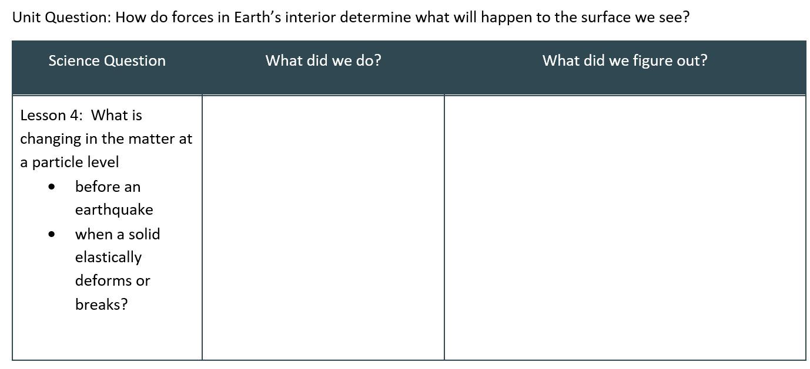
Lesson 4 Progress Tracker

Slide 41
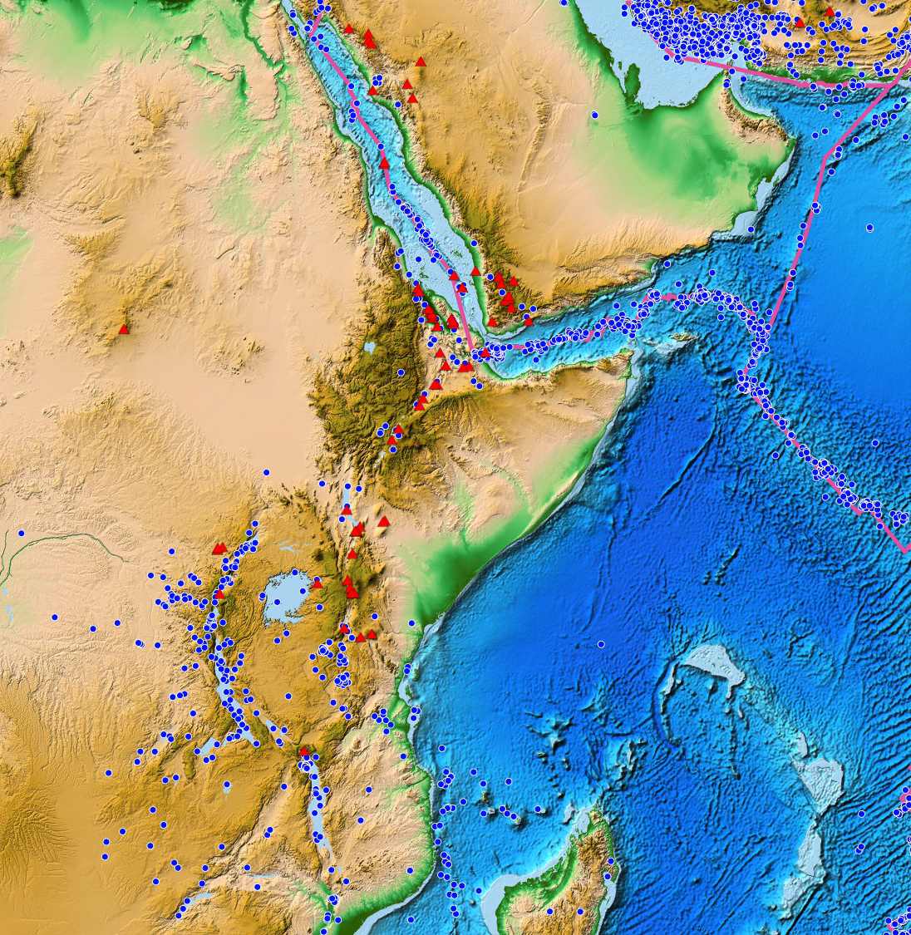
Navigate
With your class
Take a poll: Can we fully explain what is happening at Afar, or do we need more information/data?
Notes:
Navigate into Lesson 5. Present slide CC. Ask students to raise their hand (yes or no) in response to the prompt:
Can we fully explain what is happening at Afar, or do we need more information/data?
Establish agreement that because the Afar events didn’t happen at a plate boundary, something must be going on there that is different from what we think is happening for most earthquakes, or for the volcanic eruption in the Electronic Exit Ticket, which did occur near a plate boundary. We need some additional data/information to figure out the case sites that appear to be exceptions.

