Slide 1


Slide 2
Researcher Degrees of Freedom and P-Hacking
Two of my least favorite parts of science…

Slide 3
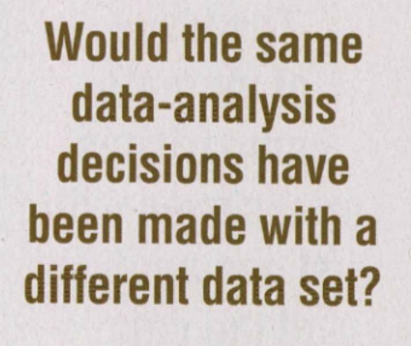
What really are “Researcher Degrees of Freedom?”
Simmons et. al., really paint researcher degrees of freedom as a risky business, I think, by highlighting that these are not all decisions that can be made beforehand and that it is a “common (and accepted practice) for researchers to explore various analytic alternatives, to search for a combination that yields ‘statistical significance,’ and to then report only what ‘worked.’” (p 1359)
Both papers make points about data exclusion– let’s talk about that as a researcher degree of freedom that all of us engage in and likely we don’t always report all of the ways we decided in incredible detail. Who excludes data? How? For what? How do you report it?
In the Gellman and Loken paper, they tough on the researcher degrees of freedom involved in measurement- in deciding which measurements, how to give them, etc. This is something inescapable in our lines of work, so how are people handling these choices? Is “following the literature” enough?

Slide 4
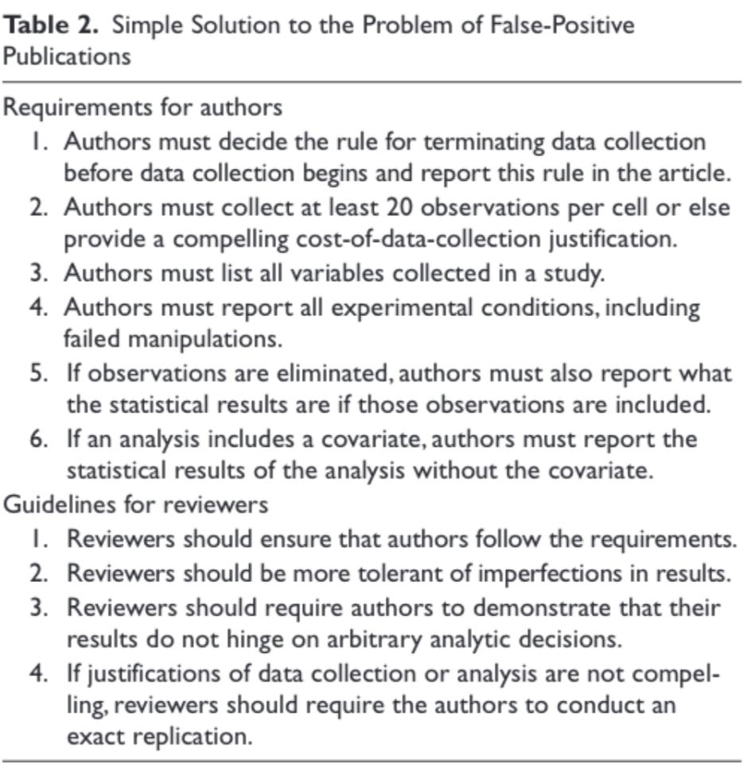

Slide 5
Defining p-Hacking
“If these decisions are not made in advance but rather are made as the data are being analyzed, then researchers may make them in ways that self-servingly increase their odds of publishing (Kunda, 1990). Thus, rather than placing entire studies in the file-drawer, researchers may file merely the subsets of analyses that produce nonsignificant results” (Simonsohn et al., 2014, pg 534)
What are the parameters? Do we all p-hack all the time? How do we hold ourselves to higher standards when it comes to pre-planning all analyses?

