Slide 1

Reproducibility Week 2
Is there really a replication crisis?

Slide 2
Goodman et al., 2016
“reproducibility refers to the ability of a researcher to duplicate the results of a prior study using the same materials as were used by the original investigator." (p 1).
Does not add new evidential weight, but may add more subjective weight
Methods reproducibility means providing "enough detail about study procedures and data so the same procedures could, in theory or in actuality, be exactly repeated" (p 2).
Results reproducibility is "obtaining the same results from the conduct of an independent study whose procedures are as closely matched to the original experiment as possible" (p 2-3).
"Robustness refers to the stability of experimental conclusions to variations in either baseline assumptions or experimental procedures." (p 4).
"Generalizability (...transportability), which refers to the persistence of an effect in settings different from and outside of an experimental framework" (p 4).
Inferential reproducibility is "the drawing of qualitatively similar conclusions from either an independent replication of a study or a reanalysis of the original study" (p 4).

Slide 3
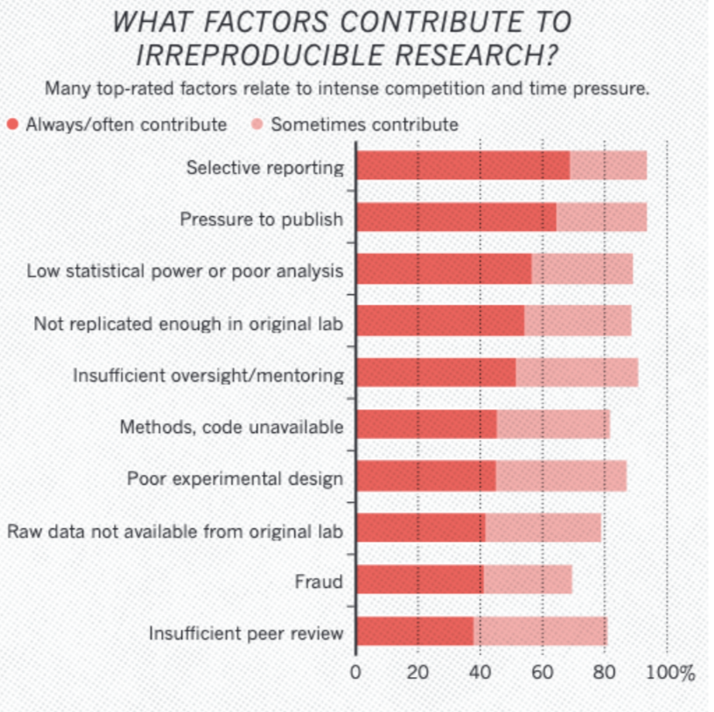
Baker & Penny, 2016
The authors highlight two main responses from the survey about contributing factors to the reproducibility crisis: pressure to publish and selective reporting.
Together, briefly talk through these responses. Do you think that they key issues here are, in fact, selective reporting and pressure to publish, or are other potential problems even more important?

Slide 4
Ioannidis, 2016
"Corollary 1: The smaller the studies conducted in a scientific field, the less likely the research findings are to be true." (p 0697)
"Corollary 2: The smaller the effect sizes in a scientific field, the less likely the research findings are to be true." (p 0697)
"Corollary 3: The greater the number and the lesser the selection of tested relationships in a scientific field, the less likely the research findings are to be true." (p 0698)
"Corollary 4: The greater the flexibility in designs, definitions, outcomes, and analytical modes in a scientific field, the less likely the research findings are to be true." (p 0698)
"Corollary 5: The greater the financial and other interests and prejudices in a scientific field, the less likely the research findings are to be true." (p 0698)
"Corollary 6: The hotter a scientific field (with more scientific teams involved), the less likely the research findings are to be true." (p 0698).
"A major problem is that it is impossible to know with 100% certainty what the truth is in any research question."

Slide 5
Epistemic Struggle: What is True in science? How do we know?
Notes:
Posit one hypothesis- reproducibility can help answer this.

