Slide 1
Overcoming Structural Barriers: The Modifying Effect of Migrant Networks and Coordinated Financial Policies on International Investment
Kelly McCaskey
University at Buffalo, SUNY
February 19, 2015

Slide 2
Migrant Networks on International Investment

Slide 3
Financial policy coordination increases the strength of migrant networks.

Slide 4
But, the level of strength is different for different types of investment.

Slide 5
An increase in familiarity.

Slide 6
A decrease in information asymmetries and transaction costs.

Slide 7
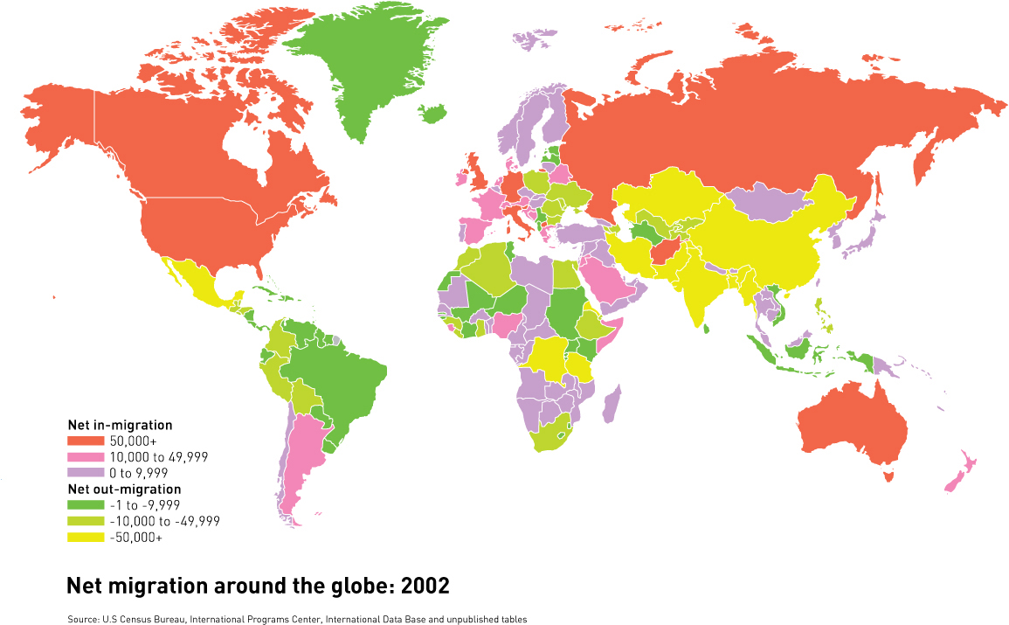
What is a migrant network?
Net Migration Around the Globe: 2002
Source: rgs.org, US Census Bureau, International Programs Center, International Database

Slide 8
Portfolio Investment vs. FDI
“Passive” investment
Pre-determined strategy without forecasting
No active management or control
Stocks, bonds, and hedge funds
Direct investment
Production element along the supply chain
Horizontal
Vertical
Raw material procurement, manufacturing, customer service, R&D

Slide 9
How does increased familiarity increase investment?

Slide 10
Dual Taxation Treaty
Bilateral tax treaty
Favorable investment atmosphere
Overcome inefficiencies in investment

Slide 11
Hypothesis 1
A dual taxation treaty increases the positive effect of a migrant network on international portfolio investment.

Slide 12
Hypothesis 2
The effect of a migrant network on FDI should be similar in dyads with and without a dual taxation treaty.

Slide 13
Y = β_{cons} + β_{Migrant}(MigrantStock) + β_{DTT} (DTT )
+ β_{Migrant×DTT} (MigrantStock × DTT )
+ β_{controls}(Controls) + ε

Slide 14
Controls
The dyad’s market size (GDP*GDP)
Distance
Contiguous border
Preferential trade agreement
Economic growth correlation
Bilateral phone traffic
Common language
Common legal heritage
Common currency
Common religion

Slide 15
Data
2002
Migrant networks
World Bank
International portfolio investment
International Monetary Fund
56 source, 154 destination countries
FDI
OECD
28 source, 158 destination countries

Slide 16
Marginal Effect
0.12
0.36

Slide 17
Marginal Effect
0.17
0.16
0.12
0.36

Slide 18
In 2002…
~ 2 million Filipinos residing in the United States

Slide 19
In 2002…
A DTT would have caused portfolio investment to increase by
~ $10 million

Slide 20
In 2002…
A DTT would have caused FDI to decrease by
~ $39,000

Slide 21
Financial policy coordination can increase the strength of migrant networks, but …

Slide 22
… this varies with regard to the type of investment.

Slide 23
Questions?

Slide 24
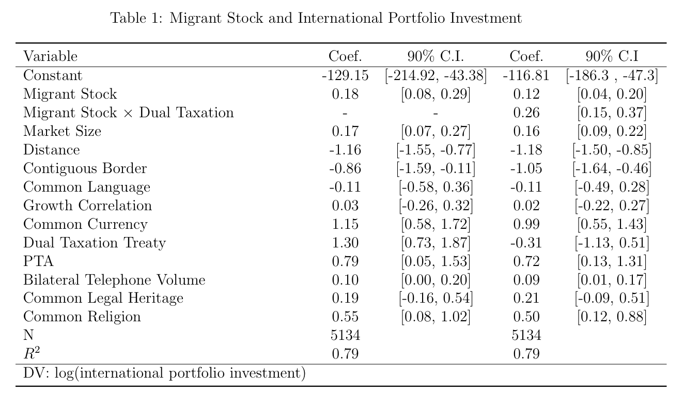

Slide 25
