Slide 1
DataScience@Syracuse July 2018 Portfolio Milestone
Kelly Schillaci

Slide 2
Data Collection
Using the appropriate tools to collect and organize the data
Every course project required data collection
Scripting for Analytics – Suicide Analysis: Kaggle
Data Analytics – Olympic Games Performance: Merged 2 datasets from Kaggle
Text Mining – Ted Talks Analysis: Merged 2 datasets from Kaggle. Labeled Manually
Marketing Analytics - Zillow Analysis: Kaggle
Data Analysis and Decision Making – Process Improvement: Collected Manually

Slide 3


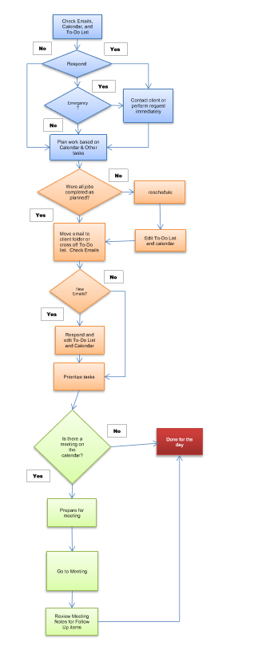

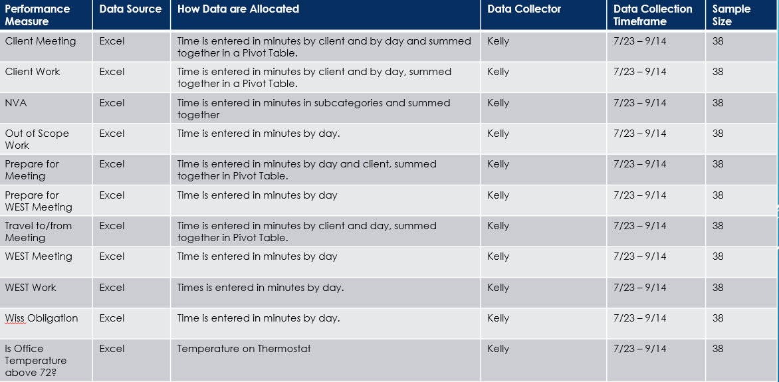
Data Collection - continued
Data Analysis and Decision Making – Process Improvement
Collected continuous data from 7/23 – 9/14. 7/23 - 8/24 were before my process improvement and 8/27 – 9/14 were after the improvement. I also collected discrete data if the office temperature was over 72 degrees.
I made an Excel Spreadsheet with my main categories that contained formulas to total each activity for the day. Each activity was recorded in increments of minutes. I always have my laptop at work so tracking was very easy.
My Continuous Data Variables: NVA activities(Y), Client Meeting (X1), Client Work (X2), Out of Scope Work (X3), Prepare for Client Meeting (X4), Prepare for WEST Meeting (X5), Travel to/from Meeting (X6), WEST Meeting (X7), WEST Work (X8), and Wiss Obligation (X9).
Total Sample Size was 38. 25 before the process improvement and 13 after.
With 95% confidence and margin of error of .174, I would need 97 samples before the improvement and 50 samples after the improvement.

Slide 4
Data Analysis
Identifying patterns in the data via visualization, statistical analysis, and data mining
Every course project required data analysis
Scripting for Analytics – Suicide Analysis: Visualizations
Data Analytics – Olympic Games Performance: Visualizations, Statistical Analysis, Data Mining
Text Mining – Ted Talks Analysis: Visualizations, Statistical Analysis, Data Mining
Marketing Analytics - Zillow Analysis: Visualizations, Statistical Analysis
Data Analysis and Decision Making – Process Improvement: Visualizations, Statistical Analysis

Slide 5
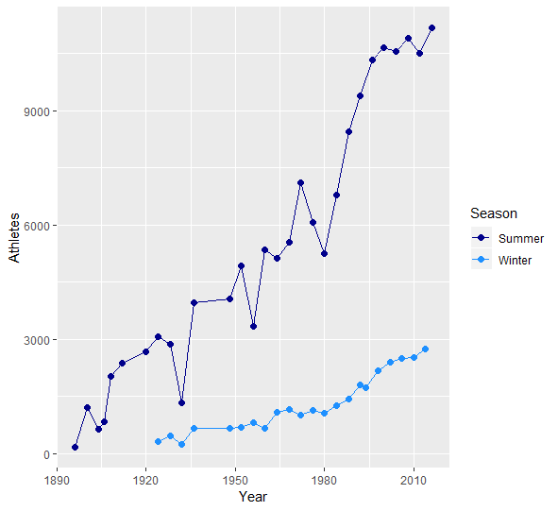
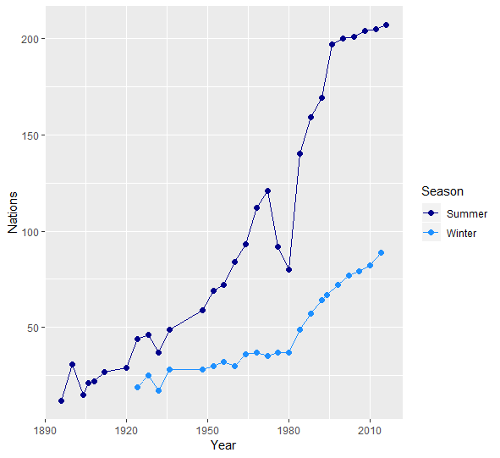
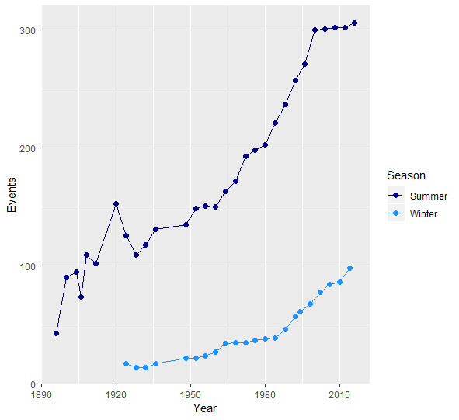
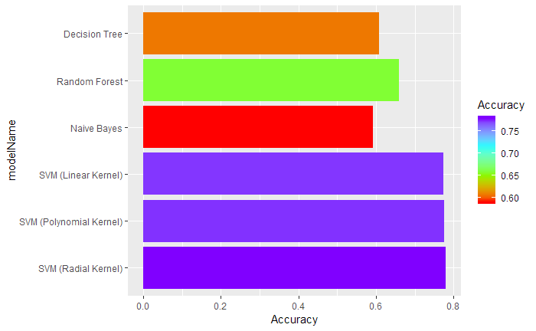
Data Analysis - continued
Data Analytics – Olympic Games Performance: Visualizations, Statistical Analysis, Data Mining
there are significantly more athletes, nations, and events at each Olympic games
women are competing in the Olympics at a rapidly increasing rate, closing the representation gap between the two genders
In predicting the outcome for a certain athlete, country is one of the most significant factors

Slide 6
Strategy and Decisions
Developing alternative strategies based on data
2 course projects required making decisions and recommendations based on the data analysis
Marketing Analytics - Zillow Analysis: Make recommendations to real estate investors
Data Analysis and Decision Making – Process Improvement: Propose strategies to save time based on data analysis

Slide 7
Strategy and Decisions - continued
Marketing Analytics - Zillow Analysis: Make recommendations to real estate investors:
For clustering analysis, data from Dallas (the city), Irving, and Garland were used. Cluster 1 has the highest year over year growth in all types of homes. The majority of Cluster 1 is in Dallas.
The values of the homes are increasing at an exponential rate. y = 101352e^(0.0459x)
5 bedroom homes in Dallas have the highest average growth rate.
Target market to advertise to, based on Prizm Analysis, would be clients in the Money & Brains segment because they are likely to invest in large homes. They also have the income to spend on fashionable houses.

Slide 8
Implementation
Developing a plan of action to implement the business decisions
1 course project required implementing a proposed plan
Data Analysis and Decision Making – Process Improvement

Slide 9
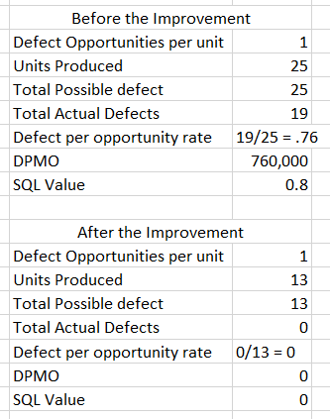
Implementation - continued
Data Analysis and Decision Making – Process Improvement
GOAL: A 10% reduction in NVA activities, could lead to 2 hours a week I can spend on IT projects, to save the company $18,200 annually
BASELINE: I spent an average of 2.446 hours per day on NVA activities before the improvement. The SQL was .8, with a number of DPMO of 760,000, before the improvement
After my process improvement, my mean of time spent on NVA activities decreased 44%. The standard deviation decreased significantly as well. I would love to say that my new process is the reason for such dramatic improvements, but the beginning of the month is when I have all my client meetings and I was a little behind from the long weekend for Labor Day. I definitely need more time to analyze my new process.
SQL is used to provide a baseline to compare.
The defect was spending 2 or more hours on NVA Activities.
The SQL value went from .8 to 0, which is obviously not realistic. The 13 days observed after the improvement were incredibly busy with client meetings. My firm closes the office Friday and Monday for Labor Day. I lost 2 days to prepare for the client meetings.

Slide 10
Conclusion
Data collection involves using the appropriate tools to collect and organize the data
Data analysis comprises identifying patterns in the data via visualization, statistical analysis, and data mining
Strategy and decisions objectives entail developing alternative strategies based on data
Implementation includes developing a plan of action to implement the business decisions

