Slide 1

Suicide Rates Overview
1985 to 2016
Kelly Schillaci

Slide 2
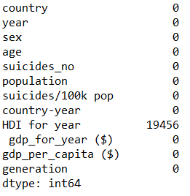
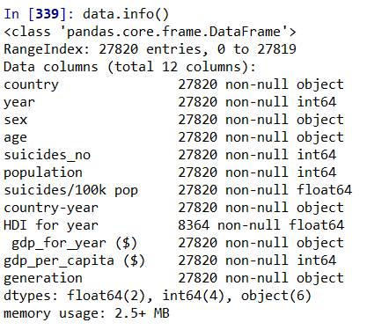
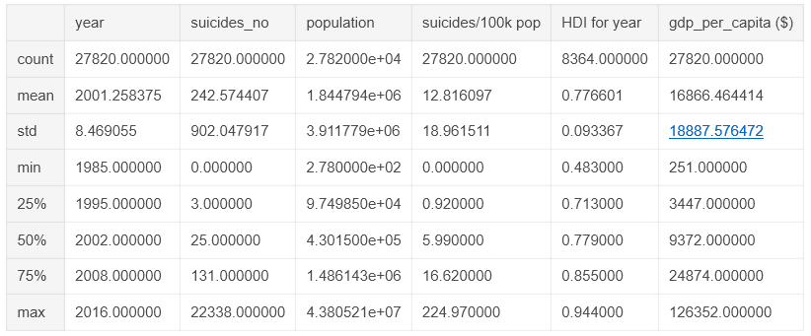
Data
https://www.kaggle.com/russellyates88/suicide-rates-overview-1985-to-2016
The master file compares socio-economic info with suicide rates by year and country. The compiled dataset was pulled from four other datasets linked by time and place and was built to find signals correlated to increased suicide rates among different cohorts globally, across the socio-economic spectrum. The variables include country, year, sex, age group, count of suicides, population, suicide rate, country-year composite key, HDI for year, gdp_for_year, gdp_per_capita, generation (based on age grouping average). Human Development Index (HDI) is used to measure whether a particular country is underdeveloped, developing or fully developed. The index relies on levels of education, life expectancy, literacy and gross domestic product to rank countries into groups. A quick analysis of the variables show what steps will be needed to clean and transform the data for analysis.

Slide 3
Analysis Questions
Question 1: What residents are most likely to commit suicide?
Question 2: What time frame did most suicides occur?
Question 3: Are men or women more likely to commit suicide?
Question 4: What age group is most likely to commit suicide?

Slide 4
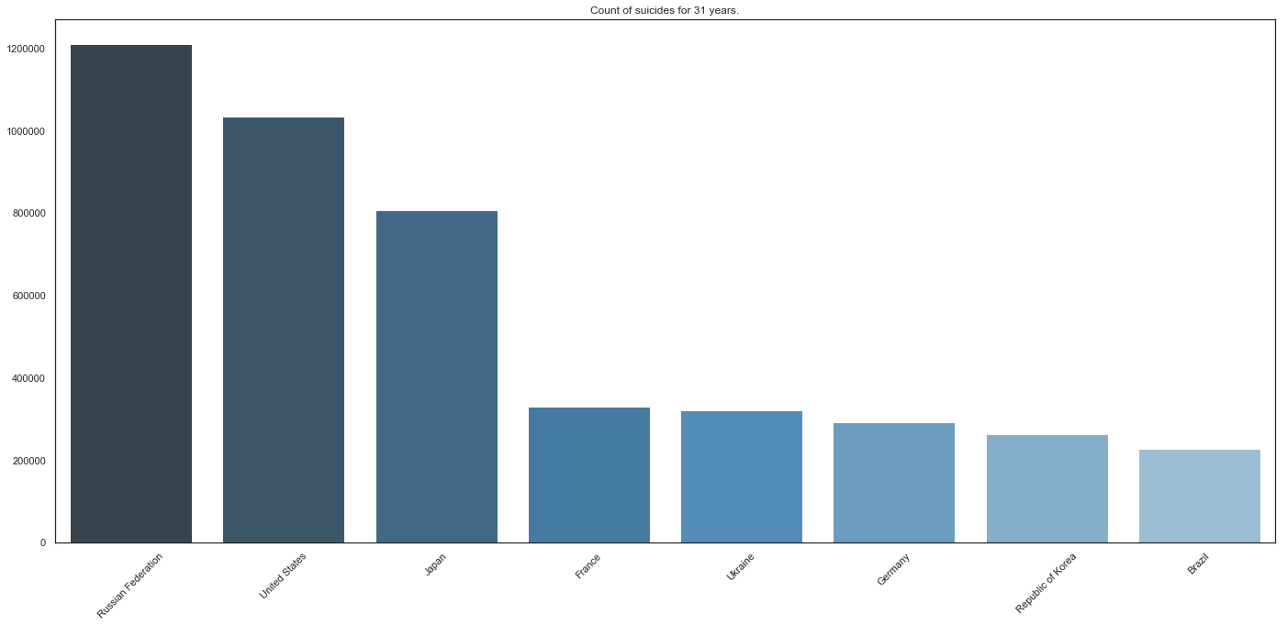
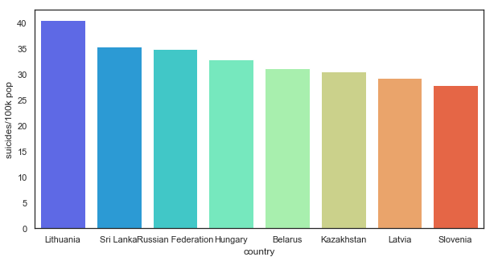
Country Analysis
Conclusion
The countries with the highest amount of suicides are Russian Federation, US, Japan, France, Ukraine, Germany, Republic of Korea, and Brazil.
The top 8 countries based on the mean of suicides/100K are Lithuania, Sri Lanka, Russian Federation, Hungary, Belarus, Kazakhstan, Latvia, and Slovenia.
Next Steps
It would be interesting to compare the results to happiness data.

Slide 5
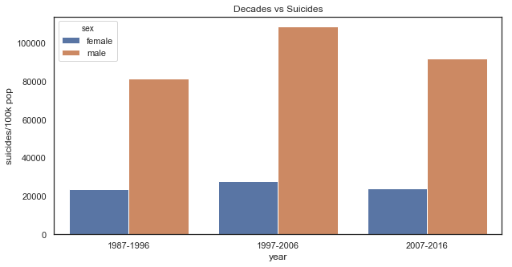
Decade Analysis
Conclusion
1997-2006 had the highest suicide rate
That decade has the highest rate based on actual counts and suicides/100K
Next Steps
Analyze world events that may explain the reason for the spike.

Slide 6
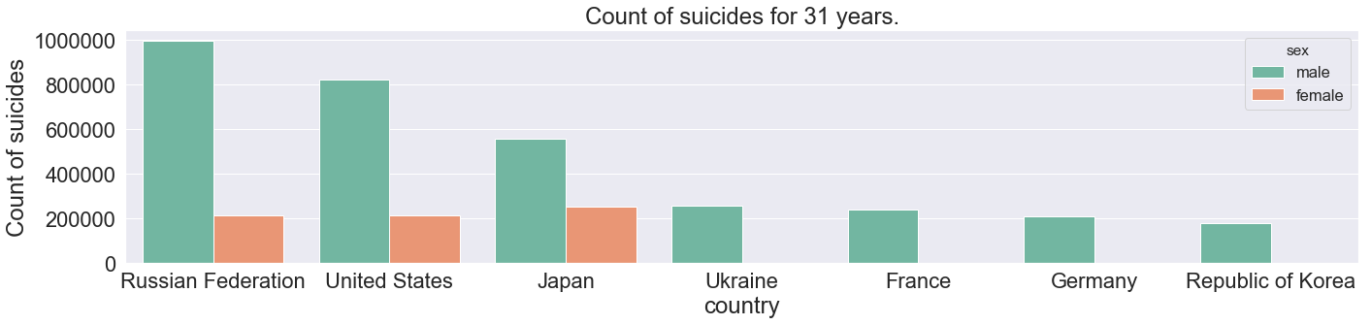
Gender Analysis
Conclusion
Men are much more likely to commit suicide, this holds consistent by timeframe and country.
Next Steps
Try to determine the reason for this – job, family, or societal pressures?

Slide 7
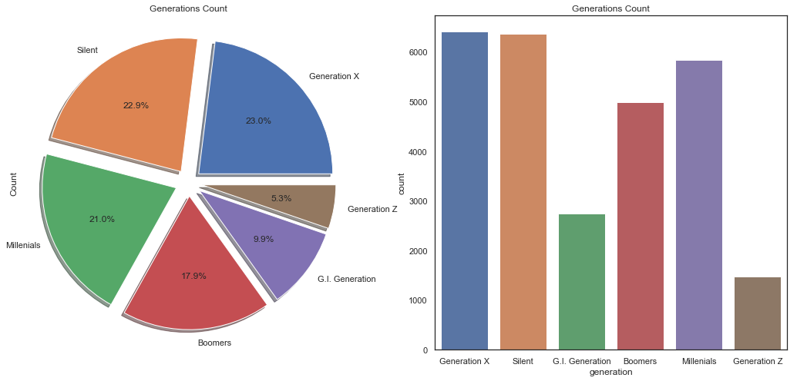
Generation Analysis
Conclusion
Generation X, Silent, and Millennials make up 66.9% of the total suicides. Generation Z is under 18 years old.
Next Steps
Why is Generation GI suicide rate so low, is it because they avoided debt, had strong loyalty, or was it not documented?

Slide 8


Slide 9
Questions?

