Slide 1

Economics Data
Team 3: RuiMing Liu, Jamal McCall, Kelly Schillaci, Thomas C. McDaniel III

Slide 2
Agenda
About Zillow
Project Goals
Data Overview
Texas Overview
Dallas Deep Dive

Slide 3
Zillow
Dedicated to empowering consumers with data, inspiration and knowledge around the place they call home, and connecting them with the best local professionals who can help.
Zillow serves the full lifecycle of owning and living in a home: buying, selling, renting, financing, remodeling and more.
Zillow's living database contains more than 110 million U.S. homes - including homes for sale, homes for rent and homes not currently on the market, as well as Zestimate home values, Rent Zestimates and other home-related information.
Zillow operates the most popular suite of mobile real estate apps, with more than two dozen apps across all major platforms.
Zillow launched in 2006 and is headquartered in Seattle.

Slide 4
Project Goal
What are the best investments for a developer within a given area?
Clustering Analysis
Growth Trends
Recommendation for Investors

Slide 5
About the Data
The original data is time series data with prices (list and sale) from 1996 to 2017 in the Unites States from Kaggle. The data consists of the type of house, geographic locations (zip, region and state), inventory status, and prices.
Key Variables from Data
MedianRentalPrice, MedianSoldPrice, ZHVI, ZRI
Notes:
ZHVI: A smoothed seasonally adjusted measure of the median estimated home value across a given region and housing type
ZRI: A smoothed seasonally adjusted measure of the median estimated market rate rent across a given region and housing type

Slide 6
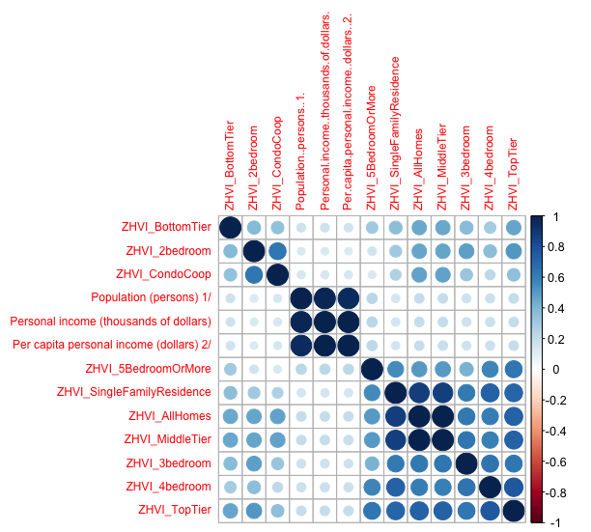
About the Data
To provide more context, we added GDP and personal income data to our existing real estate data.
The Correlation table shows the only correlation within our data set existing within the home tiers and economic markers.
There is no negative correlation within the data.

Slide 7
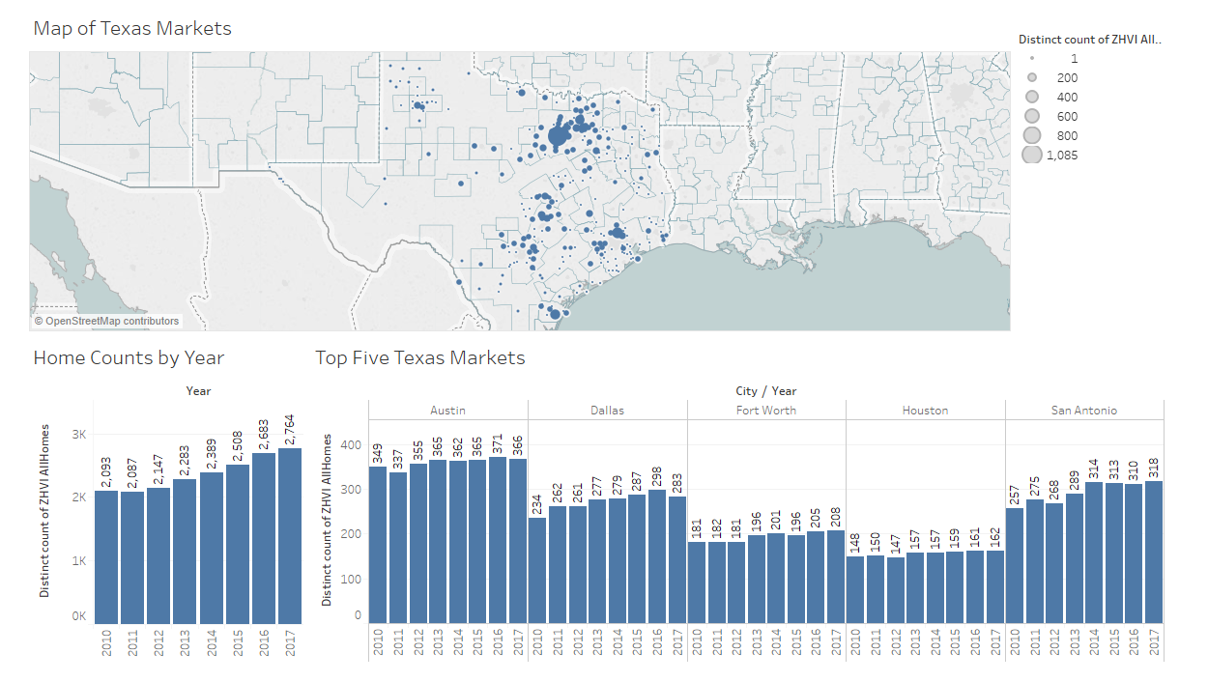
Texas Overview

Slide 8
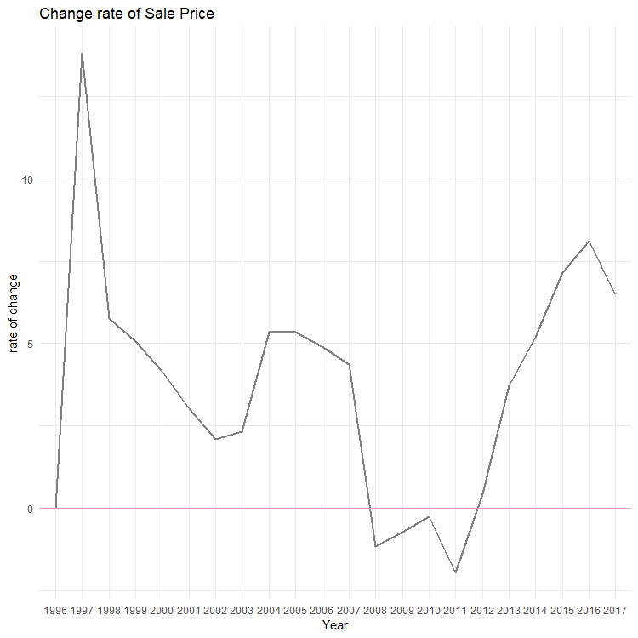
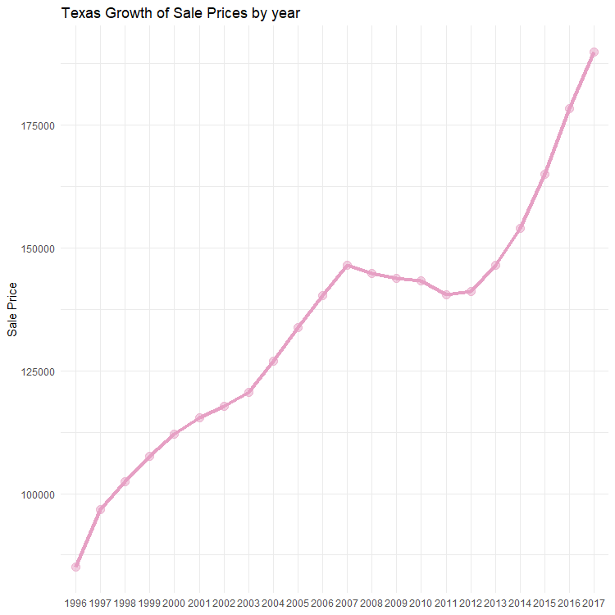
Texas Overview
Drop after 2007 after the housing market crashed for 4 years.
Rapid growth after 2012. More businesses are adding corporate offices in Austin and Dallas which is contributing to the growth.

Slide 9
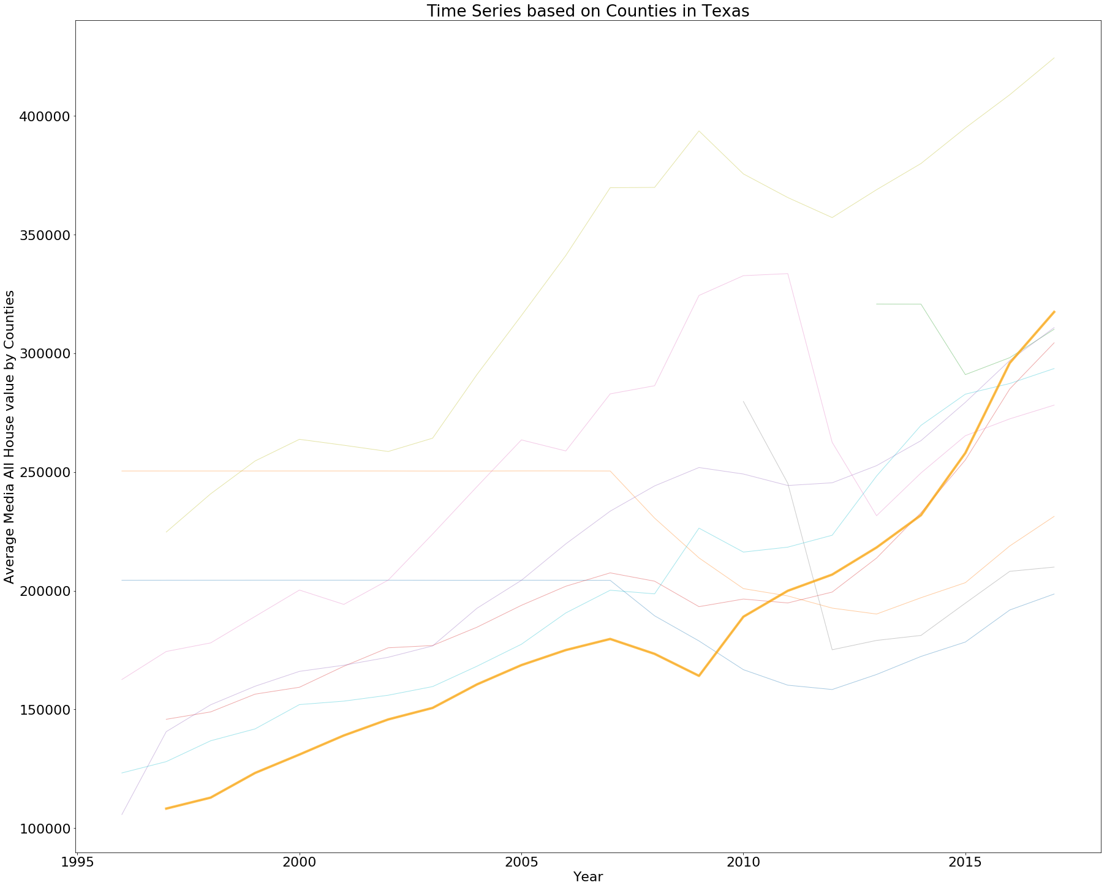
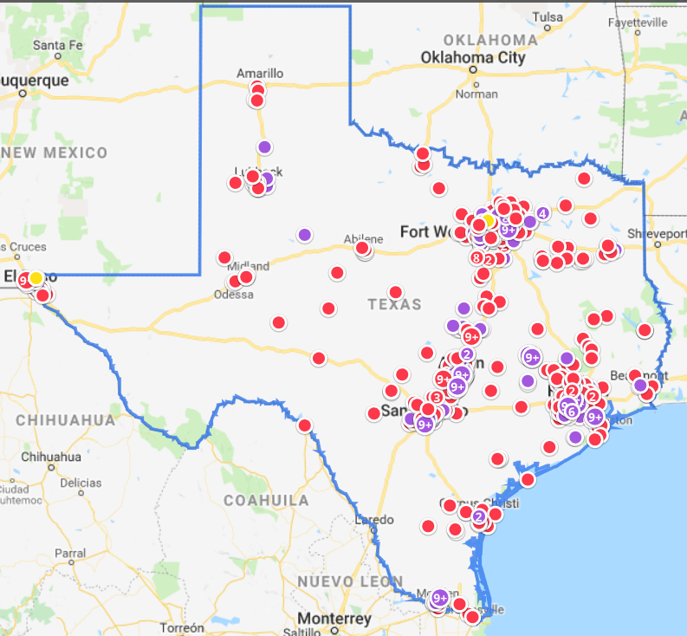
Texas Overview
Most Expensive Counties in Texas
Kendall
Blanco
Fort Bend
Travis
Bandera
Comal
Collin
Franklin
Montgomery
Aransas

Slide 10
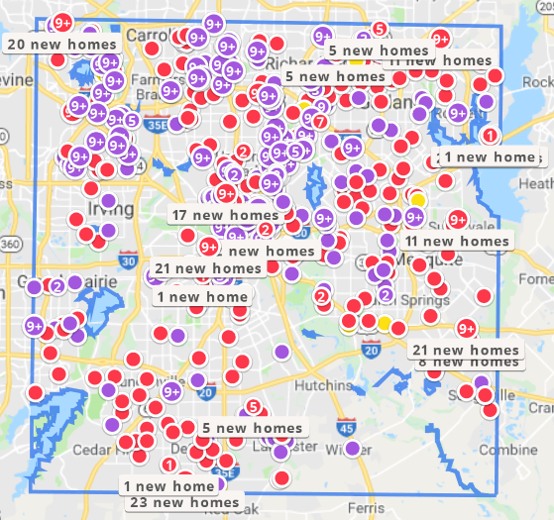
Dallas Deep Dive - Overview
Homes Available for Sale in Dallas

Slide 11
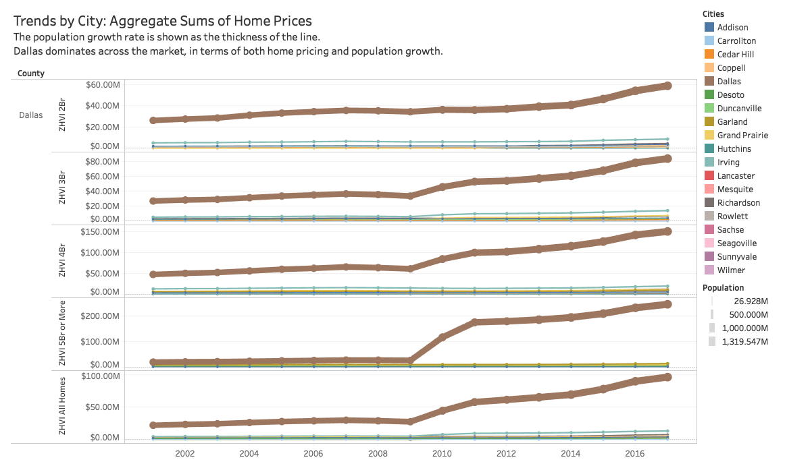
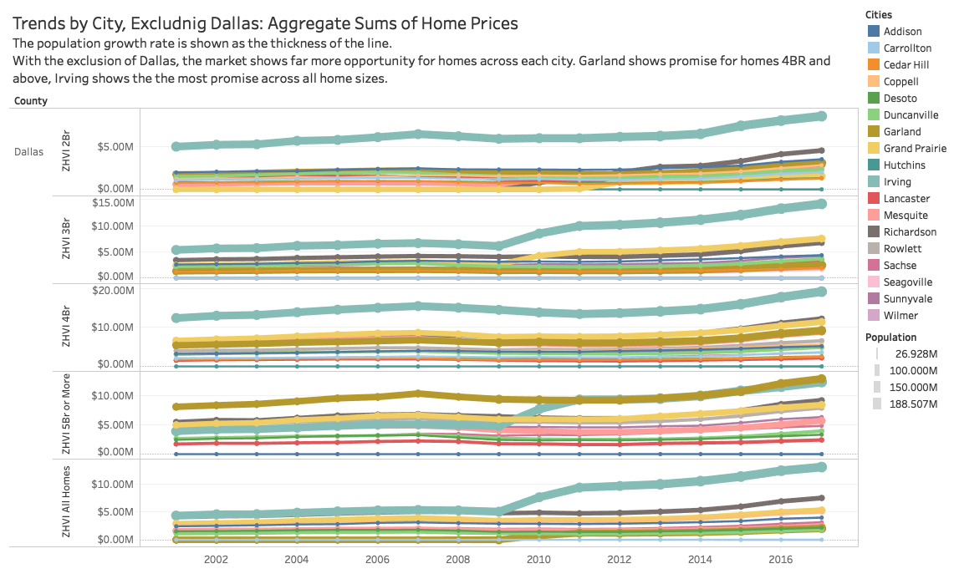
Dallas Deep Dive – Trends by City

Slide 12
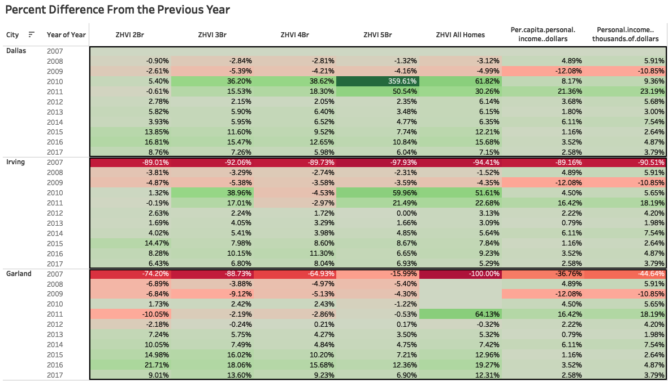
Dallas Deep Dive City Comparison

Slide 13
Dallas Deep Dive - Clustering
For clustering analysis, data from Dallas (the city), Irving, and Garland were used.
Cluster 1 has the highest year over year growth in all types of homes. The majority of Cluster 1 is in Dallas.
Recommendation: Investors should buy a 5 bedroom home in Dallas.

Slide 14
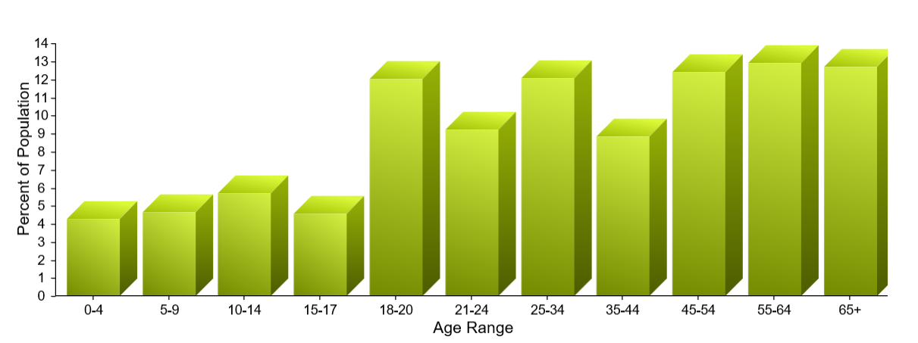
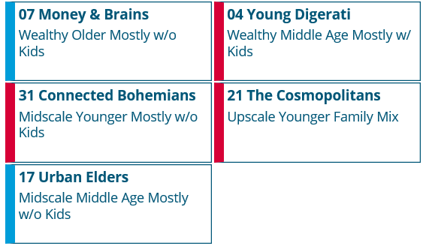
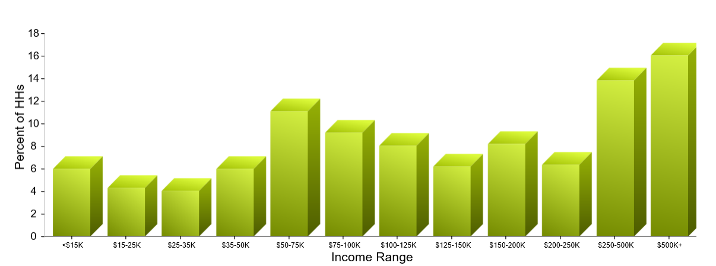
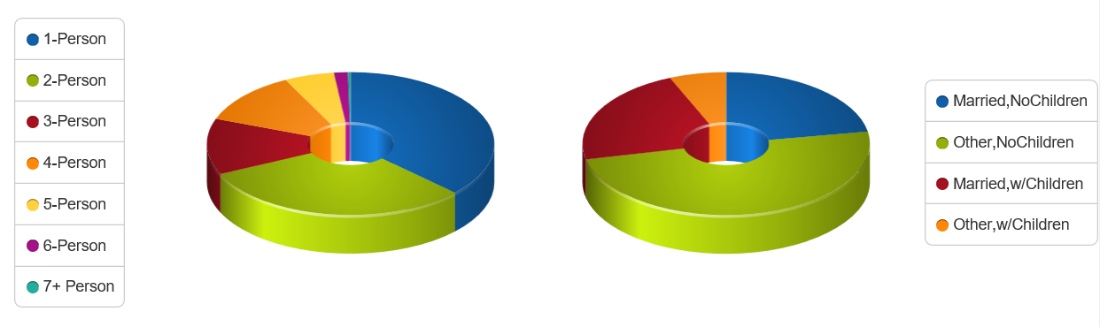
Dallas Deep Dive – Prizm Analysis 75205

Slide 15
Dallas Deep Dive Prizm Segments in Dallas
The residents of Money & Brains seem to have it all - high incomes, advanced degrees, and sophisticated tastes to match their credentials. Many of these city dwellers are married couples with few children who live in fashionable homes on small, manicured lots with expensive cars in the driveway
Young Digerati are tech-savvy and live in fashionable neighborhoods on the urban fringe. Affluent and highly educated, Young Digerati communities are typically filled with trendy apartments and condos, fitness clubs and clothing boutiques, casual restaurants and all types of bars, from juice to coffee to microbrew. Many have chosen to start families while remaining in an urban environment.
A collection of mobile urbanites, Connected Bohemians represent the nation's most liberal lifestyles. Its residents are a progressive mix of tech savvy, young singles, couples, and families ranging from students to professionals. In their funky row houses and apartments, Bohemian Mixers are the early adopters who are quick to check out the latest movie, nightclub, laptop, and microbrew.
Educated and upscale, The Cosmopolitans are urbane couples in America's fast-growing cities. Concentrated in major metro areas, these households feature older homeowners. A vibrant social scene surrounds their older homes and apartments, and residents love the nightlife and enjoy leisure-intensive lifestyles.
Urban Elders, a segment located in the downtown neighborhoods of such metros as New York, Chicago, Las Vegas, and Miami, are more likely to be renters than other households in their age cohort. They enjoy the cultural options available to them in their communities, frequently attending musical performances and other live events.

Slide 16

Dallas Deep Dive Investor Recommendations
The values of the homes are increasing at an exponential rate. y = 101352e^{0.0459x}
5 bedroom homes have the highest average growth rate
Target market to advertise to would be clients in the Money & Brains segment because they are likely to invest in large homes. They also have the income to spend on fashionable houses.

Slide 17
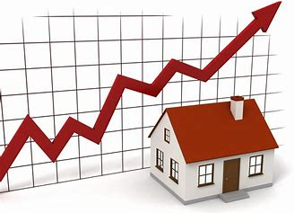
Next Steps
Additional data is needed to perform a better analysis
Number of bathrooms
Condition of home
Age of home, siding, roof, etc.
Square footage
Type and Style of Home
Lot Size
Additional Data can be obtained from:
Zillow Home Value Forecast
Zillow Rent Forecast
Negative Equity (the share of mortgaged properties worth less than mortgage balance)
Zillow Home Price Expectations Survey
Zillow Housing Aspirations Report
Zillow Rising Sea Levels Research
Cash Buyers Time Series
Buy vs. Rent Breakeven Horizon
Mortgage Affordability, Rental Affordability, Price-to-Income Ratio
Conventional 30-year Fixed Mortgage Rate, Weekly Time Series
Jumbo 30-year Fixed Mortgage Rates, Weekly Time Series
Notes:
Regression struggles

Slide 18
Questions?

