Slide 1
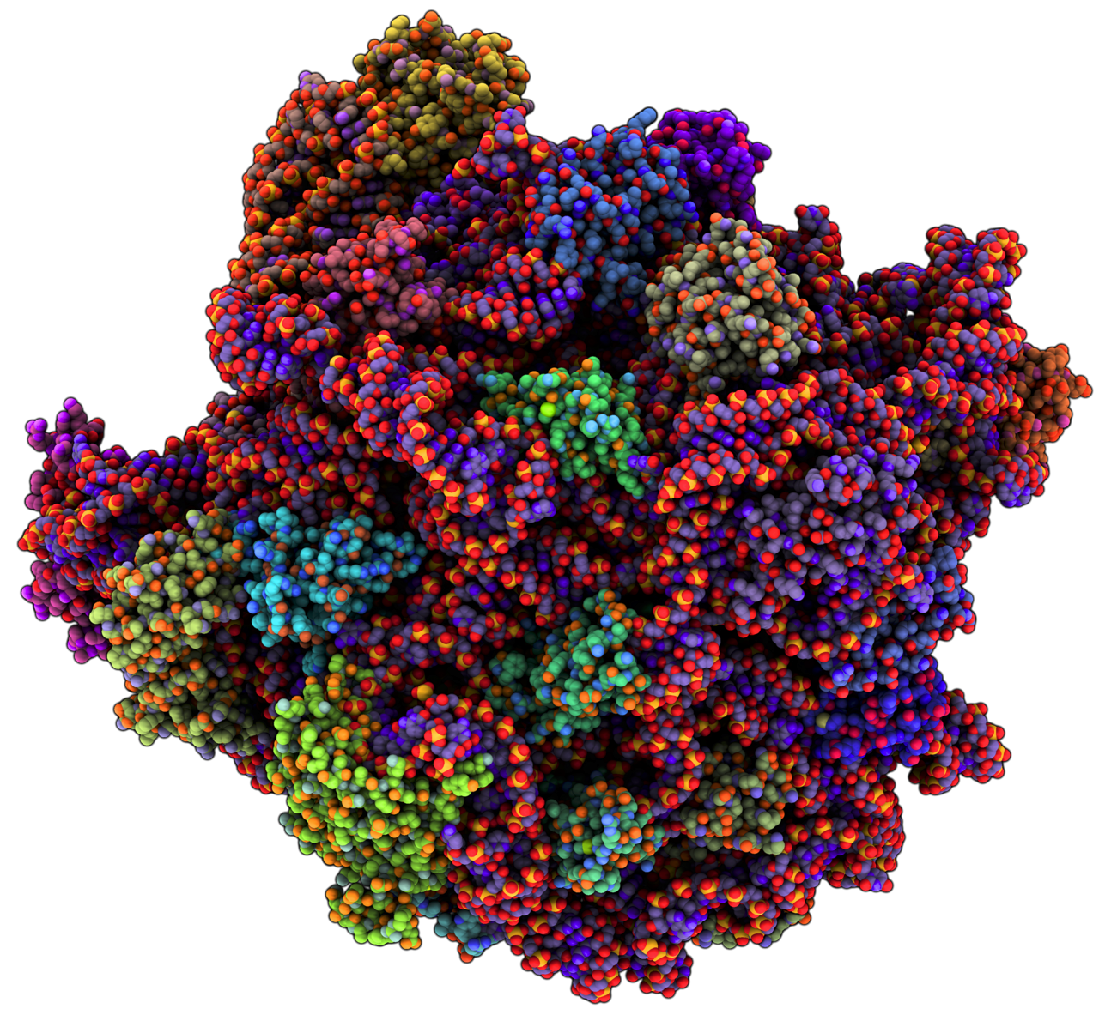
Background
Notes:
-Project title: Classification of snoRNA Types Using Classification Relevance Unit Machines
-pic of ribosome, primary use of the rRNA with modifications performed by the snoRNP snoRNA associates with

Slide 2
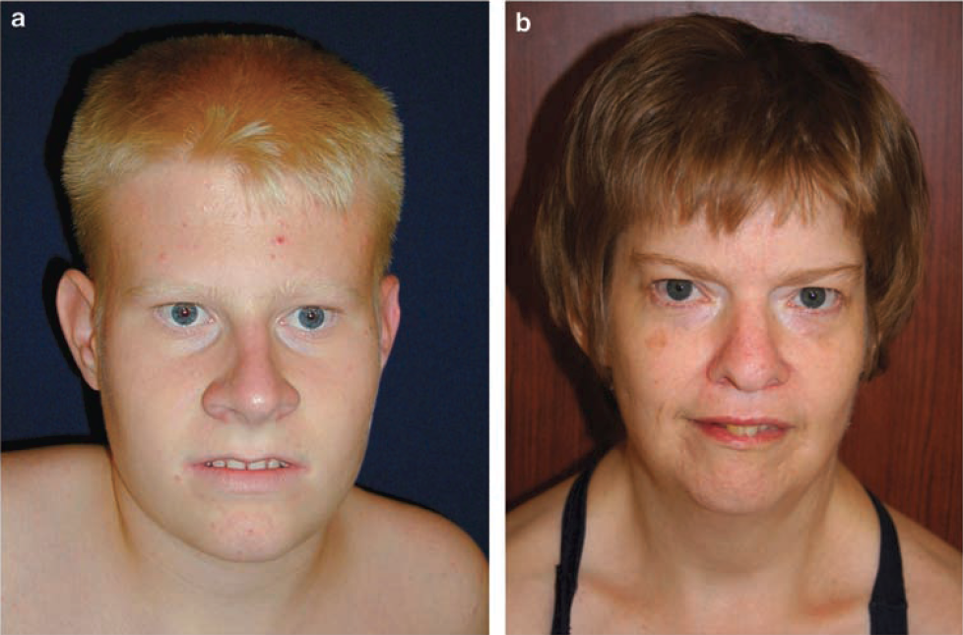
Background
Prader-Willi Syndrome
Skryabin BV et al 2007
Notes:
Importance of snoRNA?
Loss of snoRNA:
-Prader willi: 7 gene deletion on the chr14 in humans
-retardation, infertility exaggerated brow features
Duplication of snoRNA genes:
-Possibly a cofactor in autism

Slide 3
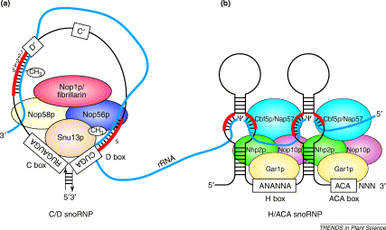
Background
John W.S Brown et al 2002
Notes:
-Cartoon of the protien/rna complexes formed with snoRNA when in snoRNP
-4 protien complex associates, 2x on HACA 1 on CD
-NOTE BINDING SITES AT MOTIFS! It's why they are so well conserved across species
Modifications
HACA rnp = psudeouryildilation
C/D rnp = methylation
Post transcriptional modifcation of rRNA can increase its longevity in the cell against endogenous rnases

Slide 4
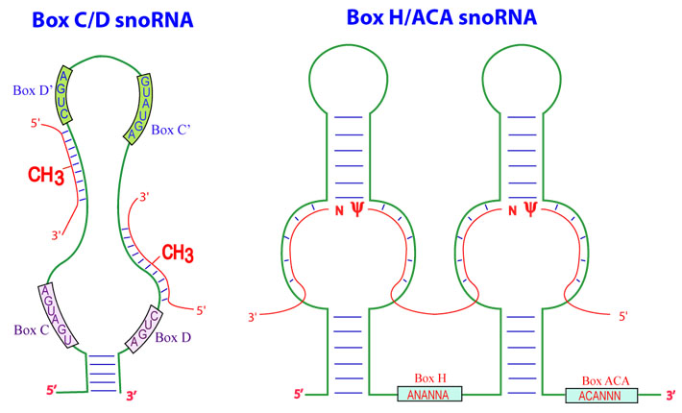
Background
Cbox: RUGAUGA Dbox: CUGA
Hbox: ANANNA
Tail: ACA
Source: http://biochem.ncsu.edu
Notes:
Talk about folding of 1D strands
stem v loop v dangling
-base ambiguity: R = purines A or G
Modifications
HACA rnp = psudeouryildilation
C/D rnp = methylation

Slide 5
Folding HACA Motif Example
VS
Notes:
Folding of 1D strand
Top: HACA
-2 loops
Bottom: random DNA seq
-5 loops
Talk about dot paren notation for folding
-Pre supplied structure motifs for folding
-Results ideal, not typical. Needs work.

Slide 6
Background
Cbox: RUGAUGA Dbox: CUGA
Hbox: ANANNA
Tail: ACA
Source: http://biochem.ncsu.edu
Notes:
Talk about basic 1D motif frequency features
-base ambiguity: R = purines A or G
Modifications
HACA rnp = psudeouryildilation
C/D rnp = methylation

Slide 7
1D Motifs as a Feature
Hbox | + | -
AGAGAA | 76 | 27
AGAGCA | 65 | 25
AAAGCA | 65 | 21
AGAGGA | 63 | 28
AGAGUA | 61 | 17
AUAGAA | 61 | 17
ACAGCA | 58 | 24
ACAGAA | 53 | 28
AGAUUA | 51 | 28
Cbox | + | -
AUGAUGA | 366 | 10
GUGAUGA | 238 | 37
CUGAUGA | 92 | 24
UUGAUGA | 84 | 28
CUGAAGA | 70 | 23
AUGAUGU | 57 | 7
CUGAUGC | 57 | 12
AUGAAGA | 45 | 10
AUGAUGG | 43 | 19
Notes:
Top 10 frequency of motifs between classes
Neg class is the opposing class, not random dna
Old feature generation method for demonstation
Talk about kmers, sliding window frequencies etc.

Slide 8
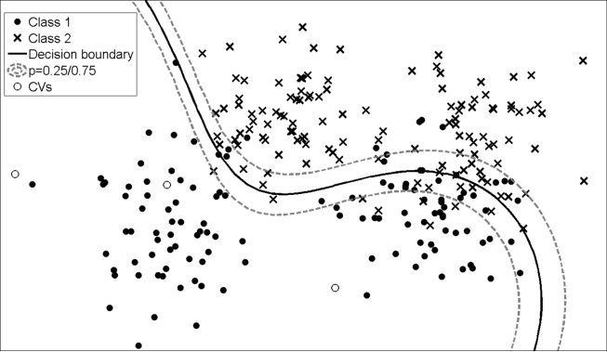
Methods
Kernel Methods
SVM
CRUM
Notes:
CRUM v SVM
Crum:
-Probalistic (not hard decisions)
-sparser kernels than SVM (faster classification)
SVM:
-need to compare the 2 for project
-faster training but generates more support vectors
-(6x more)
-requires cross validation of decisions because of nonprobalistic nautre, computationally slower

Slide 9
Objectives
Crossfold validation of current snoRNA CRUM
Add folding data as a feature for crum
Rewrite crum training program
Compare crum-snoRNA classifier with existing methods
Create web interface for easy DNA/RNA feature selection so users can generate their own models
Notes:
10 fold cross validation
Haca:
TrainErr =%6.6
TestErr = %8.69
CD:
TrainErr =%10.47
TestErr =%13.58
For k=5

Slide 10
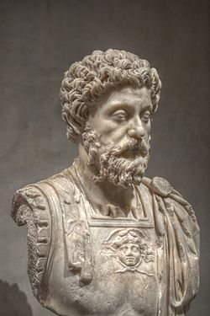
Questions?
The secret of all victory lies in the organization of the non-obvious.
-Marcus Aurelius

