Slide 1
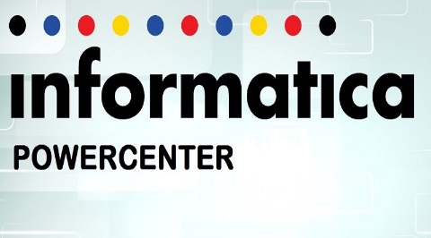
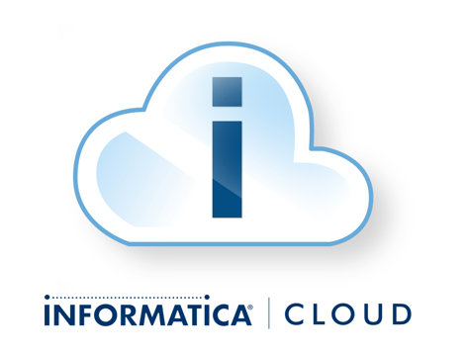
Informatica PowerCenter
Vs
Informatica Cloud

Slide 2
ETL in PowerCenter – An Overview
Extract - The ability to consistently and reliably extract data with high performance and minimal impact to source system
Transform - The ability to transform one or more data sets in batch or real-time into a consumable format
Loading - Loading data into a persistent or virtual data store

Slide 3
Informatica PowerCenter
It is a single, unified enterprise data integration platform that allows organizations of all sizes to access, discover and integrate data from any business system, in any format and deliver that data throughout the enterprise at any speed.
The main advantages of PowerCenter over other ETL tools lies in its robustness, for it can be used in both Windows and Unix based systems.
PowerCenter can read from a variety of different sources and write to as many targets, while transforming data in between.

Slide 4
Informatica PowerCenter
The main advantages of PowerCenter over other ETL tools,
  It is robust, and can be used in both windows and UNIX based systems
  It is high performing yet very simple for developing, maintaining and administering
The architecture of Informatica PowerCenter (version 9.x onwards) is based on the Service Oriented Architecture (SOA) concept.
A Service Oriented Architecture (SOA) can be defined as a group of services, which communicate with each other. The process of communication involves either simple data passing or it could involve two or more services coordinating same activity.

Slide 5






















PowerCenter Architecture
Provider
(Sources)
Informatica PowerCenter
Consumer
(Targets)
Designer
Workflow Manager
Workflow Monitor
XML, Messaging & Web services
XML, Messaging & Web services
Packed Applications
Packed Applications
Repository
Repository Service
Relational & Flat Files
Relational & Flat Files
Integration Service
Web Services
Mainframe & Midrange
Mainframe & Midrange

Slide 6
Informatica PowerCenter
Informatica 9.X represents a major change in the architecture of the project line.
PowerCenter has two types of services;
  Application services represent server based functions including Repository and Integration Services.
  Core Services represent functions that manage and maintain the environment in which PowerCenter operates and include services like Log Service, Licensing Service and Domain Service amongst many others.
Aim: Its main aim is to provide improved performance and high availability.
Approach: By reengineering the underlying architecture has been made even more service-based.

Slide 7
The PowerCenter Services:
Repository service: The Repository service manages the repository. It retrieves, inserts and updates metadata into the repository database tables.
Integration service: the integration service runs sessions and workflows.
SAP BW sevice: The SAP BW service looks out for RFC requests from SAP BW and initiates workflows to extract data from, or load data into the SAP BW.
Web services hub; The web services hub receives requests from web service clients and exposes PowerCenter workflows as services.

Slide 8
PowerCenter Hierarchy
The hierarchy goes in this way,
  Transformation
  Mapping
  Sessions
  Workflow
Transformation is the process in ETL where we actually apply the business rules in the data flow
It is here that data cleansing and formatting activities are actually performed along with data validation, which is one of its main functionalitites
In PowerCenter, transformations are the functional components

Slide 9
Features of PowerCenter
Pushdown Optimization for SAP HANA:
The PowerCenter Integration Service can push transformation logic to SAP HANA sources and targets when the connection type is ODBC.
High Availability Persistence in a Database:
You can enable the PowerCenter Integration Service to store high availability persistence information in database tables
Single Administration console to Administrator all the application services

Slide 10
Informatica Cloud - Introduction
According to Gartner, Cloud computing is #1 Strategic Technology
It has many Business Applications
Informatica cloud works on many different platforms
IT Infrastructure is maintained such as Lower costs, Accelerate Projects and Elastic Capacity

Slide 11
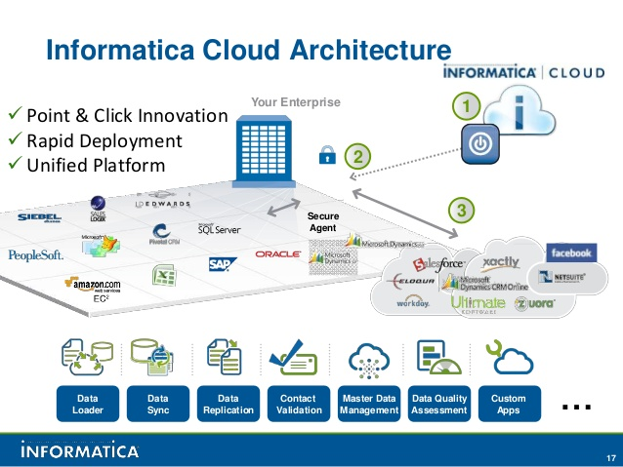
Informatica Cloud - Architecture

Slide 12
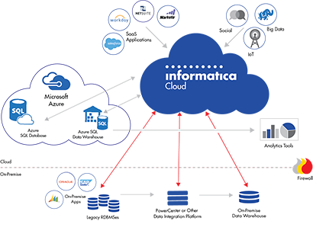
Without Data Integration , Cloud-based Systems Wont Provide The Value You Are Seeking.

Slide 13
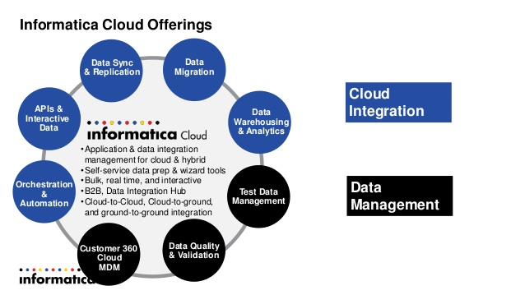
Informatica Cloud Offerings

Slide 14
Informatica Cloud Features
Data Migration
Data Synchronization
Data Monitoring
Data Replication
Data Warehousing and Analytics
Test Data Management
Data Quality
Data Validation
Cloud integration- GREEN
Data Management - BLUE

Slide 15
Informatica Cloud Application Integration
Enhanced attachments support for service connectors and the built in email service
Broader multi-protocol endpoints including REST API’s, JSON, SOAP
Increased connectivity to third party apps including FTP, AWS, SAP, etc.

Slide 16
Informatica Cloud Data Integration Hub
We can save time and costs through more efficient communication with SaaS apps
sync with each SaaS apps
Sync with SaaS app once and deliver data automatically to multiple consuming systems.

Slide 17
Advantages
Ease of Use and Maintenance
Rapid Deployment
Cost efficient
Scalable Architecture
Enterprise Functionality
Self-service
Broader adoption

Slide 18
Thank You

