Slide 1

Intro to Elm

Slide 2
About me
Mitchel
Frontend Dev @ teamweek.com (team planning software)
https://twitter.com/kelonye
https://github.com/kelonye
http://kelonye.com

Slide 3


Slide 4
What is Elm
Elm is a functional language that compiles to JavaScript.
Alternatives:
Babel
Typescript
Coffeescript

Slide 5
Why Elm?

Slide 6
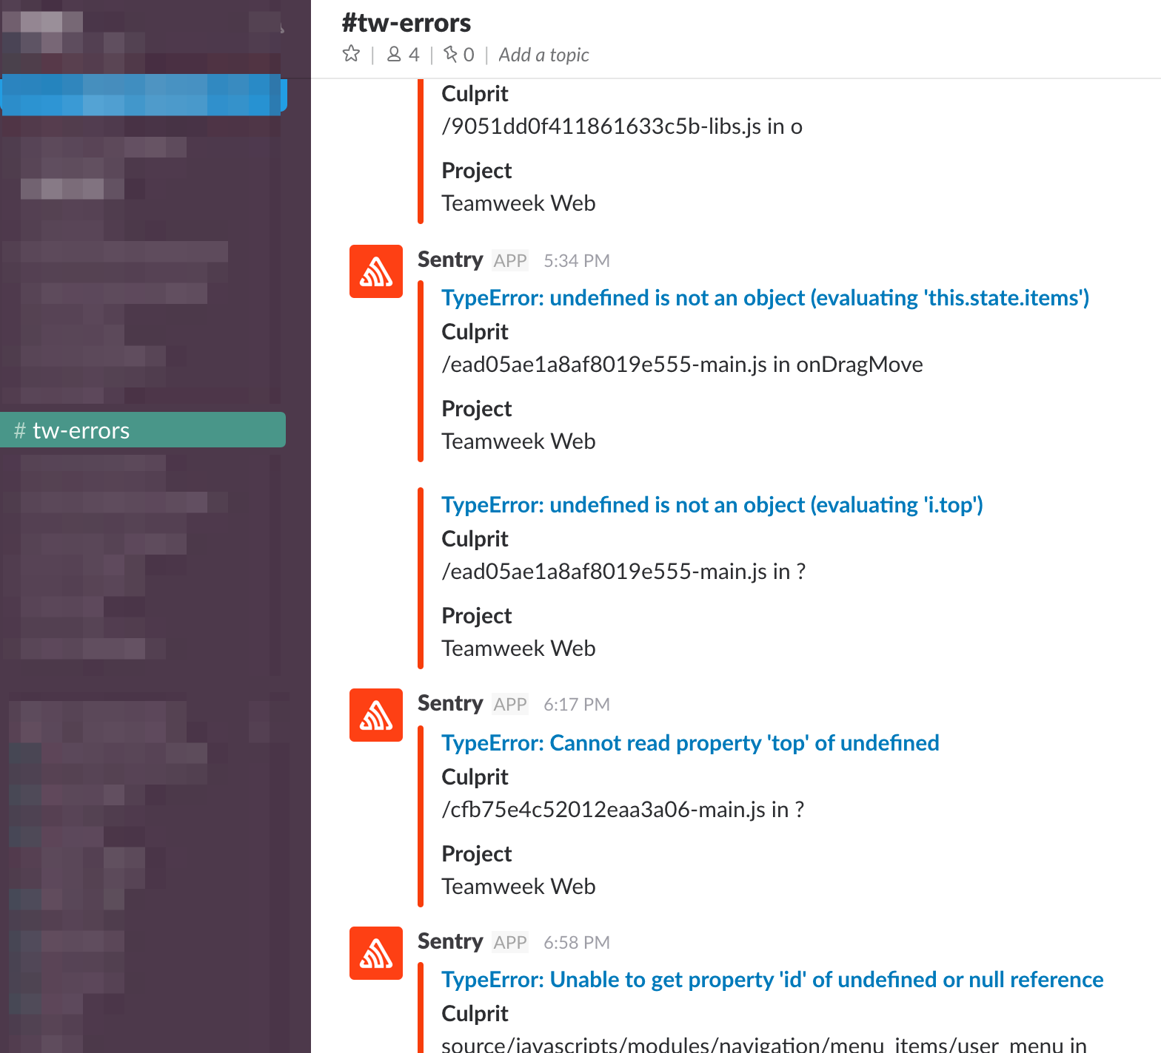
undefined is not a …

Slide 7
Elm features
Strong static types (string, int, float … less unit tests)
No runtime errors (no null or undefined in the language)
Immutability (redux)
Reactive
Elm: model(sate), view, update
React/Redux: react(view), redux (sate, update)

Slide 8
Values
Types
Immutable

Slide 9
Patterns (how do I build actual apps?)
HTML package - http://package.elm-lang.org/packages/elm-lang/html/latest/Html
Demos:
view
view, model, update
view, model, update, subscriptions

Slide 10
Resources
http://elm-lang.org/
http://elm-lang.org/docs/syntax
http://package.elm-lang.org/
https://www.reddit.com/r/elm/

