Slide 1
Apparent Competition
(Predator Mediated)

Slide 2
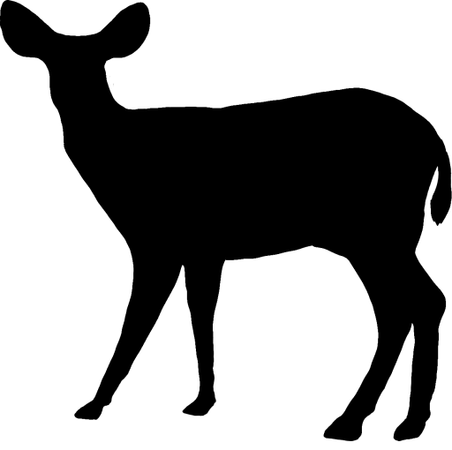

Competition
Consumption
Indirect Effect
Pictures from phylopic. Not to scale

Slide 3

Competition
Consumption
Indirect Effect
Pictures from phylopic. Not to scale

Slide 4
Competition
Consumption
Indirect Effect
Pictures from phylopic. Not to scale

Slide 5
What would convince you apparent competition:
Is happening?
Is not happening?
Fewer cougars
What’s up with other predators?
No change in cougar density

Slide 6
Coyotes:
What the heck could happen to them???

Slide 7

Pictures from phylopic. Definitely to scale
Competition
Consumption
Indirect Effect

Slide 8

Pictures from phylopic. Definitely to scale
Competition
Consumption
Indirect Effect

Slide 9
Pictures from phylopic. Definitely to scale
Competition
Consumption
Indirect Effect

Slide 10
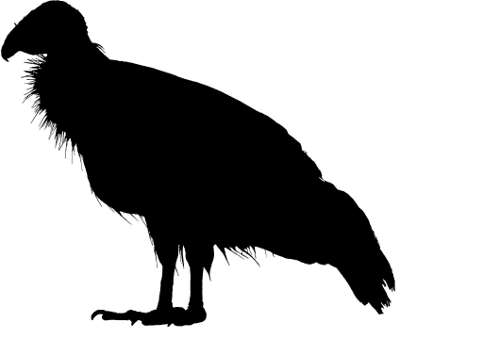
Pictures from phylopic. Definitely to scale
Competition
Consumption
Indirect Effect

Slide 11
Pictures from phylopic. Definitely to scale
Competition
Consumption
Indirect Effect

Slide 12
Pictures from phylopic. Definitely to scale
Competition
Consumption
Indirect Effect

Slide 13
Pictures from phylopic. Definitely to scale
Competition
Consumption
Indirect Effect

Slide 14
 |  | Carcasses Decrease |  | Carcasses Same
 |  | Prey Increase | Prey Same | Prey Increase | Prey Same
Cougars Competitors | Cougars Decrease
 | Cougars Same
Cougars Predators | Cougars Decrease
 | Cougars Same

Slide 15
 |  | Carcasses Decrease |  | Carcasses Same
 |  | Prey Increase | Prey Same | Prey Increase | Prey Same
Cougars Competitors | Cougars Decrease
 | Cougars Same
Cougars Predators | Cougars Decrease
 | Cougars Same

Slide 16
 |  | Carcasses Decrease |  | Carcasses Same
 |  | Prey Increase | Prey Same | Prey Increase | Prey Same
Cougars Competitors | Cougars Decrease
 | Cougars Same
Cougars Predators | Cougars Decrease
 | Cougars Same

Slide 17
 |  | Carcasses Decrease |  | Carcasses Same
 |  | Prey Increase | Prey Same | Prey Increase | Prey Same
Cougars Competitors | Cougars Decrease
 | Cougars Same
Cougars Predators | Cougars Decrease
 | Cougars Same | More coyotes killed – Unless they shift away from cougar space? | More coyotes killed

Slide 18
 |  | Carcasses Decrease |  | Carcasses Same
 |  | Prey Increase | Prey Same | Prey Increase | Prey Same
Cougars Competitors | Cougars Decrease
 | Cougars Same |  |  | Same pressures, more options – Shift in space use?
Cougars Predators | Cougars Decrease
 | Cougars Same | More coyotes killed – Unless they shift away from cougar space? | More coyotes killed | Same Pressures, more options – Shift in space use?

Slide 19
 |  | Carcasses Decrease |  | Carcasses Same
 |  | Prey Increase | Prey Same | Prey Increase | Prey Same
Cougars Competitors | Cougars Decrease
 | Cougars Same |  |  | Same pressures, more options – Shift in space use?
Cougars Predators | Cougars Decrease
 | Cougars Same | More coyotes killed – Unless they shift away from cougar space? | More coyotes killed | Same Pressures, more options – Shift in space use?

Slide 20
So anyway. That’s horrible. Sorry.

Slide 21
So anyway. That’s horrible. Sorry. New approach:

Slide 22
So anyway. That’s horrible. Sorry. New approach:
Each hypothesis approached independently
Each hypothesis can only be tested given certain conditions

Slide 23
Elk – Lagomorph Exploitation Competition
IF lagomorphs are resource limited
AND coyotes are food limited
Lagomorph abundance increases relative to outside the fence
Coyotes shift diet/space use toward lagomorphs

Slide 24
Cougar – Coyote Interference Competition
IF cougar density decreases
AND coyotes are limited by competition
Coyote abundance increases
Mesocarnivore Release

Slide 25
Cougars predate coyotes
IF cougars stay in Starkey
AND ungulate prey is limited
Cougars prey switch and eat more coyotes
Probably compensatory
Small sample size?
Coyote specialist

Slide 26
Cougars Provision Coyotes
IF cougar-provided carcasses decrease
Coyote diet, space use, or density adjusts

