Slide 1
Cities
- Las Vegas, NV
- Reno, NV
- Salt Lake City, UT
- Boise, ID
- Seattle, WA
- Los Angeles, CA
- San Francisco, CA

Slide 2
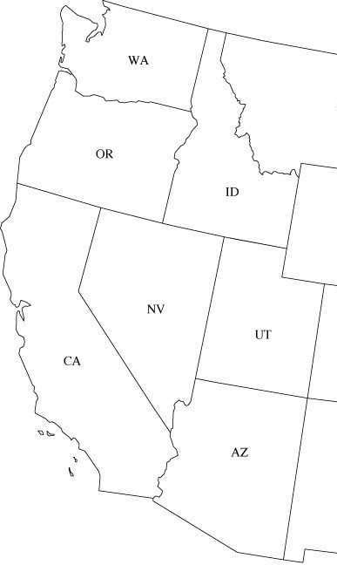
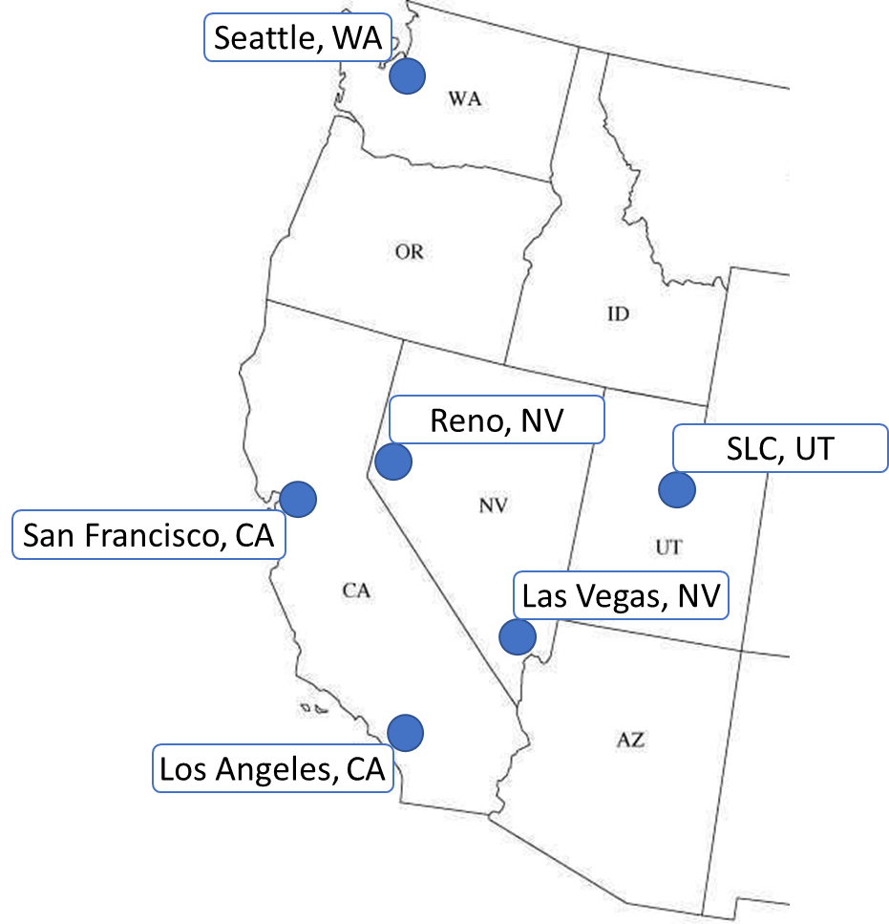
Seattle, WA
Reno, NV
SLC, UT
San Francisco, CA
Las Vegas, NV
Los Angeles, CA

Slide 3
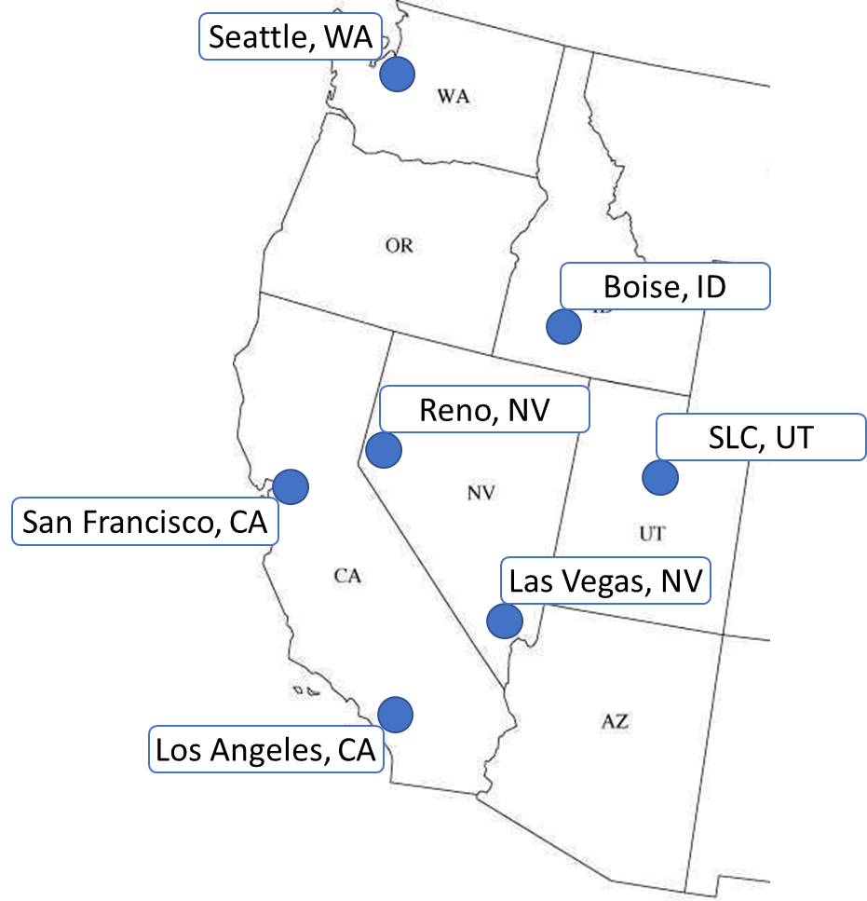
Populations
Las Vegas = 1
634,773
SLC = 2
197,756
LA = 3
3,967,000
SF = 4
874,961
Reno = 5
246,500
Seattle = 6
724,305

Slide 4
Las Vegas = 1
SLC = 2
LA = 3
SF = 4
Reno = 5
Seattle = 6
6
11
9
12
10
8
7
15
5
4
16
6
5
2
4
13
3
1
14
2
3
1

Slide 5
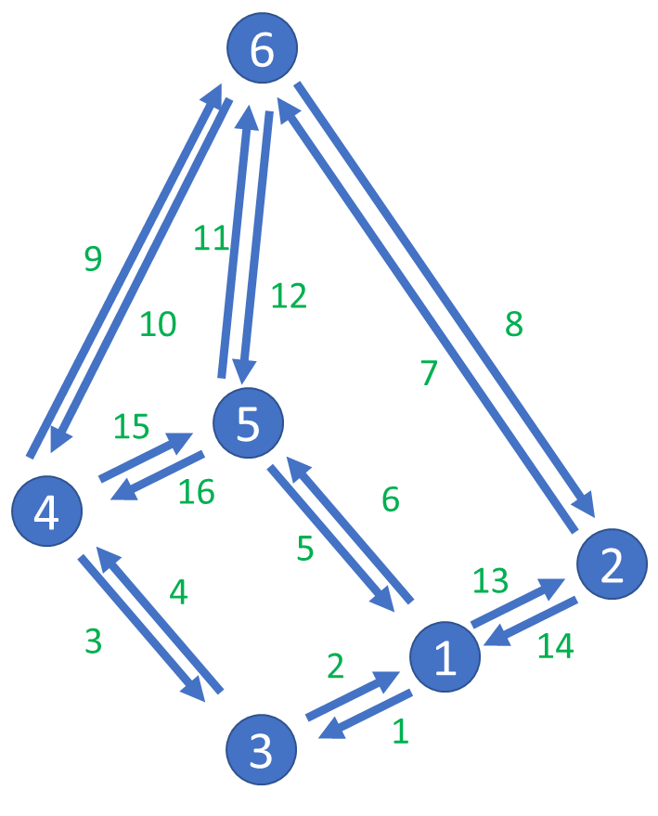
Point-to-Point Costs (Time – Hr:Min)
SEA – SF (SF – SEA)
2:05, 2:05
SEA – Reno
1:40, 1:50
SEA – SLC
1:55, 2:10
Reno – SF
1:15, 1:00
Reno – LV
1:10, 1:20
LA – LV
1:05, 1:05
SLC – LV
1:20, 1:15
LA – SF
1:20, 1:20
Las Vegas = 1
SLC = 2
LA = 3
SF = 4
Reno = 5
Seattle = 6

Slide 6
Las Vegas = 1
SLC = 2
LA = 3
SF = 4
Reno = 5
Seattle = 6
6
8
7
5
6
4
4
5
9
2
3
1
10
2
3
1

Slide 7
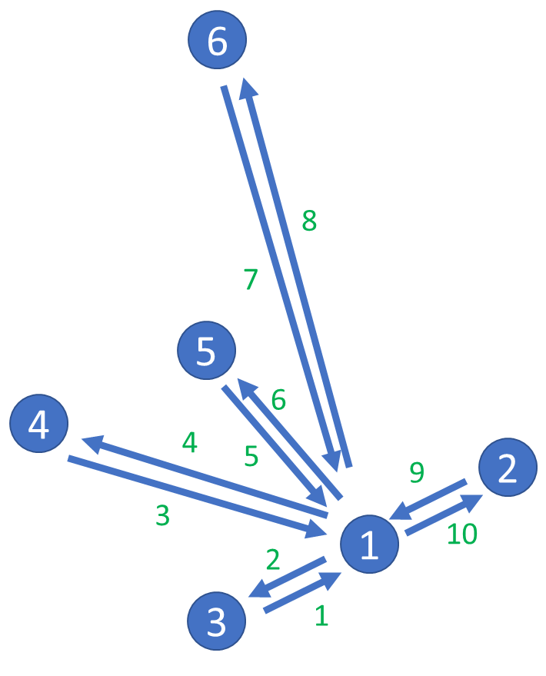
Hub-and-spoke Costs (Time – Hr:Min)
SEA – LV (LV – SEA)
2:20, 2:30
LA – LV
1:05, 1:05
SF – LV
1:25, 1:25
SLC – LV
1:20, 1:15
Reno – LV
1:10, 1:20
Las Vegas = 1
SLC = 2
LA = 3
SF = 4
Reno = 5
Boise = 6
Seattle = 7

