Slide 1
Cities
- Las Vegas, NV
- Reno, NV
- Salt Lake City, UT
- Boise, ID
- Seattle, WA
- Los Angeles, CA
- San Francisco, CA

Slide 2
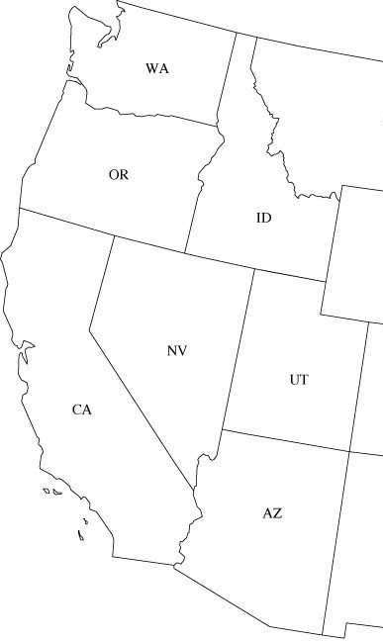
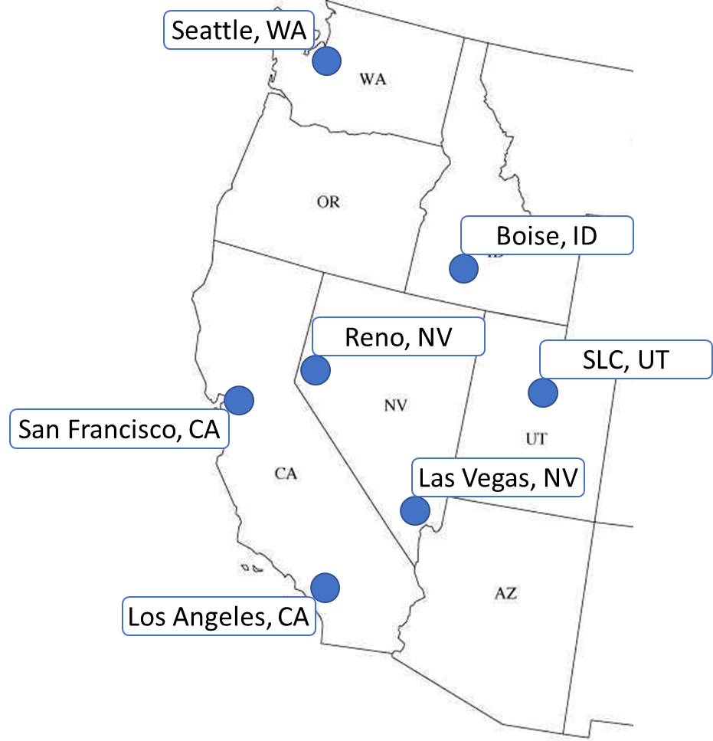
Seattle, WA
Boise, ID
Reno, NV
SLC, UT
San Francisco, CA
Las Vegas, NV
Los Angeles, CA

Slide 3
Las Vegas = 1
SLC = 2
LA = 3
SF = 4
Reno = 5
Boise = 6
Seattle = 7
7
6
5
4
2
1
3

Slide 4
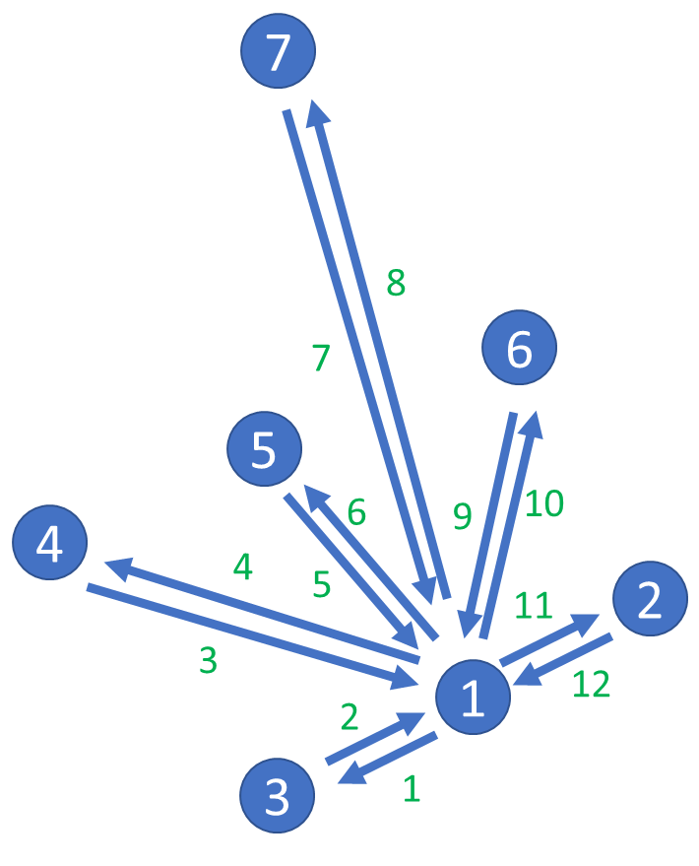
Las Vegas = 1
SLC = 2
LA = 3
SF = 4
Reno = 5
Boise = 6
Seattle = 7
7
8
7
6
5
6
9
10
4
4
5
11
2
3
1
12
2
3
1

Slide 5
Hub-and-spoke Costs (Time – Hr:Min)
SEA – LV
2:20, 2:30
LA – LV
1:05, 1:05
SF – LV
1:25, 1:25
SLC – LV
1:20, 1:15
Reno – LV
1:10, 1:20
Boise – LV
1:40, 1:40

