Slide 1
Practical Machine Learning

Slide 2
About me:
From WebShar India Pvt. Ltd.
Working with US-based client Health Fidelity with the focus of delivering NLP and analytics solutions for US healthcare system.
3.8 years of experience
2 years Full Stack Developer + 1.8 years (Data Engineer + Data Scientist)

Slide 3
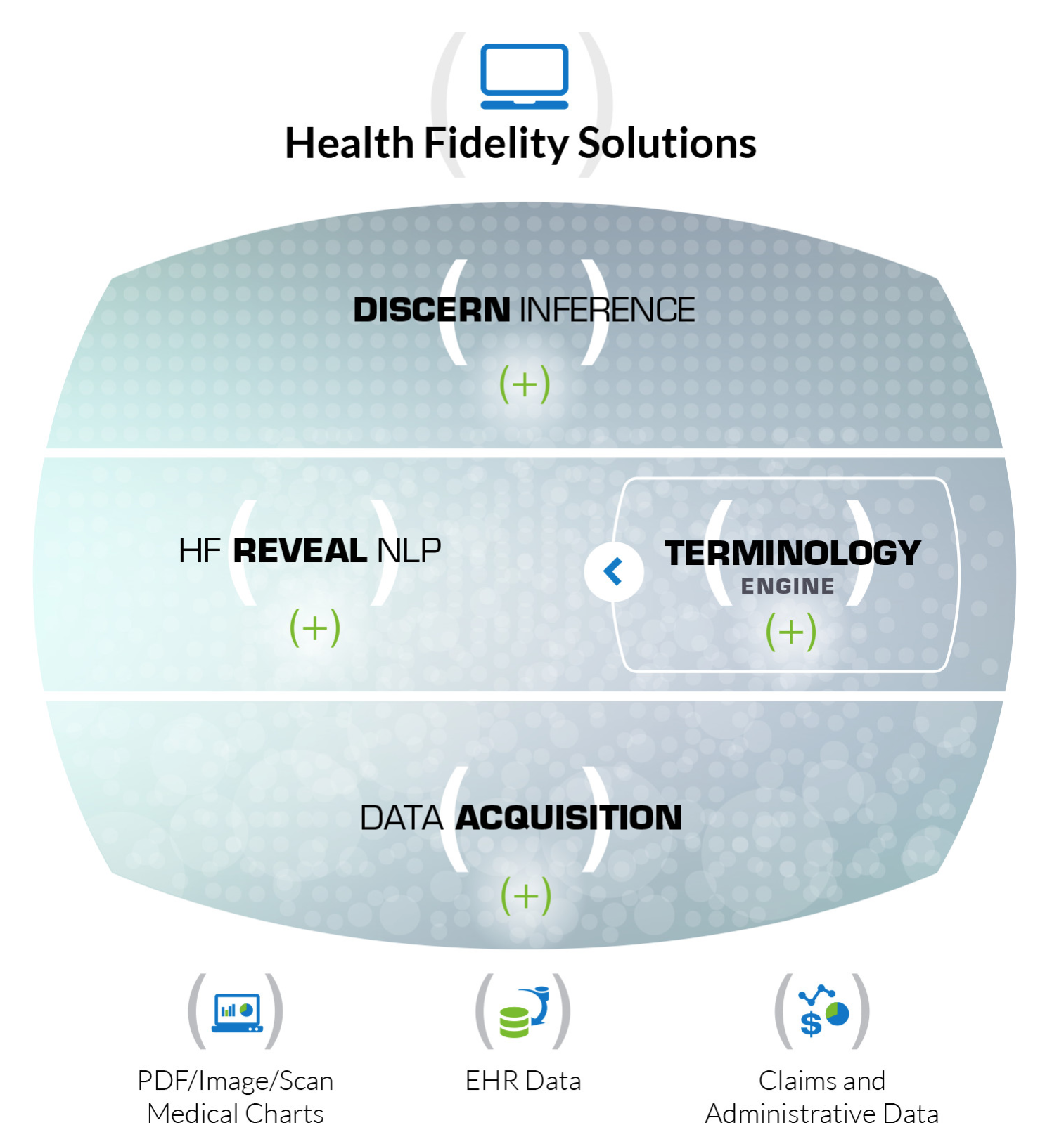

Slide 4
Agenda
Introduction to Machine Learning
Processes followed in our industry to create and validate machine learning models
With the help of popular libraries like,
NumPy
Pandas
Scikit-learn
Ipython notebook

Slide 5
What is Machine Learning
Machine Learning is the sub-field of Computer Science which gives Computer ability to learn a task without it being explicitly programmed
- Arthur Samuel

Slide 6
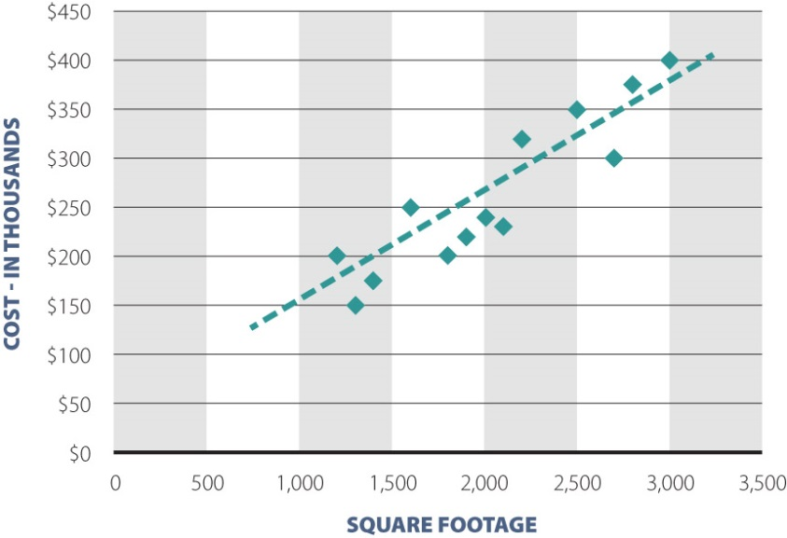

Example of Machine Learning from Data
$$y=mx+c$$

Slide 7
What is Machine Learning
A computer program is said to Learn from experience E, with respect to some class of tasks T, and performance measure P, if its performance at tasks in T, as measured by P, improves with the experience E.
Example: Digit recognition (classification)
Task (T): recognizing and classifying handwritten digits within images
Performance Measure (P): percent of digits correctly classified
Training experience (E): a database of handwritten digits with given classification

Slide 8
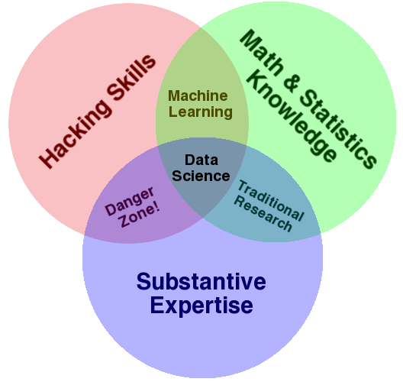
Where it fits in data science specific skills

Slide 9
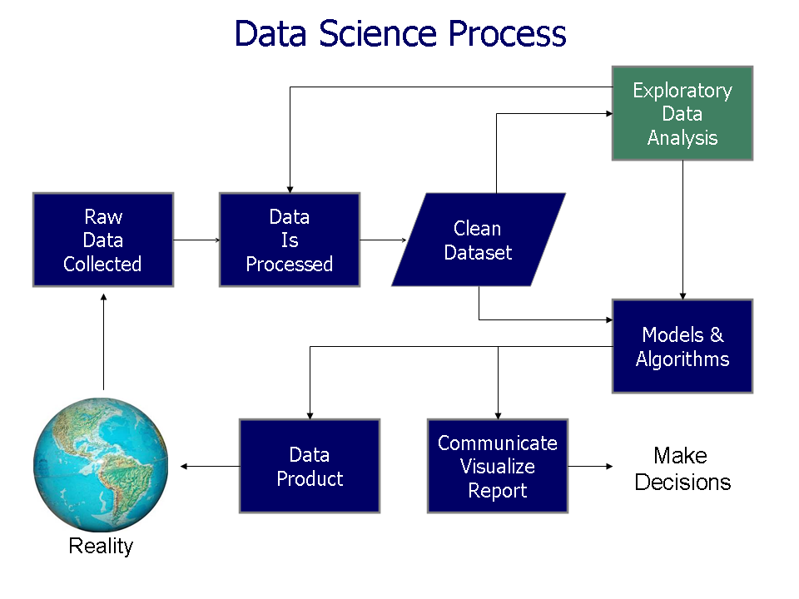
Where it fits in typical Data Science process

Slide 10
Data analysis process
Question
Communicate
Wrangle
Explore
Build Machine Learning Model
Data acquisition
Notes:
Wrangling and data exploration are intertwined
Also acquired data set can pose new questions.

Slide 11
Question Phase
E.g.: Classifying patients on various risk levels (classes) based on past medical history.

Slide 12
Data Modeling
Machine Learning
Supervised learning
Regression: Given various attributes for a house, predict its price
Classification: Given a patient with a tumor, we have to predict whether the tumor is malignant or benign.
Unsupervised learning
Clustering: Clustering news article based on topics like politics, economics, sports etc.
Non-clustering: Separating voices from a chaotic environment (cocktail party problem)
Reinforcement learning

Slide 13
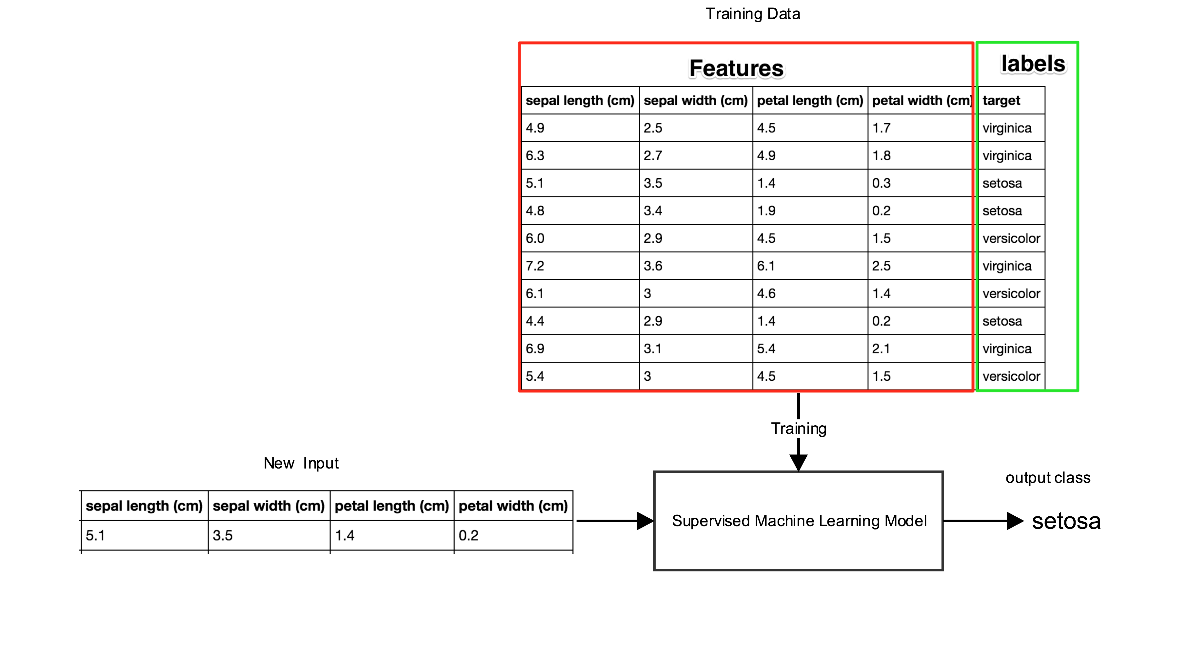
Supervised Learning (classification)

Slide 14
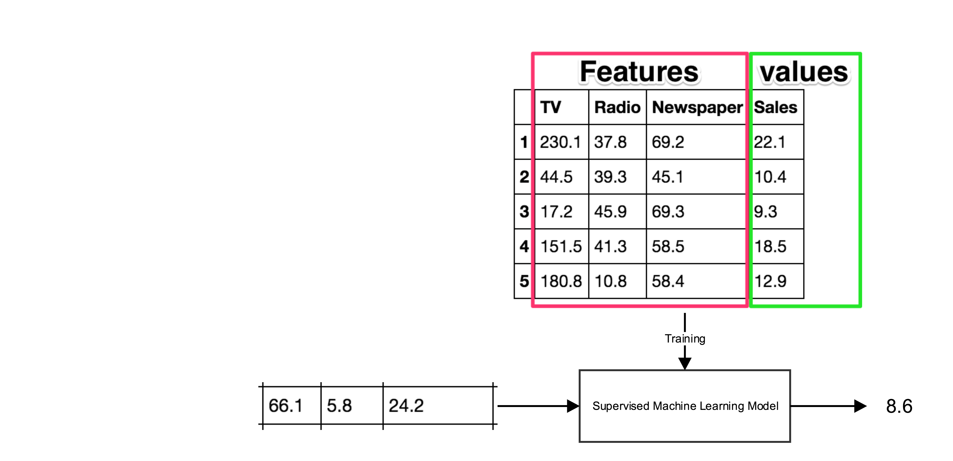
Supervised Learning (Regression)

Slide 15
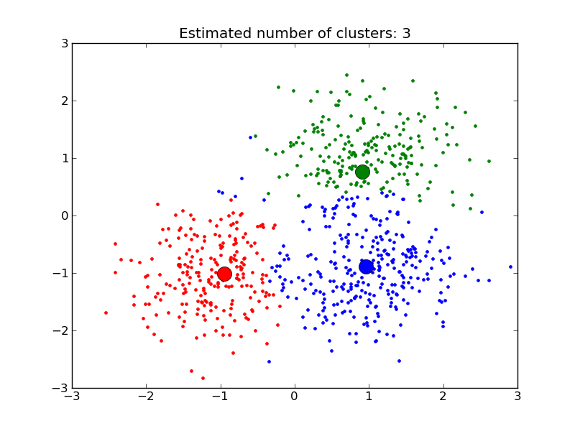
Unsupervised Learning (clusterization)

Slide 16
Demo

Slide 17
Model Validation
Precision, Recall, Support
K-Fold cross validation

Slide 18
Conclusion and Communication
Validate the designed model
Communicate the result
Incorporate the model into final product

Slide 19
Data Wrangling (Refer: Udacity Course)
Data acquisition
Get the relevant data which will help you to solve your problem
Data cleaning
Sanity checking
Addressing missing values

Slide 20
Data Acquisition
Can be acquired from various sources
FTP/SFTP
Scraping webpages (ESPN: Batting average data)
Databases
API (Twitter API)
Can be of various formats
CSV
JSON
XML

Slide 21
Data Cleaning
Missing values
System errors preventing the data to get acquired incorrectly
Unavailable attribute values
Non Response
Problems with missing values
Missing values can lead to false conclusion
It's ok to have random missing values. But systematic missing values are harmful

Slide 22
Data Cleaning (Contd.)
Addressing missing values
Partial deletion
Impution
Mean calculation
Linear Regression

Slide 23
Data Structure Libraries (Refer relevant notebooks files)
NumPy
Powerful n-dimentional array object data sctructure
Utility functions to work with this data structure
Useful linear algebra, Fourier transform, and random number capabilities
Pandas
Written on the top of NumPy
Series as basic data structure
Provides human friendly data analysis tools
Statistics
SQL like operation: groupby, merge & join
Plotting and Charting
Data cleaning abilities

Slide 24
References
Udacity courses
https://classroom.udacity.com/courses/ud170
https://classroom.udacity.com/courses/ud359
Dataschool ( http://www.dataschool.io/ )
Scikit-learn documentation

Slide 25
Useful resources
Questions
Google
Stack overflow
Library documentation
even the in-built documentation in IDE
Online courses
Udacity
Coursera
Dataschool
Competitions
Kaggle
Books
Introduction to Machine Learning with Python

Slide 26
Resources to get started with ML
Machine Learning Reads
Top-down learning path: Machine Learning for Software Engineers
A Guide to Deep Learning
Python Data Science Handbook

Slide 27
Thank You ☺

