Slide 1

Portfolio Milestone Presentation
SUID: 768295784
Kelsey Johnson
03/18/2022

Slide 2
What is Data Science
Data science has become popular in recent years and many people perceive it to be the same as data analytics, but they are not
Data science is a field made of a combination of 3 areas of expertise: Computer Programming, Statistics and Business Knowledge
A popular approach to performing data analysis is OSEMiN (O’Neil & Schutt 2013)
Many classes followed this pattern and often expanded on it by formulating a problem in the beginning and providing recommendations
Notes:
The main difference is that data scientists are well versed in computer programming and machine learning whereas data analysts are not.
OSEMiN stands for Obtain, Scrub, Explore, Model-Intrepret

Slide 3
Why Data Science?
There are 7 main objectives for the ADS Graduate Program
Describe a broad overview of the major practice areas in data science
Collect and organize data
Identify patterns in data via visualization, statistical analysis, and data mining
Develop alternative strategies based on the data
Develop a plan of action to implement the business decisions derived from the analyses
Demonstrate communication skills regarding data and its analysis for managers, IT professionals, programmers’, statisticians, and other relevant professionals in their organization
Synthesize the ethical dimensions of data science practice (e.g., privacy)
These objectives are taught throughout each class
Notes:
In 2019 when I enrolled in the Applied Data Science program I was working as a Fraud Strategy Analyst and had the opportunity to help our model owners with documentation and to learn about our vendor models that we use to help predict and prevent fraud. Learning about models was very interesting to me and decided that as much as I was learning at work, I needed to learn the data science process in order to truly understand how the models were developed. So I decided to go back to school.

Slide 4
Project Background
5 projects will be used to demonstrate the Applied Data Science Program Objectives
In IST 659 Database Administration and Management, there was an overall project in which students were tasked with designing and implementing a database to solve a data management problem of their choice
In IST 718 Big Data, the final deliverable was a group project, and we were to specify our own research questions and then answer them
In IST 707 Data Analytics, we had another group project which contained specific requirements
In IST 772 Quantitative Reasoning, I had a final test based on 3 provided datasets
In MBC 638, I had a final project based on any problem I wanted to solve that had accessible data and could have a solution implemented
Notes:
My database was built to store information related to swimming for special olympics
We identified 4 questions to research and all were based on attributes of whiskey
Our group chose to use the Google Hash Code Delivery Project
My project focused on analyzing the problem of not exercising enough
Data was collected on myself, and success parameters were established with a baseline
The goal was to conduct the analyses and write up a technical report for a scientifically knowledgeable staff member in a state legislator’s office

Slide 5
Problem Identification (Objective 1)
Problem identification happens often in the workplace and in our own personal lives
It happens when we notice a difference between what should be happening and what is happening
The difficult part is formulating the overall problem into a specific problem statement
This is the first step in applying data science

Slide 6
Objective 1
For IST 659, the project I chose was to create a database for Special Olympics of ND starting with all the information for the sport of swimming (but knowing all sports could be added)
This was developed due to a lack of stored data and coaches not having access to historic data
This project taught me that it is critical to work with subject matter experts (SMEs)
Identification of the problem may involve more than just one business line
Communication skills and being able to work as a group are necessary for success

Slide 7
Collecting and Organizing (Objective 2)
Collecting and Organizing data is a critical step in the data science process
How data is collected depends on every individual problem
It can be collected by hand, which requires it then be stored digitally or it could already exist digitally
If it already exists digitally, it must be formatted to fit the needs of the project
Notes:
It is impossible to solve a problem if the data is not cleaned and organized appropriately.
If it already exists digitally, it must be formatted to fit the needs of the project which could require joining datasets, removing, and reformatting data, and transposing data.

Slide 8
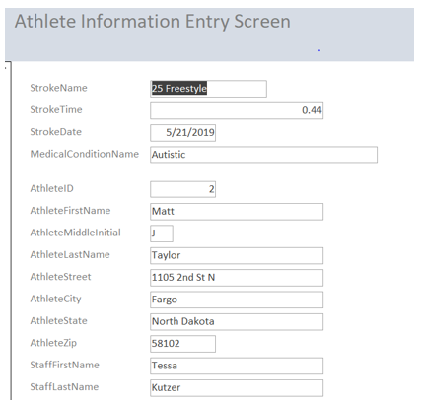
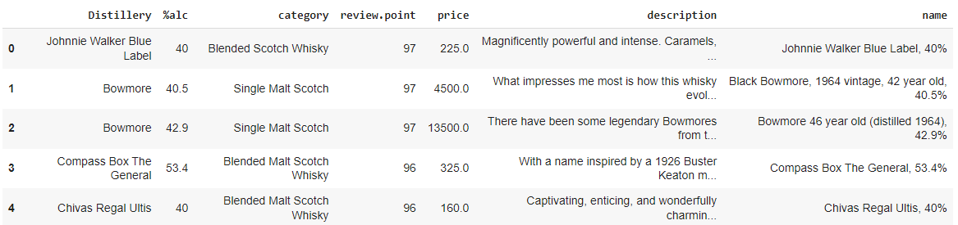
Objective 2
For IST 659, to collect data, I met with other coaches and developed together the information to be included in the database
For IST 718, our group developed our own research questions for the final project and collected data to help answer these, by searching the internet and sites such as Kaggle
These projects taught me that there are multiple ways to collect data
Collecting and organizing data is dependent upon the problem you are trying to solve and how the organization is built
In the first project example, there was no stored information to work with, so paper copies were reviewed, and digital copies created
In the second project example, the internet and websites were used to identify existing datasets
Notes:
Significant data cleansing was required as 3 datasets were used

Slide 9
Exploring (Objective 3)
Data Exploration can only occur after the data has been cleaned and prepped
This stage involves creating visualizations to see how data is related and what is happening with the data
It also involves using statistical analysis to uncover any patterns or relations between the data
There are several techniques that can be applied to create visualizations and perform statistical analysis. The ones that will be applied will vary in every situation

Slide 10
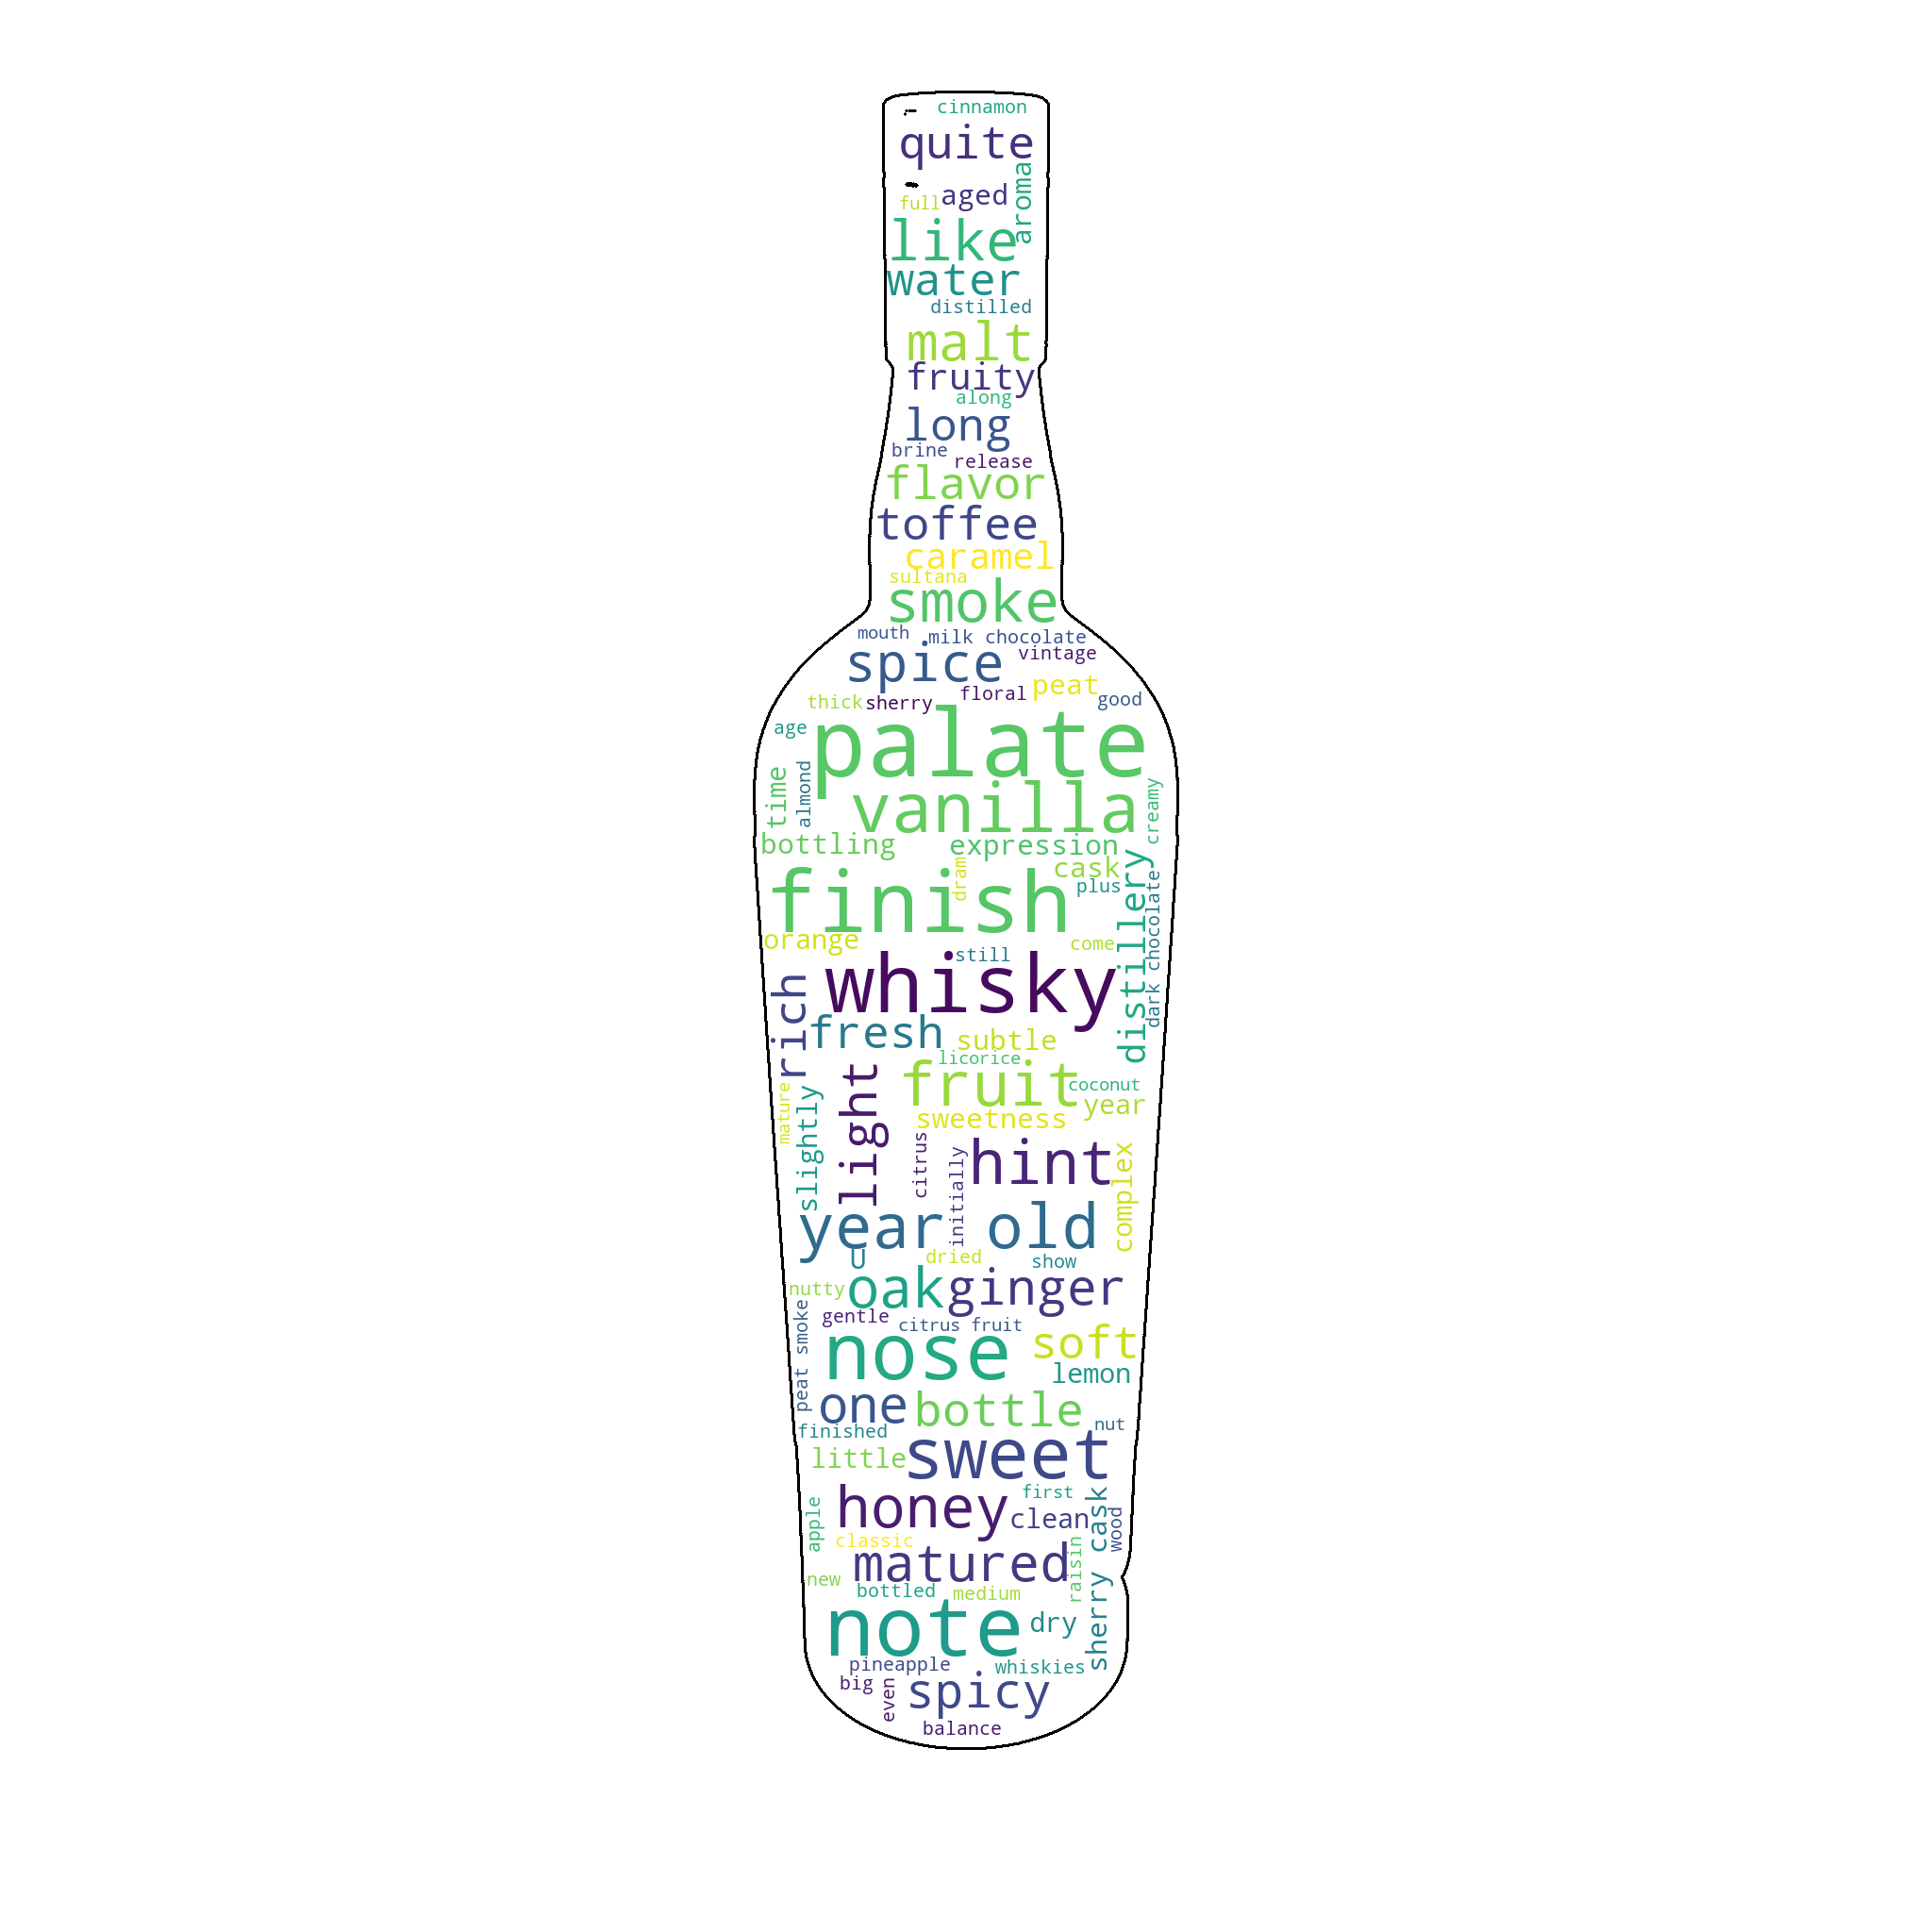
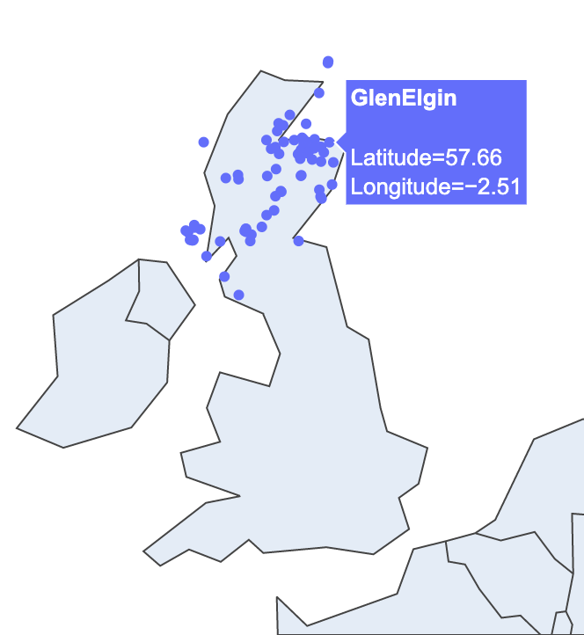
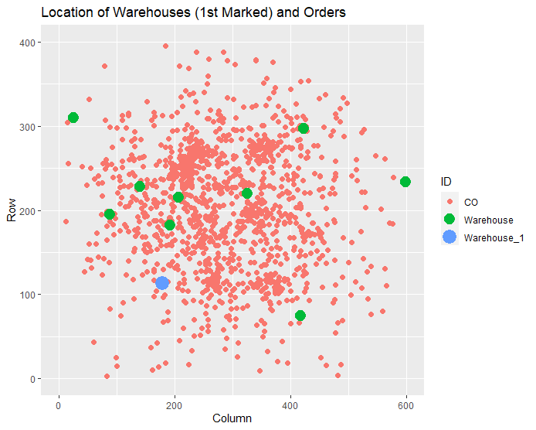
Objective 3
For IST 718, to explore the data, our group analyzed several different attribute distributions, plotted the data and conducted sentiment analysis
For IST 707, to explore the data, our group first had to plot the data and then we could analyze products and orders
These projects show that exploration is always dependent on the data you are using
The first project included descriptive statistics and sentiment analysis
The second project analyzed products by weights as well as drone and warehouse coordinates
Notes:
Graphs are a great way to help visually explain what the data is telling you

Slide 11
Data Analysis (Objective 4)
Data Analysis is performed after initial exploration has been completed
3 categories of data analysis exist: Descriptive, Predictive, and Prescriptive
These can include using one or both supervised and unsupervised machine learning techniques
These are used to help the users identify solutions or trends as needed
Notes:
There are several approaches and techniques that can be applied.
Descriptive involves using statistical methods to summarize data which leads to an understanding of the data.
Predictive involves using past data to predict future outcomes used methods such as regression, modeling, and forecasting.
Prescriptive involves optimization and forming solutions.
Some common examples of supervised learning are linear and logistic regression and decision trees.
Examples of unsupervised learning are clustering and association rule mining.
Neural networks can fall under both categories.

Slide 12
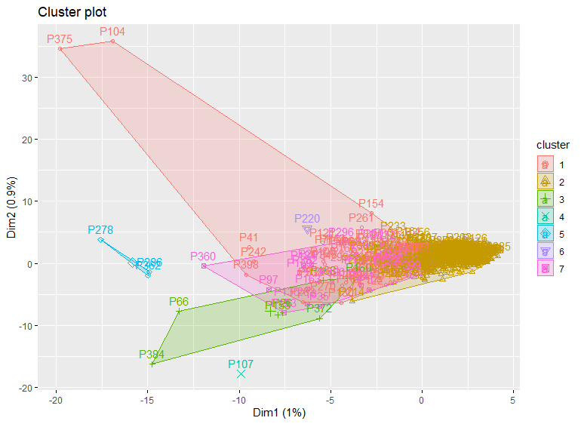
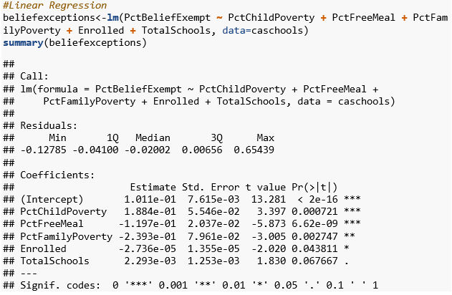
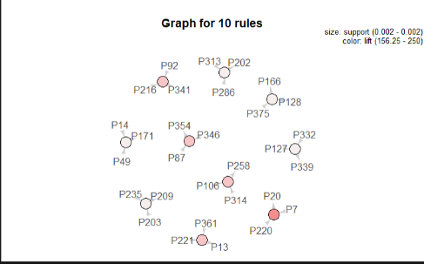
Objective 4
For IST 707, there wasn’t numerical data to analyze, instead locations and products were analyzed
For IST 772, the final was based on two separate sections: one was based on descriptive statistics and the other section was based on predictive and prescriptive analysis
A main takeaway from these two projects is that every project requires different tools and types of analysis
For the first project Clustering (K-Means) and Association Rule Mining (Apriori) were used to identify how the products and deliveries should be set up
For the second project all 3 types of analysis were used including linear and logistic regression and Bayes Factor
Notes:
A cluster plot was generated based on a simple K-Means for 7 centers. When optimizing the best route, clusters were utilized for designating products to be shipped together for maximum efficiency. Association rule mining was used to determine if relevant associations existed between various products. The Apriori algorithm was helpful to show us that there were never orders with more than 4 products
Section 2 contained both linear and logistic regression models as well as Bayes Factor.

Slide 13
Interpretation and Recommendations (Objectives 5 & 6)
Interpretation and Recommendations require communication skills to accurately pass the information on to the end users
It’s important to know the audience you are presenting to before determining how you will interpret the information
Technical users will want to know more details and will require less explanation of the methods
The opposite could occur when presenting to customers or other users who do not need to know how the recommendation was reached

Slide 14
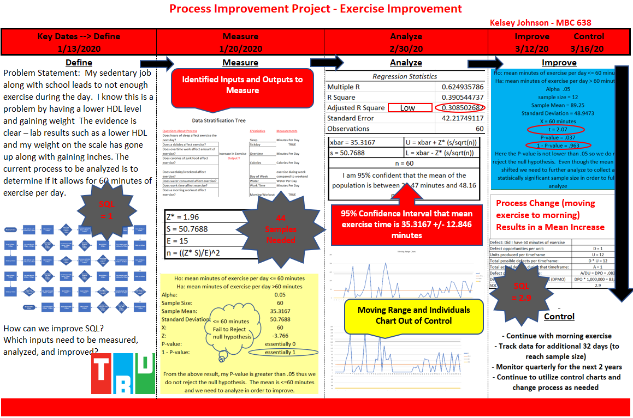
Objectives 5 & 6
For IST 772, a technical analysis was required to be written on the information that was found and to provide a recommendation based on that information
For MBC 638, the interpretation and recommendations were provided in the form of a storyboard and power point
Both projects demonstrated unique and different ways to communicate the interpretation and recommendations
A key takeaway is to know your audience
Notes:
Due to the technical analysis, graphs and specific details on the analysis were provided
The storyboard was great to show the entire project process in one visual while the PowerPoint allowed an in-depth view on each specific part of the analysis
The report and recommendation supplied in IST 772 was technical and would need to be revised if it was going to be supplied to someone without technical knowledge
The storyboard in MBC 638 is a great visual and way to showcase a project, but in some situations, it may need to be supplemented with a written report that contains all the technical information

Slide 15
Ethical Dimensions of Data Science (Objective 7)
Data scientists are in the unique situation where they are responsible for protecting data from being hacked, stolen, or used to commit fraud
This includes being responsible to not personally use the data they have access to in order to commit fraud themselves or sell to others
It’s important for organizations to hire the best employees by running appropriate background checks as well as purchasing or building the best software to secure their systems
Even employees who do not have access to personal data have a responsibility to learn about how data can be hacked and to use the systems appropriately

Slide 16
Objective 7
This is an area I did not personally take a class on (such as Information Security)
Working in ID Theft Analytics, my job is to develop solutions to prevent third-party fraudsters (fraudsters who do not know the customer) from accessing information
This is done in two different ways - by predicting fraud applications and identifying account takeovers
Predicting fraudulent applications involves using model scores as well as writing rules to decline or queue applications for manual review
Identifying account takeovers involves writing rules as well as performing additional analysis to identify how the fraudster accessed the account
Notes:
An account takeover occurs when the fraudster has enough personal information on the customer to gain access to their accounts.

Slide 17
What’s Next?
Learning about data science won’t stop
I have opportunities every day to learn more about different types of models and algorithms
With school being done, I now have more free time to focus on combining my knowledge from school with my work
I also have more time to spend improving my SAS knowledge as well as continuing to build my skills in R, Python and other tools we have learned

Slide 18
Thank You for Your Time

Slide 19
References for Portfolio Milestone Project
IST 687 Intro to Data Science
Figure 1 (Only) used from Corey Jackson’s Week 8 Review slides
IST 707 References
Christofides, N., Mingozzi, A. & Toth, P. Exact algorithms for the vehicle routing problem, based on spanning tree and shortest path relaxations. Mathematical Programming 20, 255–282 (1981). https://doi.org/10.1007/BF01589353
Rouse, Margaret. “What Is a Drone?” IoT Agenda, TechTarget, 15 July 2019, internetofthingsagenda.techtarget.com/definition/drone.
Tolga Bektas, The multiple traveling salesman problem: an overview of formulations and solution procedures, Omega, Volume 34, Issue 3, 2006, Pages 209-219, ISSN 0305-0483, https://doi.org/10.1016/j.omega.2004.10.004.
Welch, Adrienne, "A cost-benefit analysis of Amazon Prime Air" (2015). Honors Theses.
Google, #Hash Code Delivery, Problem statement for Online Qualification Round, Hash Code 2016.

Slide 20
References (Continued)
IST 718 References
Scotch Whisky Dataset, Thatdataanalyst. (2018, March 22). Scotch Whiskey Dataset [data set]. Kaggle.
https://www.kaggle.com/koki25ando/scotch-whisky-dataset
Meta-Critic Whisky Database, Selfbuilt. (2021, August 27). Meta-Critic Whisky Database.
https://whiskyanalysis.com/index.php/database/
2,2k+ Scotch Whisky Reviews, Thatdataanalyst. (2018, June 13). 2,2k+ Scotch Whisky Reviews.
https://www.kaggle.com/koki25ando/22000-scotch-whisky-reviews
Github Repository
Github: kelsajohnson/Syracuse-Applied-Data-Science-Portfolio (github.com)

