Slide 1
Introduction to R
Essential functions
By Kelsey Huntzberry, MPH

Slide 2
Class Live Stream Link
To connect to the live stream of class so you can see my shared screen enter this link: https://join.skype.com/BnvN2P9bJSEO
NOTE: You do NOT need a skype account to connect

Slide 3
Review Supplemental Code

Slide 4
Review from Last Week

Slide 5
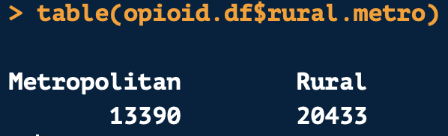
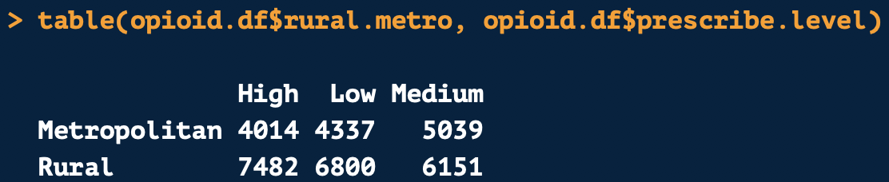
Frequency Tables
The table() function can be used to find the count of each level of a variable in a data set

Slide 6
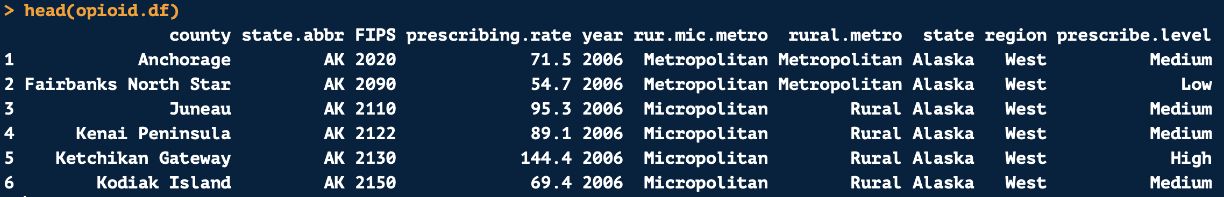
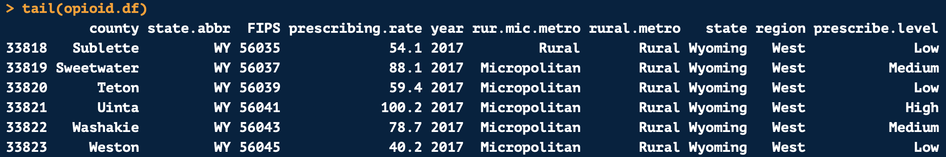
head() and tail()
head() and tail() help give you a birds eye view of a data set
head() by default shows you the first 6 rows of a data frame
tail() shows the last 6 rows of a data frame

Slide 7
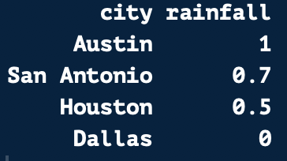
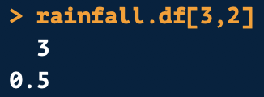
Indexing Using Position with Data Frames
Indexing works similarly on a data frame
The first number is the row position
The second number is the column position
1
2
1
2
3
4
Row 3
Column 2
Returns:
Positions

Slide 8

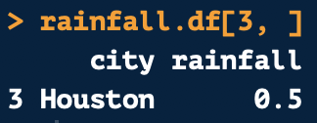
Pulling Full Rows and Columns from a Data Frame
1
2
To pull a full column, leave the row number blank
To pull a full row, leave the column number blank
Always leave the comma in!
1
2nd Column
2
3
4
Positions
3rd Row

Slide 9
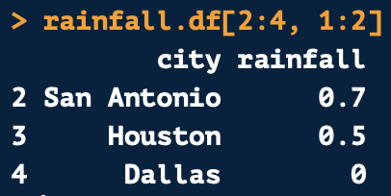
Indexing Multiple Values from a Data Frame
Like on vectors, you can pull multiple consecutive values
1
2
1
2
Row 2, 3, & 4
Column 1 & 2
3
4
Positions
Returns:

Slide 10
A Better Way? Subsetting Using Values
Indexing is hard to get used to
Luckily there is an easier way to subset data using the subset() function
You can subset based on values:
texas.df <- subset(states.df, state == “Texas”)
This will keep all values where the state variable equals Texas and remove all other values
not.texas.df <- subset(states.df, state != “Texas”)
This will remove all values where the state variable equals Texas and keep all other values

Slide 11
Keeping and Removing Variables
You can subset to a smaller group of variables:
You can also remove specific variables:
prescribe.df <- subset(opioid.df, select = c(“state”, “region”, “prescribing.rate”))
This will keep the variables state, region, and prescribing.rate
prescribe.df <- subset(opioid.df, select = -c(“state”, “region”, “prescribing.rate”))
This will remove state, region, and prescribing.rate and keep all others

Slide 12
Factor Variables

Slide 13
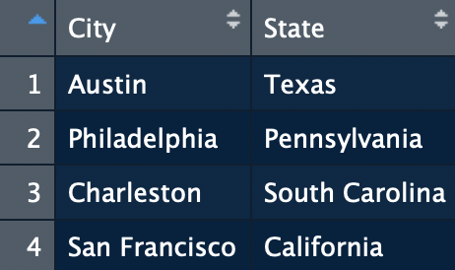
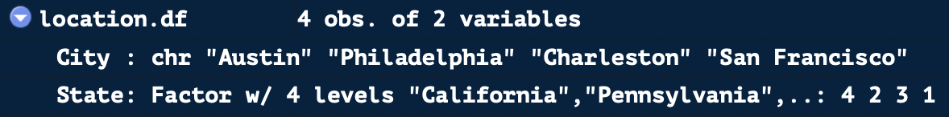
Factor Variables
Factor variables can be either strings or numeric
See that city, a character variable, is stored with string values
State is a factor variable and is stored as a number
The state name is a label, which is printed when you open up the data frame

Slide 14
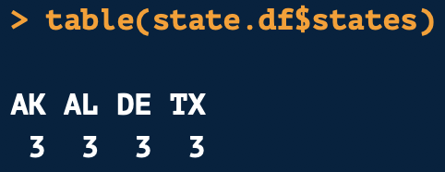
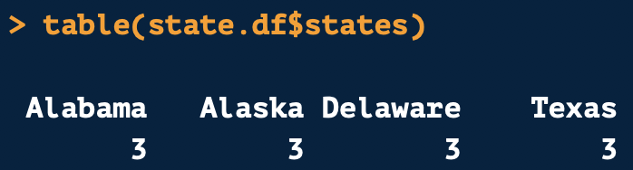
Creating Factor Variables
You can change other data types to factor variables
Levels and labels can be customized
In data frame shown on right, states is a character variable
Will change it to a factor variable converting the state abbreviation to the state name
Converts
To

Slide 15
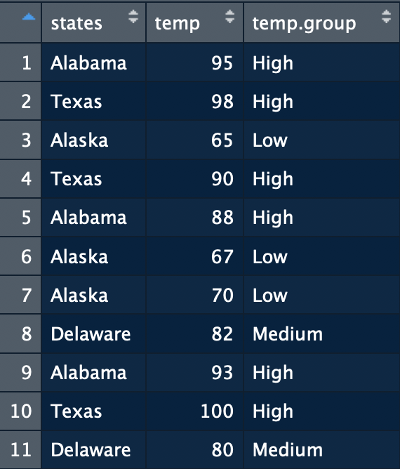
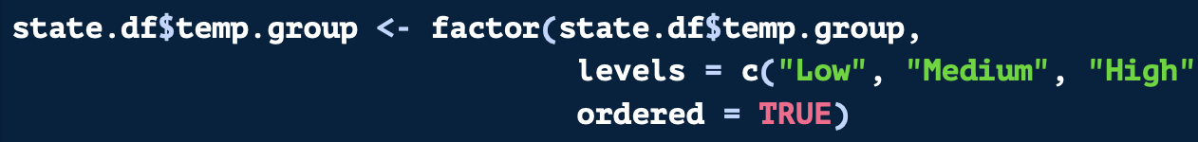
Creating an Ordered Factor Variable
states.df
In the factor() function, ordered factors can be created where one group is considered larger than another
List ordered values from low to high
Add ordered = TRUE to the factor() function
Now, High will be greater than Low

Slide 16
Missing Values

Slide 17
Types of Missing Values
NA or “not available”
Missing value
NULL or “null object”
Will be returned from a function where a value is undefined
Empty value with zero length
Infinite
Will be returned if you divide by zero
Can check missing value type by using is.na() or is.null() or is.infinite()

Slide 18
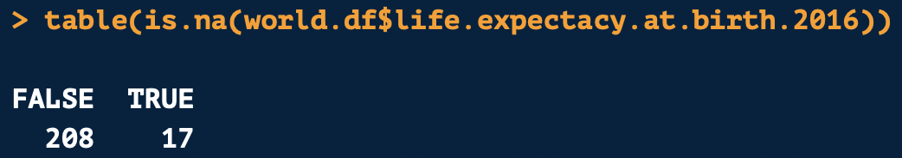
Identifying Missing Values
Can check missing value type by using is.na() or is.null() or is.infinite()
This will return a logical vector telling you whether a value is TRUE or FALSE
Can use is.na() inside the table() function to find out how many missing values are in a column

Slide 19
Replacing Values and Changing Column Names

Slide 20
Replacing Values with Indexing
You can use indexing to replace specific values in a column
The following code changes ”Virgin Islands (U.S.) to U.S. Virgin Islands when it occurs in the country column
Column you want to modify
Value you want to modify
What you want to replace the value with

Slide 21
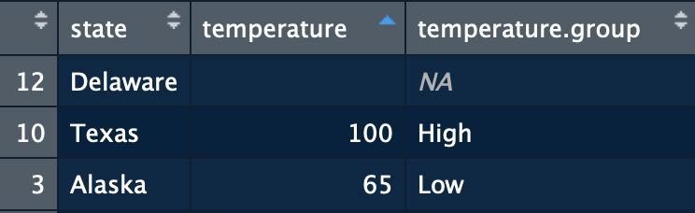
Replacing Missing Values
You may need to change missing values to zeros, blanks, or string “NA” values
Why?
If you loop over values, NA will terminate the loop
You may know that your NA values should actually be zero
The code below changes the NA values to a blank value

Slide 22
Replacing Column Names
You can replace one or all column names in a data frame with colnames()
Use indexing to change one variable name
The code below changes the column name of the 17th column in the data frame to “poverty.lt.dollar.quarter.percent.2010”
Data frame to change the column name
Position of column you want to change
New name to give the column

Slide 23
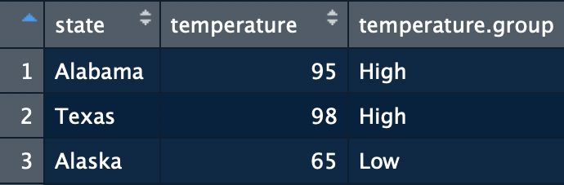
Replacing Column Names
You can replace all column names by using a vector containing the new names

Slide 24
If/Else Statements

Slide 25
If/Else Statements
If/else statements allow you to make a new variable based on values of another variable
NOTE: If any value is missing in a condition, it will always return NA
Logical (TRUE or FALSE) condition
Value if condition is TRUE
Value if condition is FALSE

Slide 26
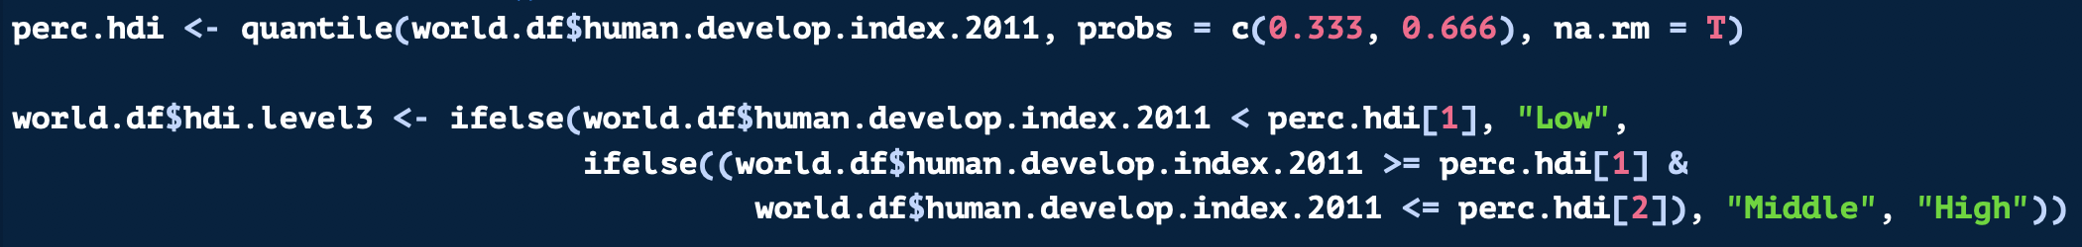
If/Else Statements
You can also nest if/else statements inside one another
You can put the second if/else statement in the FALSE position of the first statement
It will then evaluate the second statement if the first condition is FALSE

Slide 27
Merging Data Frames

Slide 28
What is Merging?
Merging or joining data means that you combine two data frames
You then specify the common columns between both data frames with the “by” statement
The merge() function will find the cases where the common columns’ values match and combine data from both data frames
By default, merge() only keeps rows where there is a match in both data frames
This is also called an inner join shown below

Slide 29
What is Merging?
Left Data Frame
Right Data Frame
Match Column

Slide 30
Left and Right Joins: What Are They?
A left join keeps the number of rows constant from the first data frame
The left data frame is the driver
A right join keeps the number of rows constant from the second data frame
The right data frame is the driver
Both joins carry along all data from the second data frame that matches
They keep the number of rows from the driving data frame constant
If there are duplicates the number of rows will increase
x is always the left data frame and y is always the left data frame

Slide 31
Left and Right Joins: How To Write Them?
Left Join
Specifies a Left Join
Right Join
Specifies a Right Join
Driving Data Frame
Matches Are Carried Along

Slide 32
Full Joins
Full joins keep all rows from both data frames regardless of whether there is a match
All unique rows are carried through
Specify a full join with all = TRUE

Slide 33
Binding Rows and Columns

Slide 34
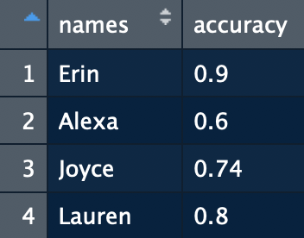
Binding Columns
You can bind or combine together two data frames with the same number of rows into one data frame with cbind()
The same can be done with vectors if they have the same length!
Below I have two vectors, one for female accuracy and another with names
I use cbind() or column bind inside of data.frame() to make these into a standard data frame with two columns
Will show below with woman and with men in R

Slide 35
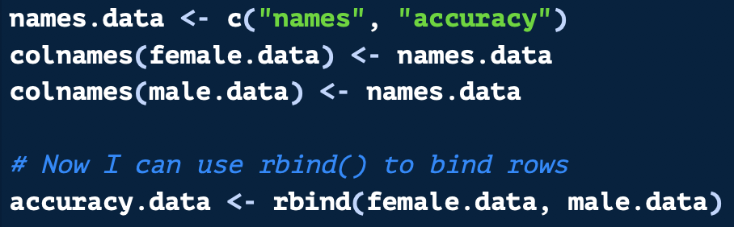
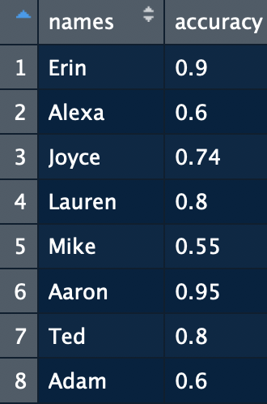
Binding Rows
Similarly, I can append two data frames with the same number of columns and same column names into one data frame with rbind()
A vector can also be added onto a data frame if its length equals the data frame’s number of columns
With rbind() we are binding rows
I will use rbind() below to append the male and female accuracy data frames I created

Slide 36
Row and Column Bind Use Examples
When would you use rbind() or cbind() in real life?
Downloading multiple years of data with same format and appending them together
Concatenating results at the end of a loop
Many other use cases! I use this often.

Slide 37
Questions?

Slide 38
Thank you for attending! Next Class is Graphing in ggplot2: Next Saturday, June 22th from 12:30 PM to 3:45 PM To attend in person go here to sign up: https://www.meetup.com/Learning-R-Programming-in-Austin/events/261791634/ To attend online go here to sign up: https://www.eventbrite.com/e/workshop-on-graphing-with-ggplot2-tickets-62415551595 Please finish the remainder of the in-class exercises for homework!

Slide 39
Class Links & Contact Info: My email: kelsey.Huntzberry@gmail.com Slack Channel to collaborate with your cohort is called r-programming-class found here: https://join.slack.com/t/learningrinaustin/shared_invite/enQtNjQ3MTcxMTczOTQyLTU4NWU2OGU5ZWQ5YzIwMTRhYjRiZTI3ODM1Yjc3ZTcwY2VjOGZkNjg2MzE1ODA1ZDA0YTRjMzNjYmIxOWQ1YmM Class Github Repository: https://github.com/kelsey-huntzberry/Intro_R

