Slide 1
Introduction to R
vectors, matrices, and indexing
By Kelsey Huntzberry, MPH

Slide 2
Class Live Stream Link
To connect to the live stream of class so you can see my shared screen enter this link: https://join.skype.com/BnvN2P9bJSEO
NOTE: You do NOT need a skype account to connect

Slide 3
Review Optional Supplemental Code

Slide 4
Data Types & Structures

Slide 5
Data Types
Numeric
Example: c(1.2, 2.6, 3.4, 4.1, 5.8)
Character
Example: c(”Alabama”, “Texas”, ”Pennsylvania”)
Factor
More in later slides
Integer
Example: c(1, 2, 3, 4, 5)
Logical
Example: c(TRUE, FALSE, FALSE, TRUE)
Notes:
Give Github link on slidesou

Slide 6
Data Structures
Variable
Consists of one value
Example: state <- “Texas”
Vector
Series of multiple values of the same type in one dimension
Example: numbers <- c(1, 2, 3, 7, 10)
List
Series of multiple values of different types in one dimension
Example: list.values <- list(1, “Alabama”, 9, TRUE)
Notes:
Give Github link on slidesou

Slide 7
Data Structures
Matrix
Rectangular array of the same type
If they are numbers, you can perform mathematical operations on each value
Data frame
Data created by combining multiple vectors so that each vector becomes a column
Each column can have a different data type
Notes:
Give Github link on slidesou

Slide 8
Deep Dive into Data Structures

Slide 9
All about Vectors
The most basic element in R is a vector
All other elements are made up of vectors
Vector: Series of multiple values of the same type in one dimension
Variable Name
Assignment
Vector Values
Notes:
Give Github link on slidesou

Slide 10
Creating a Matrix
Create a vector
fruit.prices <- c(“apple”, “orange”, “banana”, 0.30, 0.40, 0.60)
Turn the vector into a matrix:
fruit.matrix <- matrix(fruit.prices, byrow = FALSE, nrow = 3)
Add labels:
fruit.matrix <- matrix(fruit.prices, byrow = FALSE, nrow = 3,
dimnames = list(c(1,2,3), c(“fruit”, “price”)))
Notes:
Give Github link on slidesou

Slide 11
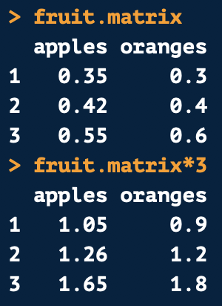
Matrices and Mathematical Operations
When a matrix is all numeric, you can perform mathematical operations with all values
If we want to purchase three of each fruit and want the total price
Notes:
Give Github link on slidesou

Slide 12
Creating a Matrix
Create a vector
fruit.prices <- c(“apple”, “orange”, “banana”, 0.30, 0.40, 0.60)
Turn the vector into a matrix:
fruit.matrix <- matrix(fruit.prices, byrow = FALSE, nrow = 3)
Add labels:
fruit.matrix <- matrix(fruit.prices, byrow = FALSE, nrow = 3,
dimnames = list(c(1,2,3), c(“fruit”, “price”)))

Slide 13
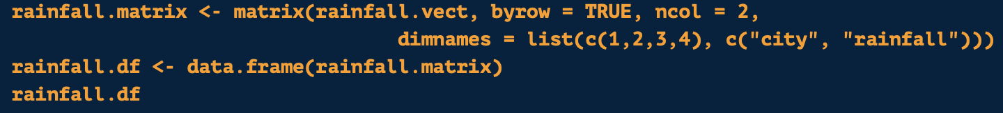
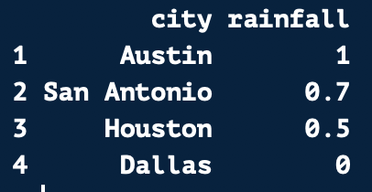
Using matrix() to Create a Data Frame
A data frame is similar to a matrix except each column can be of a different type
You can use the matrix() and data.frame() functions to create a data frame
First you create a matrix with your desired format
Then you put this code inside the data.frame() function

Slide 14
More on Data Frames
Data frames are typically like data sets you see in Excel
Every column is a variable
Remember: Use $ to refer to a variable within a data frame
Example: rainfall.df$city

Slide 15
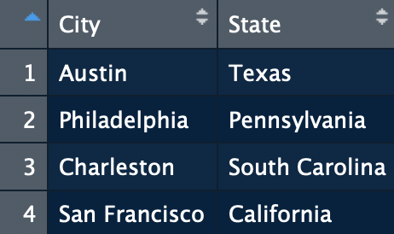
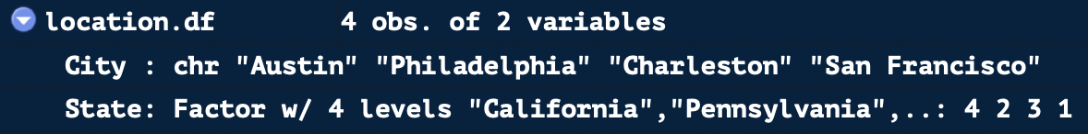
Factor Variables
Factor variables can be either strings or numeric
However, always stored as a number
See that city, a character variable, is stored with string values
State is a factor variable and is stored as a number
The state name is a label, which is printed when you open up the data frame

Slide 16
Changing Data Types

Slide 17
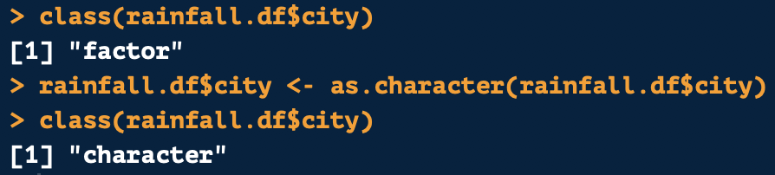
Checking & Changing Data Types
To check the data type of an object use class()
To change or coerce an object to another data type, the format is always as follows:
as.numeric() → Numeric
as.factor() → Factor
as.data.frame() → Data frame
as.character() → Character
as.list() → List
as.integer() → Integer or Whole Number

Slide 18
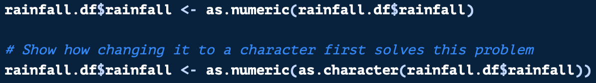
Changing from Factor to Numeric
There’s a trick for changing variables from factor to numeric
Remember: Factor variables are stored as numbers
The stored number is based on the order of your values
If you use as.numeric() on a factor variable made up of numbers, the stored numbers will be returned (which will be meaningless to you!)
Change from factor to numeric is follows:
Use this method
Use this method
NOT this method

Slide 19
Indexing with Vectors & Data Frames

Slide 20
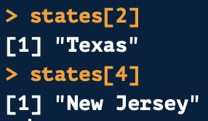
Indexing Using Position with Vectors
Each position on a vector has a numeric position
Indexing uses a value’s numeric position or value to subset a vector or data frame
Python Users: Indexing starts at 1 in R!
Example using vector above:
Positions
1
2
3
4

Slide 21
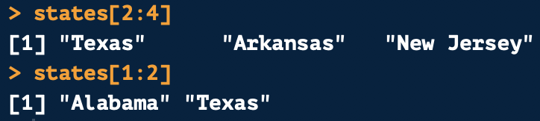
Indexing Using Position with Vectors
You can also reference a range of consecutive values with indexing using a :
Example using vector above:
Positions
1
2
3
4

Slide 22
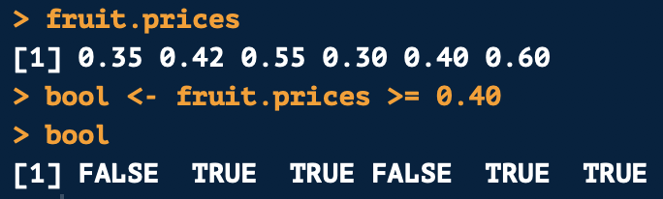
Subetting Vector Based on Value
You can also subset a vector based on its value
For example, we can pull all values greater than or equal to 0.40 in fruit.prices
First create a logical vector for fruit.prices
This will return a logical vector (i.e. TRUE/FALSE)

Slide 23

Subetting Vector Based on Value
A logical vector is stored in 1s and 0s
TRUE is stored as 1
FALSE is stored as 0
When indexing using a logical vector, it will multiply the 1s and 0s by your values
If there is a 1, the value is returned
If there is a 0, the value is dropped
Example:

Slide 24
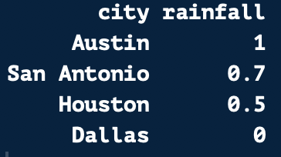
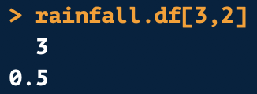
Indexing Using Position with Data Frames
Indexing works similarly on a data frame
The first number is the row position
The second number is the column position
1
2
1
2
3
4
Row 3
Column 2
Returns:
Positions

Slide 25
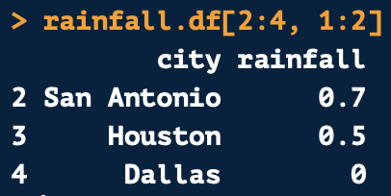
Indexing Multiple Values from a Data Frame
Like on vectors, you can pull multiple consecutive values
1
2
1
2
Row 2, 3, & 4
Column 1 & 2
3
4
Positions
Returns:

Slide 26

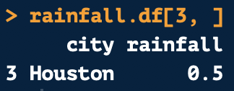
Pulling Full Rows and Columns from a Data Frame
1
2
To pull a full column, leave the row number blank
To pull a full row, leave the column number blank
Always leave the comma in!
1
2nd Column
2
3
4
Positions
3rd Row

Slide 27
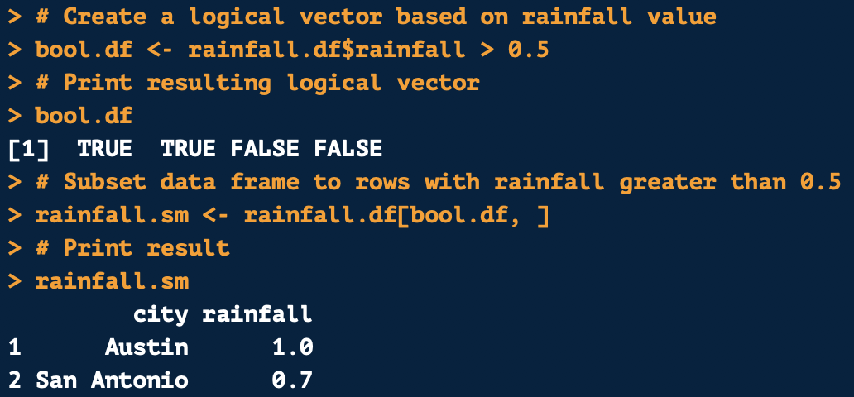
Subsetting a Data Frame Based on Value
Like with vectors, you can subset values based on their values using indexing
First create index using value a rule applying to your desired variable
In this case, pulling rainfall values greater than 0.5
This will produce a logical vector where it is TRUE if a value is greater than 0.5 and FALSE IF less than or equal to 0.5

Slide 28
Subsetting a Data Frame Based on Value
To pull all rows with rainfall greater than 0.5, put the logical vector in the row position
Because we want to pull data based on row
Keep column position blank since we want all columns for rows meeting the criteria
This will return all rows with rainfall greater than 0.5

Slide 29
Questions?

Slide 30
Thank you for attending! Next Class is Factors & Data Frames: Next Saturday, June 8th from 10:30 AM to 12:00 PM To attend in person go here to sign up: https://www.meetup.com/Learning-R-Programming-in-Austin/events/261413384/ To attend online go here to sign up: https://www.eventbrite.com/e/intro-r-factors-and-data-frames-tickets-61769889402 Optional Practice Slides are Available on Github! (all class links on the next slides)

Slide 31
Class Links & Contact Info: My email: kelsey.Huntzberry@gmail.com Slack Channel to collaborate with your cohort is called r-programming-class found here: https://join.slack.com/t/learningrinaustin/shared_invite/enQtNjQ3MTcxMTczOTQyLTU4NWU2OGU5ZWQ5YzIwMTRhYjRiZTI3ODM1Yjc3ZTcwY2VjOGZkNjg2MzE1ODA1ZDA0YTRjMzNjYmIxOWQ1YmM Class Github Repository: tps://github.com/kelsey-huntzberry/Intro_R

