Slide 1
Introduction to R
factors, data frames, and indexing
By Kelsey Huntzberry, MPH

Slide 2
Class Live Stream Link
To connect to the live stream of class so you can see my shared screen enter this link: https://join.skype.com/BnvN2P9bJSEO
NOTE: You do NOT need a skype account to connect

Slide 3
Review Optional Supplemental Code

Slide 4
Basic Functions for Data Exploration

Slide 5
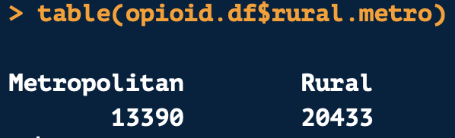
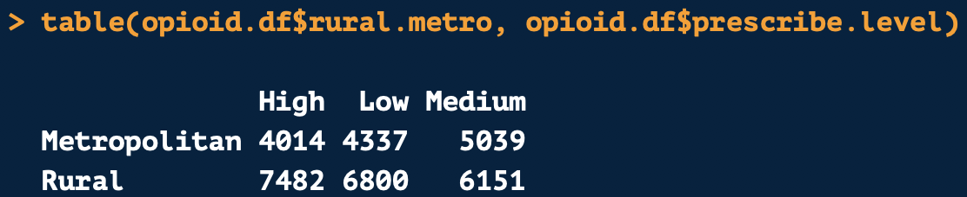
Frequency Tables
The table() function can be used to find the count of each level of a variable in a data set

Slide 6
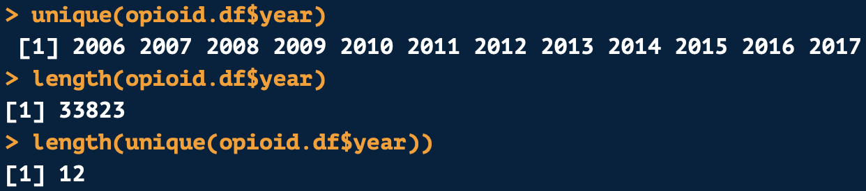
length() and unique()
The unique() function will extract all the unique values from a vector
The length() function will tell you the length or number of values in a vector
You can combined both function to tell you the number of unique values in a vector

Slide 7
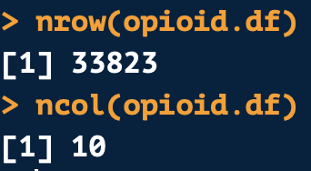
nrow() and ncol()
nrow() will tell you the number of rows and columns in a data frame
ncol() will tell you the number of columns

Slide 8
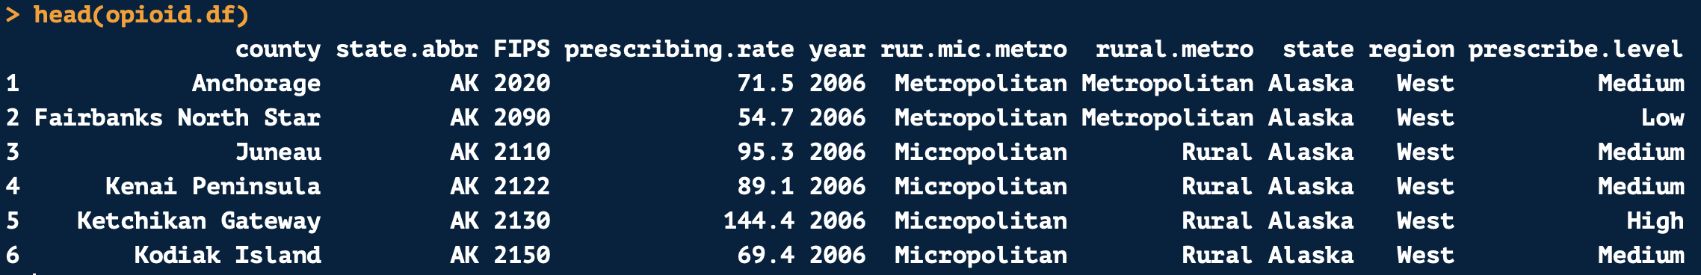
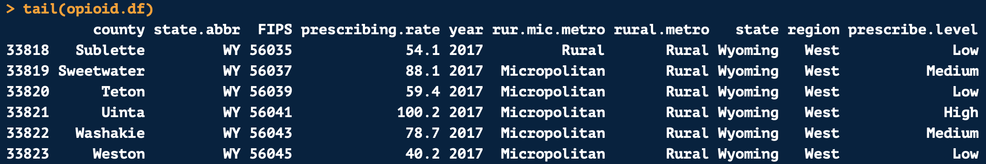
head() and tail()
head() and tail() help give you a birds eye view of a data set
head() by default shows you the first 6 rows of a data frame
tail() shows the last 6 rows of a data frame

Slide 9
Indexing with Vectors & Data Frames

Slide 10
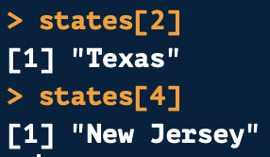
Indexing Using Position with Vectors
Each position on a vector has a numeric position
Indexing uses a value’s numeric position or value to subset a vector or data frame
Python Users: Indexing starts at 1 in R!
Example using vector above:
Positions
1
2
3
4

Slide 11
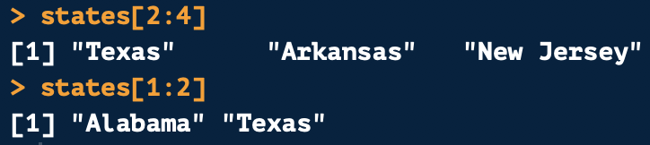
Indexing Using Position with Vectors
You can also reference a range of consecutive values with indexing using a :
Example using vector above:
Positions
1
2
3
4

Slide 12
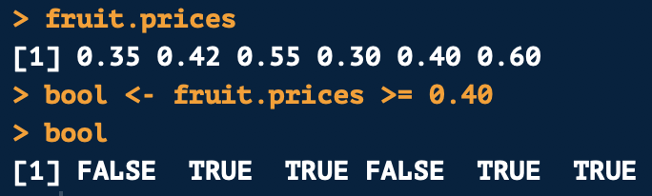
Subetting Vector Based on Value
You can also subset a vector based on its value
For example, we can pull all values greater than or equal to 0.40 in fruit.prices
First create a logical vector for fruit.prices
This will return a logical vector (i.e. TRUE/FALSE)

Slide 13

Subetting Vector Based on Value
A logical vector is stored in 1s and 0s
TRUE is stored as 1
FALSE is stored as 0
When indexing using a logical vector, it will multiply the 1s and 0s by your values
If there is a 1, the value is returned
If there is a 0, the value is dropped
Example:

Slide 14
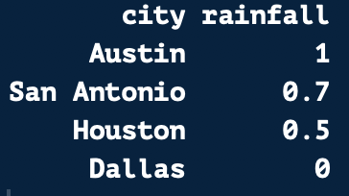

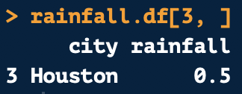
Pulling Full Rows and Columns from a Data Frame
1
2
To pull a full column, leave the row number blank
To pull a full row, leave the column number blank
Always leave the comma in!
1
2nd Column
2
3
4
Positions
3rd Row

Slide 15
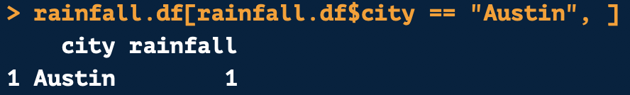
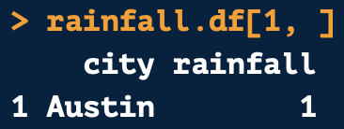
Indexing Based on Row Values
1
2
You can also index based on row values
1
2
3
Equivalent
4
Positions

Slide 16
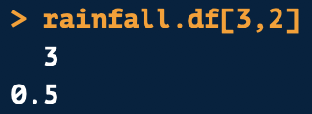
Indexing Using Position with Data Frames
Indexing works similarly on a data frame
The first number is the row position
The second number is the column position
1
2
1
2
3
4
Row 3
Column 2
Returns:
Positions

Slide 17
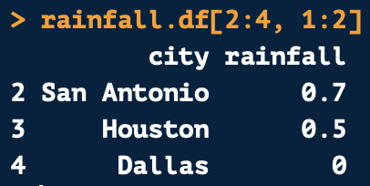
Indexing Multiple Values from a Data Frame
Like on vectors, you can pull multiple consecutive values
1
2
1
2
Row 2, 3, & 4
Column 1 & 2
3
4
Positions
Returns:

Slide 18
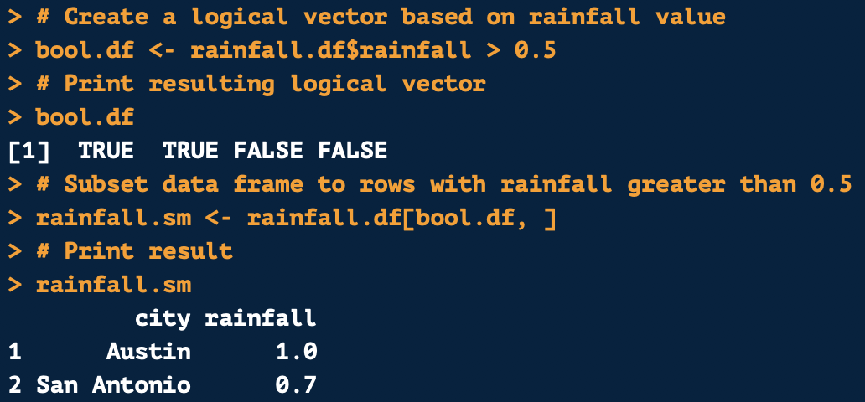
Subsetting a Data Frame Based on Value
Like with vectors, you can subset values based on their values using indexing
First create index using value a rule applying to your desired variable
In this case, pulling rainfall values greater than 0.5
This will produce a logical vector where it is TRUE if a value is greater than 0.5 and FALSE IF less than or equal to 0.5

Slide 19
Subsetting a Data Frame Based on Value
To pull all rows with rainfall greater than 0.5, put the logical vector in the row position
Because we want to pull data based on row
Keep column position blank since we want all columns for rows meeting the criteria
This will return all rows with rainfall greater than 0.5

Slide 20
The subset() Function

Slide 21
A Better Way? Subsetting Using Values
Indexing is hard to get used to
Luckily there is an easier way to subset data using the subset() function
You can subset based on values:
texas.df <- subset(states.df, state == “Texas”)
This will keep all values where the state variable equals Texas and remove all other values
texas.df <- subset(states.df, state != “Texas”)
This will remove all values where the state variable equals Texas and keep all other values

Slide 22
Keeping and Removing Variables
You can subset to a smaller group of variables:
You can also remove specific variables:
prescribe.df <- subset(opioid.df, select = c(“state”, “region”, “prescribing.rate”))
This will keep the variables state, region, and prescribing.rate
prescribe.df <- subset(opioid.df, select = -c(“state”, “region”, “prescribing.rate”))
This will remove state, region, and prescribing.rate and keep all others

Slide 23
Factor Variables

Slide 24
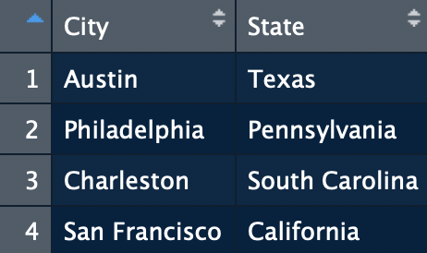
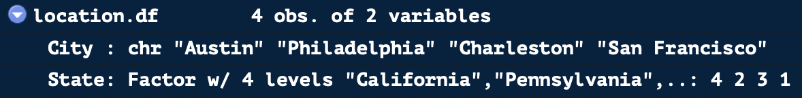
Factor Variables
Factor variables can be either strings or numeric
However, always stored as a number
See that city, a character variable, is stored with string values
State is a factor variable and is stored as a number
The state name is a label, which is printed when you open up the data frame

Slide 25
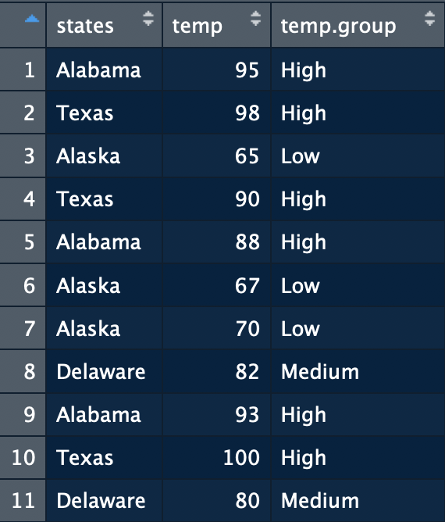
Creating Factor Variables
states.df
You can change other data types to factor variables
Levels and labels can be customized
In data frame shown on right, states is a character variable
Will change it to a factor variable with:
Abbreviation as the value
Full state name as the label

Slide 26
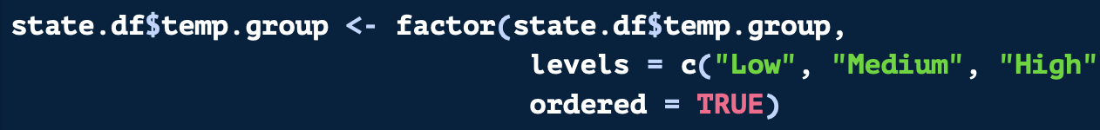
Creating an Ordered Factor Variable
states.df
You can change other data types to factor variables
Levels and labels can be customized
In data frame shown on right, states is a character variable
Will change it to a factor variable with:
Abbreviation as the value
Full state name as the label

Slide 27
Review: Changing Data Types

Slide 28
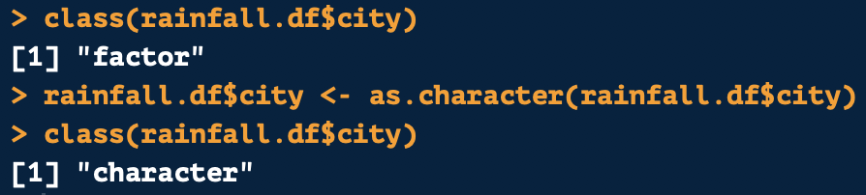
Checking & Changing Data Types
To check the data type of an object use class()
To change or coerce an object to another data type, the format is always as follows:
as.numeric() → Numeric
as.factor() → Factor
as.data.frame() → Data frame
as.character() → Character
as.list() → List
as.integer() → Integer or Whole Number

Slide 29
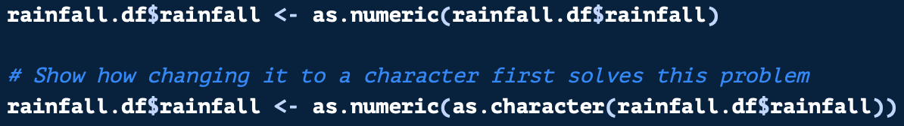
Changing from Factor to Numeric
There’s a trick for changing variables from factor to numeric
Remember: Factor variables are stored as numbers
The stored number is based on the order of your values
If you use as.numeric() on a factor variable made up of numbers, the stored numbers will be returned (which will be meaningless to you!)
Change from factor to numeric is follows:
Use this method
Use this method
NOT this method

Slide 30
Questions?

Slide 31
Thank you for attending! Next Class is Factors & Data Frames: Next Saturday, June 15th from 11:00 AM to 12:30 PM To attend in person go here to sign up: https://www.meetup.com/Learning-R-Programming-in-Austin/events/261413656/ To attend online go here to sign up: https://www.eventbrite.com/e/intro-r-lists-and-essential-functions-tickets-61770477160 Optional Practice Slides are Available on Github! (all class links on the next slides)

Slide 32
Class Links & Contact Info: My email: kelsey.Huntzberry@gmail.com Slack Channel to collaborate with your cohort is called r-programming-class found here: https://join.slack.com/t/learningrinaustin/shared_invite/enQtNjQ3MTcxMTczOTQyLTU4NWU2OGU5ZWQ5YzIwMTRhYjRiZTI3ODM1Yjc3ZTcwY2VjOGZkNjg2MzE1ODA1ZDA0YTRjMzNjYmIxOWQ1YmM Class Github Repository: https://github.com/kelsey-huntzberry/Intro_R

