Slide 1

Do older customers purchase tech support services more often than younger customers?
Kelseyann Wright
Western Governors University
D205 - Data Aquisition

Slide 2

Data Required - Churn database
Programming Environment
Customer Table | Services Table
customer_id | customer_id
age | techsupport
KEY

Slide 3
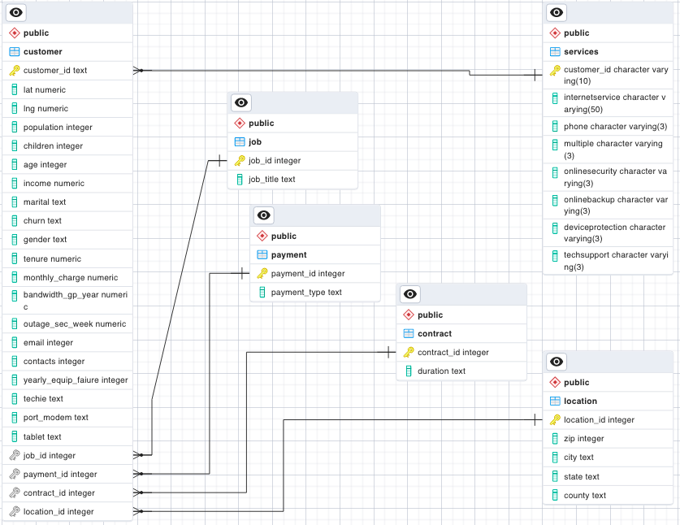
Logical Data Model – Churn Database

Slide 4
Logical Data Model – Research Question

