Slide 1
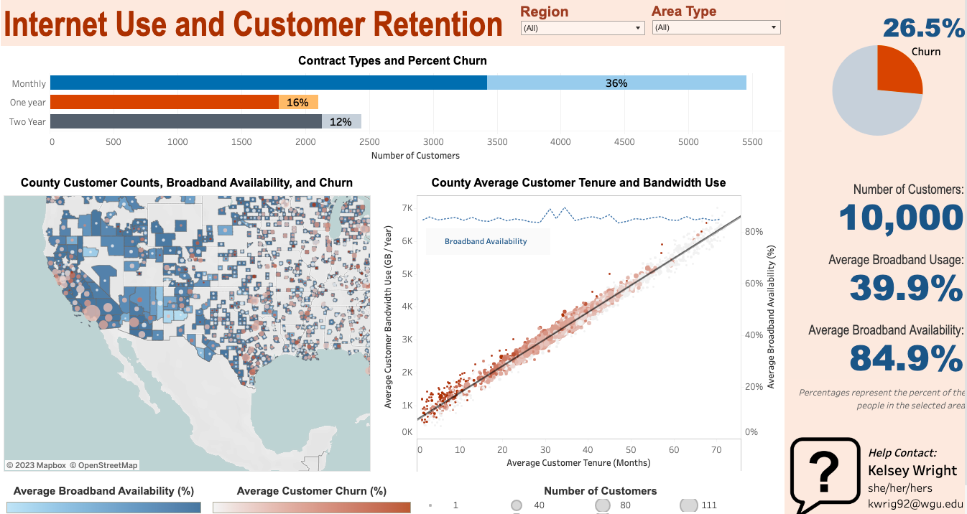
Internet Availability, Use & Customer Retention
Kelseyann Wright
D210: Representation & Reporting

Slide 2




About Me
Kelsey (she/her/hers)
Assisting with customer churn analysis for the past 5 months
Extensive data analytics experience in the environmental science industry

Slide 3
Data Summary
GOAL: Identify & understand factors related to customer churn to improve customer retention.
Customer churn
Broadband AVAILABILITY
Internal (provided) dataset
10,000 customers
Contract type, churn (yes/no), county, tenure, bandwidth usage
Generated a “region” feature (midwest, northeast, south, west) based on state
External dataset (Thomas, 2022)
County level data
Percent of people in each county with available broadband
Percent of people using broadband in each county
Federal Communications Commission (FCC) and Microsoft as of October 2020

Slide 4
Data Summary
Is customer churn related to broadband availability or use?
Are we maximizing our customer distribution in regions with more available broadband?
What areas are ideal for expansion?
Customer churn
Broadband AVAILABILITY
Internal (provided) dataset
10,000 customers
Contract type, churn (yes/no), county, tenure, bandwidth usage
External dataset (Thomas, 2022)
County level data
Percent of people in each county with available broadband
Percent of people using broadband in each county
Federal Communications Commission (FCC) and Microsoft as of October 2020

Slide 5
Dashboard Access - Tableau

Slide 6
Results – Key Findings
Month to month contracts have a higher churn rate than one and two year contracts.
More annual bandwidth use is strongly associated with longer customer tenure
Broadband availability is greater than broadband use
There are multiple counties with high internet availability and low customer counts

Slide 7
Actionable Insights
Promote longer contracts for customers rather than monthly
Promote more bandwidth use for customers
Target expansion in areas with high broadband availability to support more bandwidth use.

