Slide 1
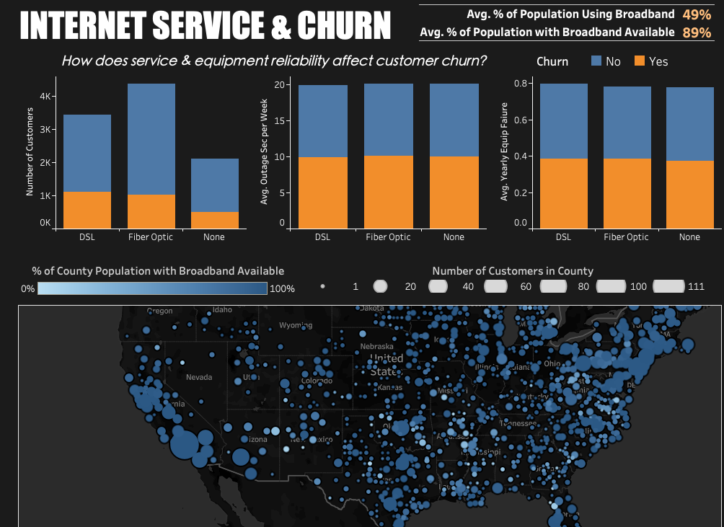
D211 Dashboard Demonstration
Kelseyann Wright
M.S. Data Analytics, Western Governors University

Slide 2
Outline
Technical Environment
Demonstration of Dashboard Functionality
Explanation of SQL Scripts
Preparation of Data Streams
Description of Data Point Alignment
Demonstration of Database Creation
Explanation of Referential Integrity

Slide 3


Technical Environment
Demonstration of Dashboard Functionality
Explanation of SQL Scripts
Preparation of Data Streams
Description of Data Point Alignment
Demonstration of Database Creation
Explanation of Referential Integrity
This Photo by Unknown Author is licensed under CC BY
This Photo by Unknown Author is licensed under CC BY-SA

Slide 4
Technical Environment
Demonstration of Dashboard Functionality
Explanation of SQL Scripts
Preparation of Data Streams
Description of Data Point Alignment
Demonstration of Database Creation
Explanation of Referential Integrity

Slide 5
Technical Environment
Demonstration of Dashboard Functionality
Explanation of SQL Scripts
Preparation of Data Streams
Description of Data Point Alignment
Demonstration of Database Creation
Explanation of Referential Integrity
This Photo by Unknown Author is licensed under CC BY

Slide 6
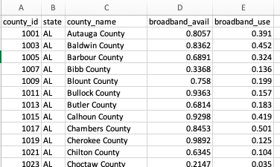
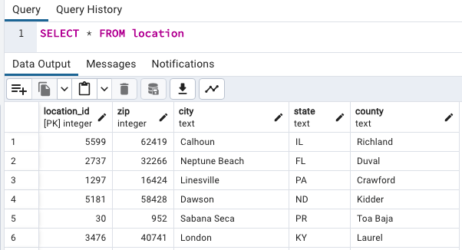
EXTERNAL DATASET
CHURN DATABASE

Slide 7
UPDATE broadband
SET county_name = REPLACE (county_name, ' County', '');
UPDATE broadband
SET county_name = REPLACE (county_name, ' City and Borough', '');
UPDATE broadband
SET county_name = REPLACE (county_name, ' Borough', '');
UPDATE broadband
SET county_name = REPLACE (county_name, ' Census Area', '');
UPDATE broadband
SET county_name = REPLACE (county_name, ' Municipality', '');
UPDATE broadband
SET county_name = REPLACE (county_name, ' Parish', '');
UPDATE broadband
SET county_name = REPLACE (county_name, ' city', '')

Slide 8
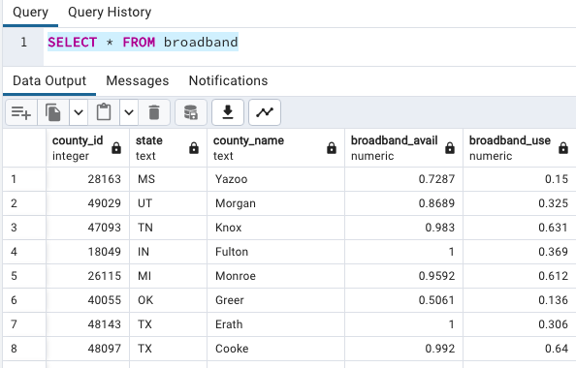

Slide 9
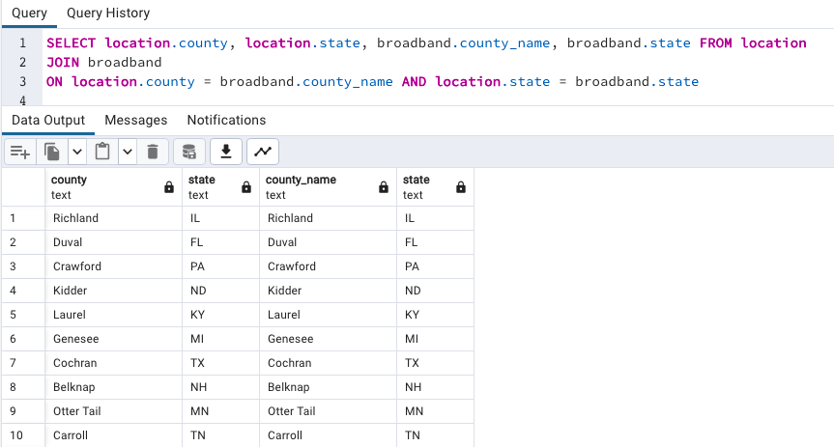

Slide 11
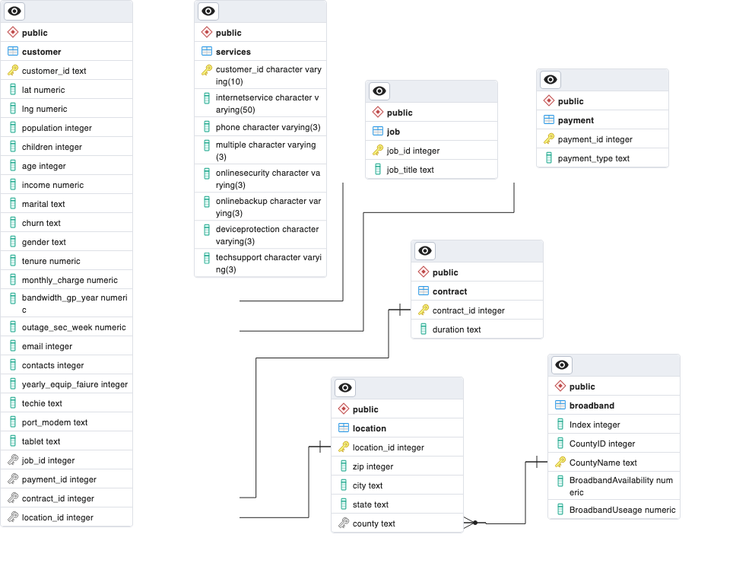

Technical Environment
Demonstration of Dashboard Functionality
Explanation of SQL Scripts
Preparation of Data Streams
Description of Data Point Alignment
Demonstration of Database Creation
Explanation of Referential Integrity
This Photo by Unknown Author is licensed under CC BY-NC

Slide 12
Technical Environment
Demonstration of Dashboard Functionality
Explanation of SQL Scripts
Explanation of Data Streams
Description of Data Point Alignment
Demonstration of Database Creation
Explanation of Referential Integrity
JOIN location
ON customer.location_id = location.location_id
JOIN broadband
ON location.county = broadband.county_name AND location.state = broadband.state

