Slide 1

crossfit – a young men’s game or not
Kelsey Heng

Slide 2

Objective
Will a younger athlete perform better at CrossFit events?
Notes:
Using past performances in events to predict an athlete’s age

Slide 3
WHY a young men’s sport?
Intense workouts
Heavy weights
High metabolic conditioning

Slide 4
Design and data acquisition
Data source
CrossFit Opens 2019’s leaderboard
Webscrapping
BeautifulSoup
Linear regression
Analysis
Polynomial regression
Selenium
Notes:
Every year the crossfit community kickstart their competition to the final games with crossfit opens, where the general community participates. So I scraped the leaderboard for 2019

Slide 5
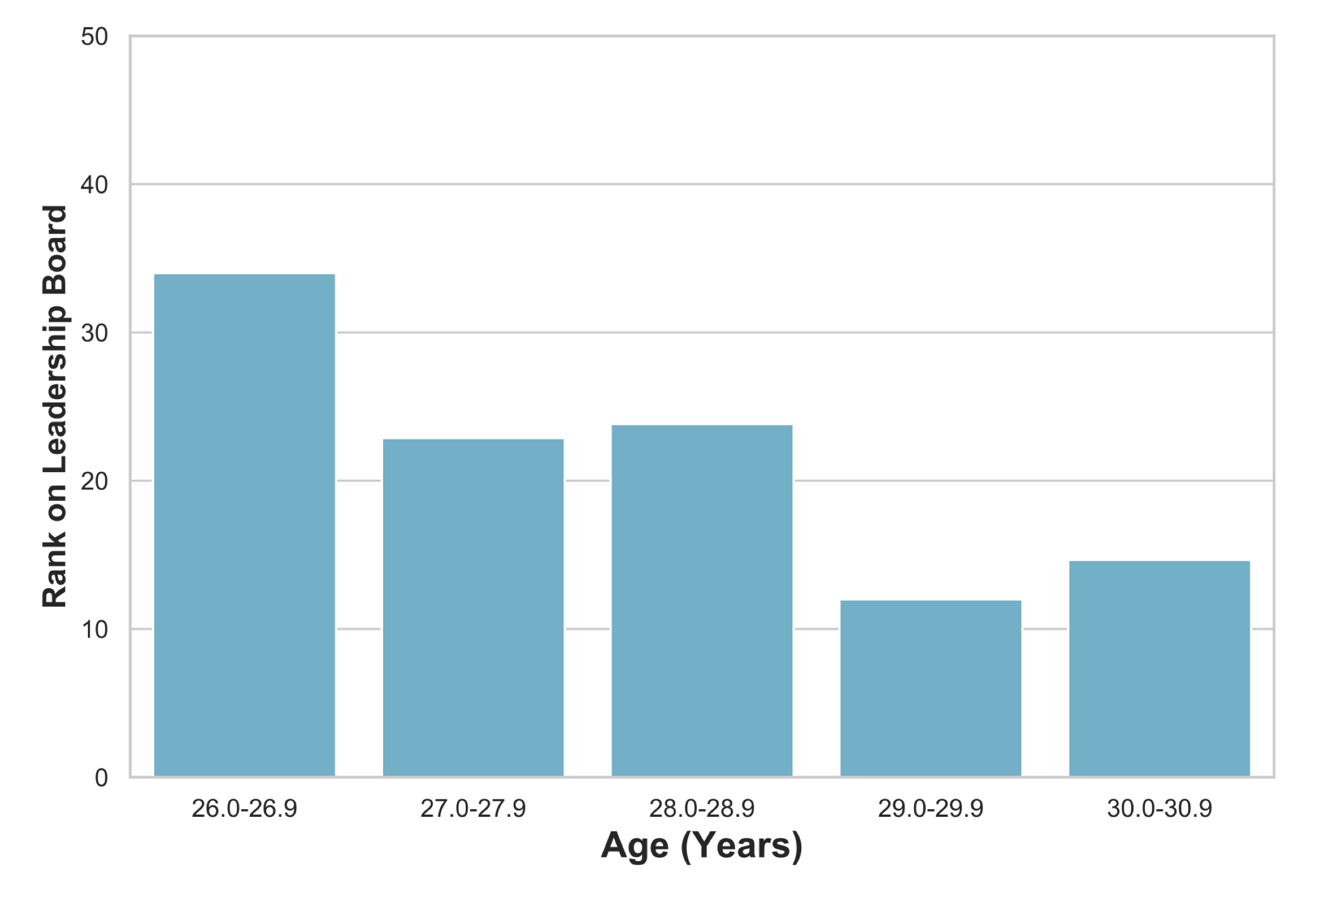
Age of the top 50 athletes
Notes:
Rank gets better as age increases towards the late 30s.
However, participants range from 16-54 years old

Slide 6
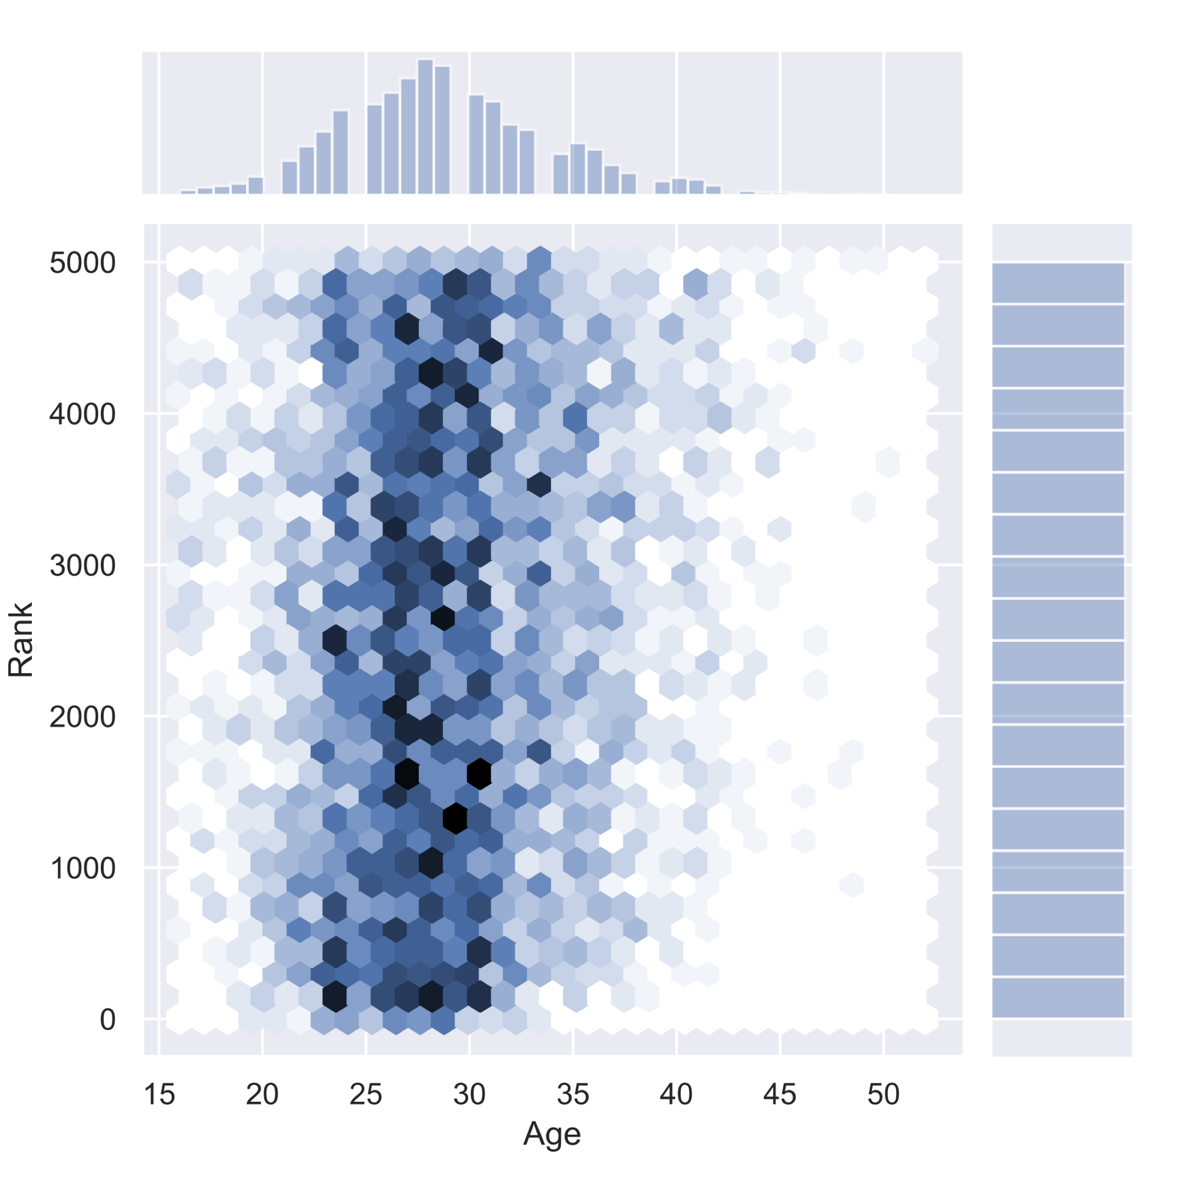
aGe vs overall rank correlation
Weak to none correlation
Widespread of leaderboard positions among age group
Notes:
Introduce the y-axis – mention that rank is lower the better
Talk about the random darker points throughout

Slide 7
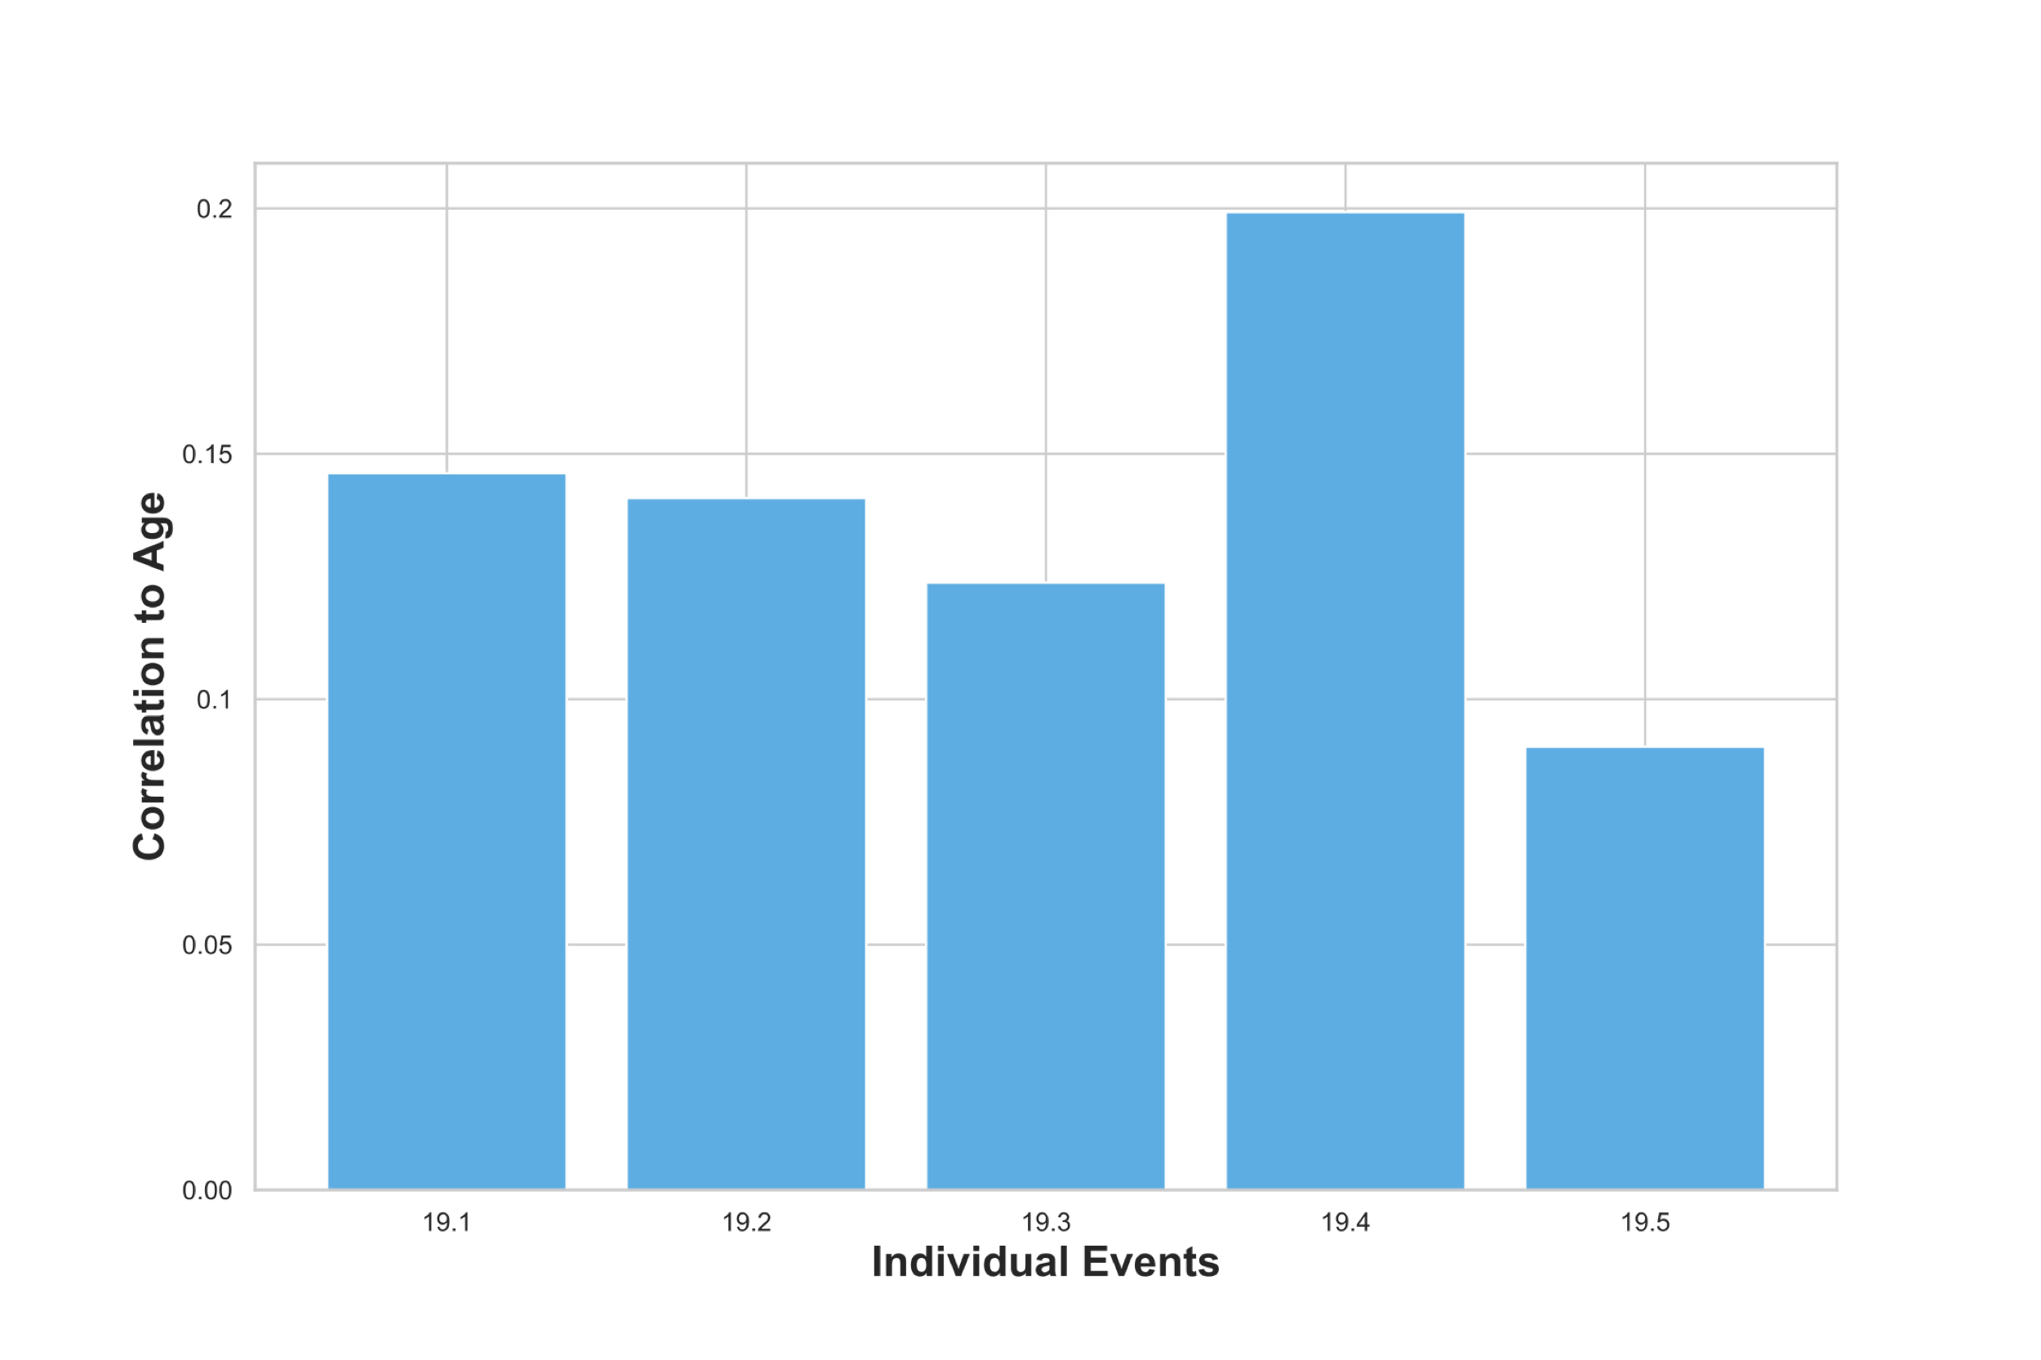
Correlation for individual event
Notes:
Correlation coefficient to age in individual events

Slide 8
insights – polynomial regression
Age vs Rank only:
Rank explains only 4.7% of the variation
All the features using Polynomial Regression:
R² = 0.082
Notes:
When we compare age vs rank, rank explains only 4.7% of the variation.
After doing some feature engineering, I included all features such as bmi and countries, the R square value only came out to 0.082

Slide 9
Conclusion
Linear regression model is not suitable for this dataset
Dataset did not fulfill any assumptions testing
CrossFit is a sport for all ages

Slide 10
Future efforts
Examine other statistics of athletes such as heaviest weight lifted
Categorize athletes into age-groups

Slide 11
Thank you!
Contact me at kelseyhenghy@gmail.com

