Slide 1
Deconstruction of a science paper’s data-evidence basis
Brian Mapes, Jan 22, 2018
MPO/ATM 624
Spring 2018

Slide 2
My Paper
Title, citation
A Study of Links Between the Arctic and The Midlatitude Jet- stream Using Granger and Pearl Causality
Savini Samarasinghe1, Marie C. McGraw2, Elizabeth A. Barnes2 and Imme Ebert-Uphoff1∗
Size of evidence set:
4 figures (plus 2 in supplement), 0 tables
? magic-number (in-text) results

Slide 3
Instructions
Copy each figure, table, or # into a slide of this powerpoint
Categorize it according to the list at EVIDENCE_TYPES.md on the course repo
If none of those categories quite fit, expand EVIDENCE_TYPES.md in your fork, and make a pull request! Try to follow the outline there, to keep our ideas compact and coherent. I may suggest edits before final PR acceptance.
Finally, paste the Abstract on a last slide here. Annotate it with little figure thumbnails connected to each claim or account of nature, to show how those are rooted in the figures (and thus in data).
Put your .pptx in your fork of the class repo, sync with your Web fork, and make a Pull Request!

Slide 4
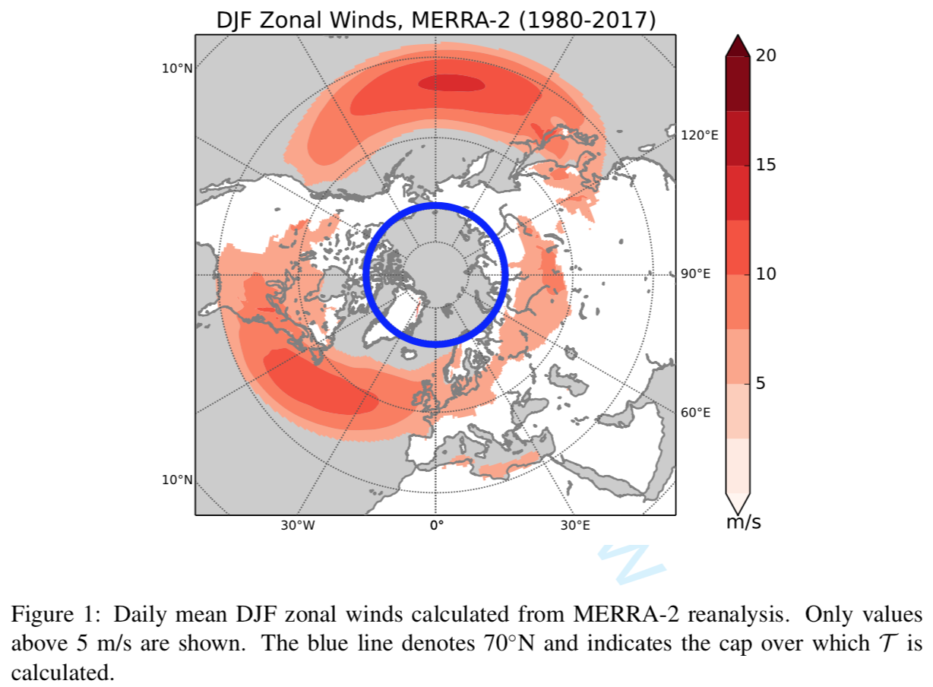
Figure 1
“summary display of raw data”
a DJF mean is a statistic, a form of summary
It also functions as a base map and guide

Slide 5
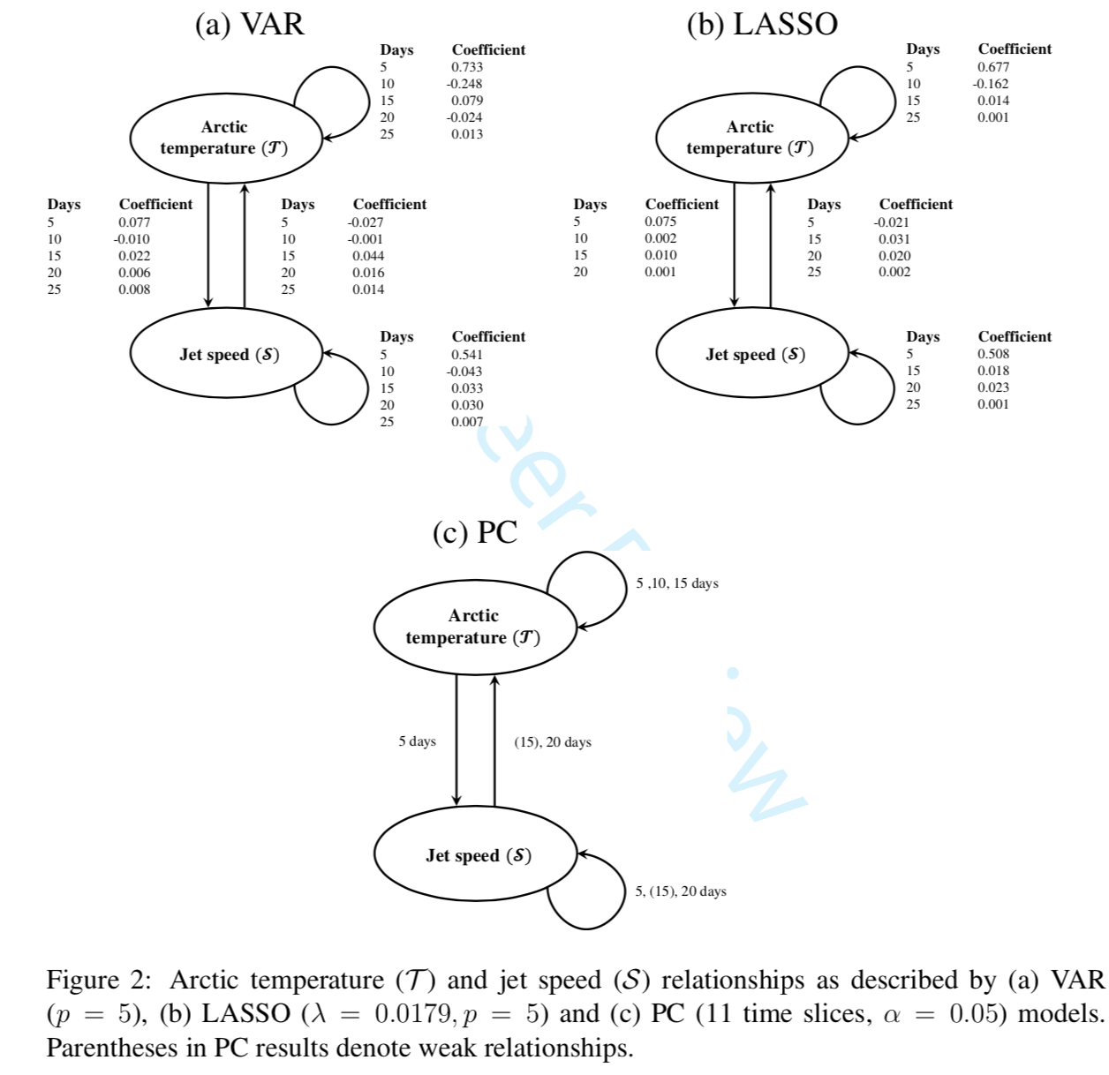
Figs 2,3
This figure is a claim of relationship(s)
Causality interpretation is claimed

Slide 6
Figs 2,3
This figure is a claim of relationship(s)
Causality interpretation is claimed

Slide 7
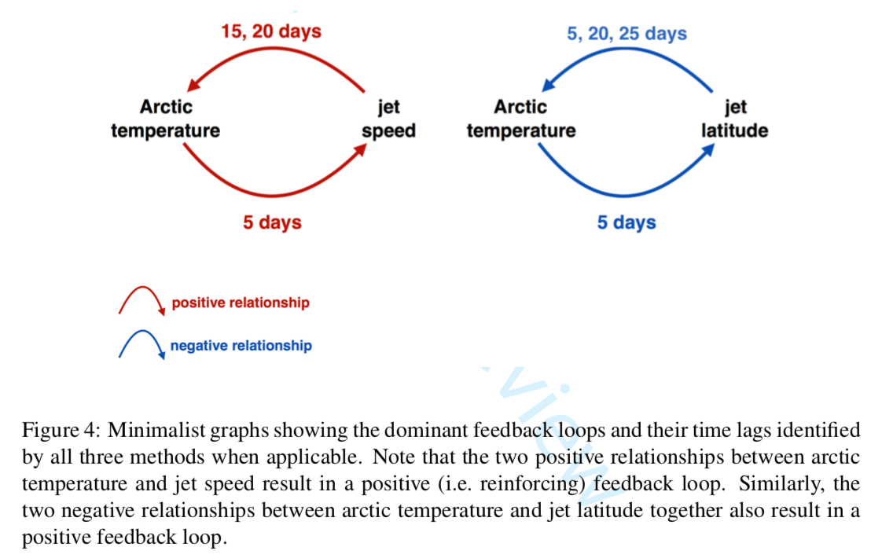
Fig 4
This figure is a schematic
summarizes meaning of other figures

Slide 8
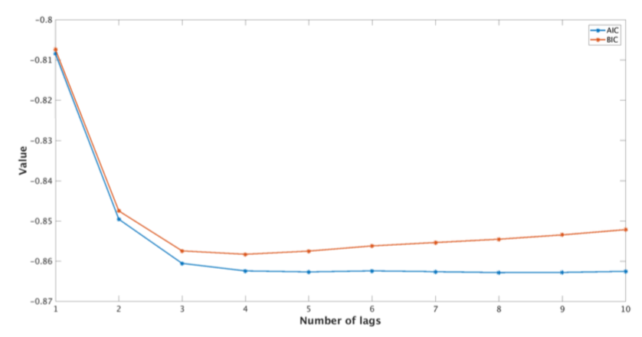
Figure S1
This figure claims similarity of red and blue
It also claims a feature: leveling out at “3-5”

Slide 9
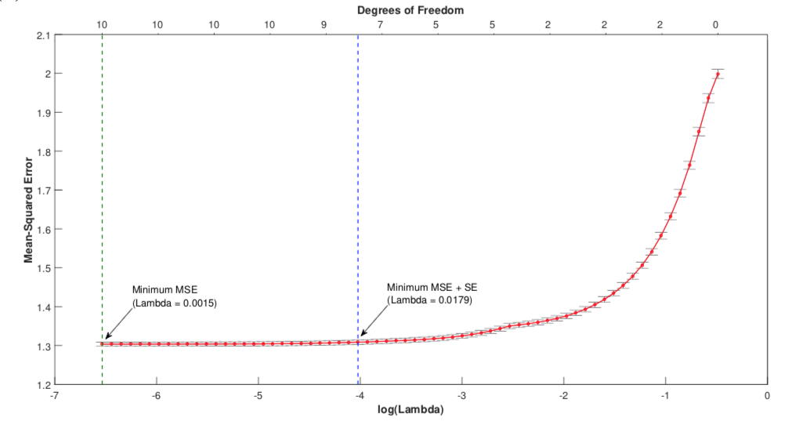
Figure S2
This figure claims a feature (flatness between green and blue lines), justifying truncation (simplification) choices in a statistical modeling exercise.

Slide 10
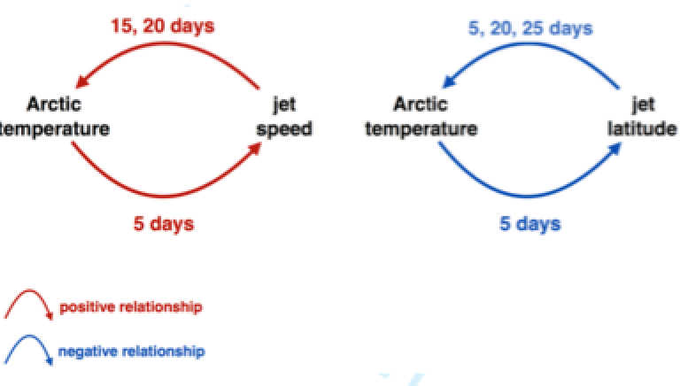
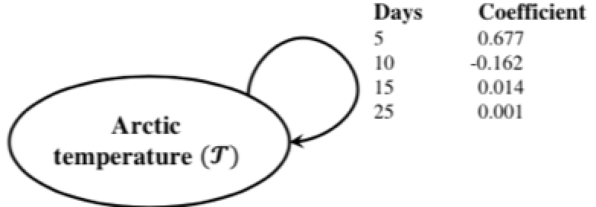
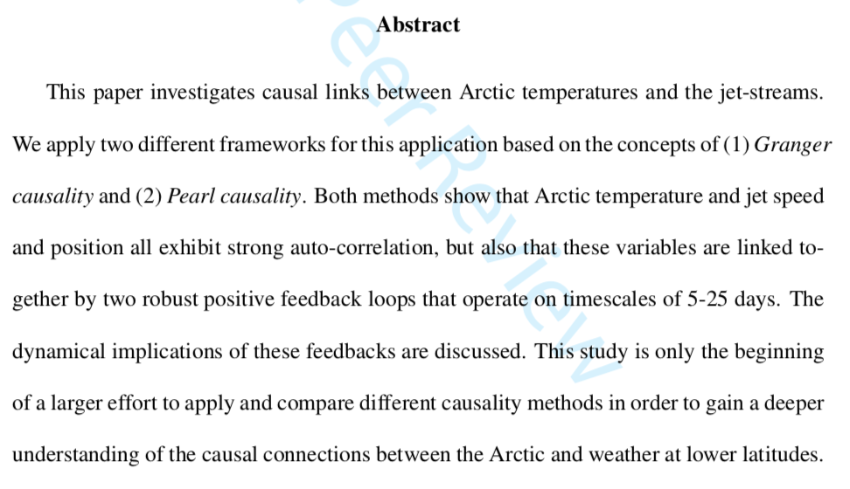
The Abstract, and how figures support its claims

