Slide 1
Gross domestic product Kelsey Thompson Colorado State University Global MIS 445: Statistics in Business Analytics Professor Mark Bateh December 29, 2023 (Turned in)
​

Slide 2
Intro to Gross domestic product (GDP)
GDP: The cost of all completed goods and services produced within a nation over a defined timeframe.
GDP: Measures economic health
(Fernando, 2023)
Histogram: Can properly illustrate the data distribution within a GDP dataset.
Notes: A histogram visually displays the distribution of continuous data, like GDP, using bars to represent frequency within specific value ranges. Bar height indicates the number of data points in each range, organized in ascending order with equal-sized intervals. (Irizarry, 2021)

Slide 3
Steps of exploratory analysis for the real, U.S. GDP.
Download FRED-realGDP.xls
Transfer the data set into SAS Studio.
Run a Summery Statistics

Slide 4

Summery Statistics
The mean for the data set is 3.2189474.
The Standard Deviation is 3.8712818.
The Minimum value is -10
the Maximum Value is 16.7.
The Number of data points (salary) is 285.

Slide 5
The Histogram IS an appropriate graph for this dataset
Displays the distribution of quantitative data.
Employs differing heights, to engage preattentive processing, for effective data visualization.
Facilitates swift and proficient comprehension of the information. (Berrier, Joel, et al, 2016)
Notes: Through comprehensive research in visual processing, it has been demonstrated that certain graphical features—including length, 2D location, width, size, intensity, color, and shape—are preattentively processed by humans. (Berrier, Joel, et al, 2016)

Slide 6
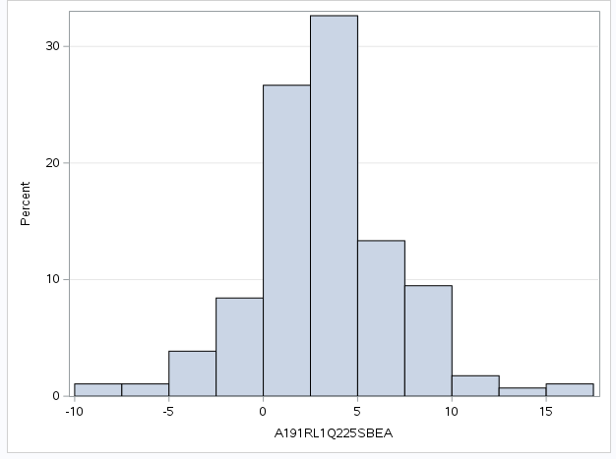
Histogram of this GDP dataset

Slide 7
Summery
Upon the successful upload of the Gross Domestic Product data, SAS was utilized to run summary statistics. Subsequently, a histogram was generated to effectively visualize this dataset.

Slide 8
References
Berrier, Joel, et al. (2016) Statistics in Business Analytics. zyBooks. https://learn.zybooks.com/zybook/23WB-MIS445-1Winter2024
Fernando, Jason (November 30, 2023) Gross Domestic Product (GDP). Investopedia https://www.investopedia.com/terms/g/gdp.asp
Irizarry, Rafael. (2021). Data Science for Biologists. https://rafalab.dfci.harvard.edu/dsbook/gapminder.html

