Slide 1
Chapter 3.
Section 3.6.2
Jaeyoung Kang
https://github.com/Embeddedroid
July 29, 2021

Slide 2
Contents
◼︎ Conditional Move Instructions
◼︎ Do-While
◼︎ While

Slide 3
Conditional Move Instructions(1/4)
Conditional Move instructions
• conditional move : conditional transfer of data
◦ Alternative of the conditional control transfers
◦ Compute both outcomes of conditional operation
◦ Select one based on whether or not the condition holds
• Good for modern processor
◦ Pipelining
◦ branch-prediction logic
• Good for fairly simple computation
• Misprediction causes severe program performance degradation

Slide 4
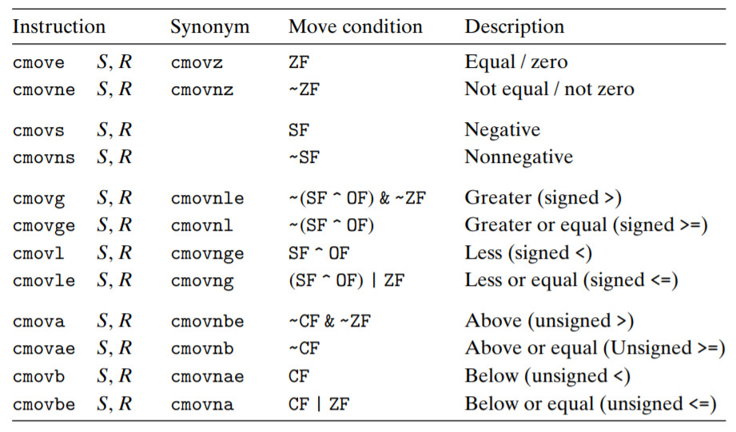
Conditional Move Instructions(2/4)
Conditional Move instructions

Slide 5
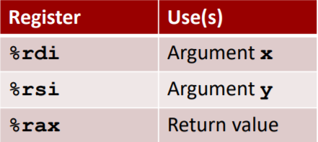
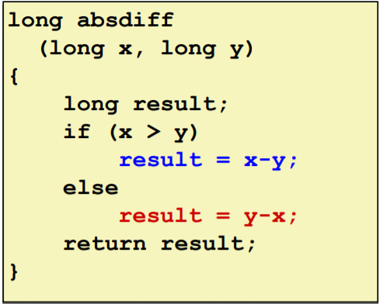
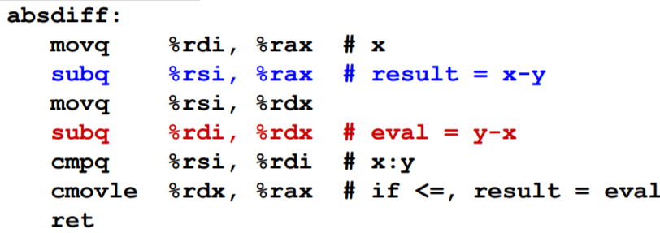
Conditional Move Instructions(3/4)
Conditional Move Example

Slide 6

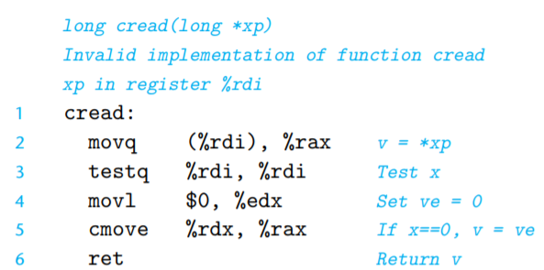
Conditional Move Instructions(4/4)
Not all conditional expressions can be compiled using conditional moves
• Expensive Computations
◦ Bad Performance → Only makes sense when computations are very simple
• Risky Computations
◦ Unsafe
▪ C function ▪ Assembly Code
▪ movq occurs even when the test fails
(null pointer deference error)

Slide 7
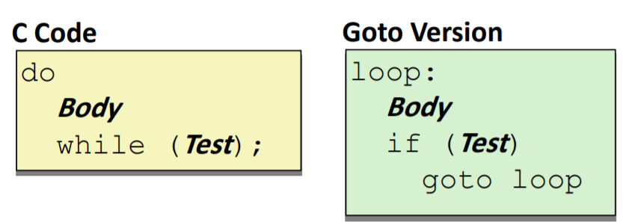
Do-While (1/2)
Do-While Loop example
• Use conditional branch to either continue looping or exit loop
• “Jump-to-middle” translation
• Used with -Og

Slide 8
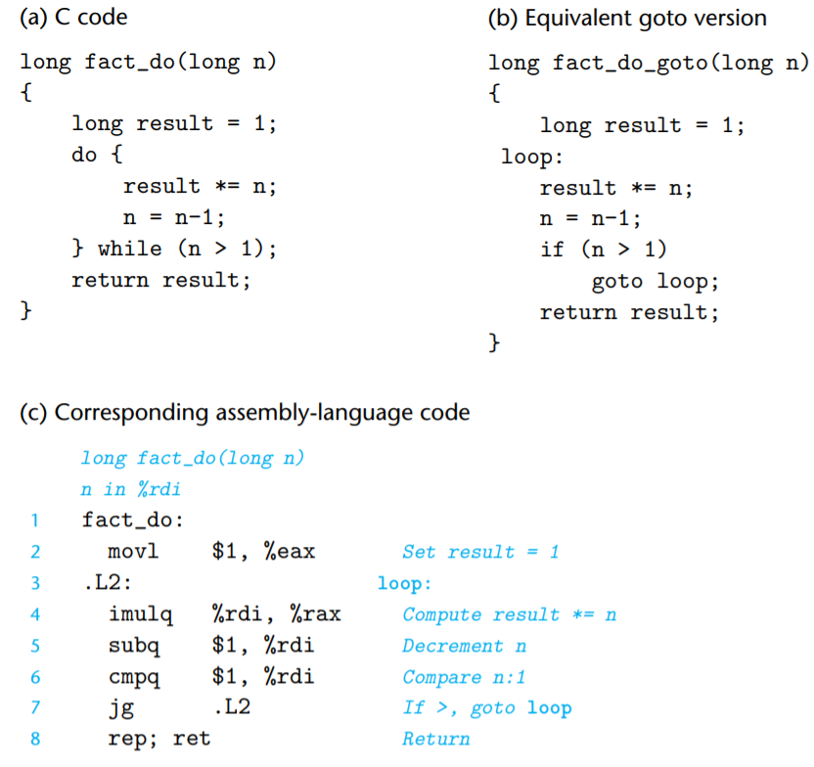
3.2 Program Encodings (1/4)

Slide 9
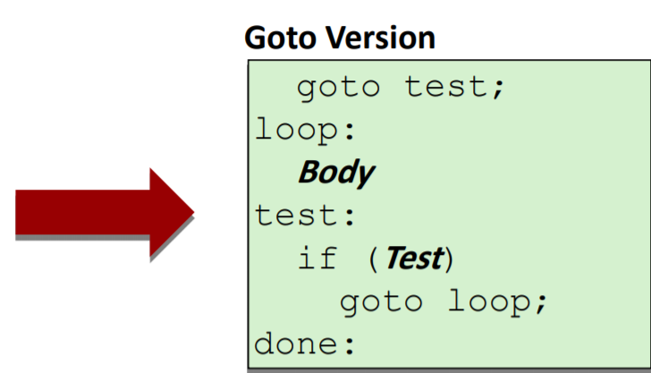
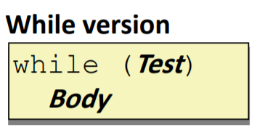
While(1/2)
While Loop example
• Use conditional branch to either continue looping or exit loop
• “Jump-to-middle” translation
• Used with –Ol

Slide 10
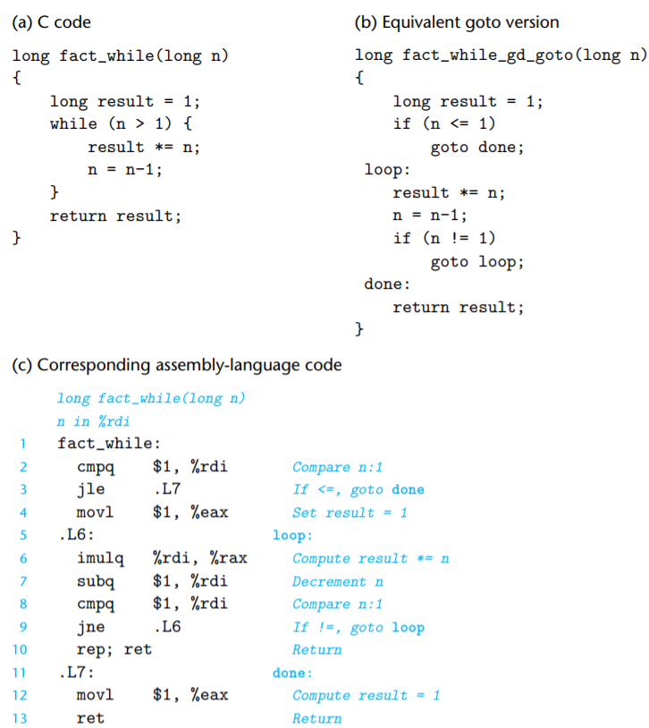
3.2 Program Encodings (1/4)

Slide 11
QnA

