Slide 1
Chapter 2. Representing and Manipulating Information
Section 2.2
Juyoung Kim
https://github.com/keltion
July 15, 2021

Slide 2
Contents
◼︎ 2.2 Integer Representations
• 2.2.1 Encoding Integers
• 2.2.4 Conversion between Signed and Unsigned
• 2.2.6 Expanding the Bit Representation of a Number
• 2.2.7 Integer Truncating Numbers
• 2.2.8 Advice On signed versus Unsigned

Slide 3
2.2.1 Encoding Integers(1/4)
• Encoding Integers
￮ Unsigned B2U(X)
- nonnegative numbers
￮ Two’s Complement B2T(X)
- negative, zero, and positive numbers
- the range of negative numbers extends one further than the range of positive numbers WHY?

Slide 4
2.2.1 Encoding Integers(2/4)
• Unsigned Encodings B2U(X)
- Treating x⃗ as a number written in binary notation. [x_{w−1}, x_{w−2}, . . . , x₀]
- MIN = 0, MAX = 2^{w}-1
- PRINCIPLE uniqueness of unsigned encoding
w=4
MIN
0 | 0 | 0 | 0
1 | 0 | 1 | 1
MAX
1 | 1 | 1 | 1
1×2³ + 0×2² + 1×2¹ + 1×2⁰ = 11

Slide 5
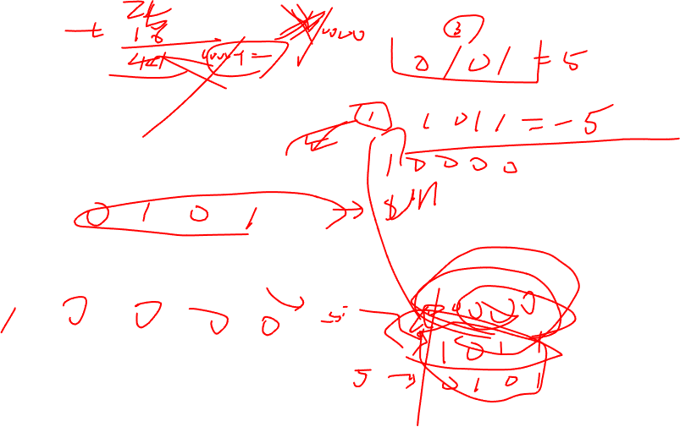
2.2.1 Encoding Integers(3/4)
• Two’s-Complement Encodings B2T(X)
- This is defined by interpreting the most significant bit of the word to have negative weight (sign bit)
- MIN = -2^{w-1}, MAX = 2^{w-1}-1 |MIN|= |MAX|+1
- PRINCIPLE uniqueness of two’s-complement encoding
w=4
MIN
1 | 0 | 0 | 0
1 | 0 | 1 | 1
MAX
0 | 1 | 1 | 1
-1×2³ + 0×2² + 1×2¹ + 1×2⁰ = -5
-8
-1
0
1
7

Slide 6
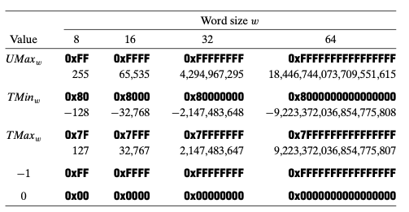
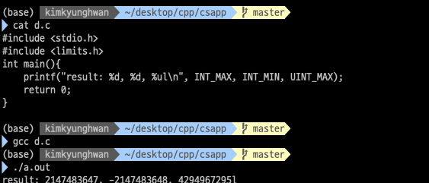
2.2.1 Encoding Integers(4/4)
• C Programming
- #include <limits.h>
- Declares constants

Slide 7

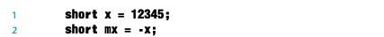
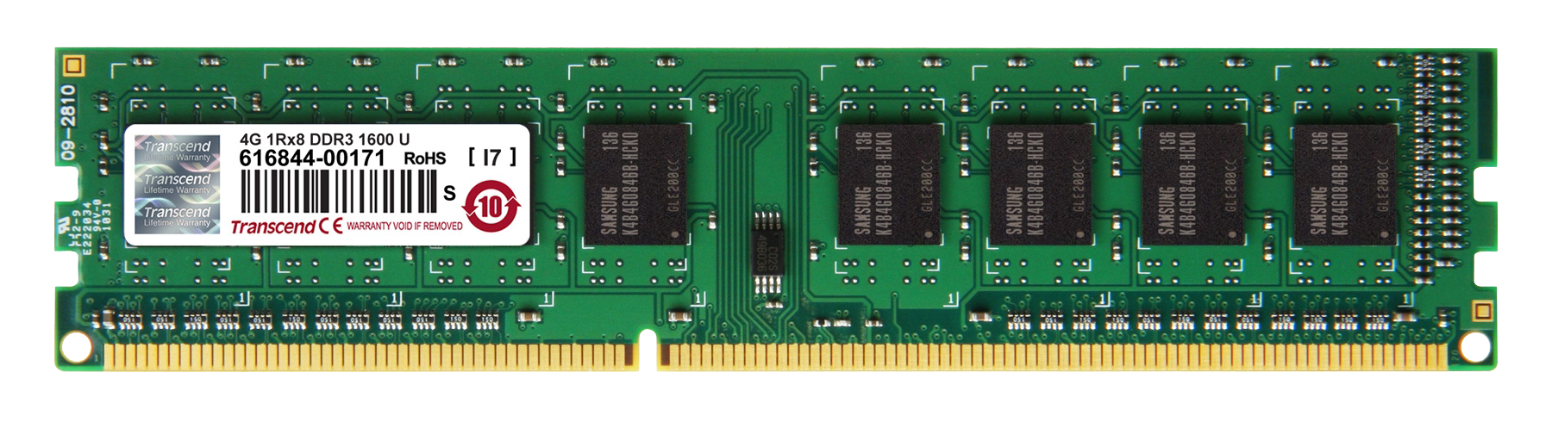

2.2.4 Conversion between Signed and Unsigned(1/2)
• Conversions between Signed and Unsigned (Same Same)
- The numeric values might change, but the bit patterns do not
- The effect of casting is to keep the bit values identical but change how these bits are interpreted.
- PRINCIPLE uniqueness of two’s-complement encoding
VS
v
x= 0x3039 mx= 0xCFC7
1 | 1 | 0 | 0
1 | 1 | 1 | 1
1 | 1 | 0 | 0
0 | 1 | 1 | 1
v = -12345 uv = 53191
uv
1 | 1 | 0 | 0
1 | 1 | 1 | 1
1 | 1 | 0 | 0
0 | 1 | 1 | 1

Slide 8

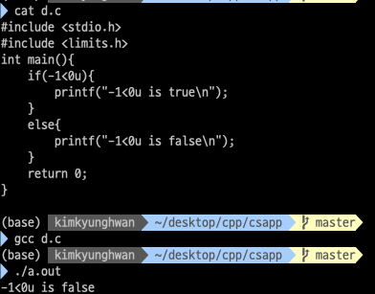

2.2.4 Conversion between Signed and Unsigned(2/2)
• Signed versus Unsigned in C
￮ Constants
- signed 1234
- unsinged 1234u
￮ Casting
- Explicit casting
- Implicit casting
- If there is a mix of unsigned and signed in single expression, signed values implicitly cast to unsigned

Slide 9
2.2.6 Expanding the Bit Representation of a Number(1/2)
• Expanding the Bit Representation of a Number
￮ unsign extension (zero extension)
￮ sign extension (copies of the most significant bit)
1 | 0 | 1 | 1
unsign
sign
0 | 0 | 0 | 0
1 | 0 | 1 | 1
1 | 1 | 1 | 1
1 | 0 | 1 | 1
0 | 0 | 1 | 1
unsign
sign
0 | 0 | 0 | 0
0 | 0 | 1 | 1
0 | 0 | 0 | 0
0 | 0 | 1 | 1

Slide 10

2.2.6 Expanding the Bit Representation of a Number(2/2)
► Relative order of conversion from one data size to another and between unsigned and signed
1 | 1 | 0 | 0
1 | 1 | 1 | 1
1 | 1 | 0 | 0
0 | 1 | 1 | 1
1. data size -> signed
1 | 1 | 1 | 1
1 | 1 | 1 | 1
1 | 1 | 1 | 1
1 | 1 | 1 | 1
1 | 1 | 0 | 0
1 | 1 | 1 | 1
1 | 1 | 0 | 0
0 | 1 | 1 | 1
2. Signed 0> data size
0 | 0 | 0 | 0
0 | 0 | 0 | 0
0 | 0 | 0 | 0
0 | 0 | 0 | 0
1 | 1 | 0 | 0
1 | 1 | 1 | 1
1 | 1 | 0 | 0
0 | 1 | 1 | 1

Slide 11
2.2.7 Integer Truncating Numbers
• Truncating Numbers
- modulus operation
￮ unsign
￮ sign
1 | 1 | 0 | 0
1 | 0 | 0 | 0
unsign
200
-56
sign
1 | 0 | 0 | 0
1 | 0 | 0 | 0
8
-8
100 mod2⁴

Slide 12
2.2.8 Advice On signed versus Unsigned
• Advice On signed versus Unsigned

Slide 13
QnA

Slide 14
