Slide 1
Chapter 2. Representing and Manipulating Information
Section 2.3
Jaeyoung Kang
https://github.com/Embeddedroid
July 15, 2021

Slide 2
Contents
◼︎ 2.3.1 Unsigned Addition
◼︎ 2.3.2 Two’s Complement Addition ︎
◼︎ 2.3.3 Two’s Complement Negation
◼︎ 2.3.4 Unsigned Multiplication
◼︎ 2.3.5 Two’s Complement Multiplication
◼︎ 2.3.6 Multiplying by Constants
◼︎ 2.3.7 Dividing by Powers of 2

Slide 3
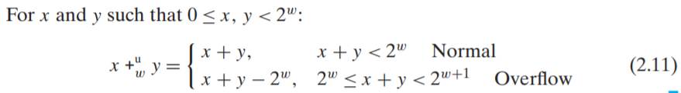
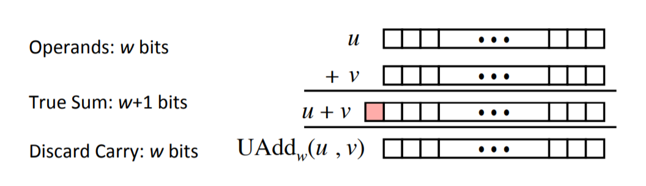
2.3.1 Unsigned Addition

Slide 4
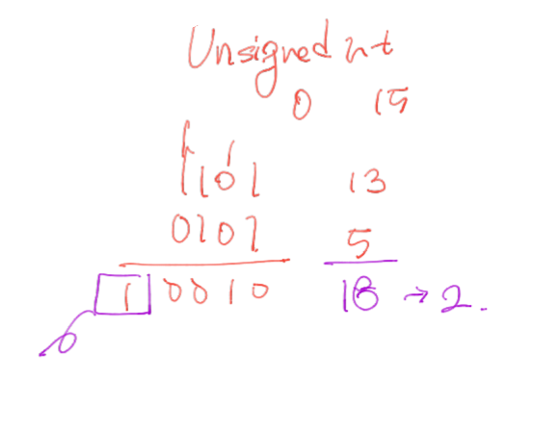
2.3.1 Unsigned Addition

Slide 5
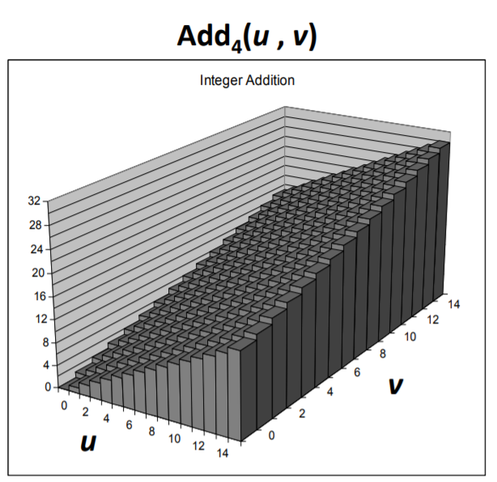
2.3.1 Unsigned Addition
Visualizing Addition
• 4 bit integers u, v
• compute true sum Add4(u, v)
• values increases linearly with u and v

Slide 6
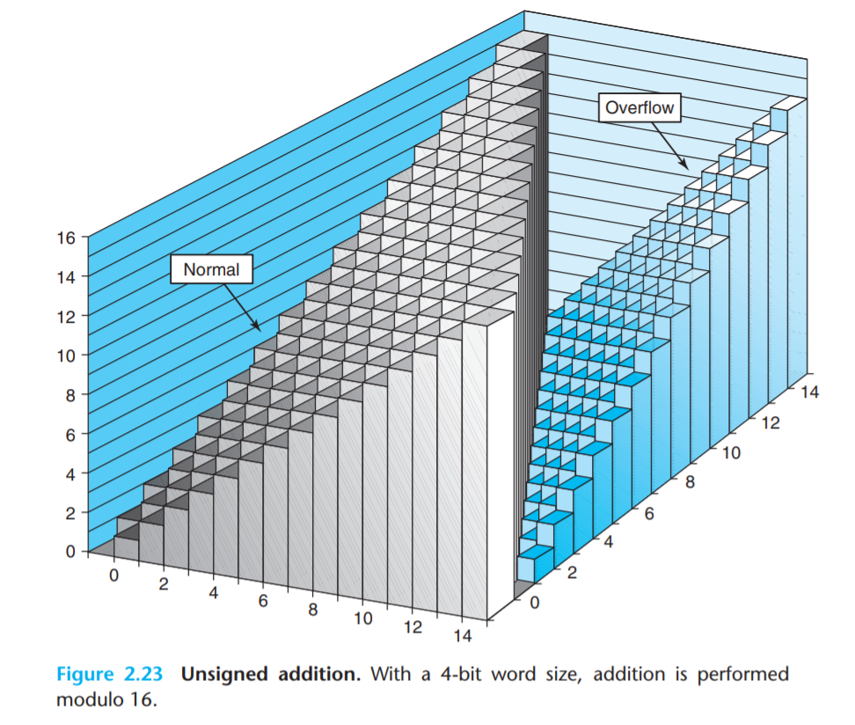
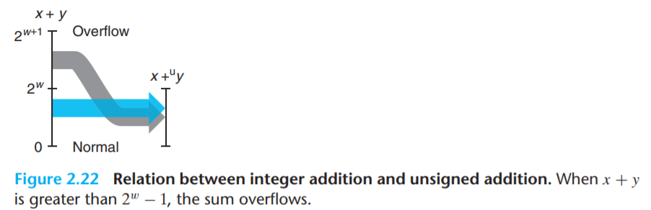
2.3.1 Unsigned Addition
Visualizing Unsigned Addition
v
u

Slide 7
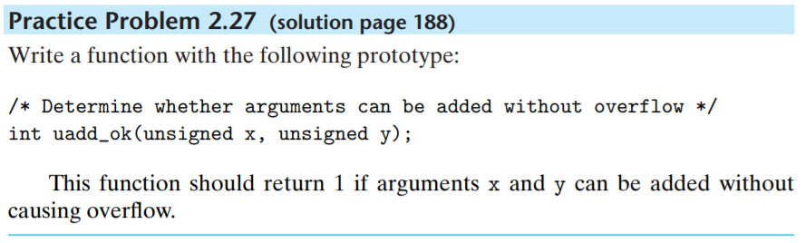
2.3.1 Unsigned Addition
Practice Problem 2.27

Slide 8
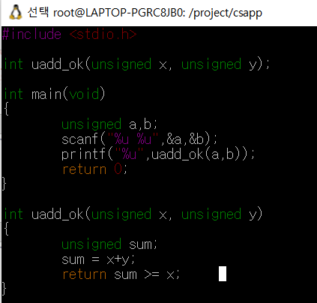
2.3.1 Unsigned Addition
Practice Problem 2.27

Slide 9
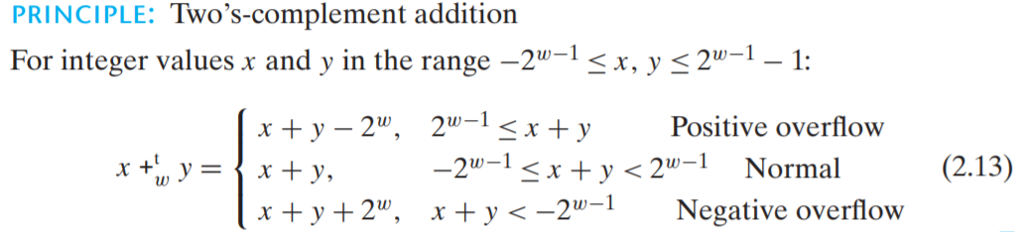
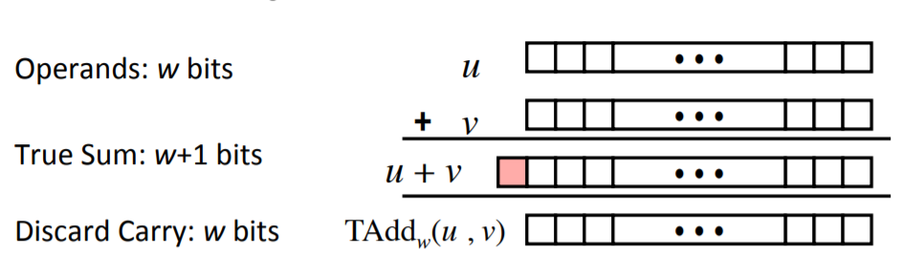
◼︎ 2.3.2 Two’s Complement Addition ︎

Slide 10
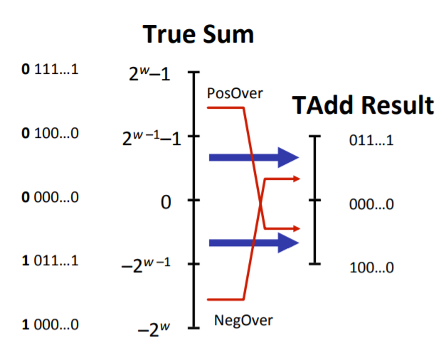
◼︎ 2.3.2 Two’s Complement Addition ︎
TAddw Overflow
• Sum requires w+1 bits
• Drop off MSB (most significant bit)

Slide 11
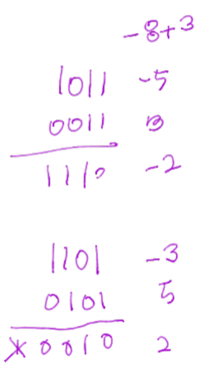
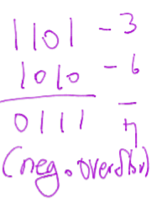
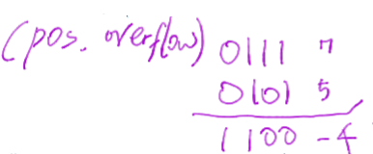
◼︎ 2.3.2 Two’s Complement Addition ︎

Slide 12
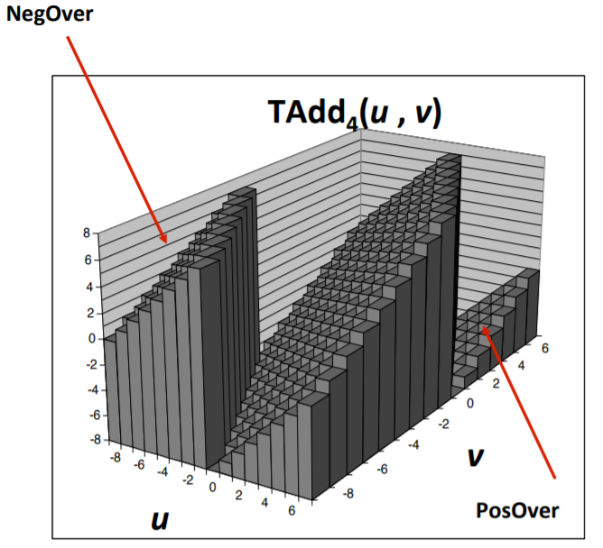
◼︎ 2.3.2 Two’s Complement Addition ︎
Visualizing Two’s Complement Addition
• Values
◦ 4-bit two’s complement complement
◦ range : -8~7
• If Sum >= 2^(w-1) : Positive Overflow
◦ becomes negative at most once
• If Sum < -2^(w-1) : Negative Overflow
◦ becomes positive at most once

Slide 13
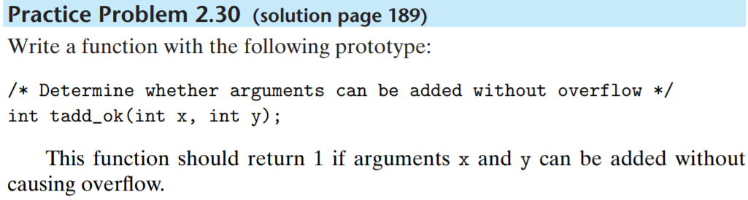
◼︎ 2.3.2 Two’s Complement Addition ︎
Practice Problem 2.30

Slide 14
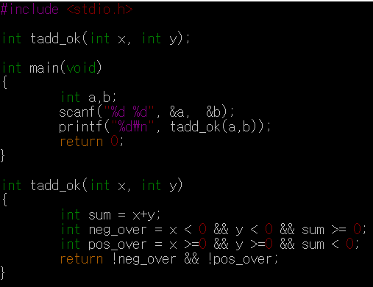
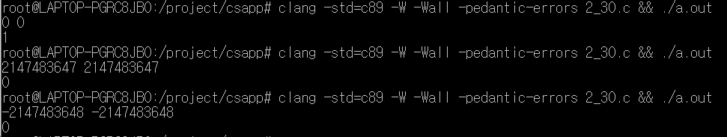
◼︎ 2.3.2 Two’s Complement Addition ︎
Practice Problem 2.30

Slide 15
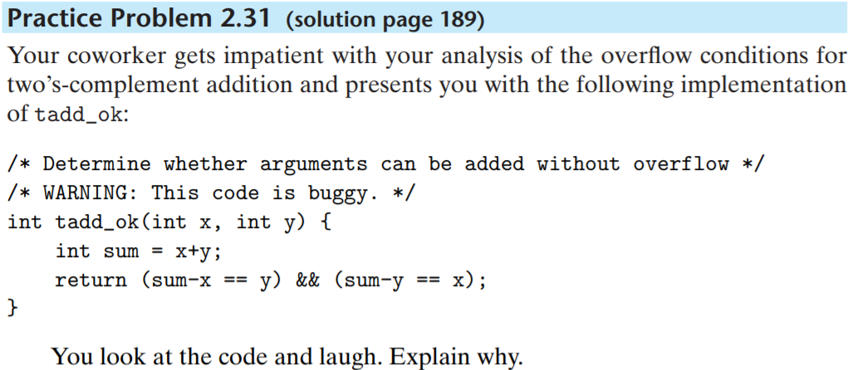
◼︎ 2.3.2 Two’s Complement Addition ︎
Practice Problem 2.31

Slide 16
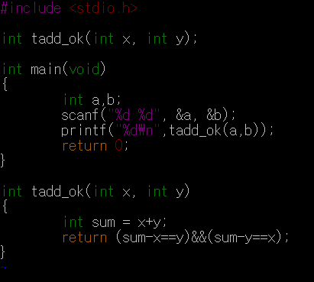

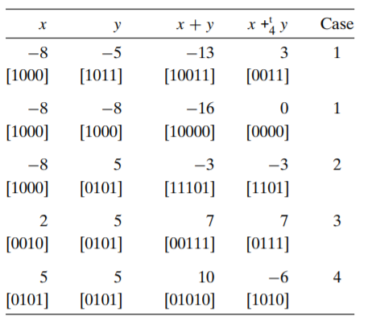

◼︎ 2.3.2 Two’s Complement Addition ︎
Practice Problem 2.31
X+y 가 overflow 가 나는지에 상관없이
항상 (x+y)-x ==y , (x+y)-y==x 성립
Two’s complement integer 는 가환성의 결과를 갖는다(abelian)

Slide 17
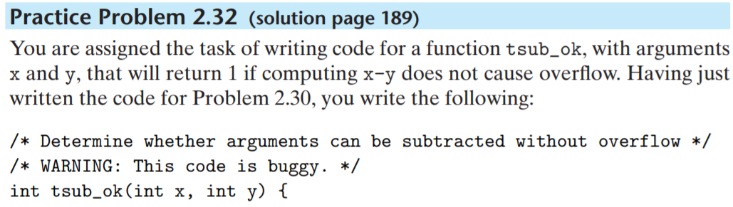
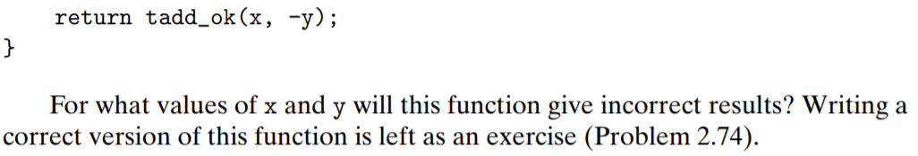
◼︎ 2.3.2 Two’s Complement Addition ︎
Practice Problem 2.32
Y = Tmin(INT_MIN) 일 때 문제 발생

Slide 18
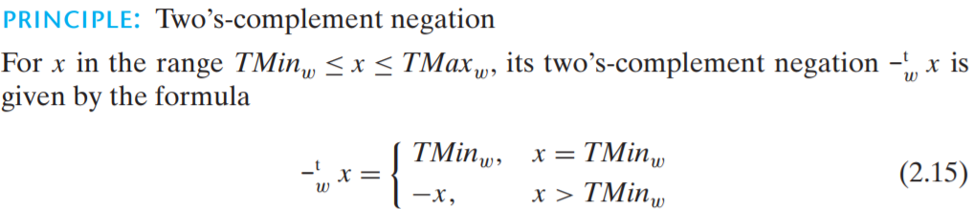
◼︎ 2.3.3 Two’s Complement Negation

Slide 19
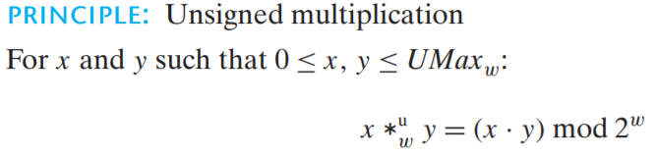
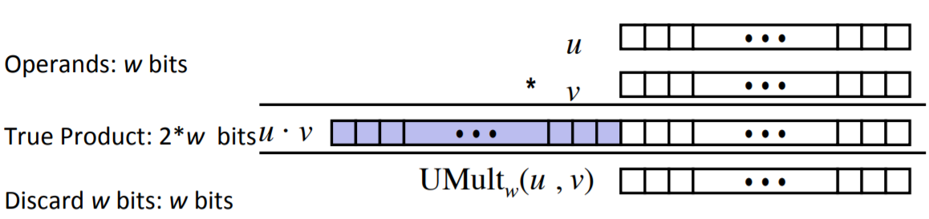

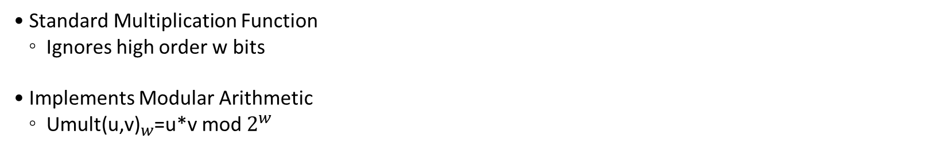
◼︎ 2.3.4 Unsigned Multiplication
Unsigned : Result Range 0 <= x*y $≤{\left(2^{w}−1\right)}^{2}$
• Standard Multiplication Function
◦ Ignores high order w bits
• Implements Modular Arithmetic
◦ ${\text{Umult}\text{(}\text{u}\text{,}\text{v}\text{)}}_{w}$=u*v mod $2^{w}$

Slide 20
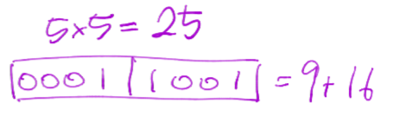
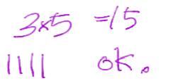
◼︎ 2.3.4 Unsigned Multiplication
Unsigned : Result Range 0 <= x*y $≤{\left(2^{w}−1\right)}^{2}$
overflow

Slide 21
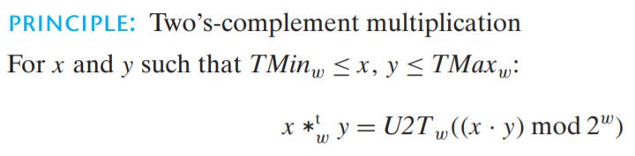
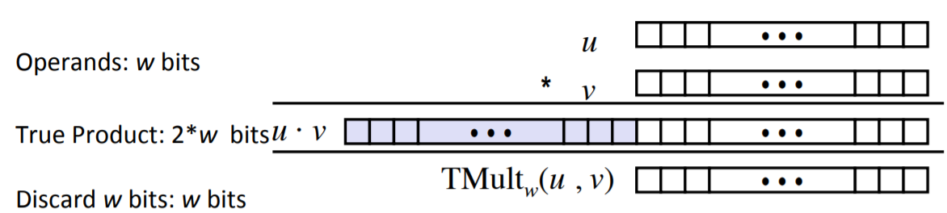
◼︎ 2.3.5 Two’s Complement Multiplication
Two’s Complement Multiplication Range : $\left(−2^{w−1}\right)∗\left(2^{w−1}−1\right)≤x∗y≤{\left(2^{w}−1\right)}^{2}$

Slide 22
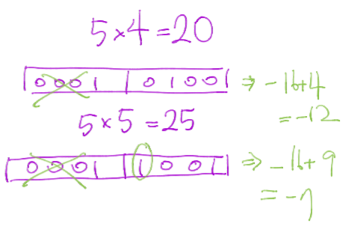
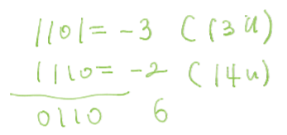
◼︎ 2.3.5 Two’s Complement Multiplication
Overflow
ok

Slide 23
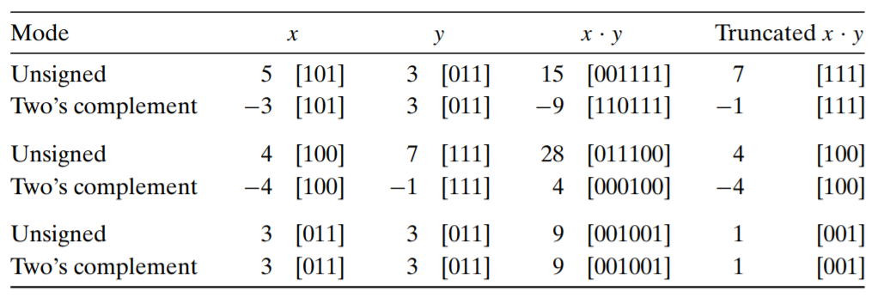
◼︎ 2.3.5 Two’s Complement Multiplication

Slide 24
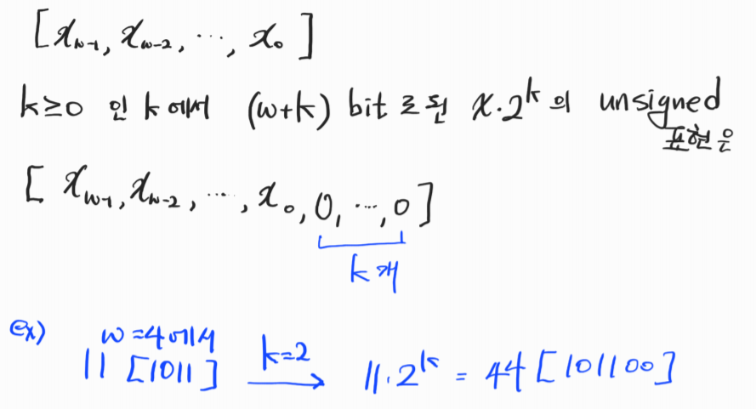
◼︎ 2.3.6 Multiplying by Constants
Multiplication by a Power of 2

Slide 25
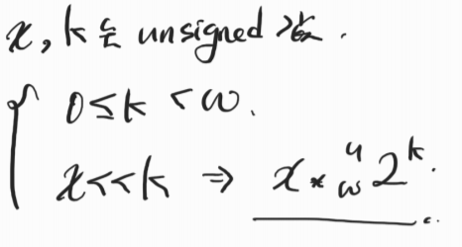
◼︎ 2.3.6 Multiplying by Constants
Unsigned Multiplication by a Power of 2

Slide 26
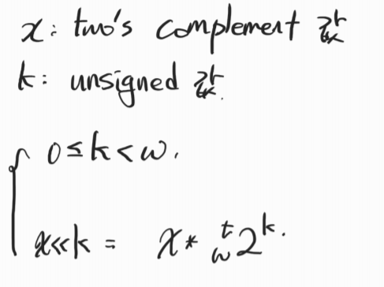
◼︎ 2.3.6 Multiplying by Constants
Two’s Complement Multiplication by a Power of 2

Slide 27
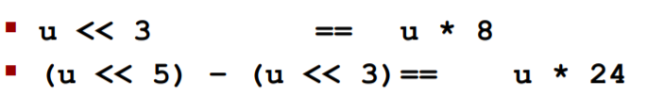
◼︎ 2.3.6 Multiplying by Constants
Examples

Slide 28
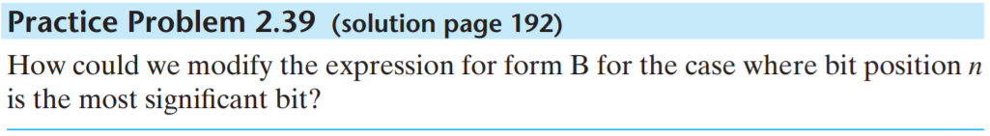
◼︎ 2.3.6 Multiplying by Constants
Practice Problem 2.39

Slide 29
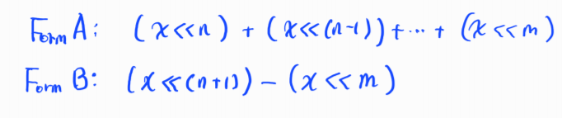
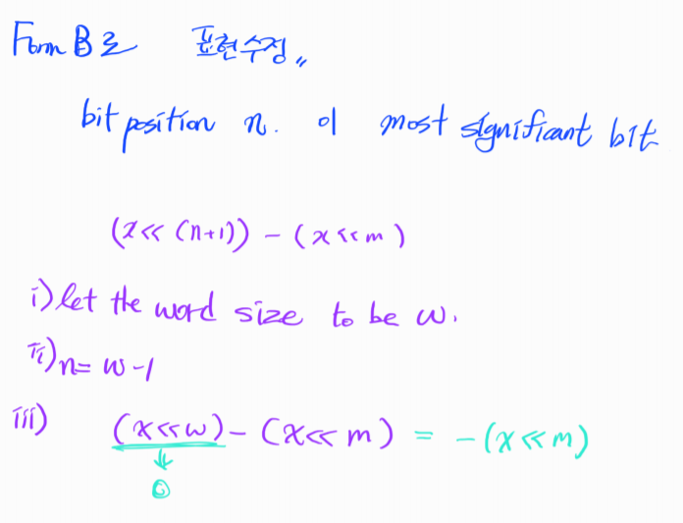
◼︎ 2.3.6 Multiplying by Constants
Practice Problem 2.39

Slide 30
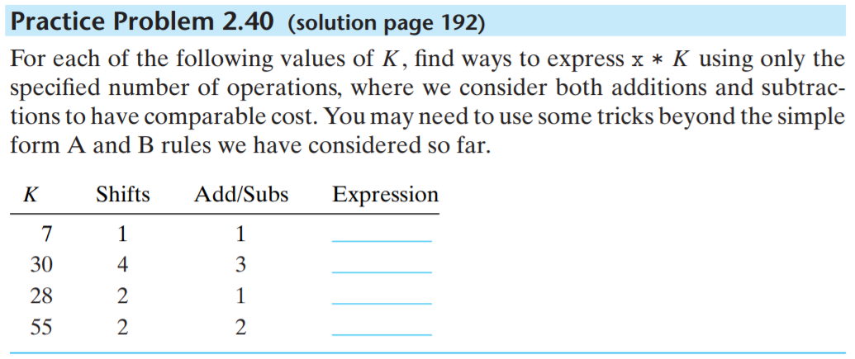
◼︎ 2.3.6 Multiplying by Constants
Practice Problem 2.40

Slide 31
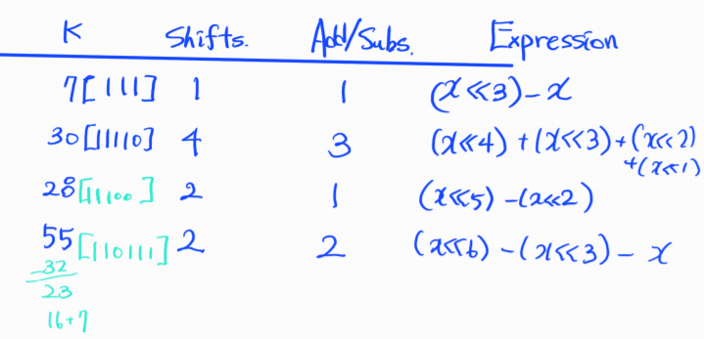
◼︎ 2.3.6 Multiplying by Constants
Practice Problem 2.40

Slide 32
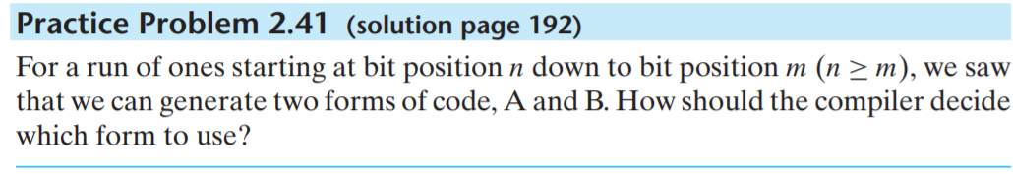
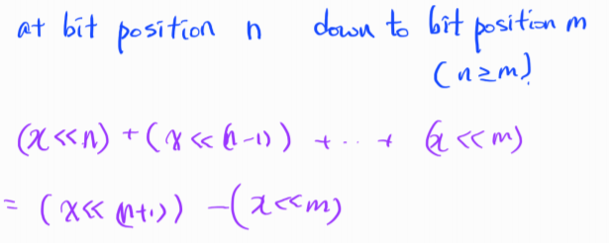
◼︎ 2.3.6 Multiplying by Constants
Practice Problem 2.40

Slide 33
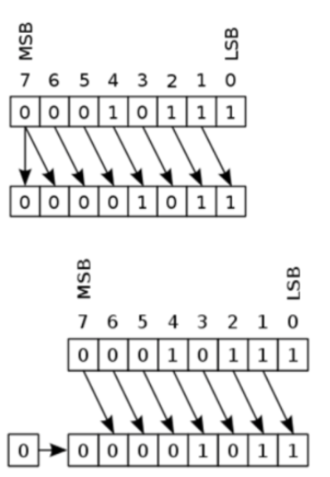
◼︎ 2.3.7 Dividing by Powers of 2
Arithmetic shift
Logic shift

Slide 34
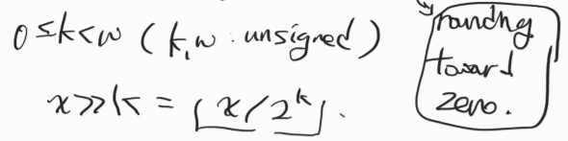
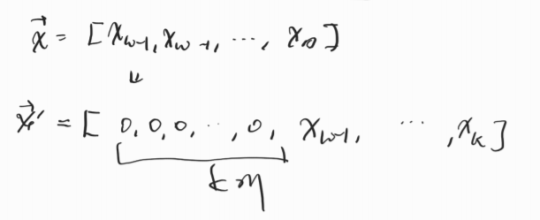
◼︎ 2.3.7 Dividing by Powers of 2
Unsigned division by a power of 2

Slide 35
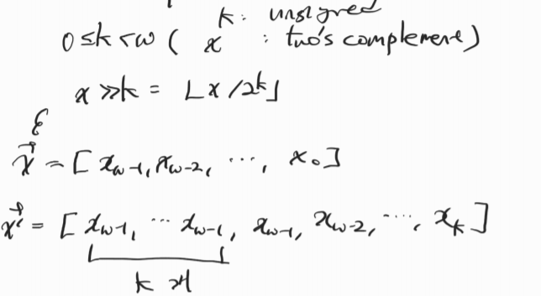
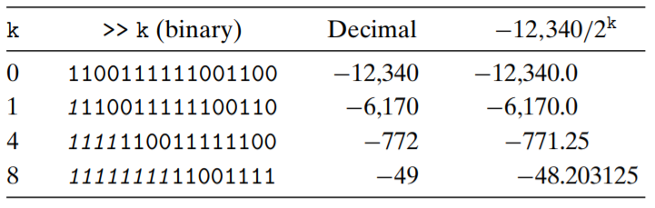
◼︎ 2.3.7 Dividing by Powers of 2
Two’s Complement division by a power of 2 (rounding down)

Slide 36


◼︎ 2.3.7 Dividing by Powers of 2
Two’s Complement division by a power of 2 (rounding up)

Slide 37
◼︎ 2.3.7 Dividing by Powers of 2
Biasing
• 음수를 right shift 할 때 발생하는 improper rounding 을 고치기 위해 shift연산 이전에 value에 대해 하는 것

Slide 38

◼︎ 2.3.7 Dividing by Powers of 2
Practice problem

Slide 39
QnA

