Slide 1
Chapter 3. Machine-Level Representation of Programs
Section 3.7
Juyoung Kim
https://github.com/keltion
July 22, 2021

Slide 2
Contents
◼︎ 3.7 Procedures
• 3.7.1 The Run-Time Stack
• 3.7.2 Control Transfer
• 3.7.3 Data Transfer
• 3.7.4 Local Storage on the Stack
• 3.7.5 Local Storage in Registers
• 3.7.6 recursive Procedures

Slide 3
Intro
► Procedures
- provide a way to package code that implements some functionality with a designated set of arguments and
an optional return value.
- There are many different attributes that must be handled when providing machine-level support for procedures.
￮ Passing control : by setting PC
￮ Passing data : provide parameters , be able to return value
￮ Allocating and deallocating memory : for local variables
function Q(int p){…}
function P(){
int q=3;
int p;
int a = Q(p);
return p*q;
}
Q1. 다른 함수로 점프하고 어떻게 다시 돌아오지?
Q2. 매개변수를 어떻게 전달하고 return 값을 어떻게 받아오지?
Notes:
함수 구현을 위해서 다음과 같은 것들이 필요하고 이를 machine level에서 어떻게 구현을 할것인지를 관찰
명령은 점프, 순차적으로 진행되는데 함수로 점프하고 어떻게 돌아오지? Run-time stack, register이용

Slide 4
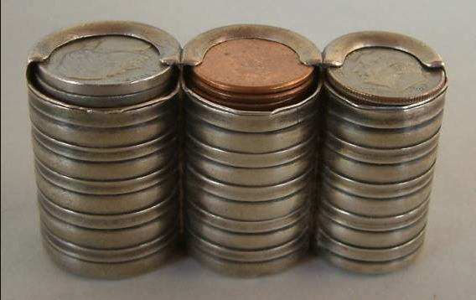
3.7.1 The Run-Time Stack
• The Run-Time Stack
- A key feature of the procedure-calling mechanism of C : stack data structure(LIFO)
stack
main
void P(){
Q();
}
int main(){
P();
}
heap
data
code
Notes:
함수 구현을 위해서 스택이 어떻게 사용되는지를 관찰

Slide 5
3.7.1 The Run-Time Stack
• The Run-Time Stack
- A key feature of the procedure-calling mechanism of C : stack data structure(LIFO)
stack
main
void P(){
Q();
}
int main(){
P();
}
P
heap
data
code

Slide 6
3.7.1 The Run-Time Stack
• The Run-Time Stack
- A key feature of the procedure-calling mechanism of C : stack data structure(LIFO)
stack
main
void P(){
Q();
}
int main(){
P();
}
P
heap
Q
data
code

Slide 7
3.7.1 The Run-Time Stack
• The Run-Time Stack
- A key feature of the procedure-calling mechanism of C : stack data structure(LIFO)
stack
main
void P(){
Q();
}
int main(){
P();
}
P
heap
data
code

Slide 8
3.7.1 The Run-Time Stack
• The Run-Time Stack
- A key feature of the procedure-calling mechanism of C : stack data structure(LIFO)
stack
main
void P(){
Q();
}
int main(){
P();
}
heap
data
code

Slide 9
3.7.1 The Run-Time Stack
• The Run-Time Stack
- A key feature of the procedure-calling mechanism of C : stack data structure(LIFO)
stack
main
P
heap
Q
data
code

Slide 10
3.7.1 The Run-Time Stack
• The Run-Time Stack
- A key feature of the procedure-calling mechanism of C : stack data structure(LIFO)
stack
Q:
(E)
P:
(C)
call Q()
(D)
main:
(A)
call P()
(B)
main
P
heap
Q
data
code

Slide 11
3.7.2 Control Transfer
• The Run-Time Stack
- A key feature of the procedure-calling mechanism of C : stack data structure(LIFO)
- As P calls Q, control and data information are added to the end of the stack
￮ control transfer
￮ data transfer
Q:
(E)
ret
P:
(C)
call Q
(D)
ret
main:
(A)
call P
(B)
main
0x72
0x7A
%rip
0x8B
P
0x8B
%rsp
0x91
0x1239
0x99
0x1239

Slide 12
3.7.2 Control Transfer
• The Run-Time Stack
- A key feature of the procedure-calling mechanism of C : stack data structure(LIFO)
- As P calls Q, control and data information are added to the end of the stack
￮ control transfer
￮ data transfer
Q:
(E)
ret
P:
(C)
call Q
(D)
ret
main:
(A)
call P
(B)
main
0x72
0x7A
%rip
0x91
1. Push RIP
2. Jump operand
P
0x8B
%rsp
0x91
0x1231
0x99
0x1239
Return address(0x91)
0x1231

Slide 13
3.7.2 Control Transfer
• The Run-Time Stack
- A key feature of the procedure-calling mechanism of C : stack data structure(LIFO)
- As P calls Q, control and data information are added to the end of the stack
￮ control transfer
￮ data transfer
Q:
(E)
ret
P:
(C)
call Q
(D)
ret
main:
(A)
call P
(B)
main
0x72
0x7A
%rip
0x72
1. Push RIP
2. Jump operand
P
0x8B
%rsp
0x91
0x1231
0x99
0x1239
Return address(0x91)
0x1231
► A call can be either direct or indirect
Notes:
Jump가 set pc?
Jump가 작동하는 원리가 pc를 바꿔서 해당 구간으로 점프하도록 하는게 아닐까?

Slide 14
3.7.2 Control Transfer
• The Run-Time Stack
- A key feature of the procedure-calling mechanism of C : stack data structure(LIFO)
- As P calls Q, control and data information are added to the end of the stack
￮ control transfer!!
￮ data transfer
Q:
(E)
ret
P:
(C)
call Q
(D)
ret
main:
(A)
call P
(B)
main
0x72
0x7A
%rip
0x7A
P
0x8B
%rsp
0x91
0x122A
0x99
0x1239
Return address(0x91)
0x1231
Q
0x122A
Notes:
대부분의 프로시저에 대한 스택 프레임은 고정 크기이며 프로시저 시작 시 할당됩니다. 그러나 일부 절차에는 가변 크기 프레임이 필요합니다. (3.10.5)
지역변수 생성시 마다 스택이 늘어나는 것 같던데.. -> !! 스택 프레임의 크기는 미리 결정해놓고 할당만 나중에!

Slide 15
3.7.2 Control Transfer
• The Run-Time Stack
- A key feature of the procedure-calling mechanism of C : stack data structure(LIFO)
- As P calls Q, control and data information are added to the end of the stack
￮ control transfer
￮ data transfer
Q:
(E)
ret
P:
(C)
call Q
(D)
ret
main:
(A)
call P
(B)
main
0x72
1. Pop
2. set RIP
0x7A
%rip
0x7A
P
0x8B
%rsp
0x91
0x1231
0x99
0x1239
Return address(0x91)
0x1231

Slide 16
3.7.2 Control Transfer
• The Run-Time Stack
- A key feature of the procedure-calling mechanism of C : stack data structure(LIFO)
- As P calls Q, control and data information are added to the end of the stack
￮ control transfer
￮ data transfer
Q:
(E)
ret
P:
(C)
call Q
(D)
ret
main:
(A)
call P
(B)
main
0x72
1. Pop
2. set RIP
0x7A
%rip
0x91
P
0x8B
%rsp
0x91
0x1239
0x99
0x1239
Return address(0x91)

Slide 17
3.7.2 Control Transfer
• The Run-Time Stack
- A key feature of the procedure-calling mechanism of C : stack data structure(LIFO)
- As P calls Q, control and data information are added to the end of the stack
￮ control transfer!!
￮ data transfer
Q:
(E)
ret
P:
(C)
call Q
(D)
ret
main:
(A)
call P
(B)
main
0x72
0x7A
%rip
0x99
P
0x8B
%rsp
0x91
0x1239
0x99
0x1239
Notes:
Stack이용

Slide 18
Intro
► Procedures
- provide a way to package code that implements some functionality with a designated set of arguments and
an optional return value.
- There are many different attributes that must be handled when providing machine-level support for procedures.
￮ Passing control : by setting PC
￮ Passing data : provide parameters , be able to return value
￮ Allocating and deallocating memory : for local variables
function Q(int p){…}
function P(){
int q=3;
int p;
int a = Q(p);
return p*q;
}
Q1. 다른 함수로 점프하고 어떻게 다시 돌아오지?
Q2. 매개변수를 어떻게 전달하고 return 값을 어떻게 받아오지?
Notes:
함수 구현을 위해서 다음과 같은 것들이 필요하고 이를 machine level에서 어떻게 구현을 할것인지를 관찰
명령은 점프, 순차적으로 진행되는데 함수로 점프하고 어떻게 돌아오지? Run-time stack, register이용

Slide 19
3.7.3 Data Transfer
• The Run-Time Stack
- A key feature of the procedure-calling mechanism of C : stack data structure(LIFO)
- As P calls Q, control and data information are added to the end of the stack
￮ control transfer
￮ data transfer
Q:
(E)
ret
P:
(C)
call Q
(D)
ret
main:
(A)
call P
(B)
main
0x72
0x7A
%rip
0x72
1. Push RIP
2. Jump operand
P
0x8B
%rsp
0x91
0x1231
0x99
0x1239
Return address(0x91)
0x1231
Notes:
Jump가 set pc?
Jump가 작동하는 원리가 pc를 바꿔서 해당 구간으로 점프하도록 하는게 아닐까?

Slide 20
3.7.3 Data Transfer
• The Run-Time Stack
- A key feature of the procedure-calling mechanism of C : stack data structure(LIFO)
- As P calls Q, control and data information are added to the end of the stack
￮ control transfer
￮ data transfer
Q:
(E)
ret
P:
(C)
call Q
(D)
ret
main:
(A)
call P
(B)
main
0x72
0x7A
%rip
0x7A
P
0x8B
%rsp
0x91
0x122A
0x99
0x1239
Return address(0x91)
0x1231
Q
0x122A

Slide 21
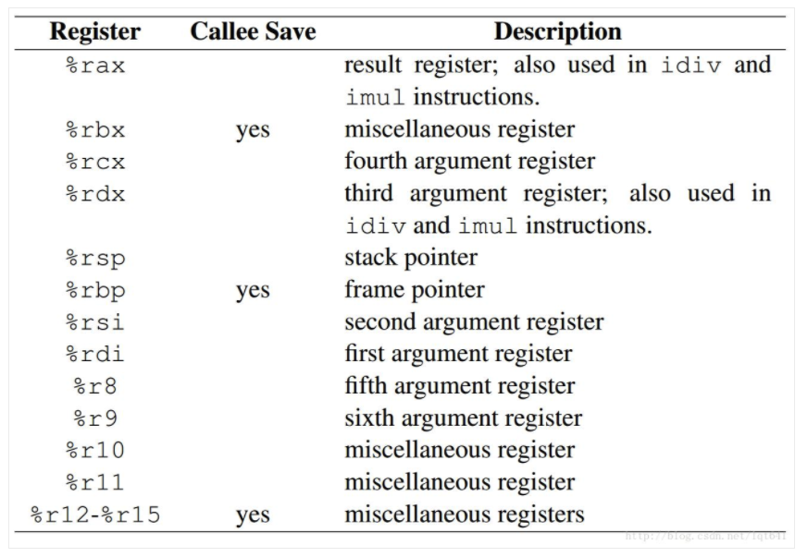
reference
► x86-64 order of passing parameters in registers
- Six registers are used to store the six parameters of the function call(%rdi, %rsi, %rdx, %rcx, %r8, %r9)
- example
- function prototype void func(int p1, int p2, int p3);
- function call void func(14, 1, 12);
%rdi
0xE
%rsi
0x1
%rdx
0xC

Slide 22
3.7.3 Data Transfer
• The Run-Time Stack
- A key feature of the procedure-calling mechanism of C : stack data structure(LIFO)
- As P calls Q, control and data information are added to the end of the stack
￮ control transfer
￮ data transfer
Q:
(E)
ret
P:
(C)
call Q
(D)
ret
main:
(A)
call P
(B)
main
0x72
0x7A
%rip
0x72
1. Push RIP
2. Jump operand
P
0x8B
%rsp
0x91
0x1231
0x99
0x1239
Return address(0x91)
0x1231
Notes:
Jump가 set pc?
Jump가 작동하는 원리가 pc를 바꿔서 해당 구간으로 점프하도록 하는게 아닐까?

Slide 23
3.7.3 Data Transfer
• The Run-Time Stack
- A key feature of the procedure-calling mechanism of C : stack data structure(LIFO)
- As P calls Q, control and data information are added to the end of the stack
￮ control transfer
￮ data transfer!! : by register & stack
Q:
(E)
ret
P:
(C)
call Q
(D)
ret
main:
(A)
call P
(B)
main
0x72
0x7A
%rip
0x7A
P
0x8B
%rsp
0x91
0x122A
0x99
0x1239
Return address(0x91)
0x1231
Q
$111
0x122A
► When passing parameters on the stack, all data sizes are rounded up to be multiples of eight

Slide 24
Intro
► Procedures
- provide a way to package code that implements some functionality with a designated set of arguments and
an optional return value.
- There are many different attributes that must be handled when providing machine-level support for procedures.
￮ Passing control : by setting PC
￮ Passing data : provide parameters , be able to return value
￮ Allocating and deallocating memory : for local variables
function Q(int p){…}
function P(){
int q=3;
int p;
int a = Q(p);
return p*q;
}
Q2. 매개변수를 어떻게 전달하고 return 값을 어떻게 받아오지?
Notes:
함수 구현을 위해서 다음과 같은 것들이 필요하고 이를 machine level에서 어떻게 구현을 할것인지를 관찰
명령은 점프, 순차적으로 진행되는데 함수로 점프하고 어떻게 돌아오지? Run-time stack, register이용

Slide 25
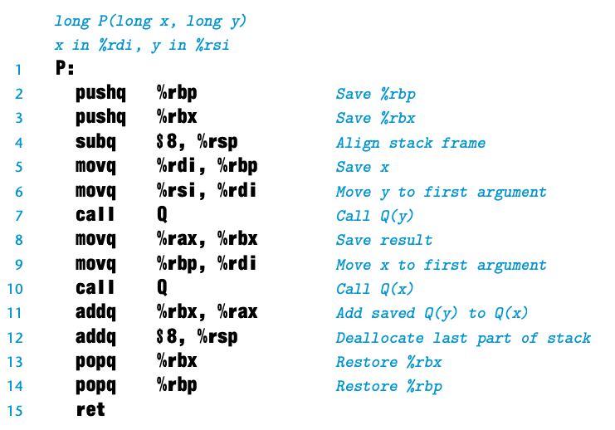
3.7.5 Local Storage in Registers
• Local Storage in Registers
- The set of program registers acts as a single resource shared by all of the procedures
- we must make sure that when one procedure(the caller) calls another(the callee)
￮ callee-saved registers : %rbx, %rbp, %r12~%r15
￮ caller-saved registers: All other registers, except %rsp
%rax
%8
0x7A
…
%rbx
%r9
Q:
(E)
ret
P:
(C)
call Q
(D)
ret
main:
(A)
call P
(B)
$111
…
%rcx
%r10
main
0x173
…
%rdx
%11
$9
…
%rsi
%12
P
$1
…
%rdi
%13
$22
…
%rbp
%14
…
…
%rsp
%r15
…
…
Notes:
Caller saved register: 호출 간에 보존할 필요가 없는 임시 값을 유지하는 데 사용됩니다.) caller의 책임
Callee saved register : 호출 간에 보존되어야 하는 수명이 긴 값을 유지하는 데 사용됩니다. 이러한 이유로 프로시저 호출 후 이 값을 복원하려는 경우 이러한 레지스터를 스택에 푸시하거나 다른 위치에 복사하는 것은 호출자의 책임입니다.따라서 callee saved register에 있는 값을 P(caller)가 안전하게 저장할 수 있다.
https://stackoverflow.com/questions/9268586/what-are-callee-and-caller-saved-registers

Slide 26
3.7.6 recursive procedures
• recursive procedures
- We can see from this example that calling a function recursively proceeds just like any other function call
- Each procedure call has its own private space on the stack
- Stack discipline provides a mechanism where each invocation of a function has its own private storage for state
information

Slide 27
QnA

