Slide 1
Chapter 3. Machine-Level Representation of Programs
Section 3.5
Juyoung Kim
https://github.com/keltion
July 22, 2021

Slide 2
Contents
◼︎ 3.5 Arithmetic and Logical Operations
• 3.5.1 Load effective address
• 3.5.2 Unary and Binary Operations
• 3.5.3 Shift Operations
• 3.5.4
• 3.5.5

Slide 3
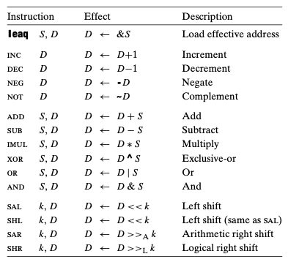
Intro
► Arithmetic and Logical Operations

Slide 4
3.5.1 Load effective address
• Load effective address
￮ leaq Src, Dst
- Src is address mode expression
- It does not reference memory at all
- cf) movq Src, Dst
leaq (%rdi), %rax vs movq (%rdi), %rax
leaq 4(%rdi), %rax vs movq 4(%rdi), %rax ? movq %rdi+4 , %rax
%rdi
0x100
0x7
0x100
0x101
%rax
0x102
0x103
0x104
0x9

Slide 5
3.5.1 Load effective address
• Load effective address
￮ leaq Src, Dst
- Src is address mode expression
- It does not reference memory at all
- cf) movq Src, Dst
leaq (%rdi), %rax vs movq (%rdi), %rax
leaq 4(%rdi), %rax vs movq 4(%rdi), %rax ? movq %rdi+4 , %rax
%rdi
0x100
0x7
0x100
0x101
%rax
0x102
0x103
0x104
0x9

Slide 6
3.5.1 Load effective address
• Load effective address
￮ leaq Src, Dst
- Src is address mode expression
- It does not reference memory at all
- cf) movq Src, Dst
leaq (%rdi), %rax vs movq (%rdi), %rax
leaq 4(%rdi), %rax vs movq 4(%rdi), %rax ? movq %rdi+4 , %rax
%rdi
0x100
0x7
0x100
0x101
%rax
0x102
0x103
0x104
0x9

Slide 7
3.5.1 Load effective address
• Load effective address
￮ leaq Src, Dst
- Src is address mode expression
- It does not reference memory at all
- cf) movq Src, Dst
leaq (%rdi), %rax vs movq (%rdi), %rax
leaq 4(%rdi), %rax vs movq 4(%rdi), %rax ? movq %rdi+4 , %rax
%rdi
0x100
0x7
0x100
0x101
%rax
0x102
0x103
0x104
0x9

Slide 8
3.5.1 Load effective address
• Load effective address
￮ leaq Src, Dst
- Src is address mode expression
- It does not reference memory at all
- cf) movq Src, Dst
leaq (%rdi), %rax vs movq (%rdi), %rax
leaq 4(%rdi), %rax vs movq 4(%rdi), %rax ? movq %rdi+4 , %rax
%rdi
0x100
0x7
0x100
0x101
%rax
0x102
0x7
0x103
0x104
0x9

Slide 9
3.5.1 Load effective address
• Load effective address
￮ leaq Src, Dst
- Src is address mode expression
- It does not reference memory at all
- cf) movq Src, Dst
leaq (%rdi), %rax vs movq (%rdi), %rax
leaq 4(%rdi), %rax vs movq 4(%rdi), %rax ? movq %rdi+4 , %rax
%rdi
0x100
0x7
0x100
0x101
%rax
0x102
0x103
0x104
0x9

Slide 10
3.5.1 Load effective address
• Load effective address
￮ leaq Src, Dst
- Src is address mode expression
- It does not reference memory at all
- cf) movq Src, Dst
leaq (%rdi), %rax vs movq (%rdi), %rax
leaq 4(%rdi), %rax vs movq 4(%rdi), %rax ? movq %rdi+4 , %rax
%rdi
0x100
0x7
0x100
0x101
%rax
0x102
0x103
0x104
0x9

Slide 11
3.5.1 Load effective address
• Load effective address
￮ leaq Src, Dst
- Src is address mode expression
- It does not reference memory at all
- cf) movq Src, Dst
leaq (%rdi), %rax vs movq (%rdi), %rax
leaq 4(%rdi), %rax vs movq 4(%rdi), %rax ? movq %rdi+4 , %rax
%rdi
0x100
0x7
0x100
0x101
%rax
0x102
0x100
0x103
0x104
0x9

Slide 12
3.5.1 Load effective address
• Load effective address
￮ leaq Src, Dst
- Src is address mode expression
- It does not reference memory at all
- cf) movq Src, Dst
leaq (%rdi), %rax vs movq (%rdi), %rax
leaq 4(%rdi), %rax vs movq 4(%rdi), %rax ? movq %rdi+4 , %rax
%rdi
0x100
0x7
0x100
0x101
%rax
0x102
0x103
0x104
0x9

Slide 13
3.5.1 Load effective address
• Load effective address
￮ leaq Src, Dst
- Src is address mode expression
- It does not reference memory at all
- cf) movq Src, Dst
leaq (%rdi), %rax vs movq (%rdi), %rax
leaq 4(%rdi), %rax vs movq 4(%rdi), %rax ? movq %rdi+4 , %rax
%rdi
0x104
0x100
0x7
0x100
0x101
%rax
0x102
0x103
0x104
0x9

Slide 14
3.5.1 Load effective address
• Load effective address
￮ leaq Src, Dst
- Src is address mode expression
- It does not reference memory at all
- cf) movq Src, Dst
leaq (%rdi), %rax vs movq (%rdi), %rax
leaq 4(%rdi), %rax vs movq 4(%rdi), %rax ? movq %rdi+4 , %rax
%rdi
0x104
0x100
0x7
0x100
0x101
%rax
0x102
0x103
0x104
0x9

Slide 15
3.5.1 Load effective address
• Load effective address
￮ leaq Src, Dst
- Src is address mode expression
- It does not reference memory at all
- cf) movq Src, Dst
leaq (%rdi), %rax vs movq (%rdi), %rax
leaq 4(%rdi), %rax vs movq 4(%rdi), %rax ? movq %rdi+4 , %rax
%rdi
0x104
0x100
0x7
0x100
0x101
%rax
0x102
0x9
0x103
0x104
0x9

Slide 16
3.5.1 Load effective address
• Load effective address
￮ leaq Src, Dst
- Src is address mode expression
- It does not reference memory at all
- cf) movq Src, Dst
leaq (%rdi), %rax vs movq (%rdi), %rax
leaq 4(%rdi), %rax vs movq 4(%rdi), %rax ? movq %rdi+4 , %rax
%rdi
0x100
0x7
0x100
0x101
%rax
0x102
0x103
0x104
0x9

Slide 17
3.5.1 Load effective address
• Load effective address
￮ leaq Src, Dst
- Src is address mode expression
- It does not reference memory at all
- cf) movq Src, Dst
leaq (%rdi), %rax vs movq (%rdi), %rax
leaq 4(%rdi), %rax vs movq 4(%rdi), %rax ? movq %rdi+4 , %rax
%rdi
0x104
0x100
0x7
0x100
0x101
%rax
0x102
0x103
0x104
0x9

Slide 18
3.5.1 Load effective address
• Load effective address
￮ leaq Src, Dst
- Src is address mode expression
- It does not reference memory at all
- cf) movq Src, Dst
leaq (%rdi), %rax vs movq (%rdi), %rax
leaq 4(%rdi), %rax vs movq 4(%rdi), %rax ? movq %rdi+4 , %rax
%rdi
0x104
0x100
0x7
0x100
0x101
%rax
0x102
0x103
0x104
0x9

Slide 19
3.5.1 Load effective address
• Load effective address
￮ leaq Src, Dst
- Src is address mode expression
- It does not reference memory at all
- cf) movq Src, Dst
leaq (%rdi), %rax vs movq (%rdi), %rax
leaq 4(%rdi), %rax vs movq 4(%rdi), %rax ? movq %rdi+4 , %rax
%rdi
0x104
0x100
0x7
0x100
0x101
%rax
0x102
0x104
0x103
0x104
0x9

Slide 20
3.5.1 Load effective address
• Load effective address
￮ Uses
- To generate pointers for later memory references
- To compactly describe common arithmetic operations
- The destination operand must be a register.
► myFunc(int* x, int y)
leaq (%rdi), %rax
leaq 7(%rdi,%rdi,4), %rax
%rdi
0x100
0x7
%rdi
0x100
0x7
0x100
0x9
%rax
%rax
0x100
0x34

Slide 21
3.5.2 Unary and Binary Operations
• Unary and Binary Operations
￮ Unary Operations
- The single operand serving as both source and destination
- example
▪︎ decq %rcx
▪︎ incq (%rsp)
￮ Binary Operations
- The second operand is used as both a source and a destination
- As with the mov instructions, the two operands cannot both be memory locations
- example
▪︎ addq %rcx, (%rax)
▪︎ subq %rdx, 8(%rax) ▪ imulq $16, (%rax,%rdx,8)
%rsp
0x100
0x7
0x100
%rax
0x100
0x7
0x100
%rdx
0x1
0x108
0x5

Slide 22
3.5.2 Unary and Binary Operations
• Unary and Binary Operations
￮ Unary Operations
- The single operand serving as both source and destination
- example
▪︎ decq %rcx
▪︎ incq (%rsp)
￮ Binary Operations
- The second operand is used as both a source and a destination
- As with the mov instructions, the two operands cannot both be memory locations
- example
▪︎ addq %rcx, (%rax)
▪︎ subq %rdx, 8(%rax) ▪ imulq $16, (%rax,%rdx,8)
%rsp
0x100
0x7
0x100
%rax
0x100
0x7
0x100
0x108
%rdx
0x1
0x108
0x5

Slide 23
3.5.2 Unary and Binary Operations
• Unary and Binary Operations
￮ Unary Operations
- The single operand serving as both source and destination
- example
▪︎ decq %rcx
▪︎ incq (%rsp)
￮ Binary Operations
- The second operand is used as both a source and a destination
- As with the mov instructions, the two operands cannot both be memory locations
- example
▪︎ addq %rcx, (%rax)
▪︎ subq %rdx, 8(%rax) ▪ imulq $16, (%rax,%rdx,8)
%rsp
0x100
0x7
0x100
0x8
%rax
0x100
0x7
0x100
%rdx
0x1
0x108
0x5

Slide 24
3.5.2 Unary and Binary Operations
• Unary and Binary Operations
￮ Unary Operations
- The single operand serving as both source and destination
- example
▪︎ decq %rcx
▪︎ incq (%rsp)
￮ Binary Operations
- The second operand is used as both a source and a destination
- As with the mov instructions, the two operands cannot both be memory locations
- example
▪︎ addq %rcx, (%rax)
▪︎ subq %rdx, 8(%rax) ▪ imulq $16, (%rax,%rdx,8)
%rsp
0x100
0x7
0x100
0x8
%rax
0x100
0x7
0x100
0x108
%rdx
0x1
0x108
0x5
0x4

Slide 25
3.5.3 Shift Operations
• Shift Operations
- The shift amount is given first and the value to shift is given second
- Can specify the shift amount either as an immediate value or with the single-byte register %cl
- With x86-64, w bits long determines the shift amount from the low-order m bits of %cl, where 2^{m} = w
- Both arithmetic and logical right shifts are possible
￮ left shift instruction
- sal - shl
￮ right shift instruction
- sar (arithmetic shift) - shr (logical shift)
- salq $4, %rax // x<<= 4
- when %cl == 0xFF,
- salw %cl %rax : %rax<< 15,
- sall %cl %rax : %rax << 31
%rsp
0x1010
0x10100000
%cl
0x1010
0x11111111
m

Slide 26
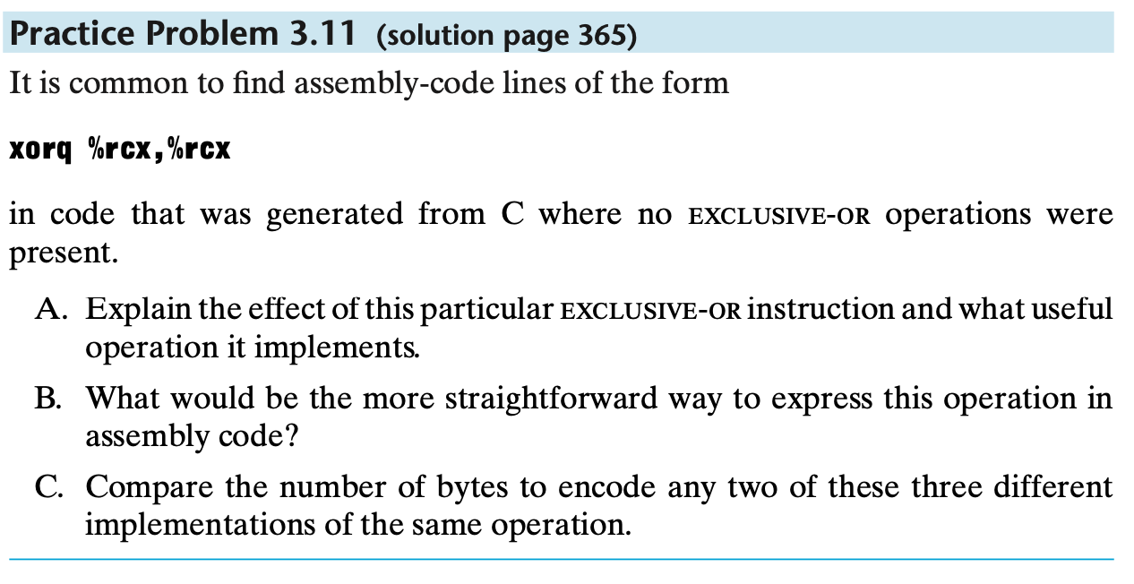
3.5.4 Discussion
• Discussion
It corresponds to the C code x = 0
movq $0, %rcx
xorq require 3 byte
movq require 7 byte
xorl %ecx, %ecx require 2 byte
movl $0, %ecx require 5byte

Slide 27
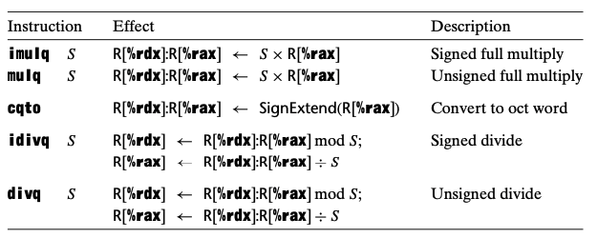
3.5.5 Special Arithmetic Operations
• Special Arithmetic Operations
- multiplying two 64-bit signed or unsigned integers can yield a product that requires 128 bits to represent (sec 2.3)
- The x86-64 instruction set provides limited support for operations involving 128-bit (16-byte) numbers

Slide 28
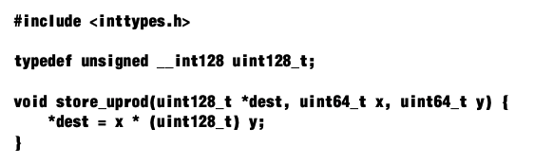
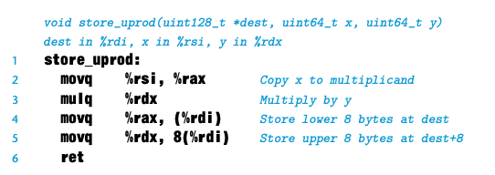
3.5.5 Special Arithmetic Operations
• Special Arithmetic Operations
￮ Multiply instructions
- mulq (for unsigned)
- imulq (for two’s-complement)
- One argument must be in register %rax, and the other is given as the instruction source operand
- The product is then stored in registers %rdx (high-order 64 bits) and %rax (low-order 64 bits)
%rdx
%rax
0xE
0x1
dest
0x1
0xE

Slide 29
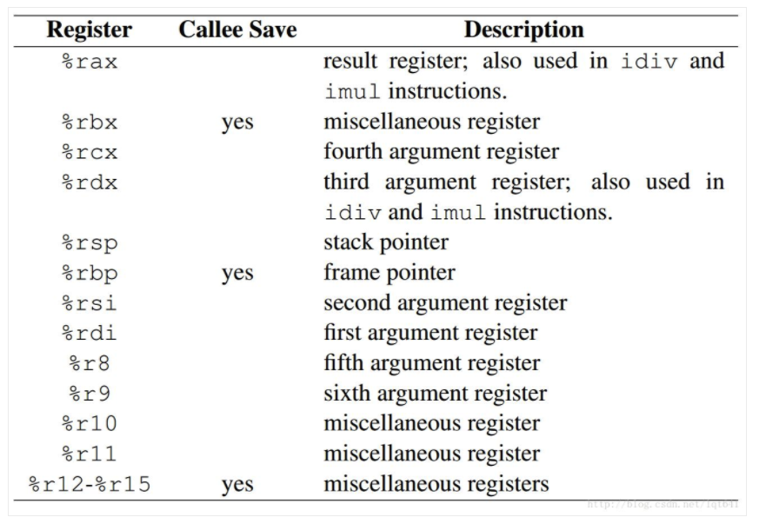
reference
► x86-64 order of passing parameters in registers
- Six registers are used to store the six parameters of the function call(%rdi, %rsi, %rdx, %rcx, %r8, %r9)
- example
- function prototype void func(int p1, int p2, int p3);
- function call void func(14, 1, 12);
%rdi
0xE
%rsi
0x1
%rdx
0xC

Slide 30
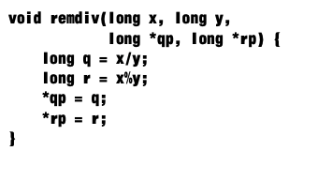
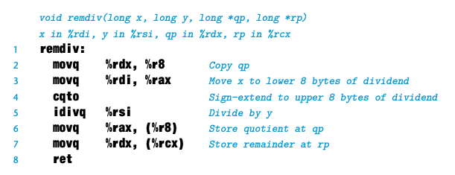
3.5.5 Special Arithmetic Operations
• Special Arithmetic Operations
￮ Devide Instructions
- divq (for unsigned)
- idivq (for two’s-complement)
- The dividend should be stored in register %rax( given as the instruction operand)
- The instruction stores the quotient in register %rax and the remainder in register %rdx
- The bits of %rdx should then be set to either all zeros (unsigned arithmetic) or the sign bit of %rax
(signed arithmetic) by cqto

Slide 31
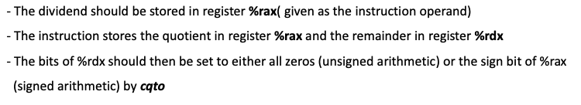
3.5.5 Special Arithmetic Operations
• Special Arithmetic Operations
￮ Devide Instructions
%rdi
x
void remdiv(long x, long y, long *qp, long *rp) {
long q = x/y;
long r = x%y;
*qp = q; *rp = r;
}
%rsi
y
%rdx
qp
%rcx
rp

Slide 32
3.5.5 Special Arithmetic Operations
• Special Arithmetic Operations
￮ Devide Instructions
%rdi
x
void remdiv(long x, long y, long *qp, long *rp) {
long q = x/y;
long r = x%y;
*qp = q; *rp = r;
}
%rsi
y
%rdx
qp
%rcx
rp
%r8
rp
Notes:
왜 굳이 나머지를 rdx에 담게하여 mov연산을 하게 할까

Slide 33
3.5.5 Special Arithmetic Operations
• Special Arithmetic Operations
￮ Devide Instructions
%rdi
x
void remdiv(long x, long y, long *qp, long *rp) {
long q = x/y;
long r = x%y;
*qp = q; *rp = r;
}
%rsi
y
%rdx
qp
%rcx
rp
%r8
rp
%rax
x
Notes:
왜 굳이 나머지를 rdx에 담게하여 mov연산을 하게 할까

Slide 34
3.5.5 Special Arithmetic Operations
• Special Arithmetic Operations
￮ Devide Instructions
%rdi
x
void remdiv(long x, long y, long *qp, long *rp) {
long q = x/y;
long r = x%y;
*qp = q; *rp = r;
}
%rsi
y
If(x<0)
%rdx
0x1000…0000
%rcx
rp
%r8
rp
%rax
x
Notes:
왜 굳이 나머지를 rdx에 담게하여 mov연산을 하게 할까

Slide 35
3.5.5 Special Arithmetic Operations
• Special Arithmetic Operations
￮ Devide Instructions
%rdi
x
void remdiv(long x, long y, long *qp, long *rp) {
long q = x/y;
long r = x%y;
*qp = q; *rp = r;
}
%rsi
y
%rdx
remainder
%rcx
rp
%r8
rp
%rax
%rax
x
quotient
Notes:
왜 굳이 나머지를 rdx에 담게하여 mov연산을 하게 할까
Cpu에서 연산된 결과값이 어떻게 레지스터에 저장될까

Slide 36
3.5.5 Special Arithmetic Operations
• Special Arithmetic Operations
￮ Devide Instructions
%rdi
x
void remdiv(long x, long y, long *qp, long *rp) {
long q = x/y;
long r = x%y;
*qp = q; *rp = r;
}
%rsi
y
%rdx
remainder
%rcx
rp
%r8
rp
%rax
%rax
x
quotient
Notes:
왜 굳이 나머지를 rdx에 담게하여 mov연산을 하게 할까
Cpu에서 연산된 결과값이 어떻게 레지스터에 저장될까

Slide 37
3.5.5 Special Arithmetic Operations
• Special Arithmetic Operations
￮ Devide Instructions
%rdi
x
void remdiv(long x, long y, long *qp, long *rp) {
long q = x/y;
long r = x%y;
*qp = q; *rp = r;
}
%rsi
y
%rdx
remainder
%rcx
rp
%r8
quotient
rp
%rax
quotient
Notes:
왜 굳이 나머지를 rdx에 담게하여 mov연산을 하게 할까
Cpu에서 연산된 결과값이 어떻게 레지스터에 저장될까

Slide 38
3.5.5 Special Arithmetic Operations
• Special Arithmetic Operations
￮ Devide Instructions
%rdi
x
void remdiv(long x, long y, long *qp, long *rp) {
long q = x/y;
long r = x%y;
*qp = q; *rp = r;
}
%rsi
y
%rdx
remainder
%rcx
remainder
rp
%r8
quotient
rp
%rax
quotient
Notes:
왜 굳이 나머지를 rdx에 담게하여 mov연산을 하게 할까
Cpu에서 연산된 결과값이 어떻게 레지스터에 저장될까

Slide 39
3.5.5 Special Arithmetic Operations
• Special Arithmetic Operations
￮ Devide Instructions
%rdi
x
void remdiv(long x, long y, long *qp, long *rp) {
long q = x/y;
long r = x%y;
*qp = q; *rp = r;
}
%rsi
y
%rdx
remainder
%rcx
remainder
rp
%r8
quotient
rp
%rax
quotient
Notes:
왜 굳이 나머지를 rdx에 담게하여 mov연산을 하게 할까
Cpu에서 연산된 결과값이 어떻게 레지스터에 저장될까

Slide 40
QnA

