Slide 1
Chapter 3. Machine-Level Representation of Programs
Section 3.6
Juyoung Kim
https://github.com/keltion
July 22, 2021

Slide 2
Contents
◼︎ 3.6 Control
• 3.6.1 Condition Codes
• 3.6.2 Accessing the Condition Codes
• 3.6.3 Jump Instructions
• 3.6.4 Jump Instruction Encodings
• 3.6.5 Implementing Conditional Branches with Conditional Control

Slide 3
Intro
addq %esi, %edi
movq %edi, %eax
movq %rdi, %rax
jmp .L2
.L3:
sarq %rax
.L2:
testq %rax, %rax
jf .L3
rep; ret

Slide 4
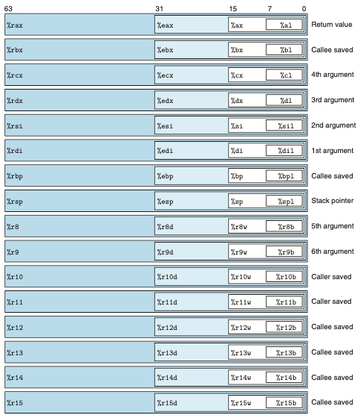
3.5.1 Load effective address(1/2)
• Condition Codes
- Condition Code registers
- Single bit
- describe attributes of the most recent arithmetic or logical operation
- can then be tested to perform conditional branches
ZF
CF
OF
SF
Integer registers
Condition code registers

Slide 5
3.5.1 Load effective address(1/2)
• Condition Codes
- Condition Code registers
- ZF(Zero) : The most recent operation yielded zero.
- CF(Carry) : The most recent operation generated a carry out of the most significant bit.
Used to detect overflow for unsigned operations.
- OF(overflow) : The most recent operation caused a two’s-complement overflow either negative or positive.
- SF(sign) : The most recent operation yielded a negative value.
▶ Not set by leaq instruction

Slide 6


3.5.1 Load effective address(1/2)
• Condition Codes
- example
￮ OF gets set
￮ CF gets set
ZF
CF
?
?
%al
0111 1111
OF
SF
?
?
ZF
CF
?
?
%al
0111 1001
OF
SF
?
?

Slide 7
3.5.1 Load effective address(1/2)
• Condition Codes
- example
￮ OF gets set
￮ CF gets set
ZF
CF
?
?
%al
1000 0000
OF
SF
?
?
ZF
CF
?
?
%al
0111 1001
OF
SF
?
?

Slide 8
3.5.1 Load effective address(1/2)
• Condition Codes
- example
￮ OF gets set
￮ CF gets set
ZF
CF
0
0
%al
1000 0000
OF
SF
1
1
ZF
CF
?
?
%al
0111 1001
OF
SF
?
?

Slide 9
3.5.1 Load effective address(1/2)
• Condition Codes
- example
￮ OF gets set
￮ CF gets set
ZF
CF
0
0
%al
1000 0000
OF
SF
1
1
ZF
CF
?
?
%al
1111 1111
OF
SF
?
?

Slide 10
3.5.1 Load effective address(1/2)
• Condition Codes
- example
￮ OF gets set
￮ CF gets set
ZF
CF
0
0
%al
1000 0000
OF
SF
1
1
ZF
CF
?
?
%al
0000 0000
OF
SF
?
?

Slide 11
3.5.1 Load effective address(1/2)
• Condition Codes
- example
￮ OF gets set
￮ CF gets set
ZF
CF
0
0
%al
1000 0000
OF
SF
1
1
ZF
CF
1
1
%al
0000 0000
OF
SF
?
0

Slide 12
3.5.1 Load effective address(1/2)
• Condition Codes
- example
￮ shift operations
The carry flag is set to the last bit shifted out(overflow flag is set to zero)
ZF
CF
?
?
%al
0111 1001
OF
SF
?
?

Slide 13
3.5.1 Load effective address(1/2)
• Condition Codes
- example
￮ shift operations
The carry flag is set to the last bit shifted out(overflow flag is set to zero)
ZF
CF
?
?
%al
1001 0000
OF
SF
?
?

Slide 14
3.5.1 Load effective address(1/2)
• Condition Codes
- example
￮ shift operations
The carry flag is set to the last bit shifted out(overflow flag is set to zero)
ZF
CF
?
1
%al
1001 0000
OF
SF
?
?

Slide 15
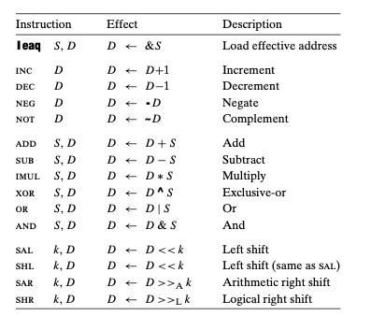
3.5.1 Load effective address(1/2)
• Condition Codes
- example
￮ inc, dec operations
inc and dec instructions set the overflow and zero flags, but they leave the carry flag unchanged.
ZF
CF
?
?
OF
SF
?
?
Notes:
Move는

Slide 16


3.5.1 Load effective address(1/2)
• Condition Codes
- two instruction classes that set condition codes without altering any other registers
￮ cmp
￮ test
%al
ZF
CF
0001
?
?
%al
OF
SF
1001
?
?

Slide 17
3.5.1 Load effective address(1/2)
• Condition Codes
- two instruction classes that set condition codes without altering any other registers
￮ cmp
￮ test
%al
ZF
CF
0001
?
?
%bl
OF
SF
1001
?
?

Slide 18
3.5.1 Load effective address(1/2)
• Condition Codes
- two instruction classes that set condition codes without altering any other registers
￮ cmp
￮ test
%al
ZF
CF
1000
?
?
%bl
OF
SF
1001
?
?

Slide 19
3.5.1 Load effective address(1/2)
• Condition Codes
- two instruction classes that set condition codes without altering any other registers
￮ cmp
￮ test
%al
ZF
CF
1000
0
1
%bl
OF
SF
1001
1
1

Slide 20
3.5.1 Load effective address(1/2)
• Condition Codes
- two instruction classes that set condition codes without altering any other registers
￮ cmp
￮ test
%al
ZF
CF
0001
?
?
%al
OF
SF
1001
?
?

Slide 21
3.5.1 Load effective address(1/2)
• Condition Codes
- two instruction classes that set condition codes without altering any other registers
￮ cmp
￮ test
%al
ZF
CF
0001
0
1
%al
OF
SF
1001
1
1

Slide 22
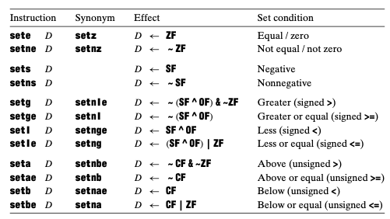
3.5.1 Load effective address(1/2)
• Accessing the Condition Codes
- Rather than reading the condition codes directly, there are three common ways of using the condition code
￮ we can set a single byte to 0 or 1 depending on some combination of the condition codes
SET instructrion
It is important to recognize that the suffixes for these instructions denote different conditions and not different operand sizes

Slide 23
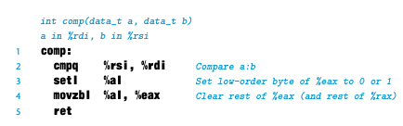
3.5.1 Load effective address(1/2)
• Accessing the Condition Codes
- Rather than reading the condition codes directly, there are three common ways of using the condition code
￮ we can set a single byte to 0 or 1 depending on some combination of the condition codes
- C expression a<b (long)
 |  | ZF | OF | SF | CF
a=b |  | 1 | 0 | 0 | 0
a<b | 3<5 | 0 | 0 | 1 | 1
 | -1<Tmax | 0 | 1 | 0 | 1
a>b | 5>3 | 0 | 0 | 0 | 0
 | 0>Tmin | 0 | 1 | 1 | 0

Slide 24
3.5.1 Load effective address(1/2)
• Accessing the Condition Codes
- Rather than reading the condition codes directly, there are three common ways of using the condition code
￮ we can set a single byte to 0 or 1 depending on some combination of the condition codes
- C expression a<b (long)
 |  | ZF | OF | SF | CF
a=b |  | 1 | 0 | 0 | 0
a<b | 3<5 | 0 | 0 | 1 | 1
 | -1<Tmax | 0 | 1 | 0 | 1
a>b | 5>3 | 0 | 0 | 0 | 0
 | 0>Tmin | 0 | 1 | 1 | 0

Slide 25
3.5.1 Load effective address(1/2)
• Accessing the Condition Codes
- Rather than reading the condition codes directly, there are three common ways of using the condition code
￮ we can set a single byte to 0 or 1 depending on some combination of the condition codes
- C expression a<b (long)
 |  | ZF | OF | SF | CF
a=b |  | 1 | 0 | 0 | 0
a<b | 3<5 | 0 | 0 | 1 | 1
 | -1<Tmax | 0 | 1 | 0 | 1
a>b | 5>3 | 0 | 0 | 0 | 0
 | 0>Tmin | 0 | 1 | 1 | 0

Slide 26
3.5.1 Load effective address(1/2)
• Accessing the Condition Codes
- Rather than reading the condition codes directly, there are three common ways of using the condition code
￮ we can set a single byte to 0 or 1 depending on some combination of the condition codes
- C expression a<b (long)
 |  | ZF | OF | SF | CF
a=b |  | 1 | 0 | 0 | 0
a<b | 3<5 | 0 | 0 | 1 | 1
 | -1<Tmax | 0 | 1 | 0 | 1
a>b | 5>3 | 0 | 0 | 0 | 0
 | 0>Tmin | 0 | 1 | 1 | 0

Slide 27
3.5.1 Load effective address(1/2)
• Accessing the Condition Codes
- Rather than reading the condition codes directly, there are three common ways of using the condition code
￮ we can set a single byte to 0 or 1 depending on some combination of the condition codes
- C expression a<b (long)
 |  | ZF | OF | SF | CF
a=b |  | 1 | 0 | 0 | 0
a<b | 3<5 | 0 | 0 | 1 | 1
 | -1<Tmax | 0 | 1 | 0 | 1
a>b | 5>3 | 0 | 0 | 0 | 0
 | 0>Tmin | 0 | 1 | 1 | 0

Slide 28
3.5.1 Load effective address(1/2)
• Accessing the Condition Codes
- Rather than reading the condition codes directly, there are three common ways of using the condition code
￮ we can set a single byte to 0 or 1 depending on some combination of the condition codes
- C expression a<b (long)
 |  | ZF | OF | SF | CF
a=b |  | 1 | 0 | 0 | 0
a<b | 3<5 | 0 | 0 | 1 | 1
 | -1<Tmax | 0 | 1 | 0 | 1
a>b | 5>3 | 0 | 0 | 0 | 0
 | 0>Tmin | 0 | 1 | 1 | 0

Slide 29

reference
► how machine code does or does not distinguish between signed and unsigned values
- Some circumstances require different instructions to handle signed and unsigned operations
0x100
1001 0000
%dil
ZF
OF
0x101
1001 0000
0
0
0x102
0x103
%sil
SF
CF
0000 0001
1
0
0x104
0000 0001
Notes:
0001 – 0010
1001 – 0001
Signed 에서
작은수 - 큰수 = carry가 발생해야함….
0 ? 1 1
Unsin
ged에서는
A>B
0 0 1 1

Slide 30
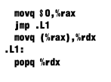

3.5.1 Load effective address
• Jump Instructions
- can cause the execution to switch to a completely new position in the program
- Jump destinations are generally indicated in assembly code by a label
￮ jmp (jumps unconditionally)
▪︎ A direct jump, where the jump target is encoded as part of the instruction
▪︎ A indirect jump, where the jump target is read from a register or a memory location
￮ jmp (jumps conditionally)
- Conditional jumps can only be direct
direct jump
indirect jump

Slide 31
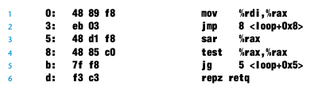
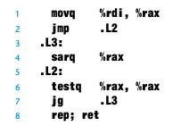
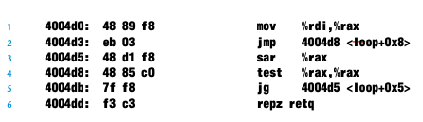
3.5.1 Load effective address(1/2)
• Jump Instruction encodings
- In assembly code, jump tartgets are written using symbolic labels
- The assembler, and later the linker, generate the proper encodings of the jump targets
▪︎ PC relative addressing
- instructions can be compactly encoded (requiring just 2 bytes)
- object code can be shifted to different positions in memory without alteration
▪︎ absolute addressing(using 4byte)
assembler
linker
Notes:
개체 코드 파일을 생성할 때 어셈블러는 레이블이 지정된 모든 명령의 주소를 결정하고 점프 명령의 일부로 점프 대상(목적지 명령의 주소)을 인코딩합니다

Slide 32
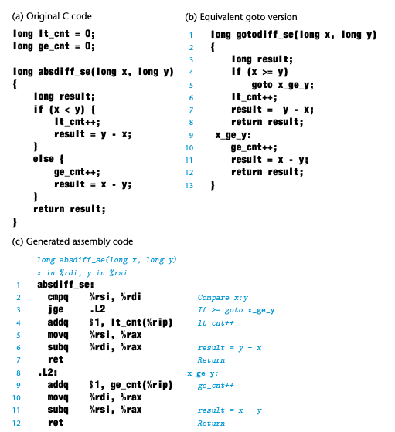
3.5.1 Load effective address(1/2)
• Implementing Conditional Branches with Conditional Control
- The most general way to translate conditional expressions and statements from C into machine code is to use
combinations of conditional and unconditional jumps

Slide 33
QnA

