Slide 1
Virtual table 동작에 대한 이해
어셈블리어 분석
Juyoung Kim
https://github.com/keltion

Slide 2

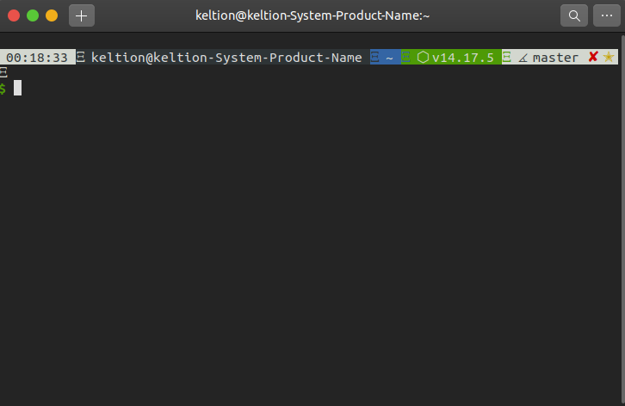

Slide 4
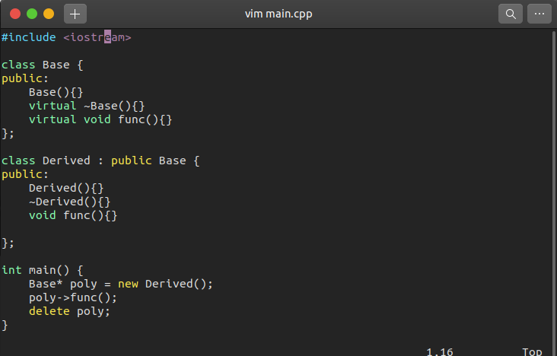
program.c

Slide 5
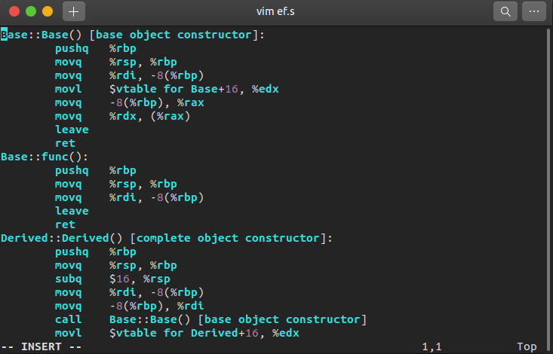
program.s / a.out

Slide 6


a.out

Slide 7


Slide 8
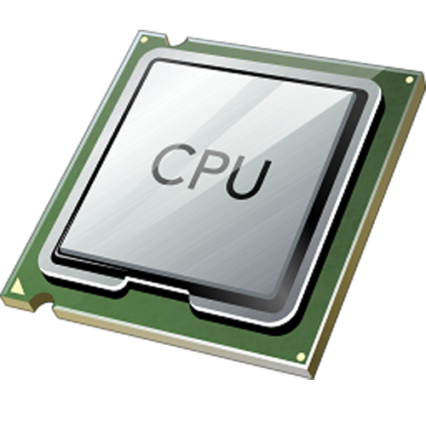
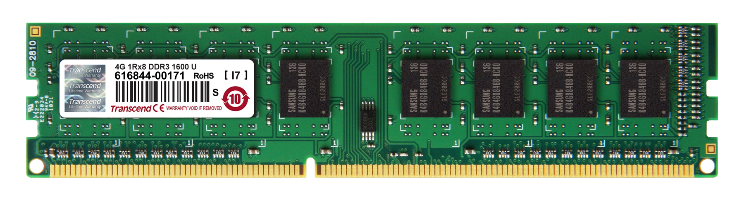

Slide 10
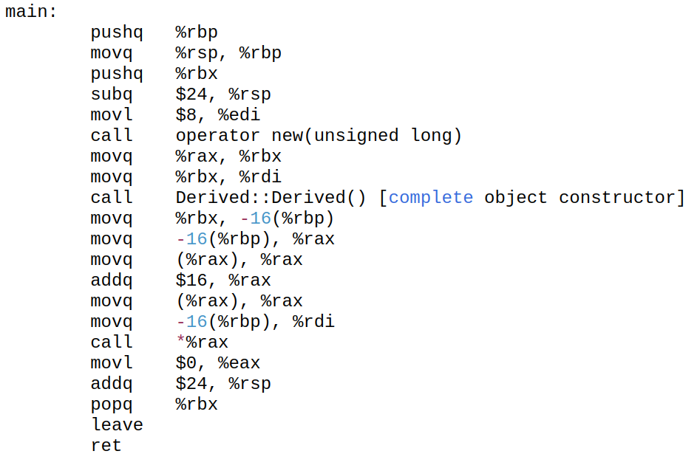
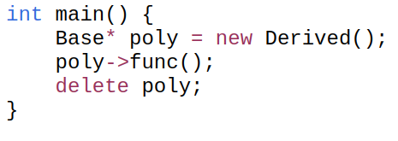
%rdi
8
%rbx
%rax
%rbp
%rsp
Code
Heap
Stack
Base::speak()
Derived::speak()
Stack for main
vTable for Base
vTable for Derived
main()

Slide 11
%rdi
8
%rbx
%rax
%rbp
%rsp
Code
Heap
Stack
Base::speak()
poly​
Derived::speak()
Stack for main
vTable for Base
vTable for Derived
main()

Slide 12
%rdi
8
%rbx
%rax
%rbp
%rsp
Code
Heap
Stack
Base::speak()
poly​
Derived::speak()
Stack for main
vTable for Base
operator new
vTable for Derived
main()

Slide 13
%rdi
8
%rbx
%rax
0xff48637
%rbp
%rsp
Code
Heap
Stack
Base::speak()
poly​
Derived::speak()
0xff486379e​
Stack for main
vTable for Base
operator new
vTable for Derived
main()

Slide 14
%rdi
0xff48637
%rbx
0xff48637
%rax
0xff48637
%rbp
%rsp
Code
Heap
Stack
Base::speak()
poly​
Derived::speak()
0xff486379e​
Stack for main
vTable for Base
vTable for Derived
main()

Slide 15
%rdi
0xff48637
%rbx
0xff48637
%rax
0xff48637
%rbp
%rsp
Code
Heap
Stack
Base::speak()
poly​
Derived::speak()
0xff486379e​
Stack for main
vTable for Base
Derived::Derived()
vTable for Derived
main()
Notes:
생성자에서 vtable을 할당받은 HEAP영역에 저장해줘. 즉 BASE를 생성하면 그 힙에 BASE V(+16)가 생성, DERIVED생성하면 그 힙에 DERIVED V가 덮어써짐

Slide 16

1. 객체를 위한 힙영역을 할당받고
2. 객체가 vTable을 가리키게 함
%rdi
0xff48637
%rbx
0xff48637
%rax
0xff48637
%rbp
%rsp
Code
Heap
Stack
Base::speak()
poly​
Derived::speak()
0xff486379e​
Stack for main
vTable for Base
Derived::Derived()
vTable for Derived
main()
Notes:
생성자에서 vtable을 할당받은 HEAP영역에 저장해줘. 즉 BASE를 생성하면 그 힙에 BASE V(+16)가 생성, DERIVED생성하면 그 힙에 DERIVED V가 덮어써짐

Slide 17

%rdi
0xff48637
%rbx
0xff48637
%rax
0xff48637
%rbp
%rsp
Code
Heap
Stack
Base::speak()
poly​
Derived::speak()
0xff486379e​
Stack for main
vTable for Base
vTable for Derived
main()
Notes:
생성자에서 vtable을 할당받은 HEAP영역에 저장해줘. 즉 BASE를 생성하면 그 힙에 BASE V(+16)가 생성, DERIVED생성하면 그 힙에 DERIVED V가 덮어써짐

Slide 18
%rdi
0xff48637
%rbx
0xff48637
%rax
vTable address
%rbp
%rsp
Code
Heap
Stack
Base::speak()
poly​
Derived::speak()
0xff486379e​
Stack for main
vTable for Base
vTable for Derived
main()
Notes:
생성자에서 vtable을 할당받은 HEAP영역에 저장해줘. 즉 BASE를 생성하면 그 힙에 BASE V(+16)가 생성, DERIVED생성하면 그 힙에 DERIVED V가 덮어써짐

Slide 19
%rdi
0xff48637
%rbx
0xff48637
%rax
Derived::
speak()
address
%rbp
%rsp
Code
Heap
Stack
Base::speak()
poly​
Derived::speak()
0xff486379e​
Stack for main
vTable for Base
vTable for Derived
main()
Notes:
생성자에서 vtable을 할당받은 HEAP영역에 저장해줘. 즉 BASE를 생성하면 그 힙에 BASE V(+16)가 생성, DERIVED생성하면 그 힙에 DERIVED V가 덮어써짐

Slide 20
%rdi
0xff48637
%rbx
0xff48637
%rax
Derived::
speak()
address
%rbp
%rsp
Code
Heap
Stack
Base::speak()
poly​
Derived::speak()
0xff486379e​
Stack for main
vTable for Base
vTable for Derived
main()
Notes:
생성자에서 vtable을 할당받은 HEAP영역에 저장해줘. 즉 BASE를 생성하면 그 힙에 BASE V(+16)가 생성, DERIVED생성하면 그 힙에 DERIVED V가 덮어써짐
각 생성자에서.. edx보통 사용

Slide 21
%rdi
0xff48637
%rbx
0xff48637
%rax
Derived::
speak()
address
%rbp
%rsp
Code
Heap
Stack
Base::speak()
poly​
Derived::speak()
0xff486379e​
Stack for main
vTable for Base
vTable for Derived
main()
Notes:
생성자에서 vtable을 할당받은 HEAP영역에 저장해줘. 즉 BASE를 생성하면 그 힙에 BASE V(+16)가 생성됨, DERIVED생성하면 그 힙에 DERIVED V가 덮어써짐
어떤 객체를 할당받는지에 따라 가리키는 VT이 달라지게 됨

