Slide 1
Computer Store
ADD PICTURE OF FRONTPAGE

Slide 2
Goal
Create a system that allows the user to browse and buy customized or complete PCs

Slide 3
Use case

Slide 4
Team
Charles Fallourd - System expert (Back end)
Daniel Bonstrom - Administrator (Back end)
Andrew Whiriskey - Designer (Front end)

Slide 5
Login
User
System
Login
Validate
Existing user
New
User
Invalid
Enter info.
Validate
Valid
Invalid
Timeout
Valid
Get details
Verify email
Send verification
email
Get frontpage
Create user

Slide 6
Transaction
User
System
Confirm basket
Check if logged in
No
Log in
Yes
Confirm user details
Get user details
Wrong
Update user details
Change details
Correct
Ask payment information
Enter payment information
Valid
Validate payment
Notify user
Invalid

Slide 7
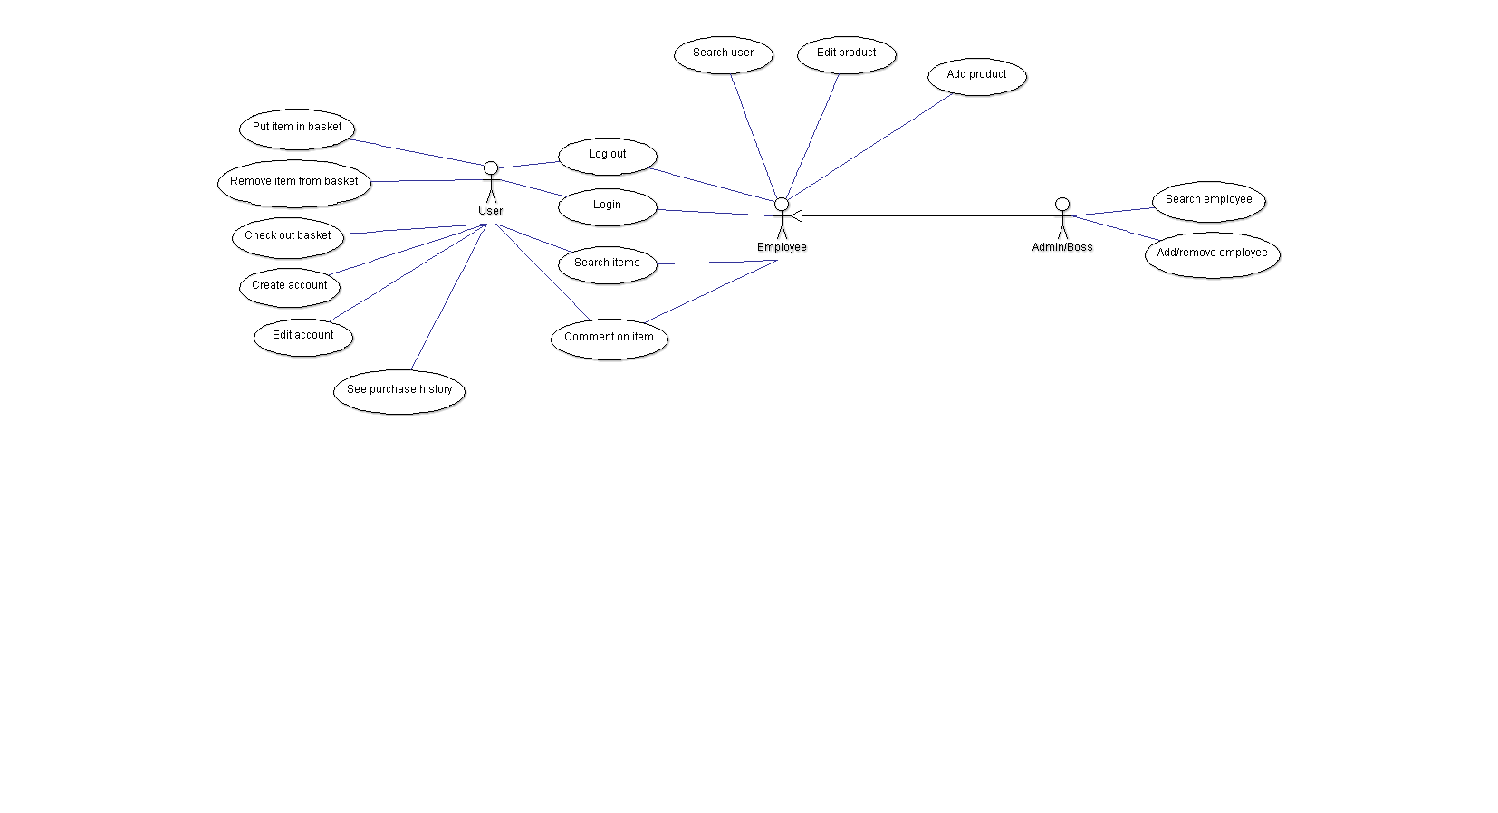
User diagram

Slide 8
Activity diagram
Insert class diagram

Slide 9
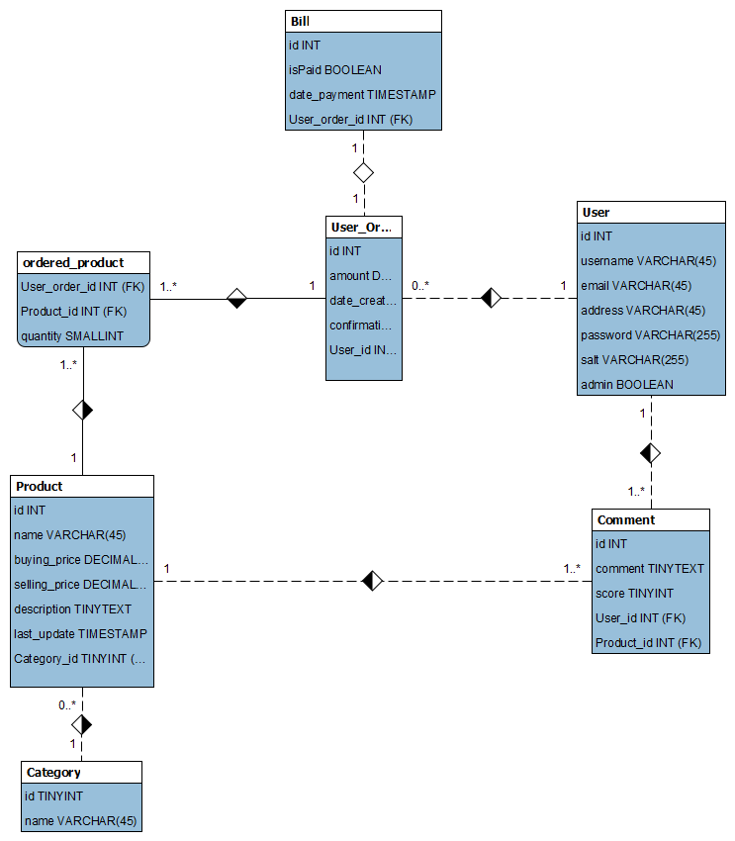
Class diagram

Slide 10
GUI design
Log in screen

Slide 11
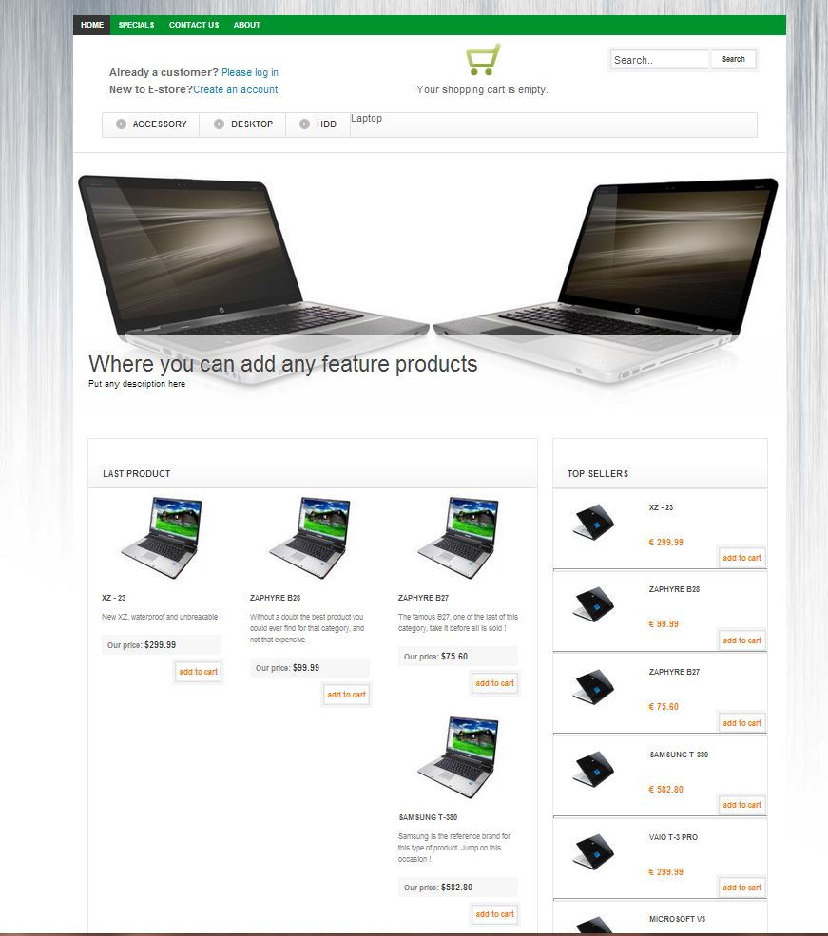
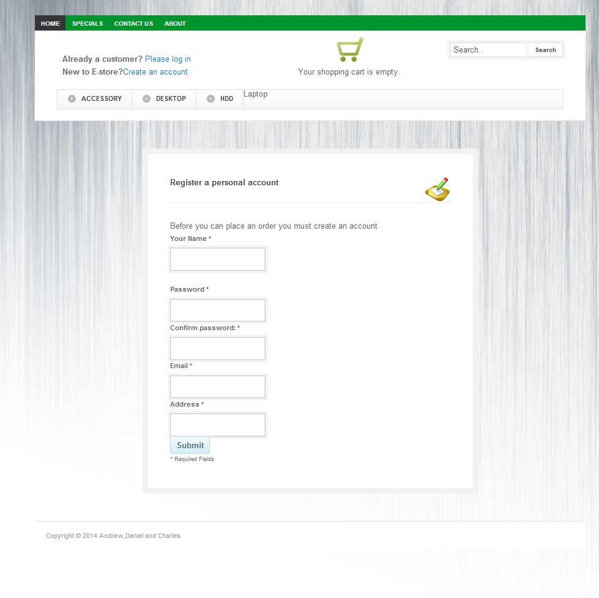
GUI design

Slide 12
GUI design
Last screen

Slide 13
Non-trivial use case?
Sequence diagram?

Slide 14
Main challenges
Creating the database
Estimating time
Get people to update the backlog...
Many to many relationships
The conversion between java classes and database
GIT!!!
Head not in sync with repository head etc
Netbeans!!!!

Slide 15
Other

