Slide 1
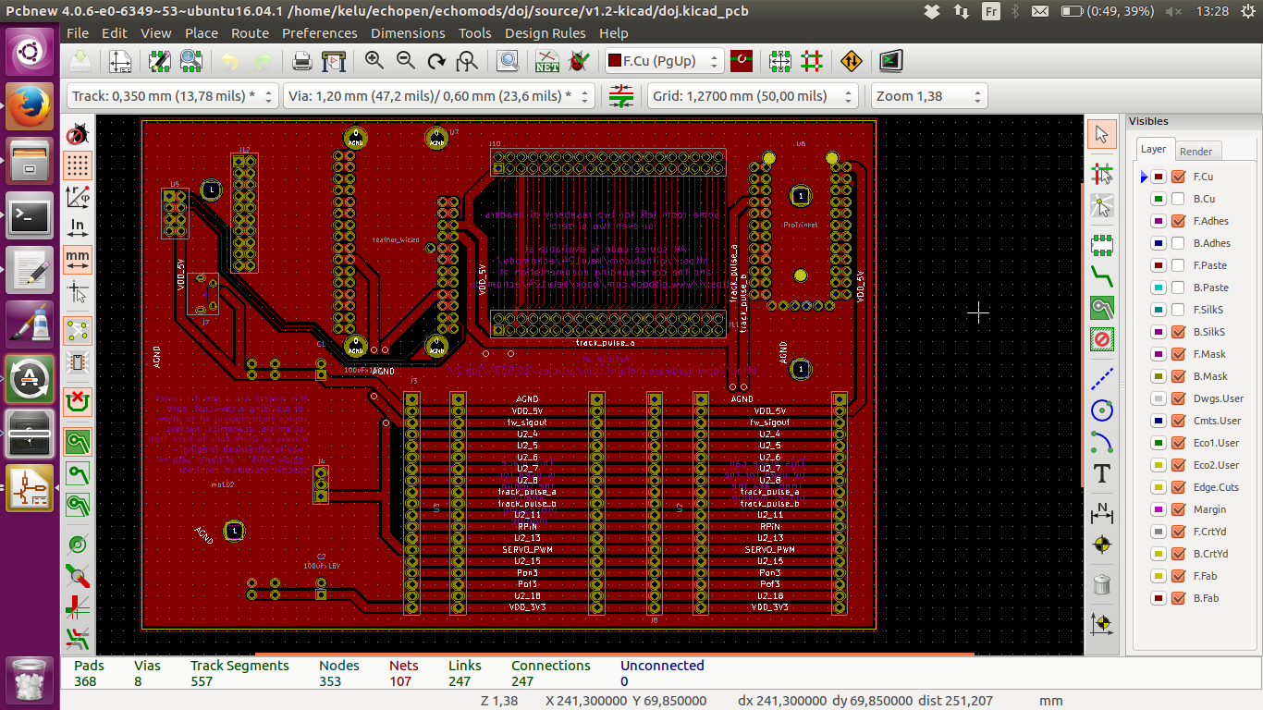

Slide 2
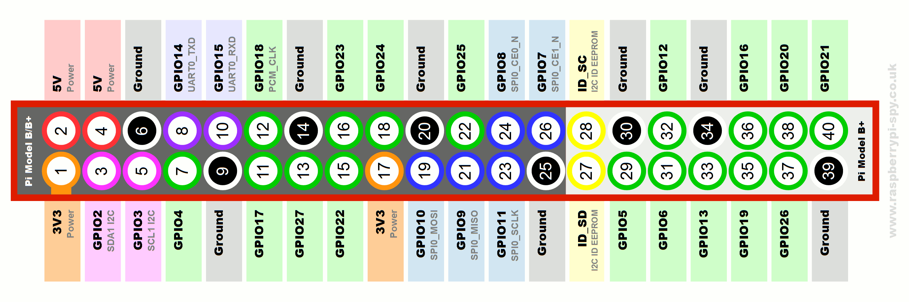
OLED
5V and GND pads
Small USB
at border of
PCB
OffSig
Poff conn
Input selector
(between RPIn and Env
or RPIn and OffSig)
Pon conn

