Slide 1
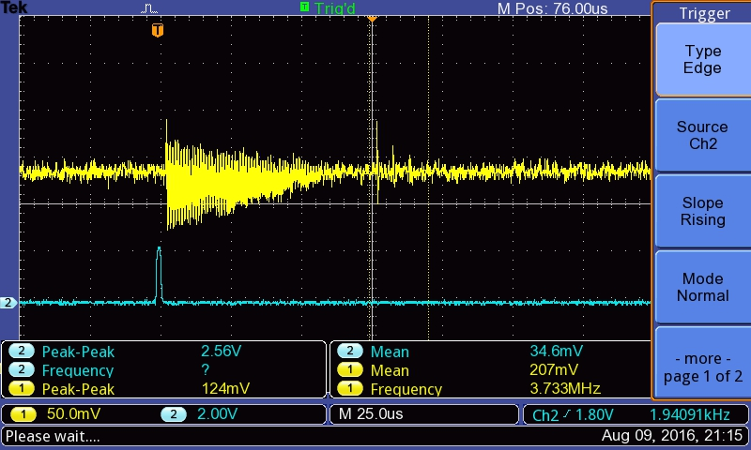
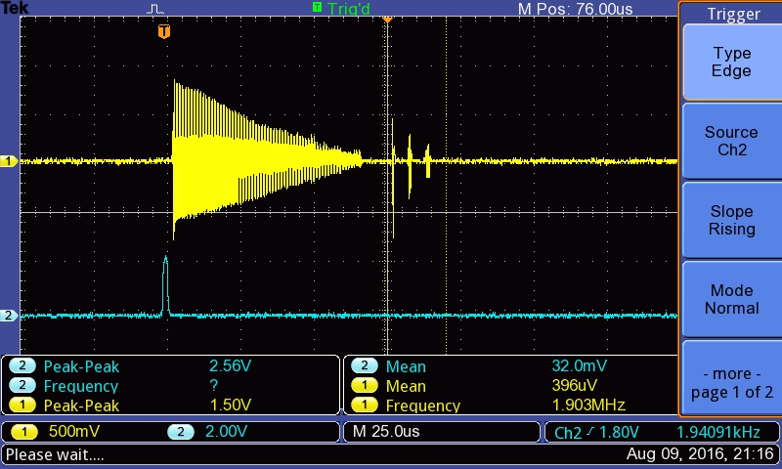
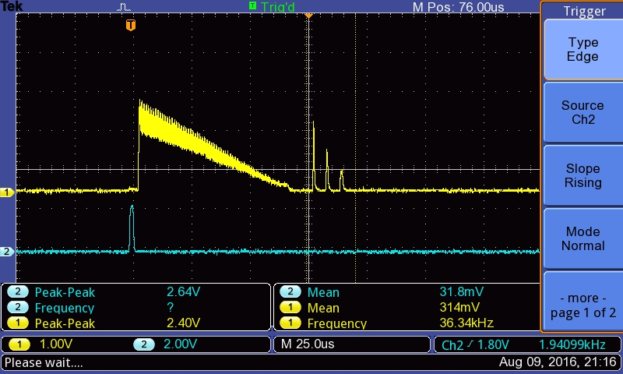
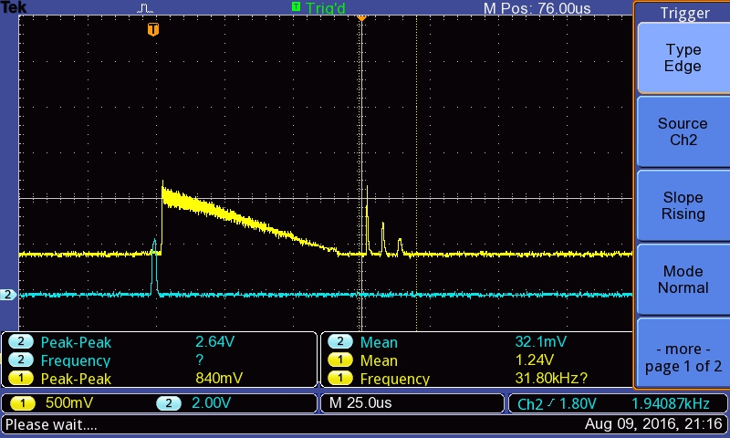
A
Raw signal (60mV)
B
Amplified (600mV)
D
Enveloppe, wo offset
Range 0-3V
C
Enveloppe, w/offset
Range 1.2-2V

