Slide 1
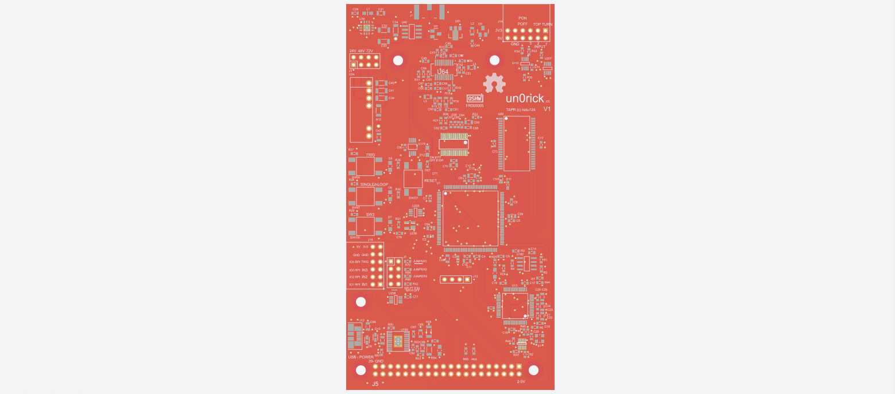
Ultrasound acquisition and processing with open source hardware : un0rick.cc
SMA placement for piezo connection
PMOD
- 6 buffered inputs
- Logic Control access
- 3.3V and 5V
High voltage pulser
- Pulser: MD1210 + TC6320
- High voltage at 25V, 50V, 75V
(selected using a jumber)
Open source
Time Gain Compensation (TGC)
- AD8331 controled by DAC
- 8 bit, 200us TGC programmable
8 Mbit SRAM, 10ns, 512 k x 16, equivalent:
- 65 full lines of 120us at 64Msps
- 840 lines of 120us at 10Msps, 8 bits
Analog to Digital Converter ADC10065
- 10-Bit 65 MSPS 3V A/D Converter
- Sampling at 64/(1+n) Msps
FPGA
- Lattice iCE40HX4K
- TQFP 144 Package
3 x push controls button + LEDS
+ 1 reset button
8 Mb SPI Flash
for FPGA configuration
PMOD
- 8 IOs
- 4 Ios shared with RPi
FT2232H interface
Four jumpers
- 3 programmable
- 1 used for RPi / USB connection
USB connector (Power supply – needs 400mA, programmation)
Raspberry Pi 20x2 Header

Slide 2
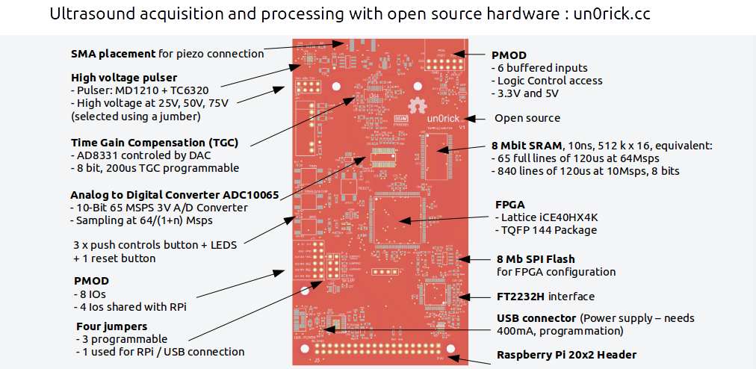

Slide 3
