Slide 1
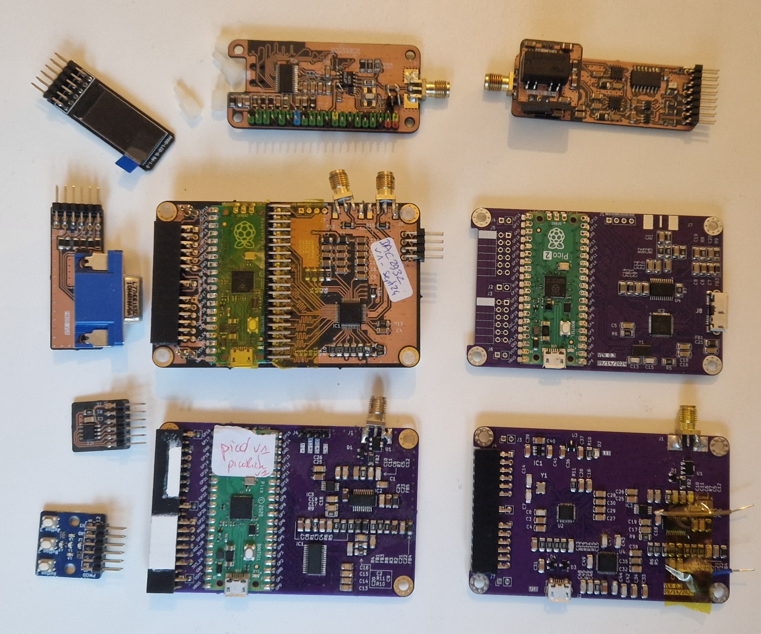
Fast ADC pHAT
HV Board (+-24V)
OLED PMOD
Bipolar pulser PMOD
40Msps dual DAC
DAC2932 DAC board
FT600Q board
100Msps ADC
+ USB3 bridge
6bits VGA PMOD
PSRAM PMOD
User Interface (icebreaker) PMOD (buttons/LEDs)
MSI SDR board
USB2-based
Mirics MSI2500 + MSI001
pic0rick
10bits 80Msps ADC
+ AD8331 amp

Slide 2
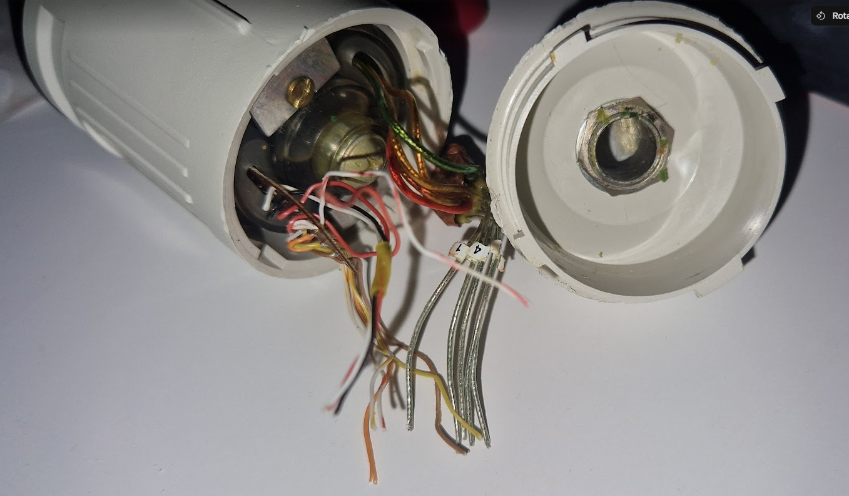
Probe accoustic window
Probe casing
5 coax for each part of the annular array
Motor control (simple wires)

